Slide 1
Module 2 Human Rights and Civil Rights
Unit 1: Human Rights

Slide 2
Module 2: Overview
Module 2 consists of the below units:
Unit 1: Human Rights
Unit 2: Civil Rights
Upon completion of this module, participants should be able to:
Recognize and define human rights and to underscore the significance of these rights in promoting a just and equitable society.
Understand what civic rights are.
Identify civil rights movements.

Slide 3
Terminology
IMPORTANT GUIDELINES ON THE TERMINOLOGIES
It is crucial to use the correct terminology in this section. People of color are not comfortable with the use of certain words and phrases shown in the following slides. It is now considered offensive and outdated to use words like "colored" and "negro".
When referring to non-whites, the correct terminology is:
Black: refers to dark-skinned African Americans, no matter their nationality.
African American: refers to people born in the United States and who have African ancestry. Many people use the terms interchangeably.
"People of color" was originally meant to be a synonym for "Black", but it has expanded to include Latinos, Asians, Native Americans, etc.
Notes:
Source: https://www.uah.edu/diversity/news/15567-which-is-the-correct-terminology-black-african-american-or-people-of-color

Slide 4
Terminology
IMPORTANT GUIDELINES ON THE TERMINOLOGIES
LGBTQ+: “An acronym for “lesbian, gay, bisexual, transgender and queer” with a "+" sign to recognize the limitless sexual orientations and gender identities used by members of the community.” (HRC Foundation. Glossary of Terms)
Sex assigned at birth: “The sex, male, female or intersex, that a doctor or midwife uses to describe a child at birth based on their external anatomy.” (HRC Foundation. Glossary of Terms)
Sexual orientation: “An inherent or immutable enduring emotional, romantic or sexual attraction to other people. Note: an individual’s sexual orientation is independent of their gender identity.” (HRC Foundation. Glossary of Terms)
People who menstruate/People with a uterus: This term does not include only cis women, but also trans and non-binary people.
Notes:
Text Source: https://www.hrc.org/resources/glossary-of-terms

Slide 5
Activity: Let’s play- Human Rights Squares
Instructions:
Each participant will receive the "Human Rights Squares", which is a grid of sixteen squares with a question in each square.
Participants will have 10-15 minutes to complete the activity. In the meantime, they will have to mingle and find different people to answer one of their 16 questions.
The name of each person who answered should be written next to the question they answered.
Participants will form a circle and respond to the following questions: Who received the most answers/which questions were the most difficult/which answers should be shared.

Slide 6
Activity: Let’s play- Human Rights Squares
Name a human right. | Name an organization that works for human rights. | What type of rights violation disturbs you the most? | Name a document that proclaims human rights.
Name a country where people are denied rights because of their race. | Name a right all children should have. | Singer who sings about rights. | Film about human rights.
Name a country where the human rights situation has recently improved. | Name a human right not yet achieved by everyone in Cyprus. | Book about rights. | How do you protest for human rights violations?
Right sometimes denied to women. | Right of yours that is respected. | What is the document that proclaims human rights? | Is there a right you have that your parents never had?
Notes:
Source: David Shiman, Teaching Human Rights. (Denver: CTIR, 1999) 3.

Slide 7
What are Human Rights?
Human rights are the rights of everyone. They are universal and that means that they are not something to earn, but instead they are a birthright to each human being.

Slide 8
What Are Human Rights: Watch Video
Notes:
Source: https://www.youtube.com/watch?v=6e8m8L9BFa4

Slide 9
What are Human Rights?
Human rights are inherent rights and freedoms belonging to every individual simply because they are human. These rights are universal, applying to everyone regardless of nationality, race, ethnicity, gender, religion, or any other status. They cannot be taken away or granted by any authority and are an essential part of human dignity and existence.
The concept of human rights is grounded in the idea that all individuals have certain fundamental rights by virtue of being human, without the need to earn or deserve them. These rights are protected by international treaties, declarations, and national laws and constitutions in various countries.

Slide 10
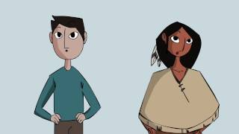
Examples of human rights include the right to life, liberty, and personal security, freedom of thought, conscience, and religion, freedom of expression and opinion, the right to education, health, and employment, and protection against torture, discrimination, and slavery, among others.
Preserving and safeguarding human rights is crucial for fostering equality, justice, and peace in societies worldwide. Governments, institutions, and individuals have the duty to uphold and protect these rights to ensure the well-being and dignity of all people.
Notes:
Source: Human rights in two minutes - YouTube

Slide 11
Activity: Create a New Country
A new land has been discovered. No one lived in this land before. There are no laws, no history. Everyone will be the new citizens of this new land.
Working in small groups, participants will give the country a name and will be appointed to draw up a list of 10 rights for the new country. No one has any position in the new country.
Each group presents its list and the whole group makes a list that includes all the rights mentioned. Discuss about the list (e.g., what would happen if some rights were excluded? Have any important rights been left out?)

Slide 12
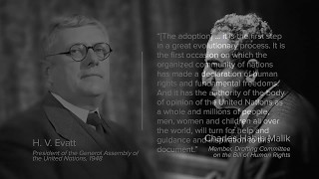
Universal Declaration of Human Rights
The Universal Declaration of Human Rights (UDHR) is a document that protects the rights of every person around the world. It serves as a worldwide road map for equality and freedom. It was created in 1948 by the United Nations in response to the things that happened during World War II. The UDHR lists 30 rights and freedoms that all people should have, like the right to be treated equally and with respect and the right to have basic needs like food and shelter met. These rights are considered to be very important, and they still apply today.
Notes:
Source: https://www.youtube.com/watch?v=5RR4VXNX3jA

Slide 13
Why Are Human Rights Important?
The importance of human rights is undeniable. People around the world fight for the right to live, for education, for safety and for choosing their own way of life.
But why are human rights so vital?
Values of tolerance, equality and respect can reduce friction within society. Putting human rights ideas into practice can helps us create the kind of society we want to live in.
In recent decades, human rights ideas have grown tremendously. This has had many positive results - knowledge about human rights can empower individuals and offer solutions to specific problems.
Human rights are a fundamental part of how people interact with others at all levels in society - in the family, the community, schools, the workplace, in politics and in international relations. It is therefore imperative that everyone strives to understand what human rights are. When people better understand human rights, it is easier to promote justice and society's well-being.
Notes:
Source: https://humanrights.gov.au/our-work/education/introduction-human-rights

Slide 14
Why are human rights important?
In 1948, the United Nations adopts the Universal Declaration of Human Rights. In the Universal Declaration of Human Rights there are 30 articles.
Group Work:
Split into groups of two-three and discuss assigned human rights.
Discussion:
Do any of the above human rights not part of your life? Do you know anyone without access to one or more of the above human rights?

Slide 15
The Universal Declaration of Human Rights safeguards the rights of every person around the world.
Dignity and Equality: Human rights are fundamental in preserving human dignity and recognizing the inherent value of every individual. They advocate that all humans possess equal rights and deserve to be treated with respect and impartiality.
Protection from Abuse: Human rights establish a protective framework to prevent and address abuses such as torture, discrimination, slavery, and other forms of mistreatment. They serve as a safeguard against oppressive and harmful practices.
Freedom and Autonomy: Human rights guarantee personal freedoms, encompassing the freedom of thought, expression, religion, and the right to participate in cultural, social, and political life. They empower individuals to make decisions about their own lives and futures.
Social and Economic Development: Access to education, healthcare, and employment are essential human rights. Fulfilling these rights can enhance individual well-being and contribute to the overall development of societies.
Peace and Stability: Societies that uphold human rights are more likely to be peaceful and stable. Human rights violations can lead to unrest, conflict, and immense human suffering.

Slide 16
The Universal Declaration of Human Rights safeguards the rights of every person around the world.
Rule of Law: Human rights form the foundation for the rule of law and a just legal system. They ensure that governments and institutions are held accountable and act in accordance with established norms and principles.
Empowerment and Advocacy: The recognition of human rights empowers individuals and communities to demand justice and accountability. It enables them to advocate for their rights and those of others.
Global Solidarity: Human rights transcend borders and cultures, being universal in nature. They foster a sense of global solidarity, encouraging international cooperation to address shared challenges.
Humanitarian Efforts: Human rights are at the heart of humanitarian endeavors, guiding relief and assistance to those in need, including refugees, displaced persons, and victims of natural disasters or conflicts.
Building a Better World: Ultimately, the promotion and protection of human rights are pivotal in constructing a world where all individuals can live in freedom, dignity, and peace.

Slide 17
Activity: Let’s explore the following cases studies.
You will be split into groups where you will review the material for your assigned case study.
1. Review Time: 20 minutes
Go over material
Find the answers to the Cyprus related questions. You may use the internet.
2. Presentation Preparation: 15 minutes
Prepare a 3 minute verbal presentation that focuses on:
Key definitions and relation to human rights found in the material
Their research on the Cyprus context
3. Presentations: 10 minutes max
You will then be assigned another group of the opposite case study and present your materials to each other.

Slide 18
Case Study 1

Slide 19
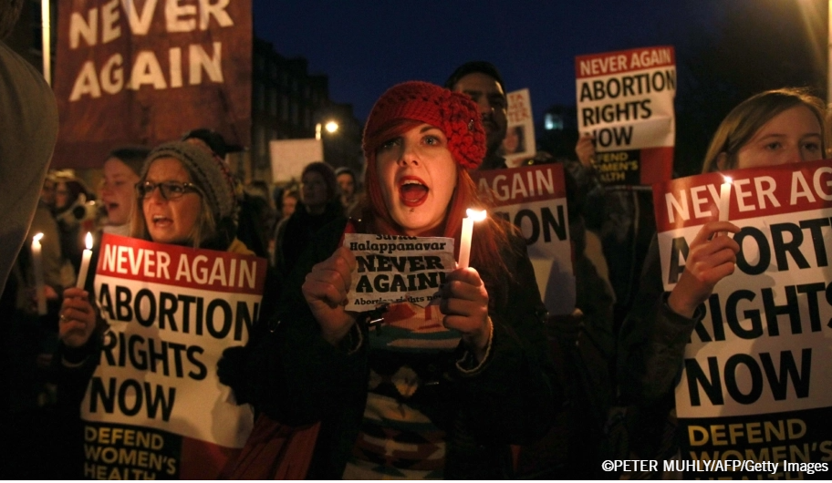
Case Study 1: Abortion
Access to safe abortion is a matter of human right
People with a uterus' “ability to access safe and legal abortions is restricted in law or in practice in most countries in the world. In fact, even where abortion is permitted by law, women often have severely limited access to safe abortion services because of lack of proper regulation, health services, or political will.
At the same time, only a minority of countries prohibit abortion. In most countries and jurisdictions, abortion is allowed to save the pregnant woman’s life, or where the pregnancy is the result of rape or incest.”
Human Rights Watch (Women's Human Rights: Abortion)
Source:©PETER MUHLY/AFP/Getty
Notes:
Text source: https://www.hrw.org/legacy/women/abortion.html
Picture source: https://www.amnesty.org/en/what-we-do/sexual-and-reproductive-rights/abortion-facts/

Slide 20
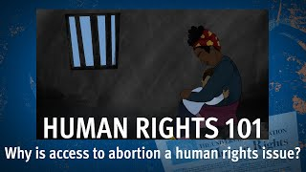
Watch Video on access to abortion as a human rights issue
Notes:
Source: Human Rights 101 | Episode 11: Why is access to abortion a human rights issue? - YouTube

Slide 21
Case Study 1: Abortion
“Abortion is a highly emotional subject and one that excites deeply held opinions. However, equitable access to safe abortion services is first and foremost a human right. Where abortion is safe and legal, no one is forced to have one.
Where abortion is illegal and unsafe, people with a uterus are forced to carry unwanted pregnancies to term or suffer serious health consequences and even death.”
Human Rights Watch (Women's Human Rights: Abortion)
Approximately 13 percent of people giving birth/or being pregnant deaths worldwide are attributable to unsafe abortion—between 68,000 and 78,000 deaths annually.
(Source: https://www.hrw.org/legacy/women/abortion.html )
Notes:
Text Source: https://www.hrw.org/legacy/women/abortion.html

Slide 22
Case Study 1: Abortion
“Women’s organizations across the world have fought for the right to access safe and legal abortion for decades, and increasingly international human rights law supports their claims.
In fact, international human rights legal instruments and authoritative interpretations of those instruments compel the conclusion that women have a right to decide independently in all matters related to reproduction, including the issue of abortion.”
Human Rights Watch (Women's Human Rights: Abortion)
Abortion rights activists protest outside of the U.S. Supreme Court on Capitol Hill in Washington, DC, Tuesday, June 21, 2022. © 2022 AP Photo/Jose Luis Magana
Notes:
Text Source: https://www.hrw.org/legacy/women/abortion.htm
Picture Source: https://www.hrw.org/news/2022/06/24/qa-access-abortion-human-right

Slide 23
Case Study 1 :Abortion Basic Facts
Criminalizing abortion does not stop abortions, it just makes abortion less safe
Preventing people with a uterus the access to abortions, does not require that abortions will stop. However, the result of ban access to abortion means that people are not able to have safe abortions and their lives are endangered. The number of unsafe abortions per year reached the 25 million.
Unsafe abortions are defined by the World Health Organization (WHO) as “a procedure for terminating an unintended pregnancy carried out either by persons lacking the necessary skills or in an environment that does not conform to minimal medical standards, or both.” (Amnesty International, Key Facts on Abortion)
On the other hand, legal and safe abortions take place from a trained medical provider. Unsafe abortions have many consequences to people with uterus and one of them is death during the unsafe procedures.
Notes:
Source: https://www.amnesty.org/en/what-we-do/sexual-and-reproductive-rights/abortion-facts/

Slide 24
Case Study 1 :Abortion Basic Facts
It’s not just cisgender women and girls who need abortions
“It is not only cisgender women and girls (women and girls who were assigned female at birth) who may need access to abortion services, but also intersex people, transgender men and boys, and people with other gender identities who have the reproductive capacity to become pregnant” (Amnesty International, Key Facts on Abortion)
Many people do not have access to health care, including abortion. Even if they do have access, societal stigma and stereotypes around gender and sexuality prevent them from accessing information and services around contraception or abortion. According to reports, 28% of transgender and gender non-conforming people are reportedly harassed in medical facilities and 19% have been denied medical care because of their gender status. In addition, race and poverty contribute to the discrimination many individuals face regarding healthcare.
Notes:
Source: https://www.amnesty.org/en/what-we-do/sexual-and-reproductive-rights/abortion-facts/

Slide 25
Case Study 1 :Abortion Basic Facts
Criminalizing abortion is a form of discrimination, which further fuels stigma
Denial of access to reproductive health services is a form of discrimination.
The above statement is supported by statements from the Committee of the United Nations Convention on the Elimination of All Forms of Discrimination against Women (CEDAW or the Convention on the Rights of Women). Discrimination does not only apply to women, but also to lesbians, bisexuals, trans people, etc.
The criminalisation of abortion, apart from being unfair to people with a uterus, contributes to increasing the stigma in society towards people seeking abortion. The perception that abortion is illegal or a sin tends to contribute to the stigmatisation of people with a uterus in health services and among their families, friends, etc. As a result, people seeking abortions risk facing discrimination and harassment.
Notes:
Source: https://www.amnesty.org/en/what-we-do/sexual-and-reproductive-rights/abortion-facts/

Slide 26
Case Study 1: Research on the Cyprus Context
What is the law about abortions in Cyprus? (if you do not know you can search online)
Was it easy to find out about abortion law?
Is the information accessible?
How much does it cost?
Who can have access to it?
What do you think of the following pictures? Discuss it.

Slide 27
Case Study 2

Slide 28
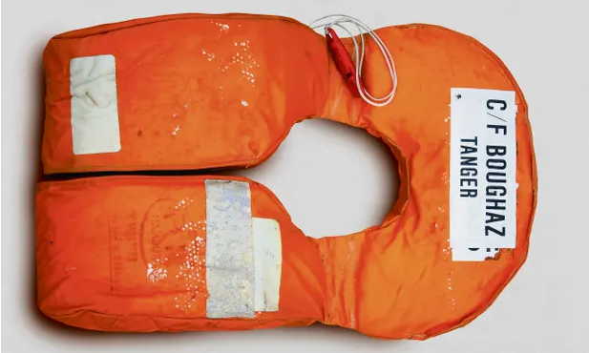
Case Study 2: Refugees, Asylum seekers and migrants
The terms “refugee, asylum seeker and migrant are used to describe people who are on the move, who have left their countries and have crossed borders.”
The terms migrant and refugee are often used interchangeably but it is important to distinguish between them as there is a legal difference.
(Amnesty International, Refugees, Asylum seekers and migrants)
Picture Source: Lifejackets have become a striking symbol of the refugee crisis. This was one of 2,500 removed or discarded vests that formed a ‘lifejacket graveyard’ in Parliament Square to draw attention to the crisis in 2016 Photograph: Hugh Peterswald/Pacific Press/LightRocket/Getty [
Notes:
Text Source: https://www.amnesty.org/en/what-we-do/refugees-asylum-seekers-and-migrants/
Picture Source: https://www.theguardian.com/world/2018/jun/20/the-list-34361-men-women-and-children-who-perished-trying-to-reach-europe-world-refugee-day

Slide 29
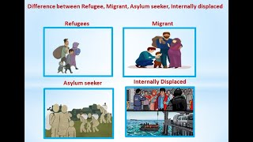
Watch Video on the differences between Refugee, Migrant, Asylum Seeker and Internally Displaced
Notes:
Source: Difference between Refugee, Migrant, Asylum seeker, Internally displaced - YouTube

Slide 30
Case Study 2: Refugees, Asylum seekers and migrants
Who is a refugee?
According to Amnesty International “A refugee is a person who has fled their own country because they are at risk of serious human rights violations and persecution there. The risks to their safety and life were so great that they felt they had no choice but to leave and seek safety outside their country because their own government cannot or will not protect them from those dangers. Refugees have a right to international protection”
Who is an asylum seeker?
“An asylum seeker is a person who has left their country and is seeking protection from persecution and serious human rights violations in another country, but who hasn’t yet been legally recognized as a refugee and is waiting to receive a decision on their asylum claim. Seeking asylum is a human right. This means everyone should be allowed to enter another country to seek asylum”
(Amnesty International, Refugees, Asylum seekers and migrants)
Notes:
Text Source: https://una.org.uk/magazine/1-2016/false-dichotomy-between-economic-migrants-and-refugees

Slide 31
Case Study 2: Refugees, Asylum seekers and migrants
Who is a migrant?
The term migrant has no legal definition internationally. According to Amnesty International, migrants are people who do not remain in their country of origin and do not have the status of asylum seekers or refugees.
Many migrants do not stay in their countries because they are working, studying or joining their families abroad. Other reasons are poverty, politics, violence, crime, environmental disasters that lead people to want to leave their country of origin. As a result, many people do not fit the legal definition of a refugee, who do not stay in their country because of the danger they may face. The human rights of migrants are violated and they have no respect or protection in the countries where they now reside.
Notes:
Source: https://www.amnesty.org/en/what-we-do/refugees-asylum-seekers-and-migrants/

Slide 32
Case Study 2: Refugees, Asylum seekers and migrants
The false dichotomy between refugees and economic migrants
One of the biggest issues nowadays is the dichotomy between economic migrants and refugees. According to Anne Althaus article, the term economic migrant has not any legal definition and it is not mentioned in migration law. The economic migrant implies that a person freely decide to stay in another country (not their home country) in order to improve their financial situation.
On the other hand the term migrant worker is used in the UN Convention on the Protection of the Rights of all Migrant Workers and Members of their Family to “designate a person engaged in a remunerated activity in a state of which they are not a national” (Althaus, 2016).
Also, migrants is “ a neutral term that denotes any person who is moving or has moved across an international border – or within a country, away from their place of residence. A person can therefore be a migrant regardless of their legal status (documented or undocumented) and of the voluntary or involuntary nature of the move” (Althaus, 2016).
Notes:
Text Source: https://una.org.uk/magazine/1-2016/false-dichotomy-between-economic-migrants-and-refugees

Slide 33
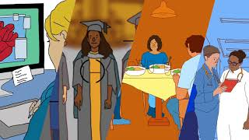
Watch Video on Refugee Rights
Notes:
Source: Refugee Rights - YouTube

Slide 34
Case Study 2: Refugee Human Rights
Refugee Human Rights:
Refugees' human rights refer to the fundamental rights and protections that are afforded to individuals who have been forced to flee their home countries due to persecution, violence, conflict, or other serious human rights violations. The protection of refugees' human rights is a critical aspect of international law and a humanitarian imperative.
The key human rights principles that apply to refugees include:
Non-Refoulement: This principle, enshrined in the 1951 United Nations Convention relating to the Status of Refugees and its 1967 Protocol, prohibits the return of refugees to a country where they would face persecution or serious harm. It ensures that individuals seeking refuge are not sent back to dangerous or life-threatening situations.
Right to Seek Asylum: Refugees have the right to seek asylum in other countries and request protection from persecution or harm. Asylum seekers should have access to a fair and efficient asylum process to determine their eligibility for refugee status.

Slide 35
Case Study 2: Refugee Human Rights
Right to Life and Security: Refugees have the right to life, liberty, and security of person, as guaranteed under the Universal Declaration of Human Rights. Host countries must take measures to protect refugees from violence, discrimination, and arbitrary detention.
Right to Freedom of Movement: Refugees should not be unlawfully confined to refugee camps or restricted areas and should have the freedom to move within the host country's territory.
Access to Basic Needs and Services: Refugees have the right to access food, shelter, clean water, education, healthcare, and other essential services. Host countries and the international community have a responsibility to ensure these rights are upheld.
Right to Work: Refugees should have the right to work and earn a living, though some limitations might apply to prevent exploitation and protect the local labor market.
Right to Family Unity: Refugees should be able to reunite with their family members, including spouses and children, as part of their right to family life and unity.

Slide 36
Case Study 2: Refugee Human Rights
Right to Education: Refugee children have the right to access education and should be provided with opportunities for schooling.
Freedom of Religion and Expression: Refugees, like all individuals, have the right to practice their religion freely and express their opinions without fear of persecution.
Protection for Vulnerable Groups: Special attention should be given to the needs and rights of vulnerable groups among refugees, such as children, women, the elderly, and people with disabilities.

Slide 37
Violations of refugees' human rights are not limited to their experiences after they arrive in the country they seek refuge in. Their rights can be violated at various stages, from their home countries to their journey and upon arrival in a host country.
Case Study 2: Violations of refugees human rights
Violence and Brutality in Home Countries: Many refugees flee their home countries due to violence, persecution, and human rights abuses. This can include discrimination, torture, sexual violence, forced labor, and other forms of brutality perpetrated by government forces, armed groups, or other individuals.
Dangerous Journeys: During their journey to a safer country, refugees often face hazardous conditions, exploitation, and abuse. Human traffickers and smugglers take advantage of their vulnerable situation, subjecting them to extortion, violence, and unsafe transportation.
Lack of Access to Education, Work, and Documentation: Once refugees arrive in a host country, they may encounter barriers that prevent them from accessing education, employment opportunities, and essential documentation. These limitations can lead to marginalization, poverty, and vulnerability to exploitation.
Detention and Deportation: In some cases, refugees may be detained or deported without proper legal procedures or adequate consideration of their circumstances. This can result in prolonged detention in inhumane conditions or returning to countries where their lives may be at risk.

Slide 38
Case Study 2: Violations of refugees human rights
Xenophobia and Discrimination: Refugees often face prejudice, discrimination, and xenophobia in their host communities. This can manifest in social exclusion, limited access to healthcare, and housing, as well as verbal and physical attacks
Pushbacks: Pushbacks occur when host countries forcibly return refugees to their countries of origin or to a third country without properly assessing their asylum claims. This practice violates international refugee and human rights law, as it denies individuals the right to seek protection and exposes them to further harm. For example, the Greek government has been reducing immigration to the islands in recent years by illegally forcing people who have arrived on Greek land (either by sea or by land) on boats and dumping them back at sea in order to leave Greece.
Notes:
Text Source: https://www.politico.eu/article/morocco-uses-migrants-to-get-what-it-wants/
Picture Source: https://www.koraki.org/end-pushbacks

Slide 39
Case Study 2: EU & Morocco
Morocco receives funding from the European Union to prevent migrants from reaching the EU. According to Frontex Executive Director Aija Kalnaja:
“Frontex acknowledges the immense efforts made by the Moroccan authorities to address the challenges of migrant smuggling, trafficking in human beings and other types of cross-border crime. These actions undoubtedly contribute to the security of the European Union. We are committed to further strengthen our partnership with Morocco as a reliable and credible partner, so that we can tackle those challenges together,”
Frontex, Frontex and Morocco to strengthen cooperation, 2022
These actions contribute to violence against people from African countries trying to flee Morocco or their home countries.
Notes:
Text Source: https://frontex.europa.eu/media-centre/news/news-release/frontex-and-morocco-to-strengthen-cooperation-upnSgq

Slide 40
Can you answer the following questions?
How are human rights of refugees in Cyprus handled by the government and the media?
How does Cyprus differentiate between migrants, refugees, asylum seekers and the displaced?
What human rights violations of refugees occurred in the island?
Was it easy to find information on this topic?
What do you think of the following slides?
Notes:
Picture Source: https://www.philenews.com/koinonia/eidiseis/article/963556/poyrnara-otan-efevg-parakaloysan-na-meino

Slide 41
Privileges Scale
Directions:
Read each statement and evaluate how accurately it describes your life. Keep in mind all members of your life: friends, family, colleagues.
Add up your score to determine the overall assessment.
RATING SCALE:
1= Never (No/False), 2= Rarely, 3=Often, 4= Always (Yes/True)
Maximum= 100
Minimum= 25
The following statements are created by:
United Nations Decade for Human Rights Education (1995-2004) No 4., ABC: TEACHING HUMAN RIGHTS Practical activities for primary and secondary school [Adapted from Social and Economic Justice: A Human Rights Perspective by David Shiman (University of Minnesota Human Rights Resource Center, 1999)]
Notes:
Privilege scale: United Nations Decade for Human Rights Education (1995-2004) No 4., ABC: TEACHING HUMAN RIGHTS Practical activities for primary and secondary school [Adapted from Social and Economic Justice: A Human Rights Perspective by David Shiman (University of Minnesota Human Rights Resource Center, 1999)]/

Slide 42
Privileges Scale
Members of my community are not discriminated against because of their race, sex, family background, disability, religion or lifestyle. (UDHR articles 2, 16; CRC articles 2, 23)
My home, school, work or local community is a place where I am safe and secure. (UDHR articles 3, 5; CRC articles 6, 37)
All students/colleagues receive equal information and encouragement about academic and career opportunities. (UDHR articles 2, 26; CRC articles 2, 29)
My home, school, work or local community provides equal access, resources, activities and accommodation for everyone. (UDHR articles 2, 7; CRC articles 2)
Members of my community will oppose discriminatory actions, materials or words in the school. (UDHR articles 2, 3, 7, 28, 29; CRC articles 2, 3, 6, 30)
When someone violates the rights of another person, the violator is helped to learn how to change her/his behaviour. (UDHR article 26; CRC articles 28, 29)
Members of my community care about me and try to help me when I am in need. (UDHR articles 3, 22, 26, 29; CRC articles 3, 6, 27, 28, 29, 31)
When conflicts arise, we try to resolve them in non-violent and collaborative ways. (UDHR articles 3, 28; CRC articles 3, 13, 19, 29, 37)
My country has policies and procedures regarding discrimination and uses them when incidents occur. (UDHR articles 3, 7; CRC articles 3, 29)
In matters related to discipline, everyone is assured of fair, impartial treatment in the determination of guilt and assignment of punishment. (UDHR articles 6, 7, 8, 9, 10; CRC articles 28, 40)
No one in home, school, work or local community is subjected to degrading treatment or punishment. (UDHR article 5; CRC articles 13, 16,19, 28)
My personal space and possessions are respected. (UDHR articles 12, 17; CRC article 16)
Notes:
Privilege scale: United Nations Decade for Human Rights Education (1995-2004) No 4., ABC: TEACHING HUMAN RIGHTS Practical activities for primary and secondary school [Adapted from Social and Economic Justice: A Human Rights Perspective by David Shiman (University of Minnesota Human Rights Resource Center, 1999)]/

Slide 43
Privileges Scale
13. My community welcomes people from diverse backgrounds and cultures, including people not born in this country. (UDHR articles 2, 6, 13, 14, 15; CRC articles 2, 29, 30, 31)
14. I have the freedom to speak out about my beliefs and ideas without fear of discrimination. (UDHR article 19; CRC articles 13, 14)
15. Members of my community can produce and disseminate publications without fear of censorship or punishment. (UDHR article 19; CRC article 13)
16. Diverse perspectives (e.g. gender, race/ethnicity, ideological) are represented in courses, textbooks, assemblies, libraries, schools and media. (UDHR articles 2, 19, 27; CRC articles 17, 29, 30)
17. I have the opportunity to participate in cultural activities and my cultural identity, language and values are respected. (UDHR articles 19, 27, 28; CRC articles 29, 30, 31)
18. Members of my community have the opportunity to participate in democratic decision-making to develop local communities policies and rules. (UDHR articles 20, 21, 23; CRC articles 13, 15)
19. Members of my community have the right to form associations within the community to advocate for their rights or the rights of others. (UDHR articles 19, 20, 23; CRC article 15)
20. My community members encourage each other to learn about social and global issues related to justice, ecology, poverty and peace. (UDHR Preamble, articles 26, 29; CRC article 29)
21. The members of my community encourage each other to organize and take action to address issues related to justice, ecology, poverty and peace.(UDHR Preamble, articles 20, 29; CRC article 29)
22. Members of my community are able to take adequate rest/recess time during the day and work reasonable hours under fair work conditions. (UDHR articles 23, 24; CRC articles 31, 32)
23. Employees in my community are paid enough to have a standard of living adequate for the health and well-being of themselves and their families. (UDHR articles 22, 25; CRC article 27)
24. I take responsibility in my community to ensure that people do not discriminate against others. (UDHR articles 1, 29; CRC article 29)
Notes:
Privilege scale: United Nations Decade for Human Rights Education (1995-2004) No 4., ABC: TEACHING HUMAN RIGHTS Practical activities for primary and secondary school [Adapted from Social and Economic Justice: A Human Rights Perspective by David Shiman (University of Minnesota Human Rights Resource Center, 1999)]/

Slide 44
Additional Resources
Amnesty International- Sexual and reproductive rights
Access abortion human rights
Overturning of Roe v Wade abortion law a ‘huge blow to women’s human rights’ warns Bachelet
INFORMATION SERIES ON SEXUAL AND REPRODUCTIVE HEALTH AND RIGHTS
Safe and Legal Abortion is a Woman’s Human Right
Dobbs v. Jackson Women’s Health Organization
Thousands of refugees and migrants suffer extreme rights abuses on journeys to Africa’s Mediterranean coast
Refugee Law
Δικαιώματα των προσφύγων
Τα θεμελιώδη δικαιώματα των μεταναστών που διαμένουν παράτυπα στην Ευρωπαϊκή Ένωση
Ποιος βοηθάει τους πρόσφυγες
Cyprus: New illegal immigration routes converge at divided island • FRANCE 24 English
The history of secret education for girls in Afghanistan – and its use as a political symbol
Afghanistan: Taliban ban women from universities amid condemnation

Slide 46
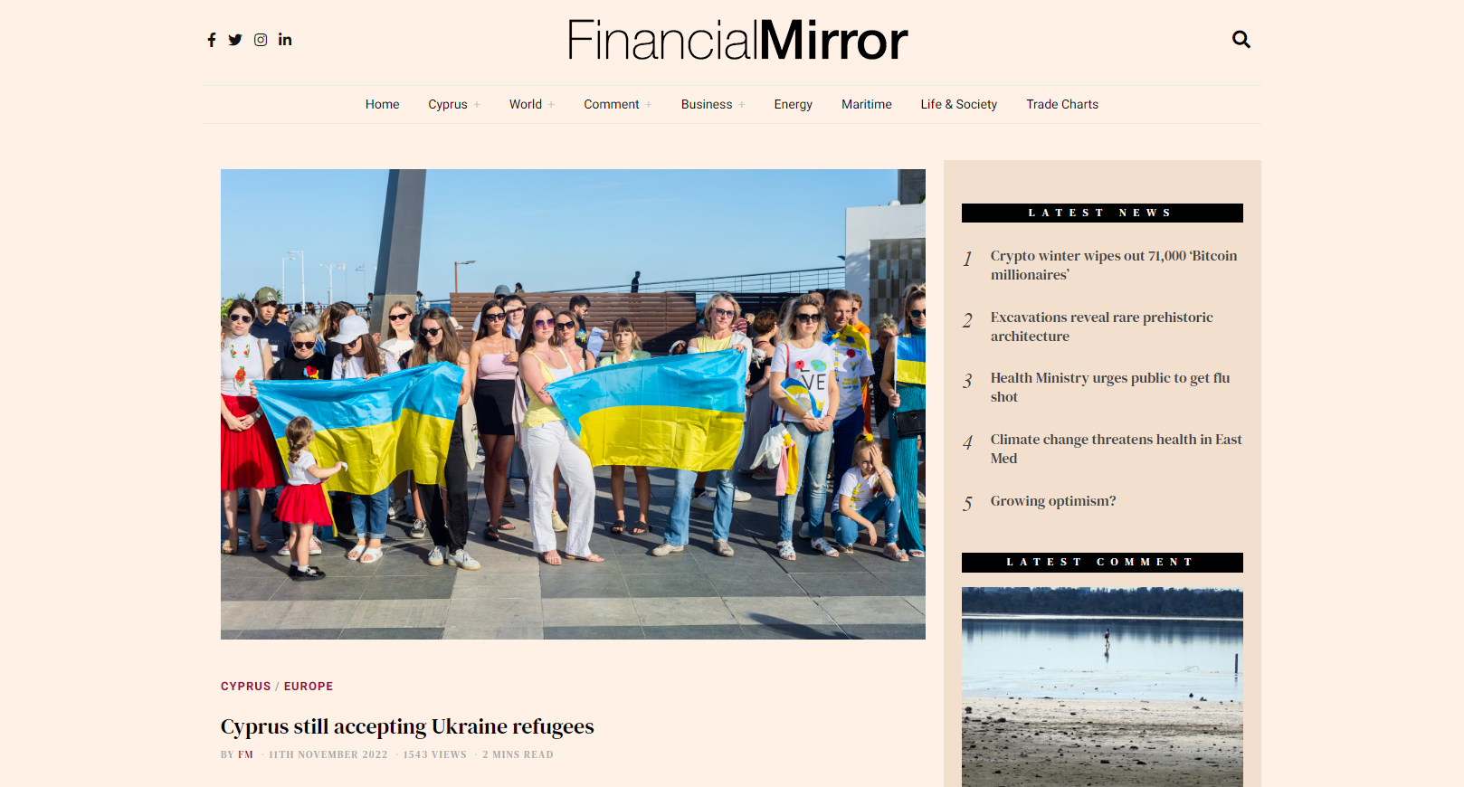
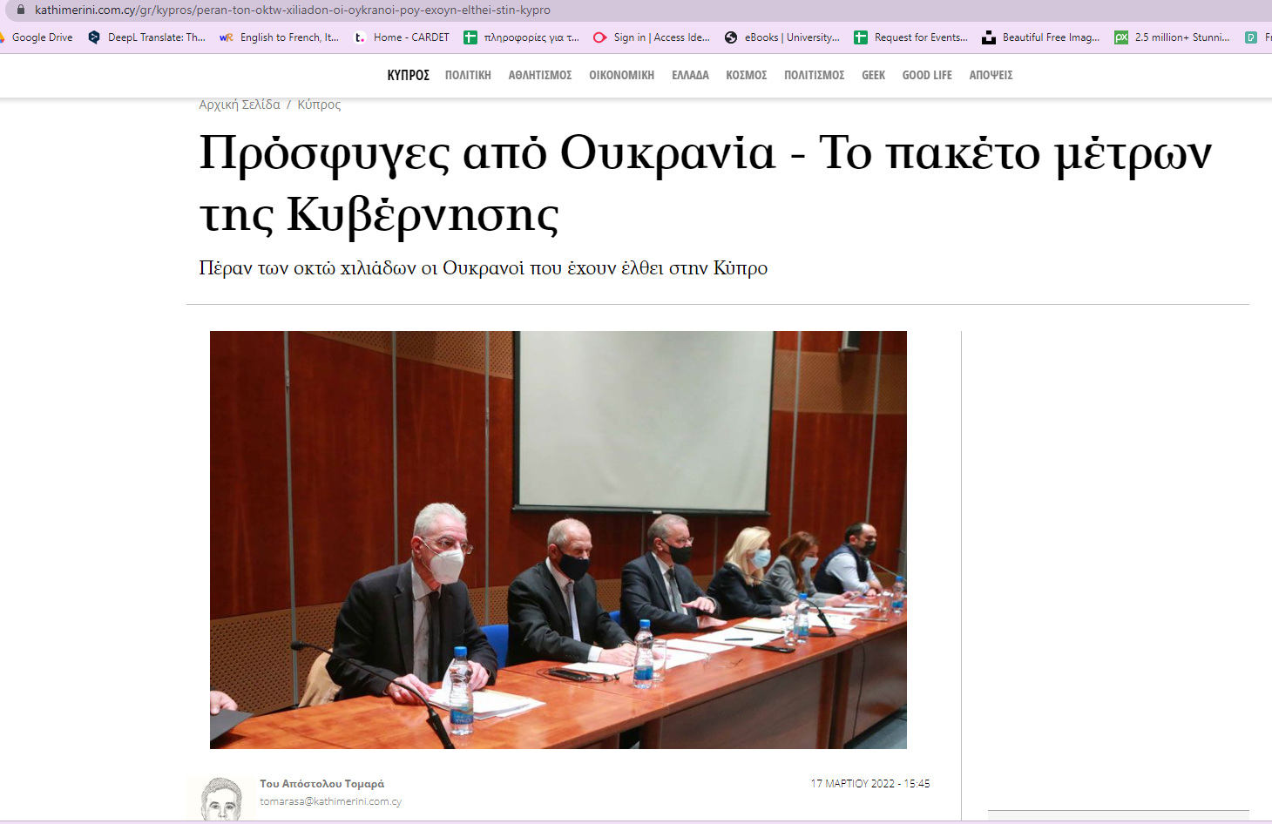
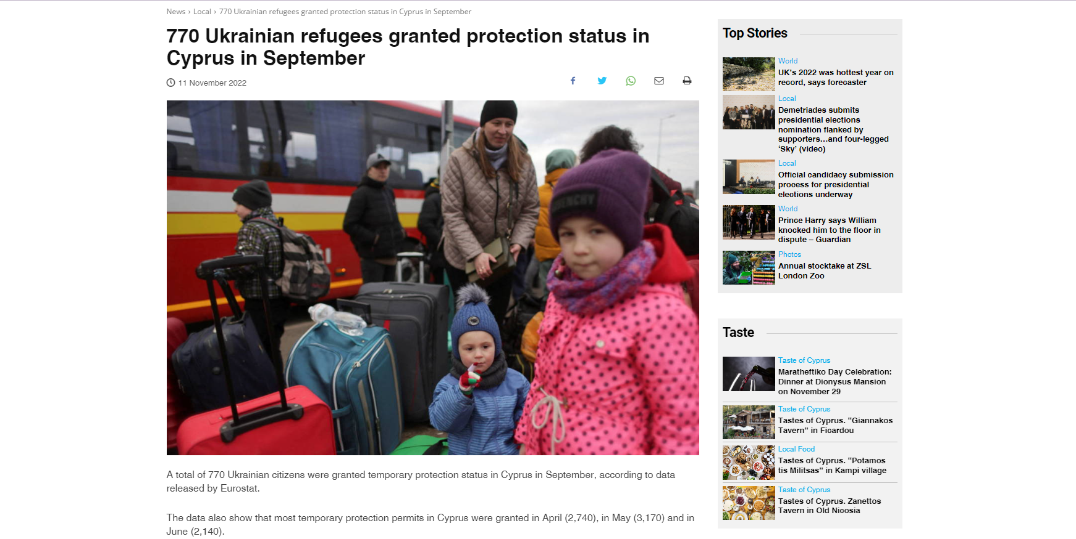
Notes:
Source:
https://www.must.com.cy/gr/people/news/etoimi-i-kypros-na-dexthei-oykranoys-prosfyges
https://www.financialmirror.com/2022/11/11/cyprus-still-accepting-ukraine-refugees/
https://neakypros.com.cy/prosfyges-apo-oykrania-to-paketo-metron-tis-kyvernisis-143363.html
https://in-cyprus.philenews.com/news/local/770-ukrainian-refugees-granted-protection-status-in-cyprus-in-september/#:~:text=A%20total%20of%20770%20Ukrainian,and%20in%20June%20(2%2C140).

Slide 47
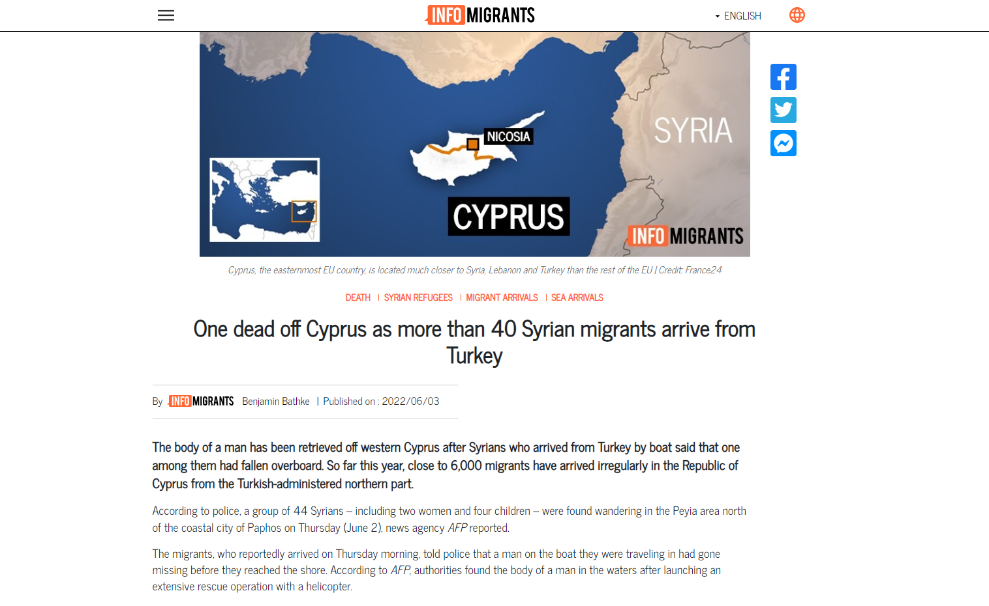
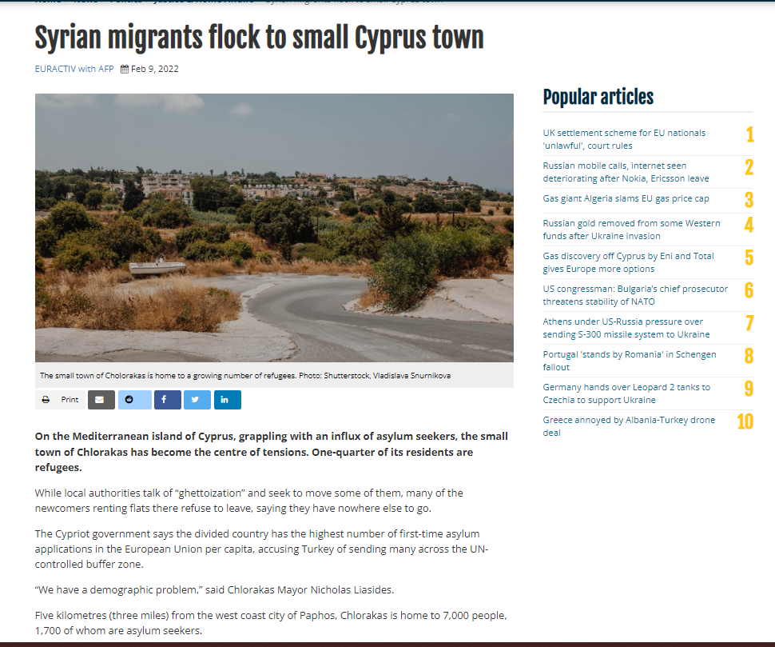
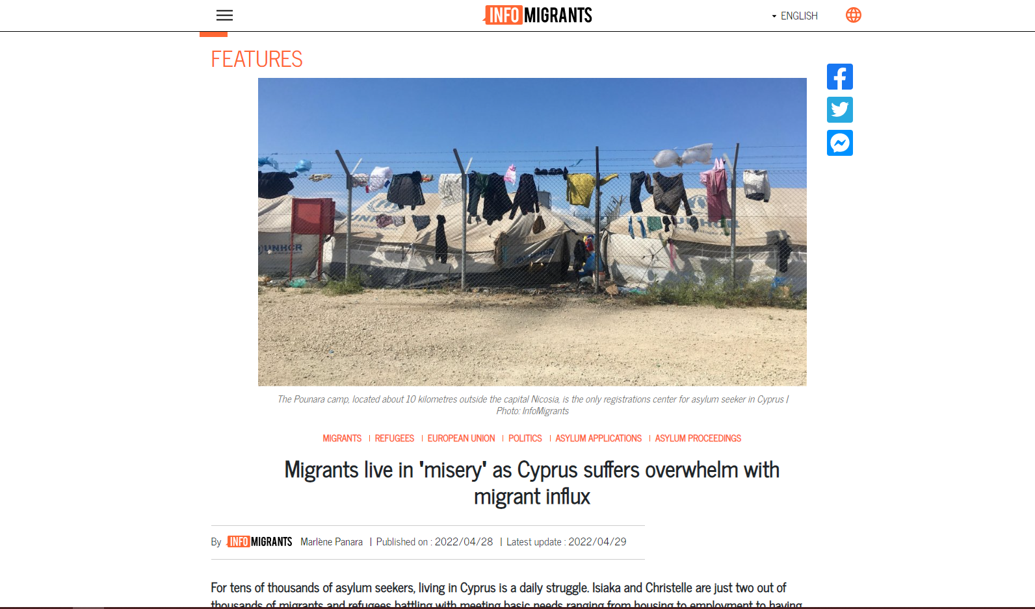
Notes:
Source: https://www.infomigrants.net/en/ and https://www.euractiv.com/section/justice-home-affairs/news/syrian-migrants-flock-to-small-cyprus-town/

Slide 48
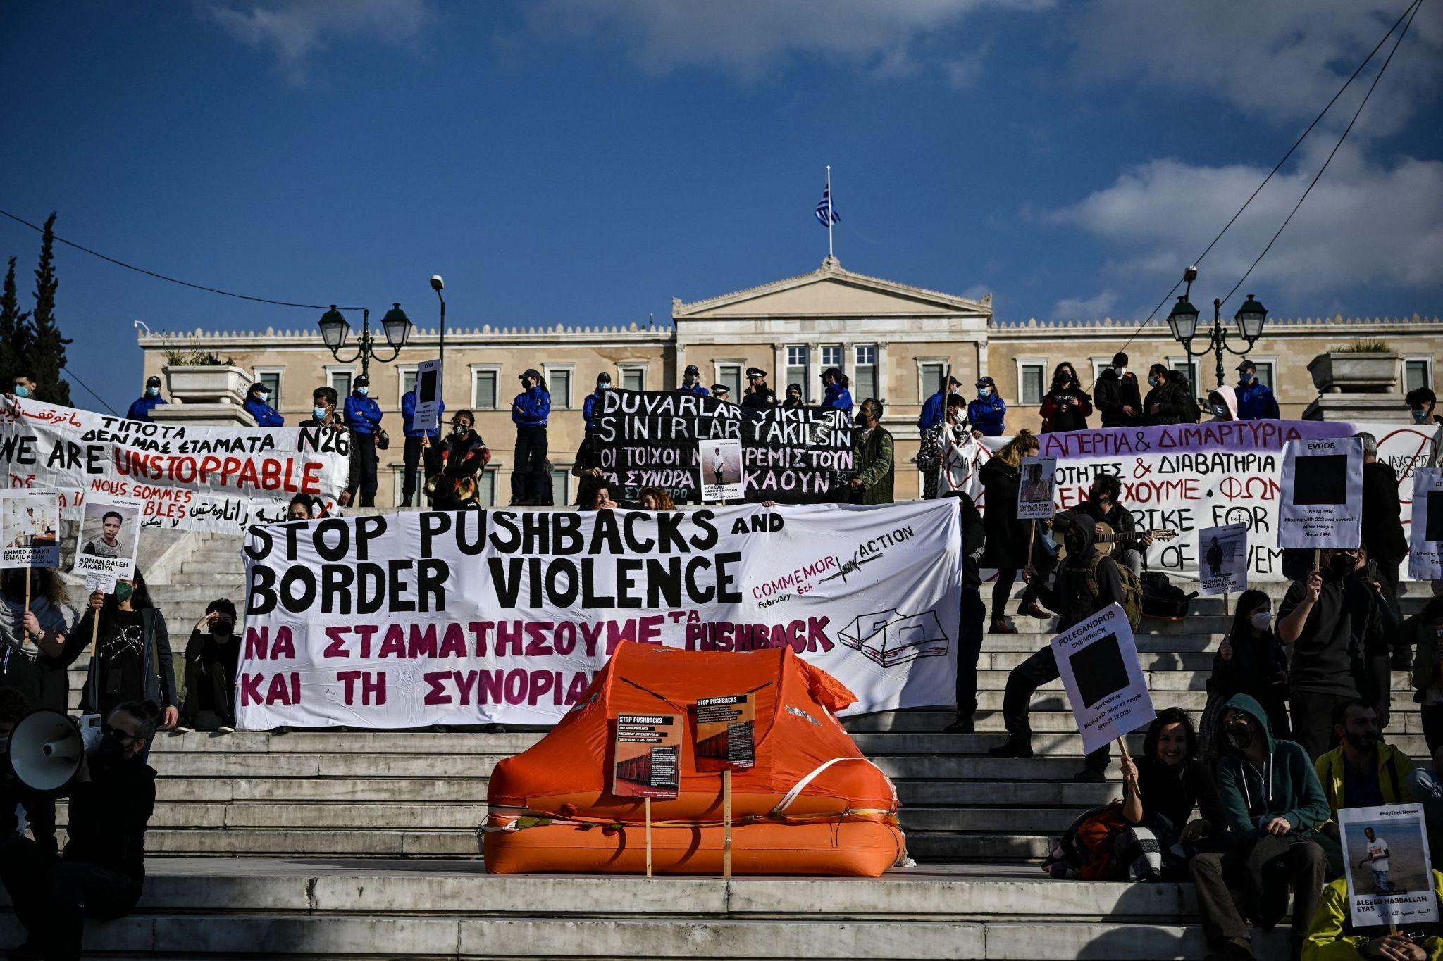
Case Study 2: Violations of refugees human rights
The violation of migrants/refugees human rights are not only after they arrive in the country they want to live, which are non access to education, work, identity, travel documents.
But also to before their arrival in the countries. Such as brutality and violence. One of the biggest issues are facing is the pushbacks.
Protesters hold signs and banners as they stand next to a life raft during a demonstration in central Athens, Greece, on Feb. 6, 2022. (AFP Photo)
Notes:
Text Source: https://www.ohchr.org/sites/default/files/Documents/Publications/FactSheet20en.pdf , https://reliefweb.int/report/world/end-violence-and-serious-human-rights-violations-against-afghan-refugees
Picture source: https://www.dailysabah.com/politics/eu-affairs/hundreds-demonstrate-against-greeces-migrant-pushbacks?gallery_image=undefined#big

Slide 49
Case Study 3
LET HER LEARN
The only country that does not allow girls to go to school is Afghanistan.
"Before the Taliban took power in Afghanistan, 3.7 million children were out of school - most of them girls. Since then, the regime has banned an additional 1,254,473 Afghan girls from attending secondary school." (Malala Fund, Afghanistan)
In addition, women were banned from attending universities in Afghanistan.
Notes:
Text Source: https://malala.org/countries/afghanistan
Picture Source: https://www.siasat.com/let-her-learn-afghans-raises-voice-against-university-ban-for-women-2485356/

Slide 50
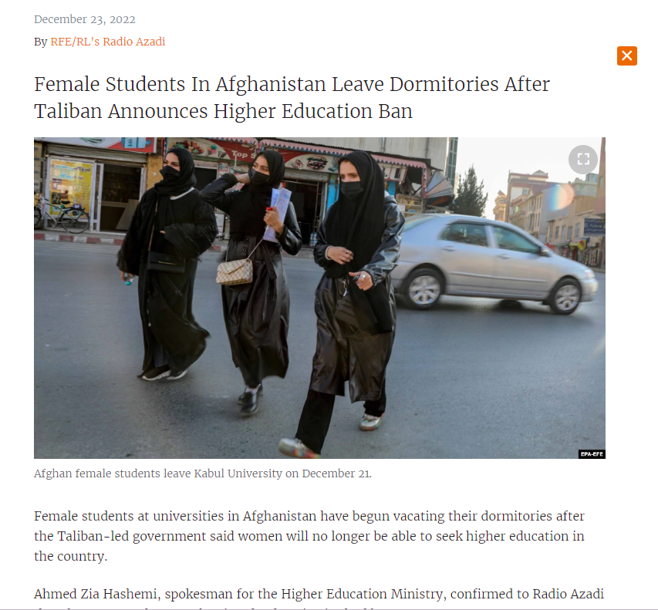
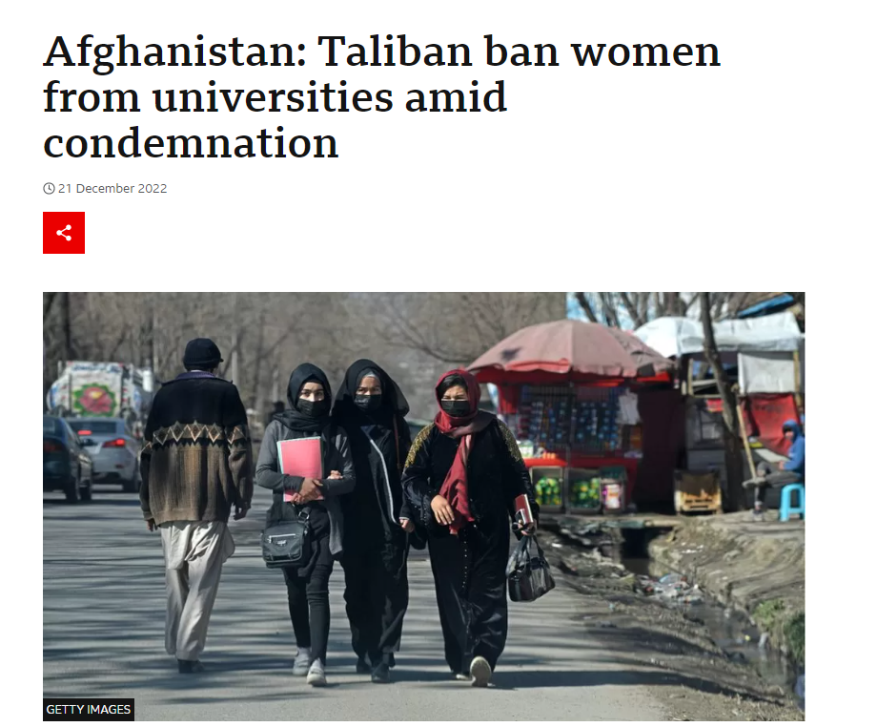
BREAKING NEWS
Source: https://www.bbc.com/news/world-asia-64045497
Source:https://www.rferl.org/a/afghan-women-leave-dormitories-taliban-ban-education/32191136.html#:~:text=Afghan%20female%20students%20leave%20Kabul,higher%20education%20in%20the%20country

Slide 51
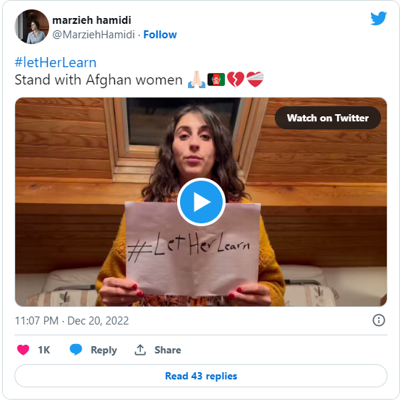
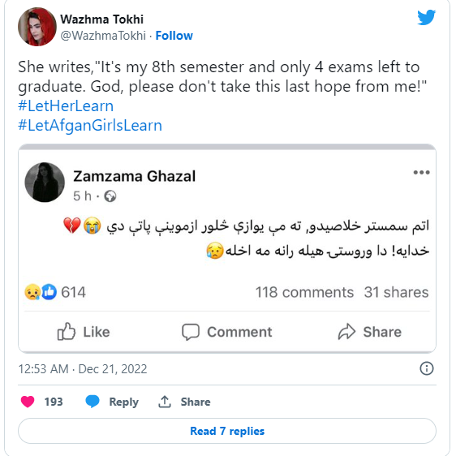
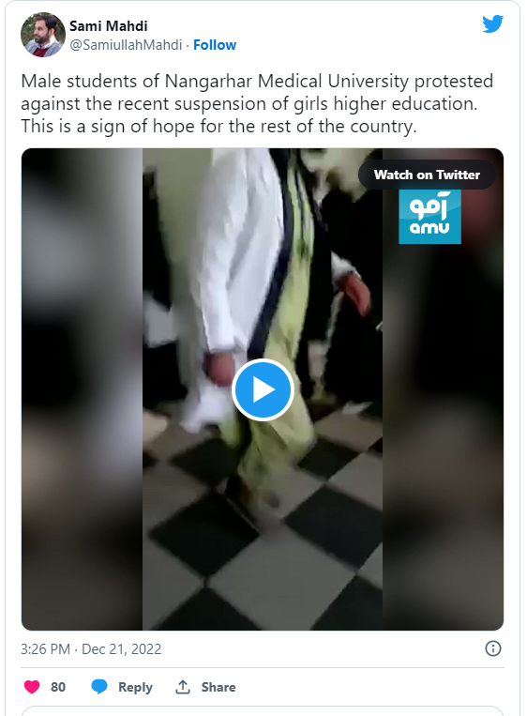
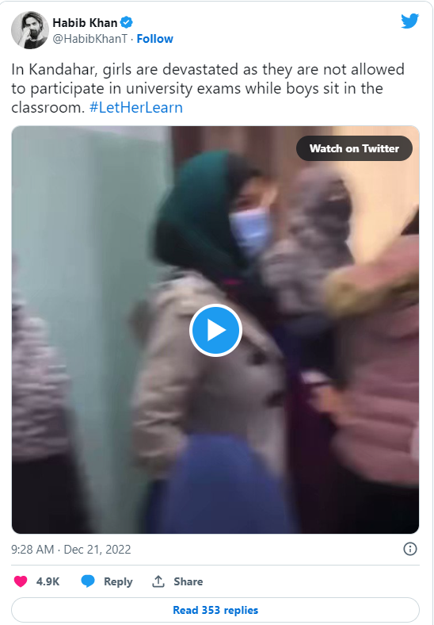
Notes:
Sources: https://www.siasat.com/let-her-learn-afghans-raises-voice-against-university-ban-for-women-2485356/

Slide 52
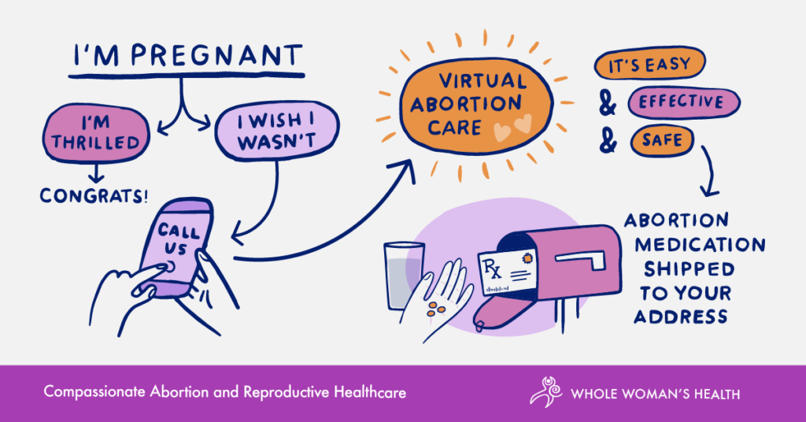
(Whole Woman’s Health, Abortion Medication by mail)
Notes:
Picture Source: https://www.wholewomanshealth.com/abortion-care/abortion-medication-by-mail/

Slide 53
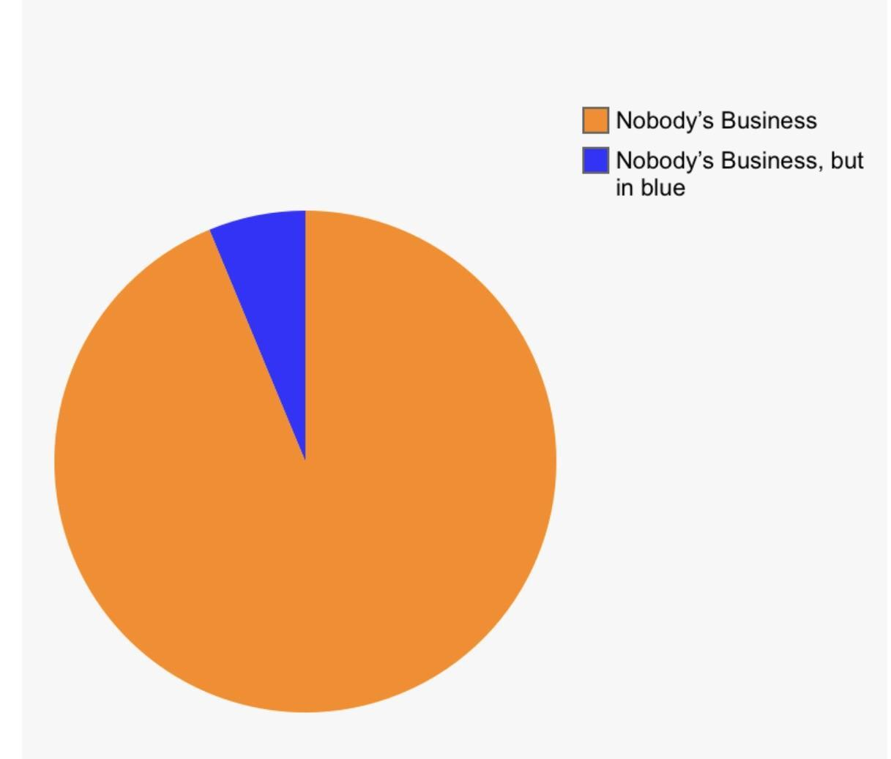
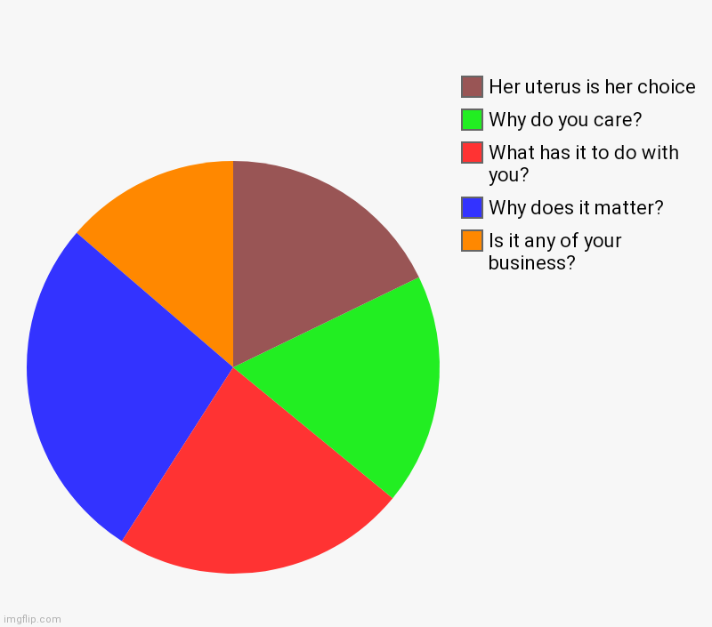
REASONS PEOPLE WITH A UTERUS GET ABORTIONS
Notes:
Source: https://imgflip.com/i/5lsnen and
https://www.reddit.com/r/PoliticalHumor/comments/bqjddl/a_helpful_pie_chart/

