Slide 1
Module 2 Human Rights and Civil Rights
Unit 2: Civil Rights

Slide 2
Unit 2: Learning Objectives & Terminology
Unit 2 Learning Objectives
Understand what civic rights are
Identify civil rights movements
IMPORTANT GUIDELINES ON THE TERMINOLOGIES
It is crucial to use the correct terminology in this section. People of color are not comfortable with the use of certain words and phrases shown in the following slides. It is now considered offensive and outdated to use words like "colored" and "negro".
When referring to non-whites, the correct terminology is:
Black: refers to dark-skinned African Americans, no matter their nationality.
African American: refers to people born in the United States and who have African ancestry. Many people use the terms interchangeably.
"People of color" was originally meant to be a synonym for "Black", but it has expanded to include Latinos, Asians, Native Americans, etc.
Notes:
(Source: https://www.uah.edu/diversity/news/15567-which-is-the-correct-terminology-black-african-american-or-people-of-color )

Slide 3
Unit 2: Learning Objectives & Terminology
IMPORTANT GUIDELINES ON THE TERMINOLOGIES
LGBTQ+: “An acronym for “lesbian, gay, bisexual, transgender and queer” with a "+" sign to recognize the limitless sexual orientations and gender identities used by members of the community.” (HRC Foundation. Glossary of Terms)
Sex assigned at birth: “The sex, male, female or intersex, that a doctor or midwife uses to describe a child at birth based on their external anatomy.” (HRC Foundation. Glossary of Terms)
Sexual orientation: “An inherent or immutable enduring emotional, romantic or sexual attraction to other people. Note: an individual’s sexual orientation is independent of their gender identity.” (HRC Foundation. Glossary of Terms)
People who menstruate/People with a uterus: This term does not include only cis women, but also trans and non-binary people.
Notes:
Text Source: https://www.hrc.org/resources/glossary-of-terms

Slide 4
Icebreaker Activity
In the same boat
Stand up and find some space in the room
Listen to the categories announced and get into groups accordingly
You may speak to other learners in order to identify the groupings.
Reflect on the activity

Slide 5
What are Civil Rights?
Civil Rights are:
“An essential component of democracy. They’re guarantees of equal social opportunities and protection under the law, regardless of race, religion, or other characteristics. Examples are the rights to vote, to a fair trial, to government services, and to public education. In contrast to civil liberties, which are freedoms secured by placing restraints on government, civil rights are secured by positive government action, often in the form of legislation”.
(Britannica, 2023)
Civil rights include:
the right to vote,
fair trial,
government service,
public education and
the use of public facilities.
Notes:
Source:https://www.britannica.com/topic/civil-rights

Slide 6
Examples of Civil rights
Participatory Democracy: The cornerstone of any democratic society is the right to vote, which ensures that all citizens can participate in the political process and have their voices heard, regardless of their race, gender, religion, or other individual attributes.
Equitable Legal Proceedings: Fairness in the judicial process is guaranteed by civil rights, which includes the right to a lawyer, the assurance of due process, and safeguards against forced self-incrimination, ensuring that justice is dispensed without bias or discrimination.
Access to Government Assistance: Civil rights also mean the obligation of the government to provide equal access to vital services, benefits, and aid, such as healthcare and social security, to all individuals irrespective of their personal traits or socioeconomic status.
Universal Public Education: Everyone has the right to be educated in a safe, inclusive environment; civil rights guarantee access to public education institutions, promoting equal opportunities for learning and growth for all students, regardless of their background.
Public Amenities Usage: Civil rights ensure that public facilities, parks, libraries, and services are accessible to all, fostering a sense of community and shared ownership without any form of bias or discrimination.
Workplace Equality: Employment rights under civil legislation protect workers from discrimination, creating a fair playing field in hiring processes, promotions, and general workplace treatment, thereby promoting diversity and inclusivity.
Fair Housing Practices: Equal access to housing, a fundamental human need, is protected under civil rights, ensuring that individuals and families can secure safe, affordable housing without facing discrimination based on race, religion, gender, or other factors.

Slide 7
Examples of Civil rights
Non-Discrimination: Civil rights provide safeguards against prejudiced treatment in public life, making spaces such as hotels, public transportation, and services more inclusive, and ensuring that everyone can participate fully and freely in society.
Freedom to Marry: The right to choose one's partner and form a family is a personal decision protected by civil rights, granting individuals the freedom to marry without experiencing discrimination based on their race, religion, or gender.
Free Speech and Expression: Freedom of speech, a vital pillar of a democratic society, is protected under civil rights, empowering individuals to share their ideas and opinions openly, fostering a culture of dialogue, debate, and understanding.
Peaceful Congregation and Protest: Civil rights grant the privilege to assemble peacefully and protest, a critical tool for citizens to voice their concerns, seek redressal, and contribute to societal change without fear of undue government interference.
Personal Privacy: Civil rights protect personal privacy, prohibiting unwarranted intrusions into people's lives and preserving the dignity and freedom of individuals by allowing them to keep their personal affairs private.
Law's Equal Protection: The principle of equal protection under the law, enshrined in civil rights, ensures fair and equal treatment of all individuals, regardless of their personal characteristics, thereby reinforcing justice and fairness in society.
Racial Equity: The struggle for civil rights has been closely tied to racial equality, providing safeguards against racial segregation and discrimination, and promoting social cohesion and mutual respect among all racial and ethnic groups.

Slide 8
Examples of Civil rights
Gender Equity: By ensuring equal rights and opportunities regardless of gender or gender identity, civil rights legislation paves the way for gender equity, thereby dismantling barriers to advancement and ensuring everyone can contribute to society's progress.
LGBTQ+ Protections: Civil rights for LGBTQ+ individuals protect them against discrimination based on their sexual orientation or gender identity, promoting acceptance, and fostering a society that values all its members equally.
Rights for the Disabled: Civil rights ensure that individuals with disabilities are granted equal access and opportunities in society, promoting an inclusive community that values diversity and accommodates the needs of all its members.
Immigrant and Refugee Rights: Civil rights uphold the protections and due process for immigrants and refugees, ensuring they are treated with dignity and fairness, and recognizing their contributions to the societal and cultural fabric.
It's important to note that civic rights can vary from one country to another based on their legal systems and cultural norms. In some cases, certain rights might be protected by constitutions or specific laws, while in other instances, they may be protected by international agreements and conventions.

Slide 9
Civil Rights Movements
Civil rights movements refer to social and political efforts that strive to secure equal rights and opportunities for marginalized or oppressed groups in a society. These movements address issues related to race, ethnicity, gender, sexual orientation, disability, and other forms of discrimination. Throughout history, civil rights movements have played a crucial role in challenging unjust laws, practices, and societal norms, resulting in significant changes in many countries. Some prominent examples of civil rights movements include:
The American Civil Rights Movement: The Civil Rights Movement in the United States emerged in the 1950s-1960s, with its roots dating back to the time of the American Civil War and the abolition of slavery. Key milestones include the Emancipation Proclamation in 1863 and the passage of the 13th Amendment, which abolished slavery.
African-American Civil Rights Movement: Focused on ending racial segregation and discrimination against African Americans, this movement saw pivotal events such as the Montgomery Bus Boycott and Martin Luther King Jr.'s leadership, culminating in his iconic "I Have a Dream" speech during the March on Washington.
Vote for Women: Women's suffrage movements fought for voting rights in the Western world, led by figures like Emmeline Pankhurst and the Women's Social and Political Union (WSPU) in the UK, which ultimately resulted in women gaining the right to vote in 1918.

Slide 10
Civil Rights Movements
LGBTQ+ Rights Movement: Advocating for the rights and acceptance of lesbian, gay, bisexual, transgender, and queer individuals, this movement achieved milestones such as decriminalization of homosexuality and recognition of same-sex marriage in many countries.
Disability Rights Movement: This movement worked towards ensuring equal rights and accessibility for people with disabilities, leading to significant legislation like the Americans with Disabilities Act (ADA) in the United States.
Indigenous Rights Movements: These movements focused on addressing historical injustices faced by indigenous peoples, advocating for land rights, cultural preservation, and self-determination.
Anti-Apartheid Movement: Originating in South Africa, this movement aimed to dismantle the apartheid system of racial segregation and discrimination, leading to the establishment of a multiracial democracy.
Hispanic and Latino Civil Rights Movements: Advocates in the United States fought for the rights and recognition of Hispanic and Latino communities, tackling issues related to immigration, labor rights, and representation.

Slide 11
American Civil Rights Movement
The beginning:
Historians refer to the beginning of the Civil Rights Movement in the 50s-60s in United States. However, the context of that time began 100 years before during the American Civil War and specifically with the slavery.
Lincoln, in 1863 signed the Emancipation Proclamation, an executive order which declared all slaves in the Confederate States free. Later, as a result of the Civil War, the 13th Amendment was passed.
In 1866, Congress passed the Civil Rights Act which granted citizenship to all people born in the United States and provided for “full and equal benefit of all laws and proceedings for the security of person and property.”
(Virginia Geographic Alliance, A Story Map)
The 13th amendment officially ended slavery and stated:
"Neither slavery nor involuntary servitude, except as a punishment for crime whereof the party shall have been duly convicted, shall exist within the United States, or any place subject to their jurisdiction.“
(Virginia Geographic Alliance, A Story Map)
Notes:
Source: https://vga.maps.arcgis.com/apps/MapJournal/index.html?appid=9a16f431ccc84f11958e0983d3d1f8df#

Slide 12
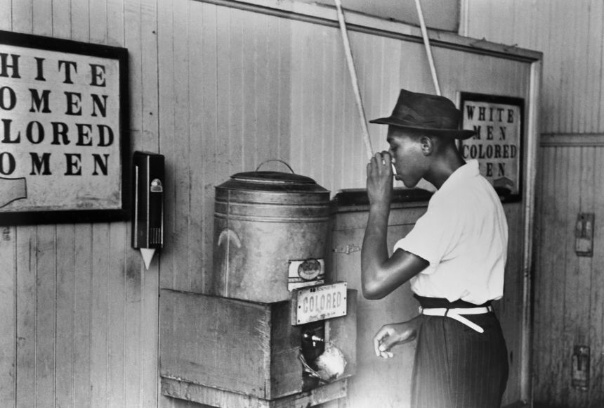
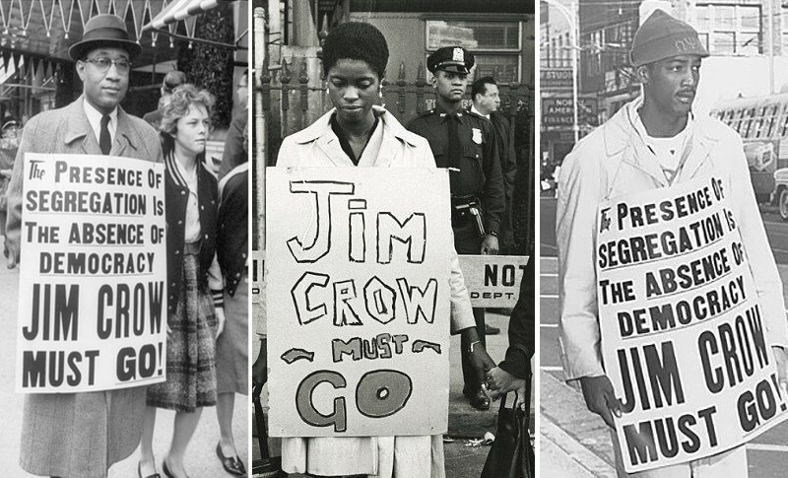
American Civil Rights Movement
The Jim Crow Era:
Even though the 13th amendment passed, the African Americans were not experiencing equality. Blacks did not have the right to “vote, fair wages, education, and many other opportunities that white Americans enjoyed.”
The denial of their rights is known as Jim Crow laws, which “mandated racial segregation in schools, restaurants, public transportation, etc.”
(Virginia Geographic Alliance, A Story Map)
Notes:
Source: https://vga.maps.arcgis.com/apps/MapJournal/index.html?appid=9a16f431ccc84f11958e0983d3d1f8df
Pictures Sources: https://floridahumanities.org/event/the-jim-crow-era-2/ and https://education.nationalgeographic.org/resource/black-codes-and-jim-crow-laws

Slide 13
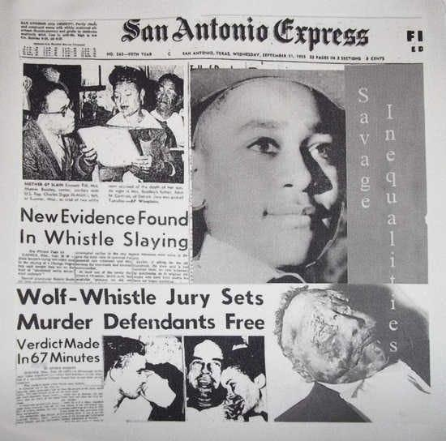
American Civil Rights Movement (1955)
Emmett Till
Emmett Till is kidnaped and murdered in Mississippi. He was 14 years old. He murdered by Roy Bryant and brother-in-law, because according to Carolyn Bryant Till went to the Bryant store and whistled to her.
Notes:
Picture: https://www.insightnews.com/opinion/columnists/why-emmett-tills-last-living-killer-deserves-to-be-locked-up/article_56246d2c-146b-11ed-ba69-579a8a07ee9f.html

Slide 14
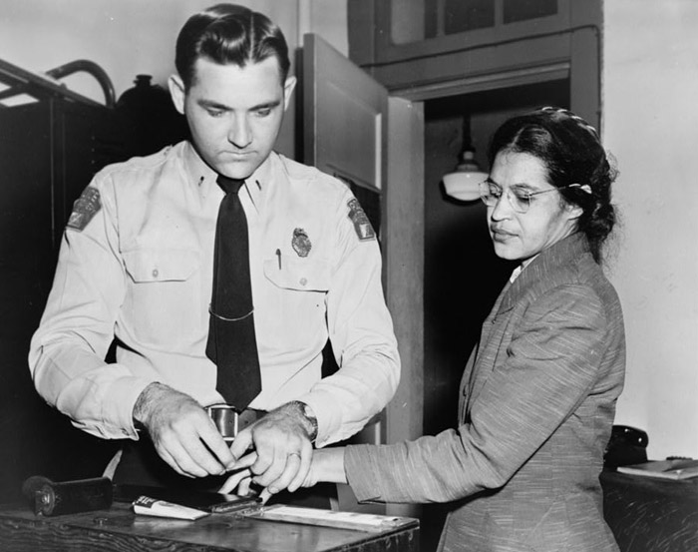
American Civil Rights Movement (1956)
Rosa Parks
Rosa Parks is arrested after refusing to give up her seat in a white section of a Montgomery, Alabama bus. This action sparked the Montgomery Bus Boycott that lasted most of 1956 until the bus system was forced to integrate on December 20, 1956.
Notes:
Picture: https://vga.maps.arcgis.com/apps/MapJournal/index.html?appid=9a16f431ccc84f11958e0983d3d1f8df#

Slide 15
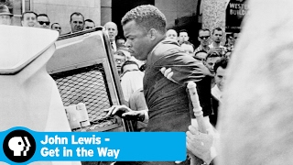
American Civil Rights Movement (1960)
Sit-ins
Four black college students in North Carolina stage a sit-in at a Woolworth lunch counter, encouraging peaceful protest of unjust law.
The North Carolina sit-ins spark other sit-in events across the country, leading to a movement in 65 cities across the country. View the video below to learn about the strategy and purpose of these sit-ins.
JOHN LEWIS - GET IN THE WAY | The Nashville Sit-Ins | PBS
Notes:
Text Source: https://vga.maps.arcgis.com/apps/MapJournal/index.html?appid=9a16f431ccc84f11958e0983d3d1f8df#

Slide 16
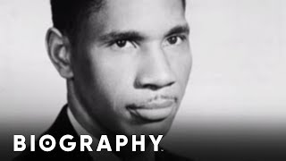
American Civil Rights Movement (1963)
Medgar Evers
Medgar Evers, a National Association for the Advancement of Colored People (NAACP) field secretary, is assassinated at his home in Jackson, Mississippi.
Medgar Evers - Civil Rights Activist | Mini Bio | BIO
Notes:
Source: https://vga.maps.arcgis.com/apps/MapJournal/index.html?appid=9a16f431ccc84f11958e0983d3d1f8df#

Slide 17
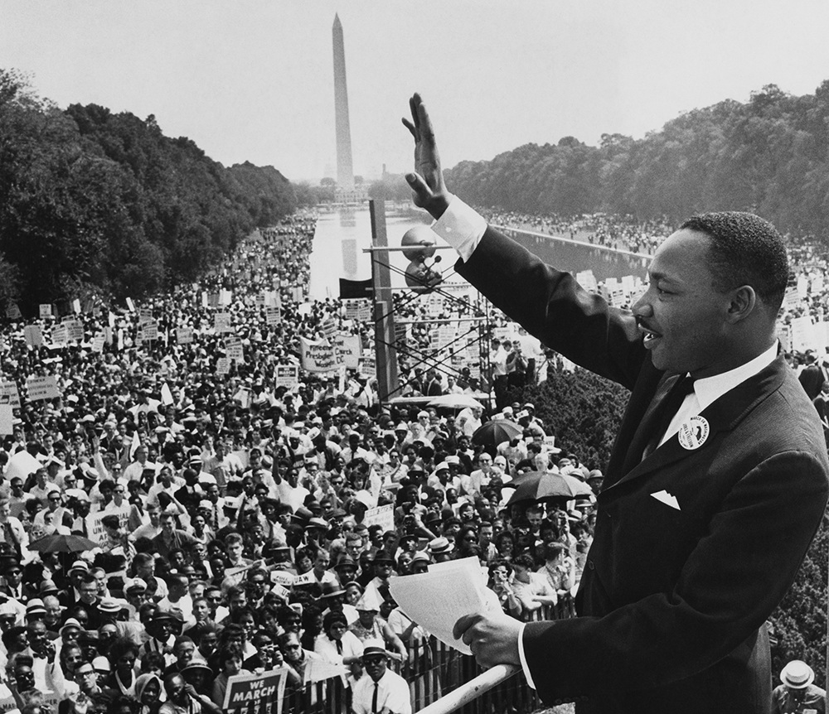
American Civil Rights Movement (1968)
Martin Luther King, Jr.
Martin Luther King, Jr. is assassinated by a sniper while standing on his hotel room balcony in Memphis, TN. Martin Luther King Jr. was the most widely recognized icon of the movement and a well-known advocate for peaceful protest.
Martin Luther King was assassinated on the evening of April 4, 1968, while standing on the balcony of his motel room in Memphis, Tennessee, where he was to lead a protest march.
Notes:
Text Source: https://vga.maps.arcgis.com/apps/MapJournal/index.html?appid=9a16f431ccc84f11958e0983d3d1f8df# and
https://www.nobelprize.org/prizes/peace/1964/king/biographical/
Picture: https://today.tamu.edu/2020/01/15/why-i-have-a-dream-remains-one-of-historys-greatest-speeches/

Slide 18
Listen to the speech of Martin Luther King. Jr
I Have a Dream speech by Martin Luther King .Jr HD (subtitled)

Slide 19
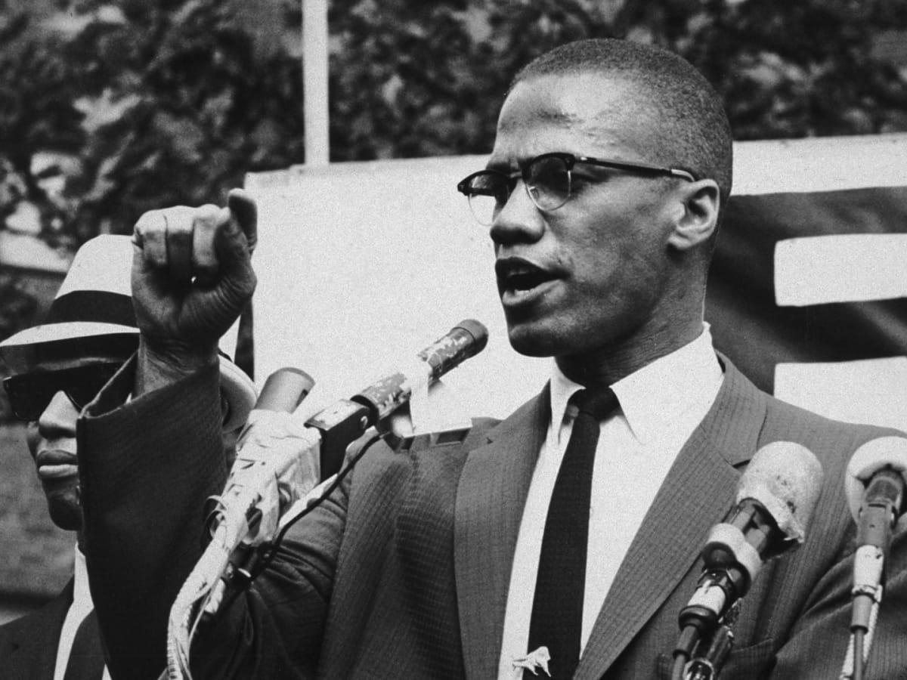
American Civil Rights Movement
Malcolm X
Malcolm X “was a minister, a leader in the civil rights movement and a supporter of Black nationalism. He urged his fellow Black Americans to protect themselves against white aggression ‘by any means necessary’”
(History, Malcolm X)
Malcolm X was assassinated on February 21, 1965, at an Organization of Afro-American Unity rally in the Audubon Ballroom in New York City.
Notes:
Text Source: https://www.history.com/topics/black-history/malcolm-x
Picture Source: https://www.history.com/topics/black-history/malcolm-x

Slide 20
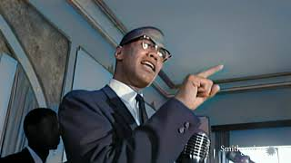
Listen to the speech of Malcolm X
Malcolm X’s Fiery Speech Addressing Police Brutality

Slide 21
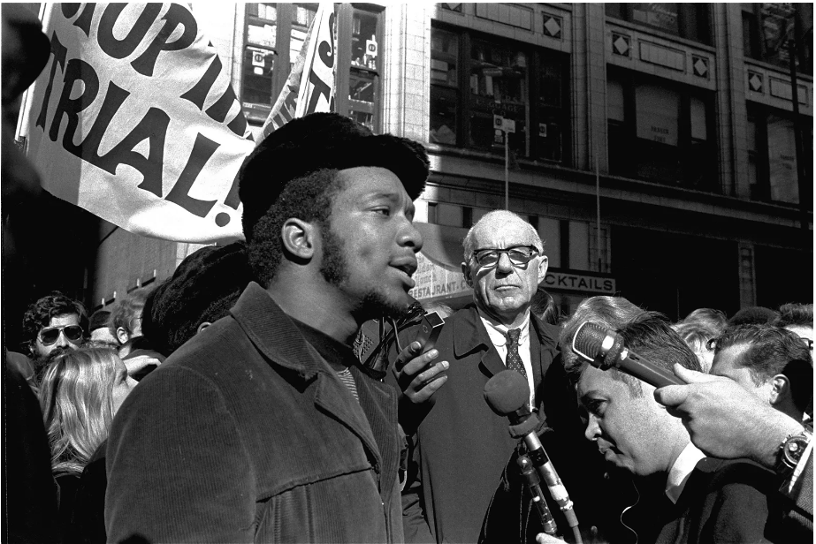
American Civil Rights Movement
Black Panther Party
In Chicago the leader of the party, Fred Hampton, was assassinated by the FBI, in 1969 in his house while sleeping.
Notes:
Text Source: https://nmaahc.si.edu/explore/stories/black-panther-party-challenging-police-and-promoting-social-change
Picture Source: https://www.britannica.com/biography/Fred-Hampton

Slide 22
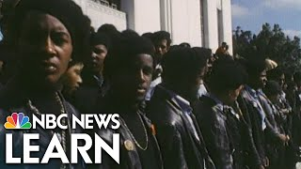
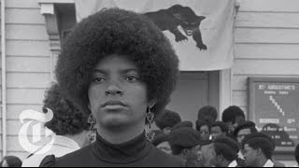
Watch the video below of Black Panther Party
Black Panther
Black Panthers Revisited | Op-Docs | The New York Times

Slide 23
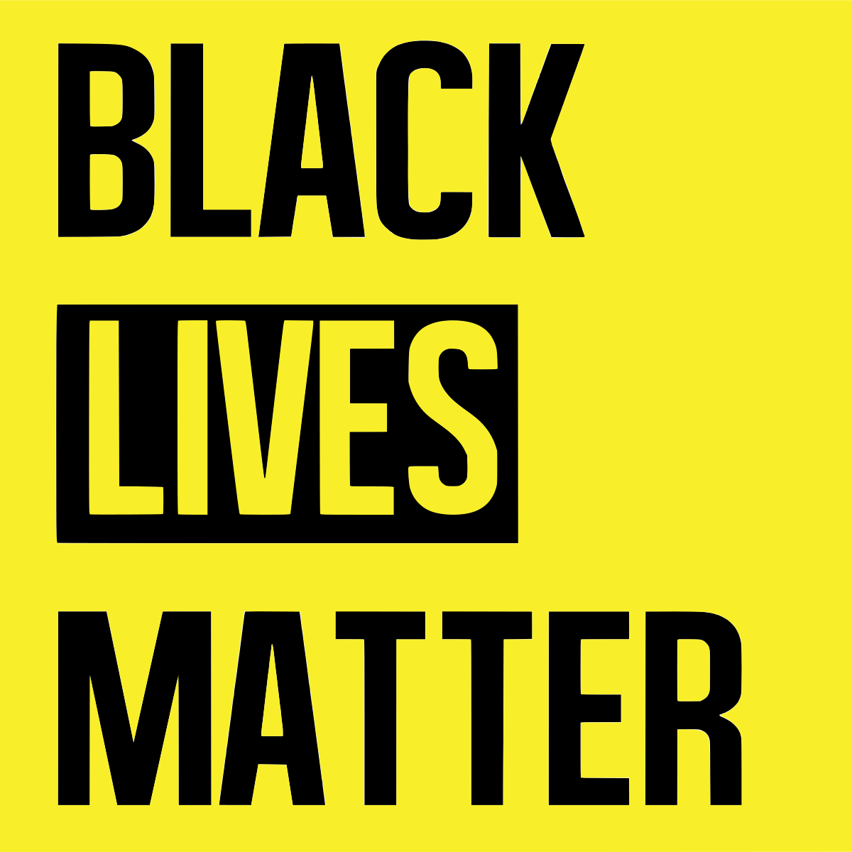
American Civil Rights Movement: Today
Black Lives Matter
“#BlackLivesMatter was founded in 2013 in response to the acquittal of Trayvon Martin’s murderer.”
(Black Lives Matter, About)
The movement became national headlines in 2020 with the death of George Floyd and all the demonstrations not only in US but around the globe.
Notes:
Text Source: https://blacklivesmatter.com/about/
Picture Source: https://en.wikipedia.org/wiki/Black_Lives_Matter

Slide 24
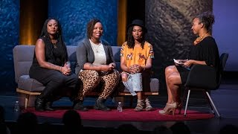
Listen to the interview of Black Lives Matter founders
An interview with the founders of Black Lives Matter | Alicia Garza, Patrisse Cullors, Opal Tometi

Slide 25
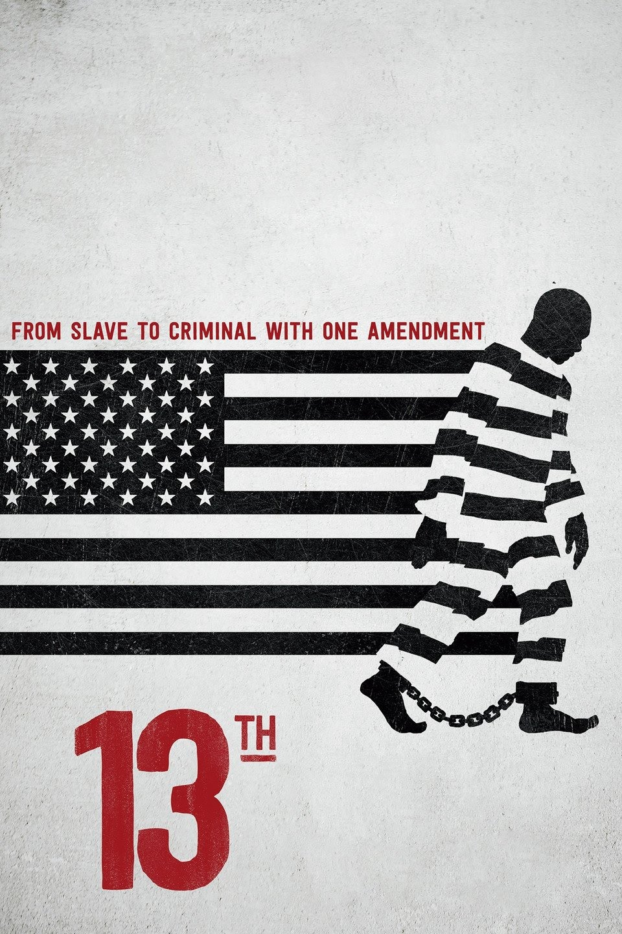
Do You Want To Know More?
13th (2016) Documentary: https://www.youtube.com/watch?v=K6IXQbXPO3I
Who Killed Malcolm X? Documentary: https://www.youtube.com/watch?v=bqqOQBalq5k
12 Years a Slave (2013) Movie
Time: The Kalief Browder Story (2017)
Trial 4 (2020)
Book recommendations: https://www.bcu.ac.uk/social-sciences/blog/blm-book-recommendations
Podcasts: https://www.npr.org/sections/codeswitch/ , https://www.nytimes.com/2020/01/23/podcasts/1619-podcast.html ,
Black Lives Matter: https://www.youtube.com/watch?v=tbicAmaXYtM
Notes:
Picture Source: https://www.imdb.com/title/tt5895028/

Slide 26
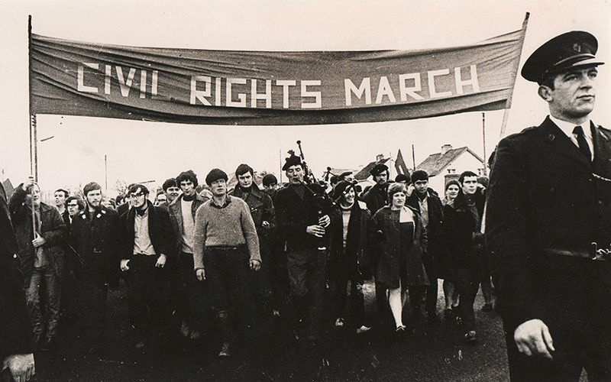
Northern Ireland Civil Movement
The events of the civil rights movement in the United Stated inspired the civil rights movement in Northern Ireland in the 1960s. The movement in Northern Ireland was aiming to end the institutional discrimination against Catholics in Ulster.
The Catholics were facing discrimination in the workplaces, on hiring policies and workplace conditions. Other than that, Catholics faced discrimination even on housing and the allocation of homes by the government were discriminated against them.
Additionally, most of the schools were Protestants and Catholic children were attended schools funded by the Catholic church. Because of the segregation, most of Protestants and Catholics were never mixed. They were never interacting with each other, get married etc.
Notes:
Text Source: https://alphahistory.com/northernireland/northern-ireland-civil-rights-movement/
Picture Source: https://www.irishcentral.com/opinion/others/northern-ireland-civil-rights-movement

Slide 27
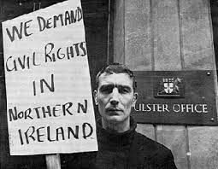
Northern Ireland Civil Movement
The Anti-Catholic discrimination existed in politics as well. Unionists were increased their strengthen in Northern Ireland and they were manipulating their elections and decreased the power the Catholic politicians had. The unionists legislation also rigged the rights to vote and excluded Catholics.
At the municipal level, right to vote had only the individuals who were property owners. Also, the homeowners who paid rated, they could vote in local council elections. The landlords had up to six votes and tenants (public or rented housing) were not permitted to vote at all.
In 1963, O’Neill elected as prime minister and improve relations with the Republic of Ireland and move to reconciliation with Northern Ireland’s Catholics.
Notes:
Picture Source: https://cain.ulster.ac.uk/events/crights/nicra/nicra78.htm

Slide 28
South Africa Civil Rights Movement
In South Africa civil rights movement was aimed to the end of racial segregation system known as apartheid.
Apartheid was a system of legislation that segregated non-white citizens of South Africa and began in 1948 with the gained of power by the National Party.
In apartheid system, non-white South Africans which were the majority of the population were forced to:
Live in separated areas from the white population.
Use separated public facilities.

Slide 29
South Africa Civil Rights Movement
The resistance to the apartheid started in the 40s and by the 60s most of the resistance movement leaders were imprisoned. The movement included African National Congress (ANC) party.
In the 1990, Nelson Mandela (who was the founder of Umkhonto we Sizwe (“Spear of the Nation”), the military wing of the ANC) was release from prison. In 1994, Mandela became the first Black president of South Africa.

Slide 30
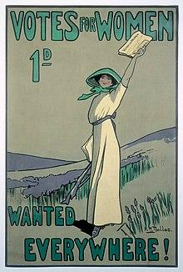
Vote for Women
An essential aspect of the civil rights movement for voting rights was that of women in the Western world.
Emmeline Pankhurst and her daughters started the suffragette movement in Manchester, UK in 1903. They founded the Women's Social and Political Union (WSPU) in 1903.
The suffragettes were arrested by the police at the various meetings they organised. After years of humiliation by the media, men and the government for their fight for the right to vote, women were first given the vote in the UK in 1918.
However, only white women participated in the suffragette movements. Many of the leaders of the movement were middle class women, but many working class women were involved in the movement.
Notes:
Picture Source: https://en.wikipedia.org/wiki/Women%27s_suffrage_in_the_United_Kingdom

Slide 31
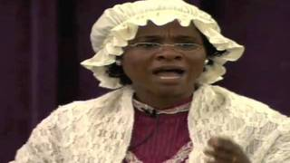
Watch the powerful speech of Sojourner Truth
In 1950, during the women's rights convention in Akron, Ohio, Sojourner Truth, a former slave, delivers her now memorable speech, “Ain't I a woman?”.
Sojourner Truth Speech of 1851, "Ain't I a Woman"

Slide 32
Women Right to Vote in Cyprus
Women in Cyprus had the right to vote by the British Empire in 1918. However, according to Petro Papapolyviou, women in Cyprus voted for the first time in 1905 during the complex Archbishop issue (1900-1910), which was one of the most complicated side issues that arose was the election of the Nicosia Education Committee.
“In the absence of an Archbishop, the two factions (Kythian and Cyrenaic) were involved in a long and costly legal battle, claiming control of the capital's educational institutions and legal representation of the Orthodox Archdiocese.
Under the Education Act of April 1905, the right to vote was given to "all taxpayers", i.e., anyone who paid business or property taxes, whereas until then all male residents had voted in educational elections. As a frightened editor of a Nicosia newspaper stated, "so that those who do not own a shop or pay property tax (and in the capital they are the majority, because their properties are registered to their ladies) are not entitled to vote". (Papapolyviou, 2015)
Notes:
Source: https://papapolyviou.com/2015/03/14/i-psifos-ton-ginekon-stin-kipro/

Slide 33
Women Right to Vote in Cyprus
The new law gave more than 900 women in Nicosia the right to vote, leading to a pioneering feminist conquest. Despite the malicious comments, tax-paying Nicosia women were invited to vote in the 5/18 June 1905 election for an Education Committee. Ultimately, the election ended in a fiasco as both factions felt they had won, and the case went the way of the courts. The next day, an unprecedented demonstration of men and women marched to the Commissariat.
"The ladies, numbering a thousand or more, were in the lead, and the men marched in silence and in extreme order. (...) The women's parachutes, their wide-legged pipes and their various amphibianisms added to the demonstration. This peaceful and modest rally of the women and men of our island's capital is sure to leave an indelible mark on the political annals of the island, since it is the first rally of men and women, the last of whom took an active part in politics for the first time and in an American way. A few months later, the House restored male monarchy, and all went smoothly into history”. (Papapolyviou, 2015)
Notes:
Source: https://papapolyviou.com/2015/03/14/i-psifos-ton-ginekon-stin-kipro/

Slide 34
Discussion
In small groups discuss:
What stood out for you?
Did the material challenge any preconceptions or biases you previously held about civil rights issues or marginalized communities?
In what ways do you see parallels between past civil rights movements and current social issues?

Slide 35
Activity: Debate
Scotland
In Scotland, the voting age is 16 years old for parliamentary elections. In other words, people have the right to vote from the age of 16 and above.
Cyprus
In Cyprus, in the past, the right to vote was compulsory. However, now the right to vote is optional.

Slide 36
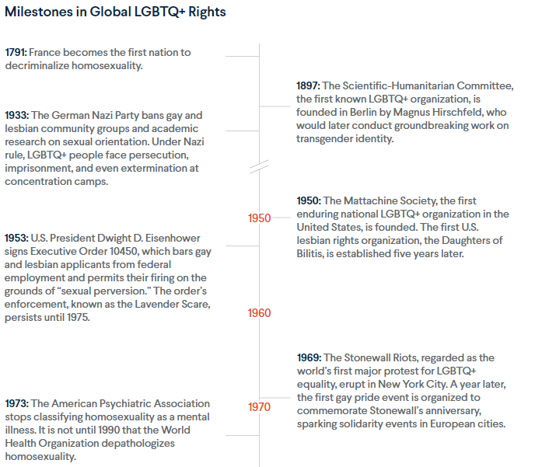
LGBTQ+ Rights
(The Changing Landscape of Global LGBTQ+ Rights, 2021)
Notes:
Text Source: https://www.cfr.org/article/changing-landscape-global-lgbtq-rights

Slide 37
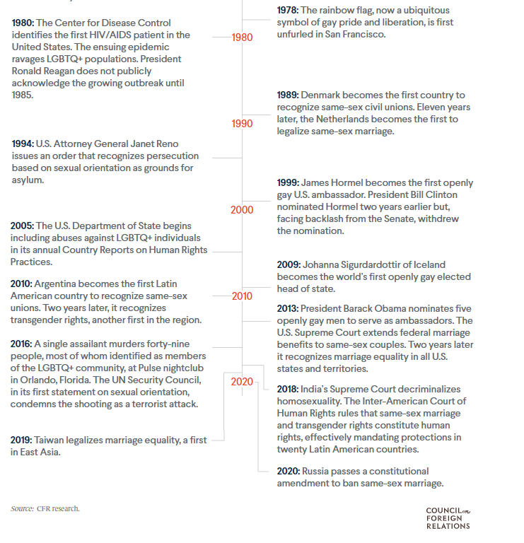
LGBTQ+ Rights
(The Changing Landscape of Global LGBTQ+ Rights, 2021)
Notes:
Text Source: https://www.cfr.org/article/changing-landscape-global-lgbtq-rights

Slide 38
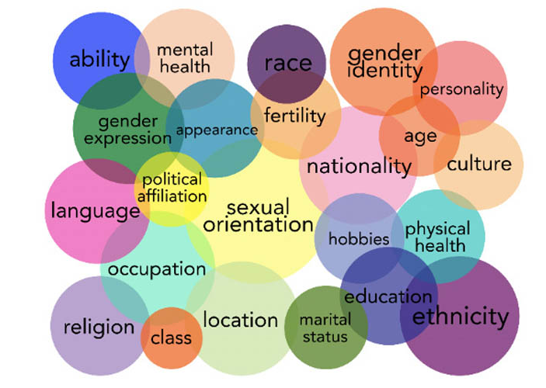
Intersectionality
The term intersectionality was first introduced in 1989 by critical race theorist Kimberlé Crenshaw, who provided a framework that must be applied to all situation's women face, recognizing that all the aspects of identity enrich women's lived experiences and compound and complicate the various oppressions and marginalization women face.
Notes:
Text Source:https://library.law.howard.edu/civilrightshistory/women/intersectionality#:~:text=The%20term%20intersectionality%20was%20first,complicate%20the%20various%20oppressions%20and
Picture Source: https://researchguides.library.syr.edu/fys101/intersectionality

Slide 39
Notes:
Source: https://awis.org/intersectionality/

Slide 40
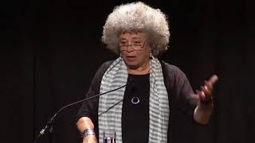
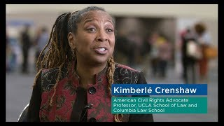
Intersectionality
Angela Davis on Intersectional Feminism
Kimberlé Crenshaw: What is Intersectionality?

Slide 41
Activity: President for a day
Everyone should spend 5 minutes coming up with arguments relating to civil rights and any related policies they might have regarding them.
Candidates should keep in mind that the group of voters they will pitch their arguments to are not interested in the voting process and hold misconceptions on politicians.
Split into groups of 4. All candidates will pitch to each other and as a group elect the president. Learners cannot vote for themselves in this process. Once a group has elected, join another group and repeat the process now with two candidates.
Continue repeating the process until one candidate is elected.

Slide 42
Additional Resources:
Black codes and Jim crow laws
The Assassination of Medgar Evers - A Hero Silenced - Extra History
Malcolm X’s Daughter Ilyasah Shabazz on Her Father’s Legacy & the New Series “Who Killed Malcolm X?”
Malcolm X assassination: Case reopened
Ida b Wells
Civil Rights Leader
Black Panthers
Race, Class, and the Demographics of the British Suffragette Movement
Who were the Suffragettes?
Start of the suffragette movement
Women's Suffrage.
FYS 101: Intersectionality
Matcha Phorn-in, defender of indigenous people and LGBTIQ community
Fridays for future
Remembering Armstead Robinson
The urgency of intersectionality | Kimberlé Crenshaw

