Slide 1
Module 3 CSOs & Media - Essential Components of a Democracy
Unit 1: CSOs

Slide 2
Module 3 – Overview
The Module consists of the below Units:
Unit 1: CSOs
Identify the role of CSOs in democracy
Unit 2: Media
Upon completion of this module, you should be able to:
Identify and understand the nature of CSOs (characteristics, challenges).
Acknowledge and appreciate the significance of CSOs within a democratic context.
Comprehend and define the role and contributions of media within a democratic society.

Slide 3
Definition of CSOs
A civil society organization (CSO) or non-governmental organization (NGO) “is any non-profit, voluntary citizens’ group which is organized on a local, national or international level.” ( United Nations, Civil Society. About us)
CSOs can be characterized as task-oriented organisations and as organisations that promote a variety of services, such as raising citizens' concerns to governments, monitoring policies and promoting political participation at the community level.
Notes:
Text Source: https://www.un.org/en/civil-society/page/about-us#:~:text=Task%2Doriented%20and%20driven%20by,participation%20at%20the%20community%20level
Picture Source: https://www.enicbcmed.eu/spain-ppi4med-looking-innovation-procurement-expert-its-capacitation-programme-based-ppi4med-model

Slide 4
CSOs
A civil society organization (CSO) is any non-profit, voluntary citizens’ group which is organized on a local, national or international level.
Civil Society Organizations play a crucial role in advocating for and promoting positive change in society, as well as providing services and support to communities in need. CSOs operate outside of government control and are not motivated by profit.
CSOs are task-oriented and driven by people with a common interest, perform a variety of services and humanitarian functions, bring citizens’ concerns to Governments, monitor policies, and encourage political participation at the community level.
Notes:
Picture Source: https://www.freepik.com/free-vector/company-newcomers-personnel-staff_12084777.htm#query=civil%20society%20organizations&position=32&from_view=search&track=country_rows_v2

Slide 5
Characteristics of Civil Society Organizations
Mission and Purpose: CSOs are established with a specific mission or goal centered around addressing social, cultural, environmental, or economic issues. This purpose guides their actions and initiatives.
2. Non-Profit Nature: CSOs are not-for-profit entities, meaning they do not aim to generate profits for private individuals or shareholders. Any surplus funds are reinvested into their programs and activities.
3. Independence: CSOs operate independently of government control and are not directly affiliated with political parties or government agencies. This independence enables them to remain impartial and advocate for issues that might not align with the government's agenda.
4. Advocacy and Awareness: CSOs actively engage in advocacy work to influence public policy and raise awareness about pressing issues. They strive to mobilize public support and promote policy changes that align with their mission.

Slide 6
Characteristics of Civil Society Organizations
5. Services and Support: Many CSOs provide direct services and support to communities in need, ranging from healthcare and education to humanitarian aid and community development.
6. Grassroots and Voluntary Efforts: CSOs often rely on grassroots efforts and the dedication of volunteers who are passionate about their cause. They garner support from individuals, communities, and businesses to achieve their objectives.
7. Transparency and Accountability: CSOs maintain credibility and trust by operating with transparency, providing information about their funding sources, expenditures, and overall operations. They are accountable to their stakeholders, including donors and the communities they serve.

Slide 7
Why Are They Important?
“Civil society plays a vital role in any healthy democracy. It offers a space in which people can come together to share interests and common goals; and a means to challenge the failings of current systems and thus improve society.”
(Why Civil Society Matters., Giving Thought)
CSO’s are in the front line and try to make the world more diverse and equal. Their actions are giving voice to marginalised groups.
Speaking up for disadvantaged people
Giving people a mechanism for change
Whistleblowing and tackling corruption
Developing better policy
Making services more efficient
Notes:
Text Source: https://www.cafonline.org/about-us/blog-home/giving-thought/why-civil-society-matters#:~:text=Civil%20society%20plays%20a%20vital,systems%20and%20thus%20improve%20society

Slide 8
Activity: Country Case Studies
Split into small groups; country assignments.
Discuss in your group: What impact might these policies have for CSOs and society in general?
Discuss as a big group.
Notes:
Picture Source: Image by <a href="https://pixabay.com/users/openclipart-vectors-30363/?utm_source=link-attribution&amp;utm_medium=referral&amp;utm_campaign=image&amp;utm_content=1294991">OpenClipart-Vectors</a> from <a href="https://pixabay.com//?utm_source=link-attribution&amp;utm_medium=referral&amp;utm_campaign=image&amp;utm_content=1294991">Pixabay</a>

Slide 9
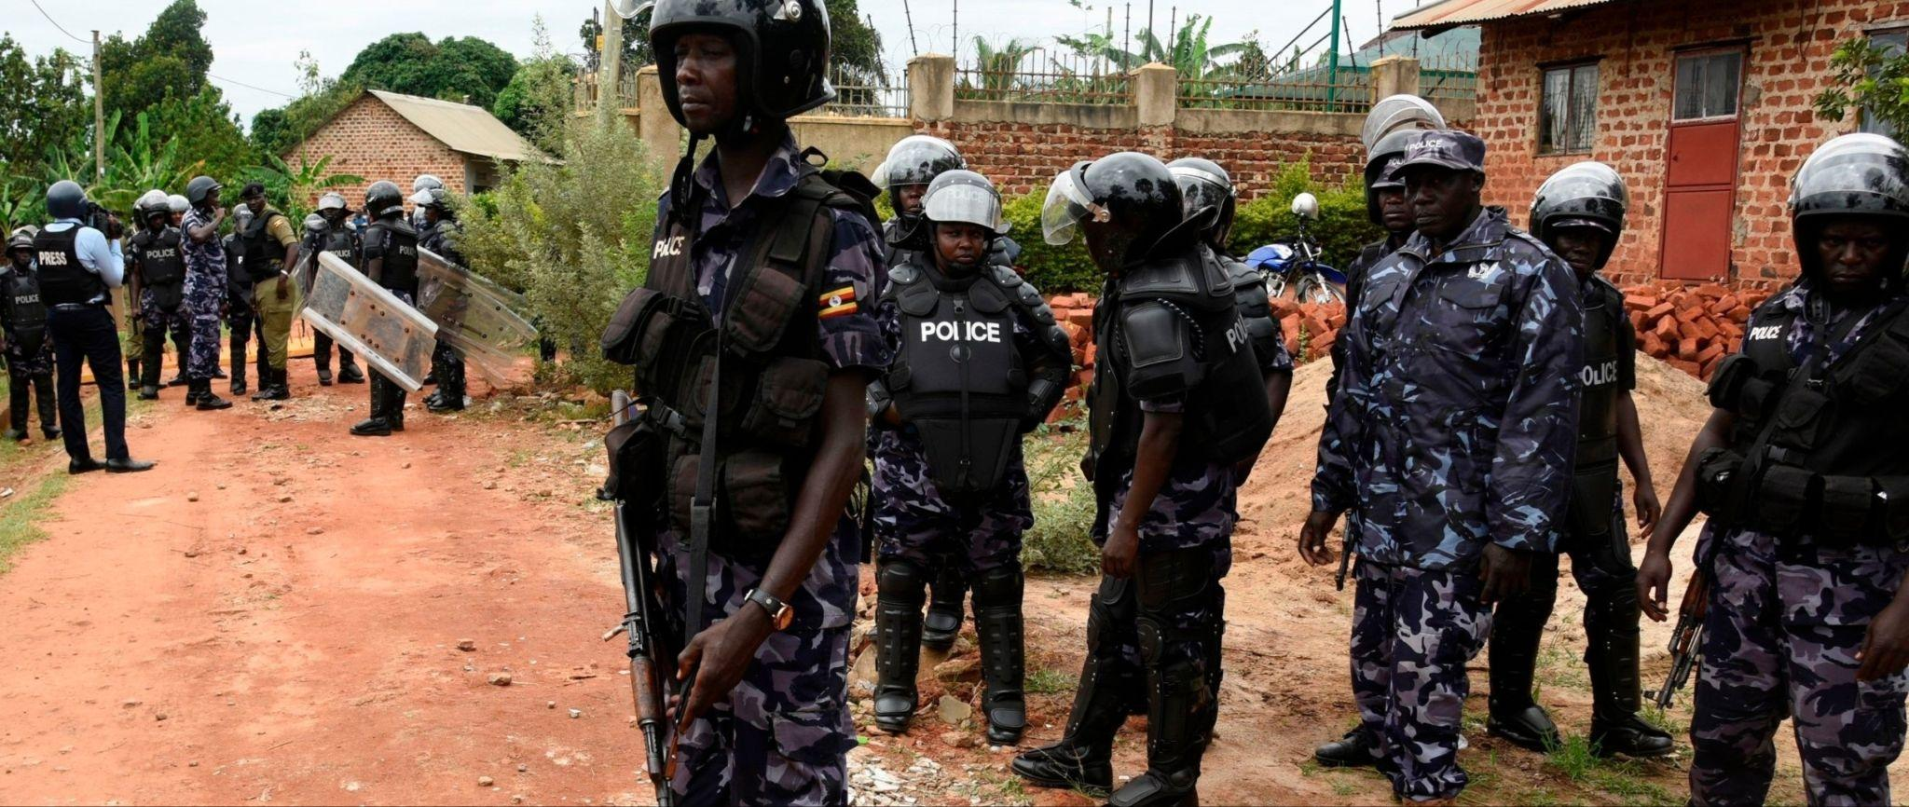
Global Case Studies of CSOs
Uganda (2013)
In 2013, the President of Uganda gave his approval to the Public Order Management Act, which gives the police the power to ban public gatherings and decide on appropriate places to hold public meetings. The freedom of civil society has been further limited by the Non-Governmental Organizations Act of 2016, that requires organizations to seek permission from local and regional authorities before engaging in any activity.
(Charities Aid Foundation, 2017)
Notes:
Picture Source:
https://www.amnesty.org/en/latest/news/2020/03/uganda-constitutional-court-nullifies-law-used-to-prohibit-protests/

Slide 10
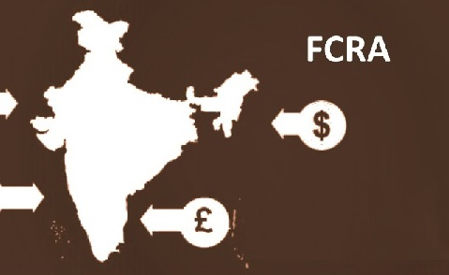
Global Case Studies of CSOs
India (2010)
The 2010 Foreign Contribution Regulation Act in India was intended to restrict foreign agencies (and the domestic CSOs they fund) from engaging in activities that could be considered "anti-national" or "anti-development".
(Charities Aid Foundation, 2017)
Notes:
Picture Source:
https://www.google.com/url?sa=i&url=https%3A%2F%2Fblog.ipleaders.in%2Flegal-aspect-ngos-foreign-contribution-regulation-act-2010%2F&psig=AOvVaw0PaWXienkEsP98j0QsdSjv&ust=1689937392357000&source=images&cd=vfe&opi=89978449&ved=0CBEQjRxqFwoTCJjz3cORnYADFQAAAAAdAAAAABAD

Slide 11
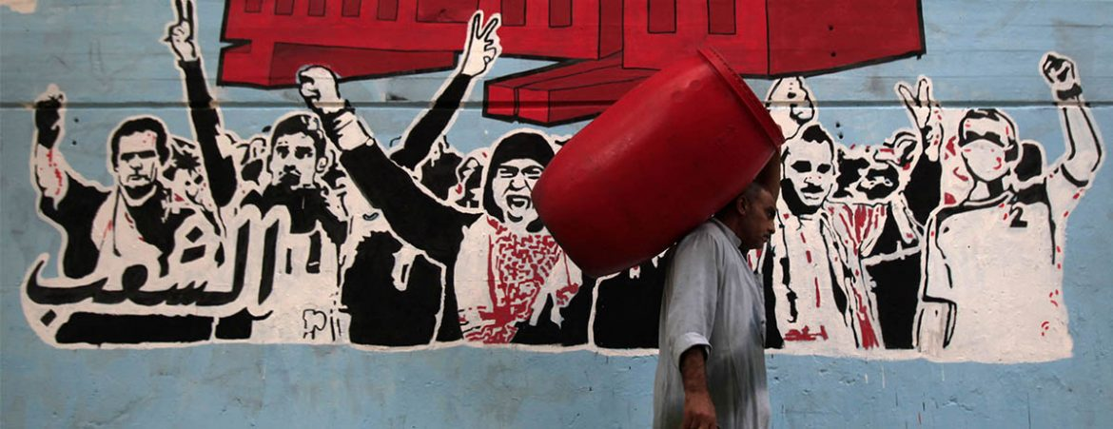
Global Case Studies of CSOs
Egypt (2016)
During 2016, Egypt's parliament adopted a restrictive bill on civil associations, which provides the power to close down any CSO that is deemed not to be operating in accordance with the government's plan.
(Charities Aid Foundation, 2017)
Notes:
Picture Source:
https://cihrs.org/egypt-legal-commentary-on-regulations-of-ngo-law-n-149-for-2019-on-civic-associations/?lang=en

Slide 12
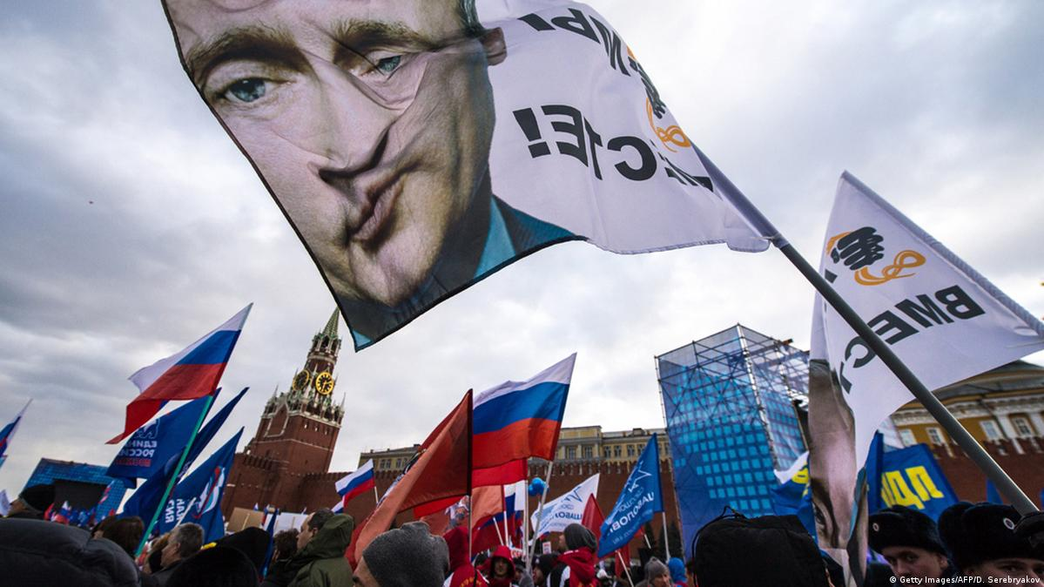
Global Case Studies of CSOs
Russia (2012)
Russia passed a law in 2012 designed to stop the work of organisations acting as foreign agents. That includes any organisation in Russia that is receiving money from foreign sources. Additionally, if an organisation is found to be carrying out anything deemed to constitute as a political activity, such an organisation would be classified as a foreign agent.
(Charities Aid Foundation, 2017)
Notes:
Picture Source:
https://www.dw.com/en/russia-bans-us-national-endowment-for-democracy-as-undesirable/a-18615167

Slide 13
Global Case Studies of CSOs
United States
In the US, in 2017, Trump signed an executive act reintroducing the so-called "Global gag rule", which prohibits international CSOs that carry out or promote abortions from receiving funding from the US government.
(Charities Aid Foundation, 2017)
Notes:
Picture Source:
https://msmagazine.com/2022/03/14/global-gag-rule-abortion-reproductive-rights-appropriations-bill-birth-control/

Slide 14
Civil Society Organizations and Democracy
“Civil society plays a vital role in any healthy democracy. It offers a space in which people can come together to share interests and common goals; and a means to challenge the failings of current systems and thus improve society.”
(Why Civil Society Matters., Giving Thought)
CSO’s try to make the world more diverse and equal.
Speak up for disadvantaged people
Whistle blow and tackle corruption
Influence in developing policies
Help make services more efficient
Notes:
Picture Source: https://www.freepik.com/free-vector/multiracial-enraged-raised-fists_9884789.htm#query=equality&position=0&from_view=search&track=sph

Slide 15
Civil Society Organizations and Democracy
CSO practitioners play an important role in promoting and protecting democratic values. They do this through a number of specific activities:
Monitor how state officials should use their power and monitor abuse of power.
Work to develop the values of democratic life.
Provide access to information and freedom of information laws.
Promote political participation by educating people.
Expose corruption.

Slide 16
How They Contribute to Democracy & Society
Many minority groups have difficulty feeling heard due to lack of representation in public debates. Moreover, in strict democratic systems, minority groups are less represented. CSOs contribute to the visibility of these groups and provide the necessary means for people to be empowered to have an influence in the public debates. For CSOs supporting a number of unpopular causes is controversial and dangerous.
R. J. Morris (2020) said that organisations such as this can play a vital role because they give these groups a means to find and claim their shared identity. An example is women who may use civil societies in difficult times to support each other, or to act socially.
Notes:
Source: From the Margins to the Mainstream: Philanthropy and social movements furthering diversity, equity & inclusion in society, 2020, pp. 3-5

Slide 17
Key Ways in Which CSOs Contribute to Democracy
Promoting Civic Engagement: CSOs provide a platform for citizens to engage in civic and political activities. By encouraging people to participate in public discussions, debates, and decision-making processes, CSOs help create an informed and active citizenry. This active engagement is fundamental to the democratic process as it ensures that diverse voices and perspectives are heard and considered in governance.
Advocating for Human Rights and Social Justice: CSOs often champion human rights and advocate for social justice issues. They act as watchdogs, monitoring government actions and holding public officials accountable for any abuse of power or violations of human rights. CSOs play a critical role in ensuring that marginalized and vulnerable groups have their rights protected and respected.
Strengthening Government Accountability: By scrutinizing government policies and actions, CSOs help keep government officials accountable. Their independent monitoring of public institutions ensures that those in power are held responsible for their decisions and actions, thereby reducing corruption and promoting good governance.

Slide 18
Key Ways in Which CSOs Contribute to Democracy
Providing Essential Services: In many cases, CSOs fill gaps in public service delivery, especially in areas where government institutions might be unable to reach or are inefficient. They run various programs and initiatives to address social and developmental issues, complementing the efforts of governments and helping to improve the overall quality of life for citizens.
Fostering Dialogue and Mediation: CSOs often act as mediators between different segments of society, bridging gaps and facilitating dialogue among diverse groups. This role is particularly critical in countries or regions facing ethnic, religious, or cultural tensions, as CSOs can help promote peaceful coexistence and resolution of conflicts through dialogue.

Slide 19
Key Ways in Which CSOs Contribute to Democracy
Monitoring Elections and Electoral Processes: CSOs contribute to free and fair elections by observing and monitoring electoral processes. They help identify any irregularities or discrepancies, ensuring the integrity of the electoral system and building trust in democratic institutions.
Encouraging Policy Advocacy and Reform: CSOs engage in policy analysis and advocacy, pushing for reforms and improvements in various areas of public interest. Their research and evidence-based recommendations can influence government policies and lead to more effective and equitable decision-making.
Capacity Building and Empowerment: CSOs work to empower citizens by providing education, training, and awareness programs. By increasing the knowledge and skills of individuals, CSOs enable them to actively participate in democratic processes and take on leadership roles within their communities.

Slide 20
Civil Society Organizations Challenges
Civil Society Organizations are essential in shaping democratic governance through promoting citizen involvement, advocating for societal fairness, delivering key services, and holding government bodies accountable. They encounter numerous obstacles in executing these roles efficiently. Here are some of these challenges:
Financial Limitations: CSOs often find it challenging to secure consistent and adequate funding due to factors such as lack of donor support, competition amongst CSOs, or strict stipulations tied to funding sources.
2. Regulatory Restrictions: Many governments impose stringent regulations that hinder CSOs' operations. This could involve laws that limit their financial resources, inhibit their freedom of assembly or expression, or are manipulated to harass or intimidate CSO members.
Political Pressure: In certain areas, CSOs may be subjected to political coercion, intimidation, or even violent threats. These conditions can restrict their operations and put their personnel and volunteers at risk.

Slide 21
Civil Society Organizations Challenges
Problems in Impact Evaluation
Changing Political and Economic Contexts
Limited Cooperation
Issues of Reliability and Confidence
Operational Capacity
Notes:
Notes:
Issues of Reliability and Confidence: CSOs can find it difficult to establish reliability and gain trust within the communities they aim to assist. This could arise from a lack of transparency, previous scandals, or the perception of being too aligned with political or economic powerhouses.
Operational Capacity: CSOs often lack the operational capacity required to effectively carry out their work. This might include insufficient skilled staff, lack of organizational structures, or a deficit in technological resources.
Limited Cooperation: The competitive nature of the CSO sector may restrict collaboration and collective initiatives. This can lead to repetitive efforts, inefficiencies, and an inability to effectively tackle large-scale issues.
Problems in Impact Evaluation: CSOs often encounter challenges in assessing and showcasing their impact. This difficulty can impede their ability to attract funding and can also harm their reputation.
Changing Political and Economic Contexts: Alterations in government, economic recessions, or societal shifts can significantly impact CSOs and the communities they aid. These external variables can disrupt funding streams, programs, and strategic objectives.

