Slide 1
Module 1 CSOs Fundamentals
Unit 1: Introduction: Common Terminologies, Categories & Types of CSOs

Slide 2
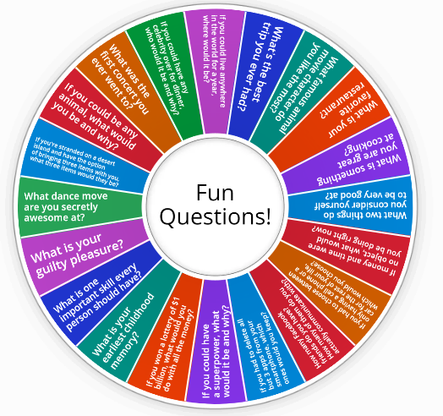
Icebreaker
Notes:
https://wordwall.net/resource/38035766/emergeicebreakerrandom-questions

Slide 3
Module 1 - Overview
The Module consists of the below Units:
Unit 1: Introduction: Common Terminologies, Categories & Types of CSOs
Unit 2: Vision, Mission, Purpose, Values and Functions
Unit 3: The fundamental principles
Upon completion of this module, participants should be able to:
Define the term Civil Society Organisation (CSO) and distinguish the different categories and types (based on their activity, of their orientation or of their levels of operations).
Draft a vision, mission, purpose and values for their not-for-profit idea, whilst identifying its functions and real-life activities.
Describe the minimum fundamental principles their not-for-profit should apply and identify methods of adhering to those principles.
Notes:
Image Source: https://www.freepik.com/free-vector/business-solution-concept-illustration_23849307.htm#query=module&position=4&from_view=search&track=sph

Slide 4
Unit 1 – Learning Objectives
Unit 1 aims to contribute to the learners’ knowledge around the common terminologies for CSOs, the different categories and types.
Upon completion of this Unit, participants should be able to:
Define the term “Civil Society Organisations” (CSOs).
Distinguish the different categories and types of CSOs (based on their activity, orientation or levels of operations).

Slide 5
Defining a Civil Society Organisation (CSO)
Watch this video and discuss the below:
What is a Civil Society Organisation?
What types of CSOs were mentioned?
What specific examples of CSOs were provided?
Notes:
Image Source: https://www.freepik.com/free-vector/youth-empowerment-abstract-concept-vector-illustration-children-young-people-take-charge-take-action-improve-life-quality-democracy-building-youth-activism-involvement-abstract-metaphor_11668194.htm#query=community%20impact&position=0&from_view=keyword&track=ais

Slide 6
Activity 1: Role play
Scenario: two participants to perform
Open dialogue for the rest of the groups
Questions and comments
Notes:
Image Source: https://www.freepik.com/free-vector/person-covering-emotions-searching-identity_8271071.htm

Slide 7
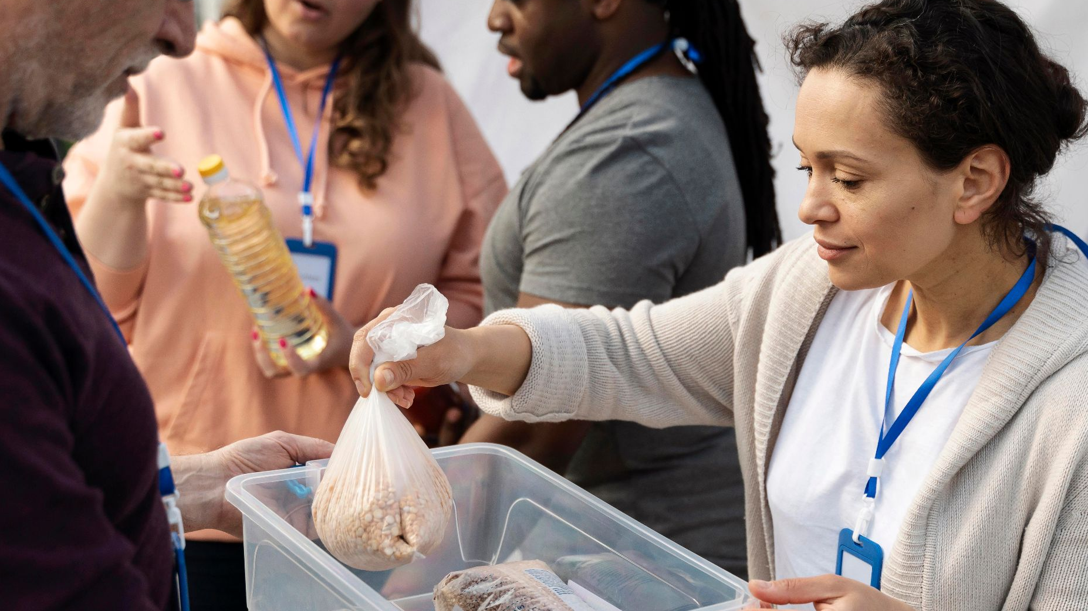
Defining a Civil Society Organisation (CSO) (cont’d)
“A civil society organisation is an organisational structure whose members serve the general interest through a democratic process and which plays the role of mediator between public authorities and citizens”.
Glossary, European Union
Notes:
Reference: EUR-Lex - European Union Area 5.1 - Civil society organizations - ETF Open Space https://eur-lex.europa.eu/EN/legal-content/glossary/civil-society-organisation.html
Image Source: https://www.freepik.com/free-photo/charity-foodbank-volunteer-group_15574040.htm#query=Civil%20Society%20Organizations&position=24&from_view=search&track=ais

Slide 8
Defining a Civil Society Organisation (CSO) (cont’d)
Civil Society Organisations (CSOs) are voluntary organisations and are distinct from government and commercial for-profit actors.
CSOs’ direction and governance is decided by their constituency members or citizens.
CSOs are formed based on different considerations such as philanthropic, cultural, scientific, ethical, religious or others.
They operate on a local, national or international level.
Notes:
All CSOs share a common characteristic; there have no significant government-controlled representation or participation.
Image Source: https://www.freepik.com/free-photo/charity-foodbank-volunteer-group_15574040.htm#query=Civil%20Society%20Organizations&position=24&from_view=search&track=ais

Slide 9
Categories of CSOs
Operational CSOs | Advocacy CSOs
Development-related projects. Undertake a wide range of activities Cover different geographical areas, i.e. community, local, district, national, regional, and international levels. | Represent specific issues, points of view, concerns or interests. Advocate for policy changes relating to a particular cause Influence the respective policies, practices, and the views of the different actors. Raising awareness events, campaigns, demonstrations and rallies to address issues, put pressure and influence policy change.
Notes:
Reference: Asian Development Bank, 2019. Civil Society Organization, Sourcebook, A Staff Guide To Cooperation With Civil Society Organizations
https://www.adb.org/sites/default/files/institutional-document/32629/files/cso-staff-guide.pdf
Image Source: https://www.freepik.com/free-vector/businessmen-with-magnifier-looking-business-process-flow-chart-business-rules-regulation-main-company-policy-it-business-analysis-concept-illustration_11668541.htm

Slide 10
Types of CSOs
List of the different types of CSOs:
Non-governmental organisations (NGOs)
Professional associations
Foundations
Independent research institutes
Community- based organizations (CBOs)
Faith-based organisations
People’s organizations
Social movements
Trade/Labor unions
Notes:
Reference: Asian Development Bank, 2019. Civil Society Organization, Sourcebook, A Staff Guide To Cooperation With Civil Society Organizations
https://www.adb.org/sites/default/files/institutional-document/32629/files/cso-staff-guide.pdf
Image Source: https://www.freepik.com/free-vector/diverse-crowd-people-different-ages-races_7732608.htm#query=community%20people&position=0&from_view=keyword&track=ais

Slide 11
Types of CSOs (cont’d)
Orientation | Level of Operations
Charitable | Community-based organisations (CBOs)
Service | City-wide organisations
Participatory | National
Empowering | International
Notes:
Reference: Asian Development Bank, 2019. Civil Society Organization, Sourcebook, A Staff Guide To Cooperation With Civil Society Organizations
https://www.adb.org/sites/default/files/institutional-document/32629/files/cso-staff-guide.pdf
Image Source: https://www.freepik.com/free-vector/social-team-helping-charity-sharing-hope_9176829.htm#query=help%20earth&position=0&from_view=keyword&track=ais

Slide 12
Activity 2: Research and share
Identify and list three CSOs in Cyprus and classify them according to:
their category (operational or advocacy).
their type (either based on orientation or level of operations).
Discuss with your team your classifications of the previous two questions and elaborate on the why.
Notes:
Image Source: https://www.freepik.com/premium-photo/close-up-students-writing-reading-exam-answer-sheets-exercises-classroom-school-with-stress_5316950.htm

