Slide 1
Module 3 CSOs & Media - Essential Components of a Democracy
Unit 2: Media

Slide 2
Module 3 – Overview
The Module consists of the below Units:
Unit 1: CSOs
Identify the role of CSOs in democracy
Unit 2: Media
Understand the importance of media in democratic countries
Upon completion of this module, you should be able to:
Identify and understand the nature of CSOs (characteristics, challenges).
Acknowledge and appreciate the significance of CSOs within a democratic context.
Comprehend and define the role and contributions of media within a democratic society.

Slide 3
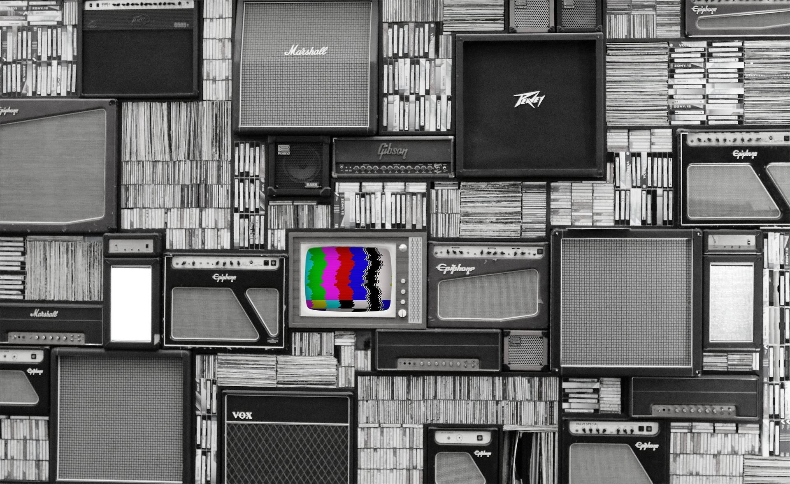
Activity: Re-Design News
Participants will critically evaluate and improve a news piece with this activity.
Split into groups and locate a short news clip on any topic on your phones and laptops.
Discuss the content utilizing the guiding questions.
How would you improve the clip? Come up with 2 other ways of communicating the news story.
Present
Notes:
Extra Info: This allows you to hold a subsequent discussion about how students would improve the clip to better communicate its points. Then, let them. Dividing them into groups, they should write five ways they would change the clip. They can then storyboard the revamped news piece.
Text Source: https://www.prodigygame.com/main-en/blog/teaching-media-literacy/
Picture Source: Image by <a href="https://pixabay.com/users/methodshop-1460919/?utm_source=link-attribution&amp;utm_medium=referral&amp;utm_campaign=image&amp;utm_content=2964103">methodshop</a> from <a href="https://pixabay.com//?utm_source=link-attribution&amp;utm_medium=referral&amp;utm_campaign=image&amp;utm_content=2964103">Pixabay</a>

Slide 4
Guiding Questions
What did you feel as you watch the news clip?
What do you think the maker of the news clip wants you to feel?
What leads you to assume this?
Have you ever experienced anything like this?
How close does it come to what you have experienced in real life?
What did you learn from this media clip?
What did you learn about yourself from watching the news clip?
What did you learn from other people’s response—and their experience?
How many other interpretations could there be?
How could we hear about them?
How can you explain the different responses?
Are other viewpoints just as valid as mine?
How do you feel about the picture(s)/video?
What extra information does it give you?
What prior media experiences have you had that influence your understanding of this media message?
How could this message be understood differently by someone with whom I disagree?

Slide 5
Media Definition
Media is the “means of communication that reach large numbers of people, such as television, newspapers, and radio”.
(Collins COBUILD Advanced Learner’s Dictionary. Copyright © HarperCollins Publishers)
Notes:
Source: https://www.collinsdictionary.com/dictionary/english/media

Slide 6
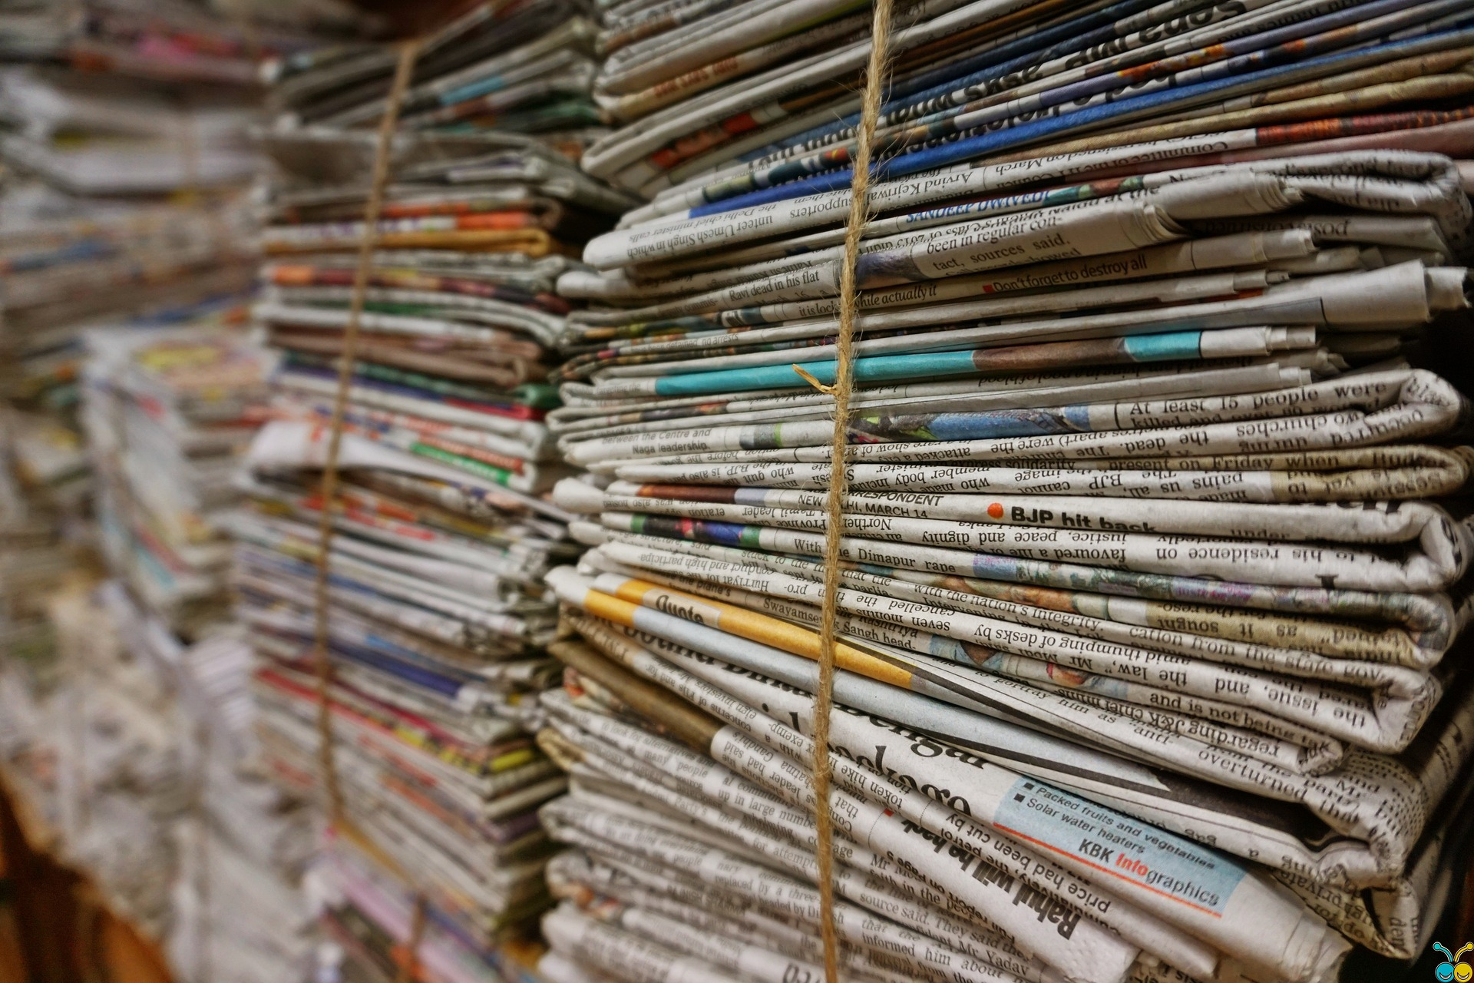
The Role and Contribution of the Media in Democracy
Media: The fourth pillar of democracy
“Media is supplying the political information that voters base their decisions on. They identify problems in our society and serve as a medium for deliberation.” (Kumar, 2016)
Media is vital in generating a democratic culture that extends beyond the political system and becomes ingrained in the public consciousness over time.
“A free, objective, skilled media is an essential component of any democratic society. Democracy is meaningless without a free, neutral and active media.” (Kumar, 2016)
Notes:
Text Source: Kumar, A. (2016, July 25). Role of media in democracy. Legal Desire Media and Insights. https://legaldesire.com/role-of-media-in-democracy/
Picture Source: Image by <a href="https://pixabay.com/users/pexels-2286921/?utm_source=link-attribution&amp;utm_medium=referral&amp;utm_campaign=image&amp;utm_content=1853667">Pexels</a> from <a href="https://pixabay.com//?utm_source=link-attribution&amp;utm_medium=referral&amp;utm_campaign=image&amp;utm_content=1853667">Pixabay</a>

Slide 7
Media and Democracy
According to O’Shaughnessy and Stadler (2008) the media ‘make sense of the world for us’ (p.34). The authors identify three central processes that the media carry out:
Representation – they represent the primary source through which we become aware of the world;
Interpretation – in their representation they provide an understanding of the events occurring;
Evaluation – they value and devalue different issues and identities, thus offering an evaluative framework (O’Shaughnessy and Stadler, 2008).

Slide 8
Media and Democracy
The relationship between media and democracy is intricate and crucial to comprehend within any democratic society. Media plays a pivotal role in keeping the public well-informed, promoting public discussions, and holding those in positions of authority accountable. Several key aspects underscore the connection between media and democracy:
Dissemination of Information: In a democratic society, it is imperative for citizens to be well-informed about current events, government actions, and policies. The media serves as the primary channel through which information is distributed to the public. This empowers citizens to make informed decisions, participate in democratic processes, and engage in meaningful public debates.
Guardian Role: An independent and unrestricted media acts as a watchdog over those in power, including government officials, corporations, and institutions. Investigative journalism plays a crucial role in uncovering corruption, abuses of power, and other wrongdoings, thereby fostering transparency and accountability.

Slide 9
Media and Democracy
Scrutinizing Government Actions: As a watchdog, the media critically examines the actions of the government and public officials. Investigative journalism delves into matters that may not receive adequate attention from other institutions. By exposing corruption, misuse of power, and malpractices, the media holds those in authority accountable for their actions.
Ensuring Government Transparency: Through Freedom of Information laws and investigative reporting, the media seeks to promote transparency within government institutions. By accessing and sharing information that might otherwise remain hidden from the public, the media helps citizens understand how their government operates and makes decisions.
Facilitating Public Discourse and Debate: Media platforms offer spaces for public discourse and debate, allowing a wide range of perspectives and opinions to be expressed. These robust discussions and the exchange of ideas are fundamental to a healthy democracy, encouraging the exploration of diverse viewpoints and the formulation of well-balanced policies.

Slide 10
Media and Democracy
Media Pluralism: A flourishing democratic society depends on media pluralism, ensuring a diverse array of media outlets with varying ownership, editorial stances, and content. This prevents the concentration of media power in the hands of a select few and ensures a broader representation of voices and opinions.
Access to Information: Media should strive to ensure that all citizens have access to information, regardless of their background, location, or socioeconomic status. Inclusivity in media access is essential for nurturing an engaged and well-informed citizenry.
Media Literacy: In a democratic society, media literacy holds significant importance. Citizens need the ability to critically evaluate the information they encounter, distinguish misinformation from accurate reporting, and comprehend media biases. This empowers individuals to be discerning consumers of information and active participants in democratic processes.

Slide 11
Challenges to the Relationship of Media and Democracy
The fundamental link between media and democracy cannot be overstated, as free and independent media is an essential pillar of any democratic society. It offers citizens critical information about the workings of their government, enables robust public discussion, and acts as a watchdog on power. But, this intricate relationship is confronted with numerous challenges in the modern world, such as:
Dominance of Media Ownership: The issue of media outlets being governed by a limited number of entities or individuals is prevalent in many nations. Such monopolization of media ownership can curtail the range of viewpoints and information made available to the populace. Moreover, media owners might exploit their platforms to advance their own political or economic gains, leading to prejudiced reporting.
Pressures on Journalistic Independence: Journalists in various parts of the world face threats and harassment, making their jobs challenging. Governments and non-state entities might employ legal and illicit means to control or suppress the media.

Slide 12
Challenges to the Relationship of Media and Democracy
Media Bias: Whether real or perceived, media bias can erode trust in journalistic institutions. When people believe that the media is favoring a particular political ideology or interest group, they may discount information from those sources, further exacerbating polarization and undermining the role of media as an impartial watchdog.
Manipulation and Propaganda: In some cases, the media can be used as a tool for propaganda and manipulation by governments or powerful entities. When the media is not free from government control or undue influence, it can disseminate biased information that undermines the democratic process.
Limited Media Access: In certain regions or authoritarian regimes, media freedom may be restricted, and journalists may face censorship or even physical threats. This lack of access to unbiased information can hinder citizens' ability to make informed decisions and participate fully in the democratic process.
Media organizations often face financial challenges due to changing business models and declining advertising revenues. These pressures can lead to cost-cutting measures that may compromise the quality and depth of reporting, reducing the media's ability to serve as an effective watchdog and inform the public adequately.

Slide 13
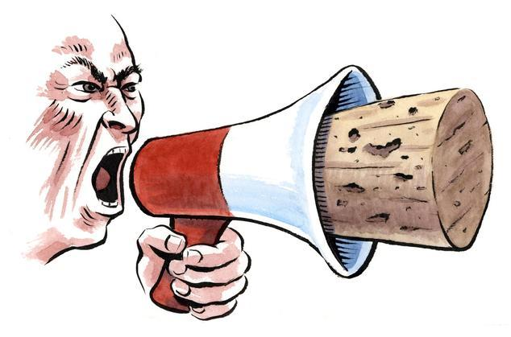
Freedom of Expression is Critical to Democracy
Freedom of expression is essential for democracy, which acknowledges that people have the right to elect the government of their choice. For democracy to function well, all the citizens must be well educated about the procedures and have the freedom to freely participate in public debate. Media have an important role in that, as they may lose the right to free speech and expression.
Notes:
Picture Source:
https://www.wsj.com/articles/the-aclu-retreats-from-free-expression-1529533065

Slide 14
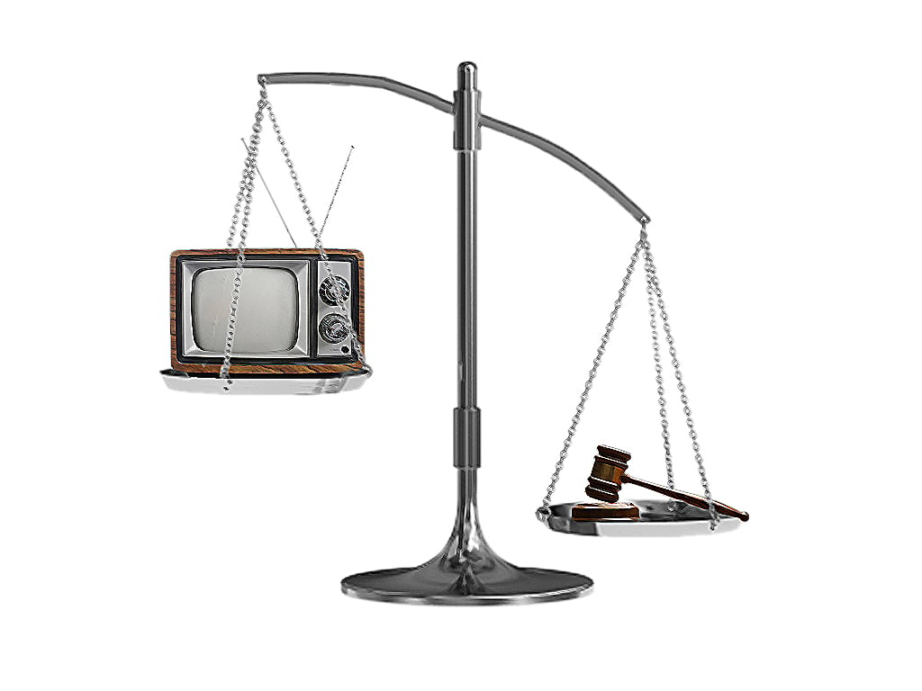
Media and Society
The public should be able to hold media accountable and moral and professional standards are respected. In this environment the media can have a constructive role in democracy.
“Media independence is guaranteed if media organizations are financially viable, free from intervention of media owners and the state, and operate in a competitive environment. The media should also be accessible to as wide a segment of society as possible. Efforts to help the media should be directed toward: the protection of press rights, enhancing media accountability, building media capacity and democratising media access.” (Kumar, 2016)
Notes:
Text Source: Kumar, A. (2016, July 25). Role of media in democracy. Legal Desire Media and Insights. https://legaldesire.com/role-of-media-in-democracy/
Picture Source: https://tribune.com.pk/story/492101/media-accountability-sc-to-form-two-member-commission

Slide 15
Activity: Our Own Show
Media messages are like onions. Whether it contains words, pictures, audio, or all three together in a multimedia experience, each message consists of many layers of ideas, attitudes, and opinions that can be either obvious or subtle and either supportive or detrimental to each of us. (Share & Thoman, 2007)
Participants will be divided into small groups, and they should create a media product from different points of view. The ability to take the same event or topic and demonstrate different ways of representing it can help show the bias and embedded values always present in media messages.
Notes:
Extra Info: The understanding that all stories are told from someone’s perspective and always carry with them a set of values and points of view inherently means that still other values are not being represented. Being able to recognize and name missing perspectives is a critical skill of democracy as we negotiate our way each day through our mediated environment.
Picture Source:
https://www.ringcentral.com/us/en/blog/in-person-team-building/
Text Source: Share, J., & Thoman, E. (2007). Teaching democracy: A media literacy approach: A media literacy educators’ guide for dilemmas + decisions ... National Center for the Preservation of Democracy.

Slide 16
Activity: Our Own Show
Get back in your original groups from the previous news activity, and pair up with one other group.
Decide amongst you which one of the two news stories you will further investigate and assign each of the groups the “Conservative” and “Liberal” group. These perspectives should guide you in your creative choices when deciding on your content development.
Develop a short podcast or news article with your news story using your assigned perspective. [30 minutes]
All groups will then present to the large group their media piece and discuss observations.
Notes:
Text Source: Share, J., & Thoman, E. (2007). Teaching democracy: A media literacy approach: A media literacy educators’ guide for dilemmas + decisions ... National Center for the Preservation of Democracy.
Picture Source:
https://www.ringcentral.com/us/en/blog/in-person-team-building/

Slide 17
Guiding Questions
What questions come to mind as you watch, read and listen?
What would the story be like if the protagonist were a different gender?
What judgments or statements are made about how to treat other people?
What ideas or perspectives are left out? How can you find what’s missing?
What view of the world do the creators of this text assume the reader or viewer holds?

Slide 18
Role of Civil Society & Media
Civil societies, through research, campaigning, awareness-raising, training, monitoring, legal help, and budget analysis, can actively inform the public or draw international attention to national or international issues. Moreover, through the CSOs many marginalized groups are able to be heard.
CSOs awareness-raising is important and is used as a tool to educate the public about their rights or complex issues.
Civil society and the media work much better together when it comes to spreading awareness. Additionally, civil societies offer education and expertise, and media enlighten the public about topics that concern and influence them and work to increase public understanding of the significance of democratic security sector governance and supervision.
Notes:
Source: http://democraticoversight.ge/en/topics/security-sector-oversight/role-of-civil-society-media

Slide 19
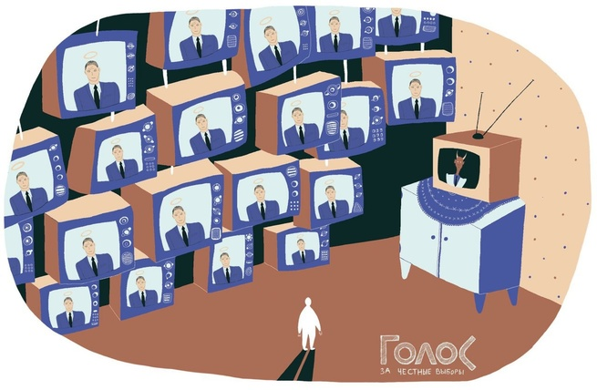
Role of Civil Society & Media
The media has the ability to apply pressure on public authorities, which gives them the capacity to put important matters on the agenda of a government. Civil society and the media can contribute to democratic security sector governance and accountability by monitoring and overseeing the following areas:
Security Sector Compliance with Laws and Regulations
Respect for Constitutional and Human Rights
Respect of Commitments Made via International, or Bilateral, Treaty Obligations and Policy Statements
Public-Spending
Corruption
Policy Processes
Effectiveness of Policies and Actions
Notes:
Picture Source:
https://www.epde.org/en/news/details/censorship-and-manipulation-how-the-media-affected-the-outcome-of-the-election-in-russia.html

Slide 20
Media and Democracy in the COVID-19 pandemic
During the COVID-19 pandemic, the democracy around the globe changed. Many countries had negative effect and the weaker the democracy, the thread on human rights grow as well.
In the figure, appears the 80 countries which democracy became weaker. In the case of Egypt:
Health workers who dared to raise concerns were attacked by the media, arrested.
(Repucci, 2019)
Notes:
Picture and Text Source: https://freedomhouse.org/report/freedom-and-media/2019/media-freedom-downward-spiral

Slide 21
Media Freedom
Over the previous ten years, media freedom has decreased globally. Populist politicians have overseen over systematic efforts to suppress the independence of the media sector in some of the most powerful democracies in the world.
That influence is a risk for democracies around the world. However, the press can claim their freedom even after long periods of oppression.
(Repucci, 2019)
Notes:
Picture and Text Source: https://freedomhouse.org/report/freedom-and-media/2019/media-freedom-downward-spiral

Slide 22
Journalists > Government
Notes:
Picture Source: https://freedomhouse.org/report/freedom-and-media/2019/media-freedom-downward-spiral

Slide 23
Notes:
Picture Source: https://freedomhouse.org/report/freedom-and-media/2019/media-freedom-downward-spiral

Slide 24
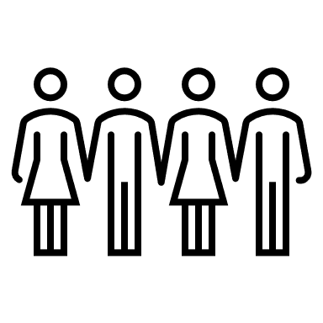
Activity: Media and Democracy
Step 1: Be divided into small groups.
Step 2: Reflect as a group and choose a topic in which you think that media played a role in affecting democracy (Cyprus or worldwide).
Step 3: Answer the following questions: Why? How? Who? What are the consequences?
Step 4: Present the topic and discuss.
Notes:
Missing photo credit?

