Slide 1
Module 4 Understanding Active Citizenship & Civic Engagement
Unit 2: Active Citizenship and Civic Engagement

Slide 2
Introduction
Civic engagement is necessary in a democratic society for the effective functioning of one’s community and state, as it fosters the democratic institutions.
It is crucial for to encourage every citizen, as well as non-government organisations, to actively participate in civil society, and be part of the political and decision-making processes. People and NGOs must continue to ensure the rights for all to participate.
Active citizenship is a term that has been used in recent years and has several meanings.
What does the term ‘active citizenship’ mean to you? There are no wrong answers and what you say and discuss will reflect where you are coming from in relation to this subject.
Let’s look at the two word separately: ‘Active’ and ‘Citizenship’ What do they mean to you?

Slide 3
Defining Active Citizenship and Civic Engagement
Visit Padlet platform (a link will be provided by the instructor)
Write on the wall what do you think Active Citizenship and Civic engagement are (words/ phrases etc.) Besides voting, what are the ways that citizens can actively participate and engage?
Get your devices (laptop or mobile) and access the internet
Group Discussion/ Reflection

Slide 4
Defining Active Citizenship and Civic Engagement

Slide 5
Definitions - Civic Engagement
‘Civic engagement means working to make a difference in the civic life of our communities and developing the combination of knowledge, skills, values and motivation to make that difference. It means promoting the quality of life in a community, through both political and non-political processes’
Source: Ehrlich, T. (Ed.). (2000). Civic responsibility and higher education. Greenwood Publishing Group.
‘Civic engagement refers to the ways in which citizens participate in the life of a community in order to improve conditions for others or to help shape the community’s future’
Source: Adler, R. P., & Goggin, J. (2005). What do we mean by “civic engagement”?. Journal of transformative education, 3(3), 236-253.
UNICEF defines civic engagement as: “individual or collective actions in which people participate to improve the well-being of communities or society in general”.
Source: Cho, A., Byrne, J. Pelter, Z. (2020) Digital civic engagement by young people. UNICEF Offices of Global insight and Policy. Accessed on January 5, 2021

Slide 6
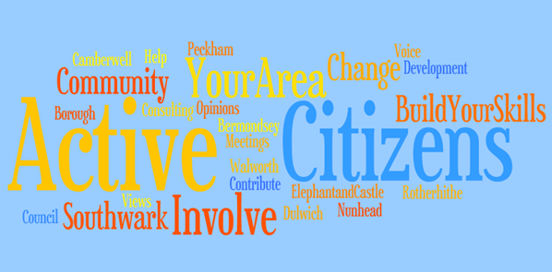
Definitions - Active Citizenship
One simple idea of active citizenship then is that of participation in public affairs: “If we are to have a healthy democracy we need to support each other in identifying the issues that concern us, and develop the confidence and skills to make a difference to the world around us.” (Woodward 2004)
Hoskins and Mascherini (2009) defined active citizenship as; Participation in civil society, community and/or political life, characterised by mutual respect and non-violence and in accordance with human rights and democracy. (Hoskins, 2009)
Active citizens’ are those who look beyond the basic legal duties and are further engaged voluntarily in activities that somehow affect the public life of their locality or communities.
Notes:
Text Source: Hoskins, B. (2014). Active Citizenship. In: Michalos, A.C. (eds) Encyclopedia of Quality of Life and Well-Being Research. Springer.
Picture source: This Photo by Unknown Author is licensed under CC BY-SA-NC

Slide 7
Forms of Active Citizenship and Civic engagement
What are the different forms of Active Citizenship and Civic Engagement?
Besides voting, how can citizens actively participate and engage?
Brainstorm in small groups and assign one representative.
Present your findings.

Slide 8
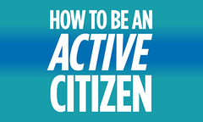
Forms of Active Citizenship and Civic engagement
Civic engagement entails the active involvement of individuals, either independently, in groups, or through non-governmental organizations (NGOs), in addressing local, national, and global issues. It encompasses a wide range of actions taken by people to advance their beliefs and interests, express their views, and participate in social and political matters.
It is crucial to recognize that civic engagement extends beyond traditional political processes such as voting. There are numerous avenues through which individuals can actively contribute to society and make a difference. This includes volunteering, community organizing, advocating for social causes, participating in public discussions and debates, engaging in peaceful protests, and supporting nonprofit organizations.
By actively engaging in civic life, individuals have the opportunity to shape their communities, express their values, and contribute to the betterment of society. Civic engagement is a vital aspect of democratic participation and helps foster an informed and active citizenry.
Notes:
Picture source: This Photo by Unknown Author is licensed under CC BY-SA-NC

Slide 9
What Constitutes an Active Citizenship?
Involvement: A good decision requires the knowledge, experience, and opinions of everybody. There must be a sense of engagement among citizens in the world around them.
Active citizenship consists of three separate but mutually dependent qualities: Active citizenship involvement, participation and influence.
Participation: Citizens should not simply be able to participate. In order to do so, they should feel a sense of duty and responsibility.
Influence: It is critical for citizens to see that their participation leads to results. It is important for participants to feel that their input is important and that the decisions are made with their input in mind.

Slide 10
Key Characteristics of Active Citizenship
Civic Involvement: Individuals who are proactive in their community engage in actions like voting in polls, participating in political debates, and becoming part of local groups. They stay updated on public affairs and show concern for topics that influence their community and nation.
Community Service: Such proactive citizens frequently dedicate their abilities and time to help various initiatives and causes, including philanthropic bodies, community improvement projects, and preservation of the environment.
Championing Causes and Taking a Stand: Proactive citizenship may entail advocating for equality, human rights, and social justice. Champions and activists strive to increase awareness of significant issues, oppose unfair policies, and advocate for progressive alterations.
Community-Led Endeavours: Proactive individuals may start community-based movements and projects to tackle local problems and generate positive effects in their immediate environment.
Engaged Democracy: The idea of proactive citizenship is deeply linked with the notion of engaged democracy, where individuals actively partake in decision-making processes, community design, and policy formation.
Community Accountability: Proactive citizens are accountable for their actions and the welfare of their community, with the objective of bringing about positive societal change.

Slide 11
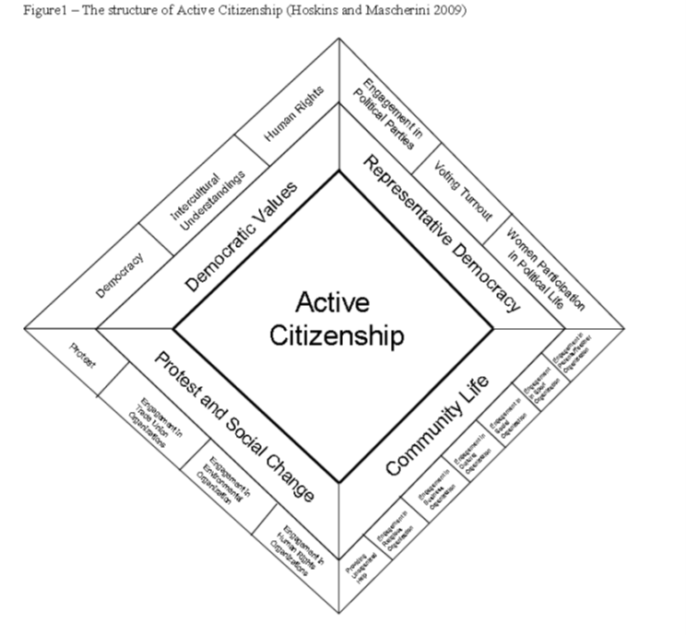
Hoskins and Mascherini Active Citizenship Operational Model
Hoskins and Mascherini, developed an operational model of active citizenship which is based on four dimensions as follows:
Protest and social change
Community life
Representative democracy
Democratic values.
Notes:
Text/ Picture Source: Mascherini, M., Manca, A. R., & Hoskins, B. (2009). The characterization of active citizenship in Europe. European Commission EUR JRC47543 EN.

Slide 12
Hoskins and Mascherini Active Citizenship Operational Model
Protest and Social change
protest activities (e.g.. signing a petition, taking part in a lawful demonstration, boycotting products, and contacting a politician)
participation in Human rights organisations (membership, participation activities, donating money and voluntary work)
participation in Trade unions (membership, participation activities, donating money and voluntary work)
participation in Environmental organisations (membership, participation activities, donating money and voluntary work)
Notes:
Text Source: Mascherini, M., Manca, A. R., & Hoskins, B. (2009). The characterization of active citizenship in Europe. European Commission EUR JRC47543 EN.

Slide 13
Hoskins and Mascherini Active Citizenship Operational Model
Community life
Religious organisations (membership, participation activities, donating money and voluntary work)
Business organisations (membership, participation activities, donating money and voluntary work)
Cultural organisations (membership, participation activities, donating money and voluntary work)
Social organisations (membership, participation activities, donating money and voluntary work)
sport organisations (membership, participation activities, donating money and voluntary work)
parent-teacher organisations (membership, participation activities, donating money and voluntary work)
unorganized help
Notes:
Text Source: Mascherini, M., Manca, A. R., & Hoskins, B. (2009). The characterization of active citizenship in Europe. European Commission EUR JRC47543 EN.

Slide 14
Hoskins and Mascherini Active Citizenship Operational Model
Representative democracy
engagement in political parties (membership, participation, donating money or voluntary work for political parties)
voting turnout (e.g. participation in European and national elections)
participation of women in political life ( e.g. percentage of women in national parliaments)
Democratic values
democracy (Democratic Values)
intercultural (immigration)
understanding and human rights (human rights in relationship to law and rights of migrants)
Their study of 19 European countries showed that the Nordic countries, and especially Sweden, have the highest rate of active citizenship, followed by Central Europe and Anglo-Saxon countries. Mediterranean countries and Eastern European countries have the least involvement in active citizenship.
Notes:
Text Source: Mascherini, M., Manca, A. R., & Hoskins, B. (2009). The characterization of active citizenship in Europe. European Commission EUR JRC47543 EN.

Slide 15
Examples of Active Citizenship
There are numerous ways individuals can engage in civic activities and contribute to society. Some examples include:
Joining a civil society organization (such as an NGO or charity) to support its work and contribute to its mission.
Taking part in protests, rallies, or grassroots initiatives to raise awareness about social issues, advocate for change, and promote civic engagement.
Becoming a member of a political party and actively participating in its activities, such as campaigning, attending meetings, and advocating for policy changes.
Writing letters or emails to elected officials and government authorities to express concerns, opinions, and suggestions on various social and political matters.
Enrolling in a trade union or professional body to collaborate with others in protecting workers' rights and advancing professional interests.
Engaging in blogging, writing articles, and actively using social media platforms to express personal views, share information, and engage in discussions about social and political affairs.
Participating in consultative bodies or advisory committees that provide input and recommendations on policy matters to decision-makers.
These forms of civic engagement allow individuals to actively contribute to their communities, express their perspectives, and influence the decision-making processes that shape society.

Slide 16
Active Citizens…
Vote
Listen to others’ ideas and offer their own ideas
Participate in things like public meetings, social groups, committees, councils
Help their society by doing good to help others
Help their neighbours
Speak out against hatred, injustice, inequality
Keep their environment clean, pick up garbage, don’t litter
Try to make their communities a better place for everyone
Protest
Pay attention to social issues
Debate
Care about what is happening in the world and try to help victims of injustice, conflict and war

Slide 17
Benefits of Active Citizenship
Return to Padlet wall (same link as previously) and answer the following question: How could becoming an active citizen benefit your community and your personality?
Briefly, state four (4) benefits of active citizenship and civic engagement.

Slide 18
Benefits of Active Citizenship
People can participate in their community.
Active citizenship supports democratic procedures.
People are empowered to take part in the decisions which affect their lives
People are supported to develop their skills and knowledge (life-long learning).
People know and understand that they are participating for political, social, or economic reasons so that they can make informed decisions.
People get involved to meet others and form networks.
People get involved to challenge or change existing structures.

Slide 19
Worksheet: Group Activity
Activity: Constraints and Motivations for Active citizenship and engagement
Students will work in groups
Each group will find a case of a situation when people don’t participate actively in their community or society.
Discuss why people do not get involved in that particular case.
Possible strategies that can be used to engage people to get involved in that situation.
Brainstorm and make a list of reasons that prevent people from being socially engaged (worksheet)
Brainstorm and make a list of how to engage people in social and civic issues (worksheet)

Slide 20
Motivations to be an Active Citizen
Participation in the Community and Connecting People: Active citizenship encourages participation in local community activities. This could be anything from local clean-up drives to organizing community events. This fosters a sense of community spirit and helps individuals build connections with each other, enhancing social cohesion.
Empowering People to Influence the Decisions Which Affect Their Lives: Active citizens have the opportunity to influence the policies and decisions that impact their daily lives. This could be through voting, participating in public consultations, or engaging with local representatives. This not only leads to policies that better reflect the needs and interests of the community, but also gives individuals a sense of agency.
Knowledge and Understanding of the Political, Social, and Economic Context of Their Participation: Active citizenship often involves gaining a deeper understanding of the political, social, and economic context of one's actions. This knowledge helps individuals make more informed decisions about their actions and how they can contribute to their community.

Slide 21
Motivations to be an Active Citizen
Ability to Challenge Existing Structures While Supporting Democratic Procedures: Active citizens are well-positioned to question and challenge existing power structures in a democratic way. They can use their voice and their vote to push for changes that they believe are necessary, helping to keep authorities accountable and ensuring that democratic processes are upheld.
Supporting People to Develop Their Skills and Knowledge to Build Fairer and More Resilient Societies: Active citizenship can contribute to personal development by encouraging individuals to learn new skills, such as leadership, communication, or problem-solving skills. These abilities are not only valuable for personal growth but also contribute to the development of a more resilient society, as individuals are better equipped to face challenges and contribute positively to their communities.

