Slide 1
Module 5 Understanding Digital Activism
Unit 1: An Introduction to Digital Activism

Slide 2
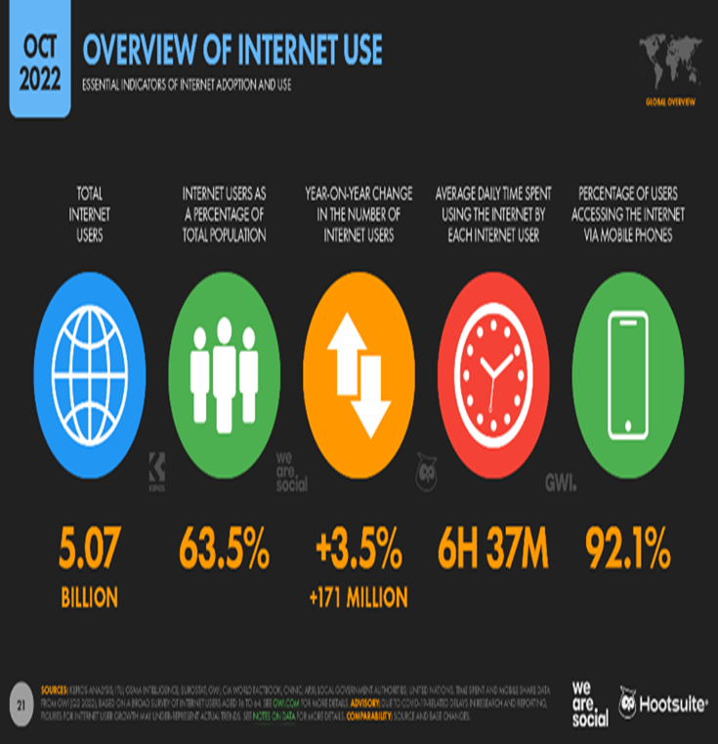
Internet use around the world
The current global usage of the internet stands at 5.07 billion people, which accounts for approximately 63.5 percent of the total population.
Despite this, there are still over 3 billion individuals who remain without internet access, primarily residing in Asia and Africa. The number of internet users continues to grow steadily, with an annual increase of 3.5 percent.
Based on existing trends, it is projected that by the end of 2023, approximately two-thirds of the world's population will have internet connectivity.
Mobile phones serve as the primary means of accessing the internet for the majority of users worldwide, with 92.1 percent utilizing this technology. On average, global internet users spend approximately six hours and 37 minutes online each day.
Notes:
Data Source: https://datareportal.com/reports/digital-2022-global-overview-report

Slide 3
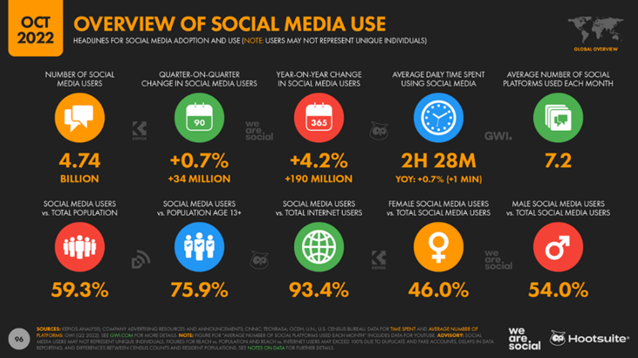
Social Media Use
Around 4.74 billion people, equivalent to 59.3 percent of the global population, are active social media users.
On average, these users engage with or visit approximately 7.2 different social media platforms each month. The number of global social media users continues to increase at a rate of 4.2 percent per year.
Furthermore, individuals spend an average of approximately two hours and twenty-eight minutes on social media every day. This indicates the significant amount of time devoted to engaging with various social platforms.
Notes:
Data Source: https://datareportal.com/reports/digital-2022-global-overview-report

Slide 4
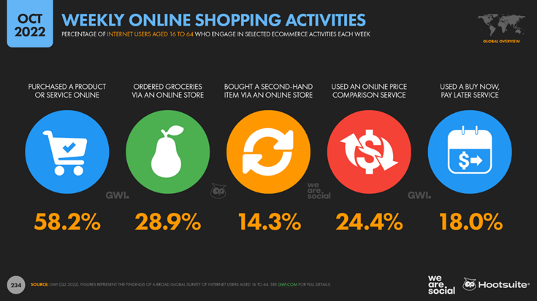
Global E - Commerce
Approximately 6 out of 10 internet users aged 16 to 64 make online purchases on a weekly basis. This highlights the widespread adoption of online shopping among this demographic.
In 2021, there was a notable increase of 18 percent in the amount spent on online consumer goods purchases compared to the previous year, 2020. This indicates a growing trend of spending on ecommerce platforms.
Online shoppers tend to spend more than $1,000 per year on consumer goods through ecommerce websites. This demonstrates the significant financial investment made by consumers in online shopping and showcases the substantial market value of ecommerce.
Notes:
Data Source: https://datareportal.com/reports/digital-2022-global-overview-report

Slide 5
Activity Time!
Questions to Answer:
How many hours do you spend on social media every day?
Which social media channels are you most active on?
How useful is social media for learning?
How often do you post on social media?
Is social media the first thing you check in the morning?
Notes:
Picture source: https://www.freepik.com/free-vector/hand-drawn-people-asking-questions-illustration_13297321.htm#query=questions&position=0&from_view=search&track=sph

Slide 6
Digital Word and ‘Digital’ Politics
A briefing from the European Parliament on digital democracy highlights the transformative nature of "public spaces" in the modern era. Traditional physical spaces like town squares and parks have been replaced by virtual social media and online platforms.
Social networks now serve as the contemporary equivalent of the ancient Greek "Agora," where conversations and debates can take place. These platforms are explicitly designed to mimic the characteristics of traditional public spaces, as evident in their design elements.
Digital platforms offer a wide range of possibilities for discussing and debating political policies, obtaining information about events, and mobilizing support for social causes. Users can express their opinions on relevant issues and have a public voice, potentially influencing policy outcomes.
The events of 2019 provide a prime example of political mobilization facilitated by social networks. Protests in various countries, including Hong Kong, Algeria, and Lebanon, were organized and coordinated through smartphones, driven by hashtags, and managed on social networks. This showcases the significant role that digital platforms can play in shaping and influencing political movements.
Notes:
Picture source: https://www.researchgate.net/publication/355954569_Social_Media_and_Social_Movements_Using_Social_Media_on_Omnibus_Law_Job_Creation_Bill_Protest_in_Indonesia_and_Anti_Extradition_Law_Amendment_Bill_Movement_in_Hongkong/figures?lo=1

Slide 7
Digital Word and ‘Digital’ Politics
Political leaders worldwide have recognized the significance of social media as an essential tool for political campaigning. According to the 2018 Twiplomacy study, there are a total of 951 Twitter accounts among 187 world leaders, with 372 being personal accounts and 579 institutional accounts. Combined, these accounts had a reach of over 400 million followers at that time.
While Twitter is the primary platform for political engagement, politicians also utilize other social media platforms. Facebook is used by 93% (179 countries) of the United Nations' member states, and Instagram is popular as well, with 81% of member states utilizing it to share images and stories, according to UN statistics. However, this extensive political presence on social media has raised concerns about the spread of misinformation and the potential for social polarization.
Given that online spaces have gained equal importance as physical venues for social interaction and political discourse, it is increasingly clear that the complete digitalization of democracy is an inevitable development.

Slide 8
Digital Activism
What is digital activism?
You may use the internet to search for information.
How would you define digital activism?
In your own words.

Slide 9
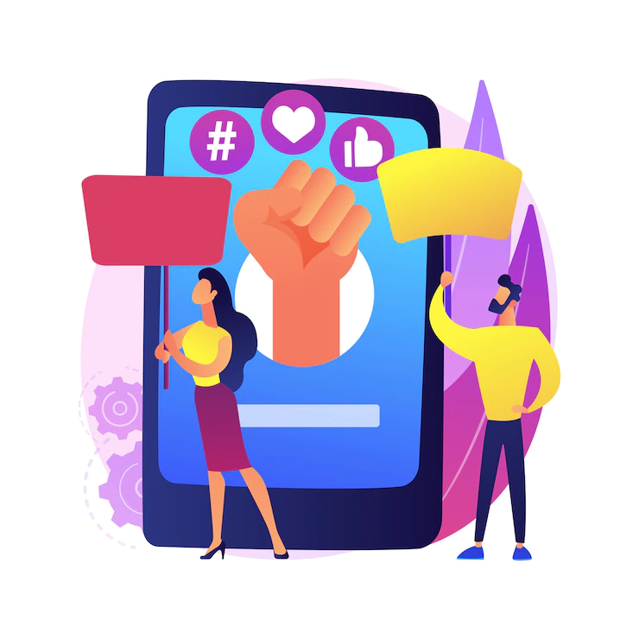
Digital Activism I
What is it?
Civic engagement and activism have traditionally been associated with physical activities such as street marches, voting, and volunteering. However, in addition to these conventional forms of political participation, young people are now embracing a broader range of practices facilitated by digital technologies, which they refer to as "digital activism."
Digital activism involves leveraging digital tools such as the internet, mobile phones, and social media to pursue social and political objectives. It enables individuals to engage in debates, discussions, and actions within a digital public sphere, akin to a virtual agora. This digital space facilitates conversations among digital citizens on global issues of shared concern. Technological advancements have enhanced citizen participation by providing interactive capabilities.
The discourse that takes place within this digital public sphere shapes public opinion and influences political actions. Young people utilize social media as a means of mobilization and as an expressive platform to voice their opinions and perspectives. It serves as a space for them to rally support, raise awareness, and contribute to societal and political change.
Notes:
Picture source: https://www.freepik.com/free-vector/online-activism-abstract-concept-illustration-internet-activism-digital-communication-social-media-posting-information-delivery-target-audience-hashtag-marketing_10783084.htm#query=online%20activism&position=5&from_view=search&track=sph

Slide 10
Digital Activism II
Digital platforms have led to new developments in social movements as a result of the increasing use of online media. Digitalization has created tremendous opportunities for public knowledge generation, discourse, and activism through the development of social media.
Online tools and social media allow activists to build community, connect with other like-minded people outside their physical environments, lobby, raise funds, and organize events. In order to spread a social message widely and quickly, individuals and organizations are increasingly using the internet. Increasing accessibility and the ability to communicate with thousands of citizens quickly have made the internet a tool of choice.
Online civic participation can be promoted and shared through social media. Youth can express their opinions on climate change and environmental issues through platforms such as Instagram, Twitter, and TikTok. By using hashtags, mentions, and direct messages, people and organizations can interact and work together to implement meaningful change.
Notes:
Picture source: https://www.freepik.com/free-vector/online-activism-abstract-illustration_20891909.htm#query=online%20activism&position=3&from_view=search&track=sph

Slide 11
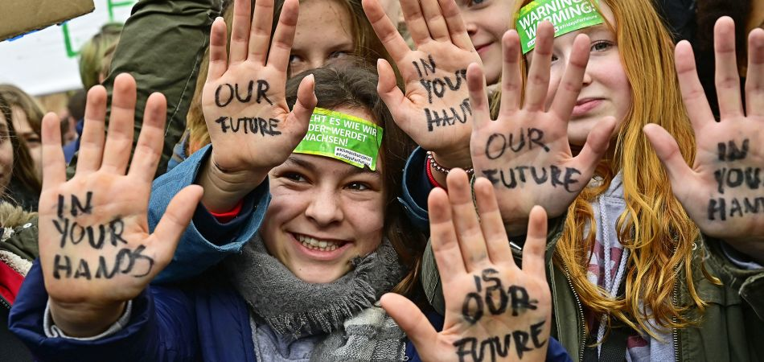
Digital Activism II
While digital activism offers a lot to the savvy campaigner, sometimes it restricts the amount of effective change it can achieve. To increase the impact of online activities, it is important to combine them with offline activities.
This combination of online and offline activism is evident in the 2019 climate strike movement. As a result of rallying behind Greta Thunberg and Fridays for Future, millions of citizens around the world are supporting environmental activism and addressing the climate crisis.
Notes:
Picture source: https://www.deutschland.de/en/topic/environment/who-is-behind-fridays-for-future

Slide 12
Examples of Digital Activism
#BlackLivesMatter
Following the killing of George Floyd on May 26th, 2020, the global movement known as #BlackLivesMatter emerged. The circulation of social media videos showcasing the injustice swiftly spread, sparking protests against racism in over 60 countries worldwide.
This wave of the Black Lives Matter social movement coincided with the Coronavirus pandemic, a period when individuals were increasingly dependent on digital platforms for their daily activities, and some were unable to physically participate in protests due to stay-at-home measures.
The movement's rapid and robust growth online can be attributed, in part, to the interconnectedness of activists through social media platforms.
Notes:
Picture source: https://www.freepik.com/free-photo/black-lives-matter-concept-with-faces_13378180.htm#query=BlackLivesMatter&position=34&from_view=search&track=ais

Slide 13
Examples of Digital Activism
#Ice Bucket Challenge
38 Celebs Do the ALS Ice BucketChallenge
An iconic digital campaign in support of Amyotrophic lateral sclerosis (ALS), also known as Lou Gehrig's Disease, took place in summer 2014. Several global celebrities were among the celebrities who tipped buckets of ice water over themselves before nominating three other people to do the same.
Challenge participants were asked to donate to the ALS Association or another ALS non-profit. Using videos, involving celebrities, and nominating others to complete the challenge, the web-friendly nature of the campaign ensured its viral spread across the web, and more than 2 million videos were uploaded to Facebook and over 3 million on Instagram, dominating social media feeds, as well as online and offline media in general.
A total of 220 million USD was raised worldwide as a result of the challenge.
Notes:
Picture source: This Photo by Unknown Author is licensed under CC BY-NC-ND

Slide 14
Examples of Digital Activism
#metoo
Sexual assault survivor Tarana Burke coined the phrase “Me Too” in 2006 to raise awareness on social media about the pervasiveness of such attacks.
The phrase became a social movement in 2017 after many women used it in a hastag on social media in response to sexual abuse allegations against Harvey Weinstein. Women around the world included the hashtag when they shared their stories of abuse and harassment, thus drawing attention to the magnitude of the issue.
Notes:
Picture source: https://www.freepik.com/free-photo/pink-letters-forming-word-metoo_2997364.htm#query=metoo&position=0&from_view=search&track=sph

Slide 15
Benefits of Digital Activism
Ensuring All Voices are Heard
In addition to spreading messages, digital activism provides a platform for individuals with digital access to voice their opinions and advocate for change, particularly benefiting those who are frequently silenced or lack a means to share their message effectively.
By enabling ordinary citizens to share their personal stories, it helps create a more comprehensive understanding of ongoing issues and can exert pressure on governments to address matters that often go unreported in traditional media.
Cost-Effective Approach
Online activism proves to be a cost-efficient method, requiring minimal effort from both organizers and supporters.
Effectiveness in Action
Viral social media campaigns have demonstrated their exceptional ability to raise funds effectively. These campaigns prompt people to engage in debates and increase awareness. While some may initially participate as "clicktivists" or "slacktivists" who simply share links, posts, or click buttons to endorse petitions, this process often leads them to uncover further issues. Consequently, some may eventually evolve into "fully-fledged activists" as they educate themselves more about the cause or problem at hand.

Slide 16
Benefits of Digital Activism
Easy Reach
Digital tools, such as social media, are powerful in creating viral social media campaigns that can effectively raise funds. Using these tools is crucial for positive change as they can connect people worldwide and globalize campaigns. Social media's interconnected nature enables activists to share slogans, pictures, and details about issues with friends and like-minded communities quickly and efficiently. This is much more energy and time-efficient than traditional methods such as going door-to-door or collecting signatures on street corners.
Dissemination
Quantifying the impact of online activism and digital campaigns can be challenging. Evaluating the success of an activist's campaign often revolves around assessing the achievement of their specific goals.
It is plausible that in many instances of online activism, the digital elements may have accomplished their intended objectives, such as raising awareness and mobilizing individuals, even if the campaign as a whole did not achieve its desired outcome.

Slide 17
Challenges of Digital Activism I
The Challenge of Clicktivism: Informed Engagement for Real Change
One challenge is that some people who engage in digital activism, known as clicktivists or slacktivists, may not be very involved or informed about the causes they support. They might simply click a button or share a post without truly understanding the issue. This can make it difficult to achieve real change.
Digital Activism vs. Offline Action: Striking a Balance for Impact
Another challenge is that online activism can sometimes be hypocritical if people do not take substantive action offline to address the issues they promote online. While digital activism can be a valuable tool, it is not a substitute for real-world action.
Slogans and Soundbites: Simplifying Messages in Online Activism
Additionally, online activism can be oversimplified, with messages reduced to soundbites or slogans. It can also be co-opted by negative forces, such as far-left, far-right, or terrorist groups.
Notes:
Picture source: This Photo by Unknown Author is licensed under CC BY-SA-NC

Slide 18
Challenges of Digital Activism I
Navigating the Minefield: Misinformation in the Digital Activism Era
Spread of Misinformation and Disinformation: The speed at which information can be disseminated online is a double-edged sword. While it can help activists quickly spread their messages, it also makes it easy for false information or propaganda to spread rapidly, leading to confusion, misunderstanding, and potential harm.
Digital Activism Under Siege: Unveiling the Threats of Harassment
Online Harassment and Cyberbullying: Digital activists often face threats, harassment, and even violence, which can deter participation. Women and marginalized groups are particularly at risk.
Shielding the Cyber Frontlines: Security and Privacy for Activists
Security and Privacy Concerns: Activists need to be very careful about their online security, as their activities can attract unwanted attention from state actors, hackers, or other hostile parties. Privacy is also a major concern, as sensitive personal information can be exposed and misused.
Notes:
Picture source: https://www.freepik.com/free-photo/scrabble-wooden-game-with-like-symbol-facebook-word-icon_2587016.htm#query=like%20facebook%20share&position=2&from_view=search&track=ais

Slide 19
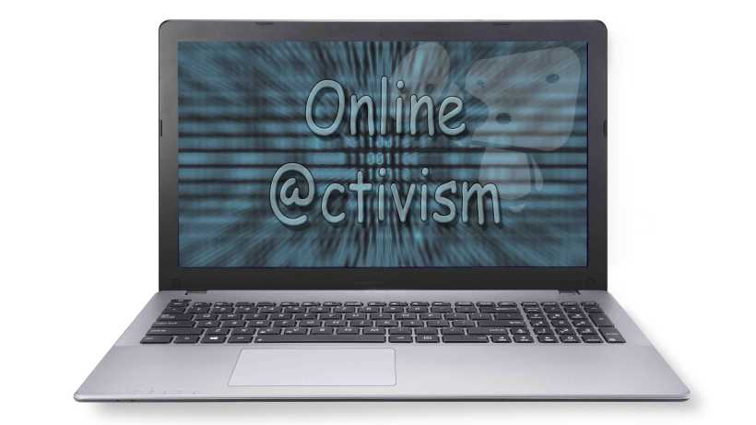
Other Related Concepts
As well as digital activism, many other terms have been used to refer to the same or similar concepts:
Online activism
Digital or E-Democracy
Digital civic engagement
Civic Tech
Clicktivism
Internet activism
Cyberactivism
Hashtag activism
Notes:
Picture Source: This Photo by Unknown Author is licensed under CC BY-SA-NC

Slide 20
Activity Time!
Summarize the key points you have learned about being an active digital citizen.
Share your thoughts on what it means to be an active digital citizen, and provide examples to support your viewpoint.
Discuss digital activism and its role in promoting social change.
Provide examples of digital activism that you are familiar with, whether through research or personal experiences of others.
Explain the impact and results of the digital activism examples you mentioned, considering the awareness raised, actions taken, or changes achieved.
Notes:
Picture Source: This Photo by Unknown Author is licensed under CC BY-SA

