Slide 1
Module 5 Understanding Digital Activism
Unit 2: Digital Skills and Tips for Digital Activism

Slide 2
Digital Competences
What are the Digital Competences?
'Digital competence is a combination of knowledge, skills and attitudes with regards to the use of technology to perform tasks, solve problems, communicate, manage information, collaborate, as well as to create and share content effectively, appropriately, securely, critically, creatively, independently and ethically.’
Anders Skov, internet sociologist, Center for Digital Dannelse.
Notes:
Picture Source : This Photo by Unknown Author is licensed under CC BY-SA

Slide 3
Digital Competences
What are the Digital Competences?
'Digital competence is a combination of knowledge, skills and attitudes with regards to the use of technology to perform tasks, solve problems, communicate, manage information, collaborate, as well as to create and share content effectively, appropriately, securely, critically, creatively, independently and ethically.’
Anders Skov, internet sociologist, Center for Digital Dannelse.
Why are digital competences important?
Notes:
Picture Source : This Photo by Unknown Author is licensed under CC BY-SA

Slide 4
The Digital Competence Framework (DigComp 2.0)
Digital Competence (DigComp 2.0) is a framework that identifies the key components of digital competence in 5 areas:
Information and data literacy: To articulate information needs, to locate and retrieve digital data, information and content.
Communication and collaboration: To interact, communicate and collaborate through digital technologies while being aware of cultural and generational diversity.
Digital content creation: To create and edit digital content.
Safety: To protect devices, content, personal data and privacy in digital environments.
Problem solving: To identify needs and problems, and to resolve conceptual problems and problem situations in digital environments.

Slide 5
The Digital Competence Framework (DigComp 2.0)
Competence area 1:
Information and data literacy
Browsing, searching, filtering data, information and digital content
Evaluating data, information and digital content
Managing data, information and digital content
Competence area 2:
Communication and collaboration
Interacting through digital technologies
Sharing through digital technologies
Engaging in citizenship through digital technologies
Collaborating through digital technologies
Netiquette
Managing digital identity
Competence area 3:
Digital content creation
Developing digital content
Integrating and re-elaborating digital content
Copyright and licences
Programming

Slide 6
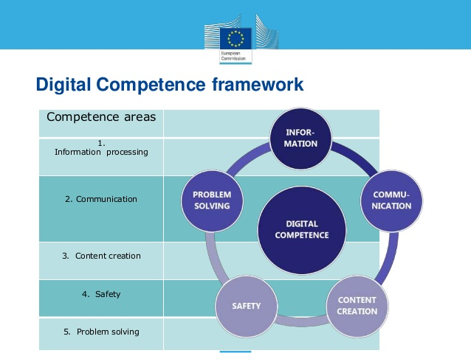
The Digital Competence Framework (DigComp 2.0)
Competence area 4:
Safety
Protecting devices
Protecting personal data and privacy
Protecting health and well-being
Protecting the environment
Competence area 5:
Problem solving
Solving technical problems
Identifying needs and technological responses
Creatively using digital technologies
Identifying digital competence gaps
Notes:
This Photo by Unknown Author is licensed under CC BY-NC-ND

Slide 7
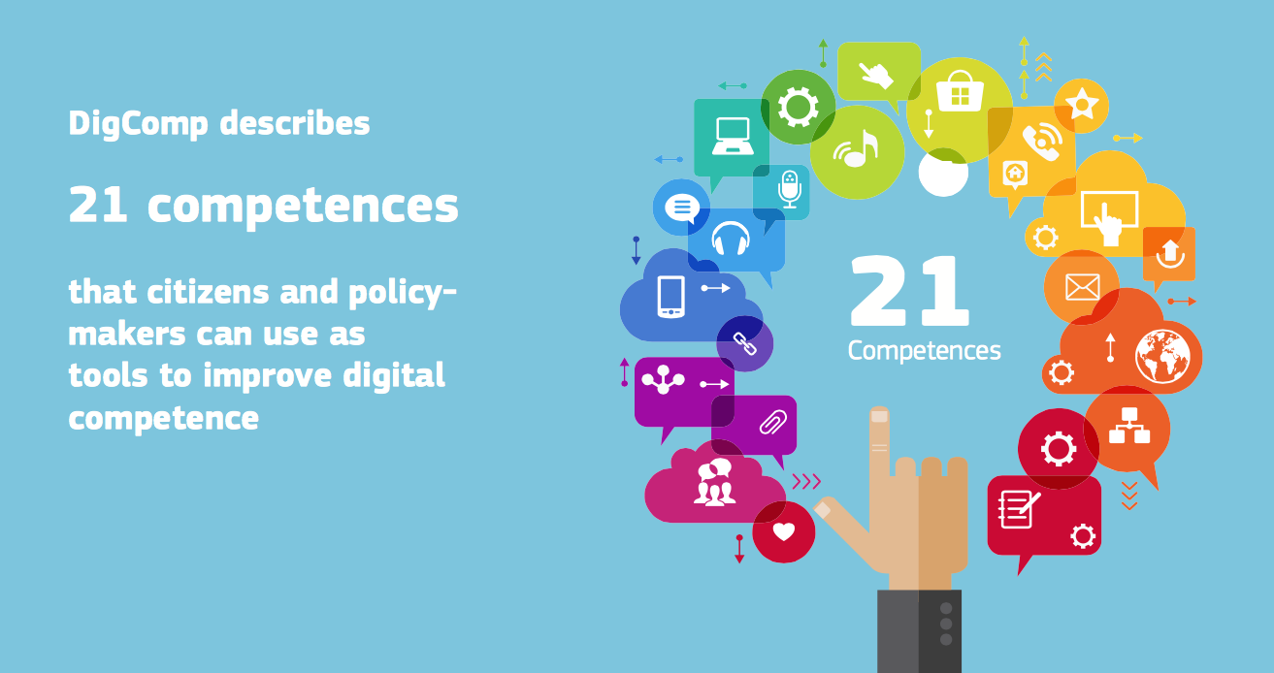
Notes:
This Photo by Unknown Author is licensed under CC BY-SA-NC

Slide 8
Digital Tools
Do you know what digital tools are?
The term "digital tool" refers to any software, website, or online resource on a computer, laptop, tablet, or smartphone.
Notes:
This Photo by Unknown Author is licensed under CC BY-SA-NC

Slide 9
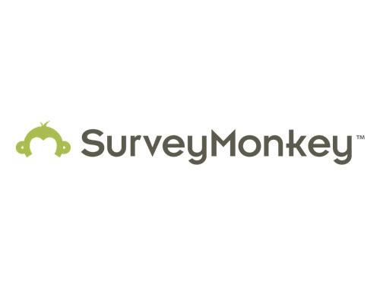
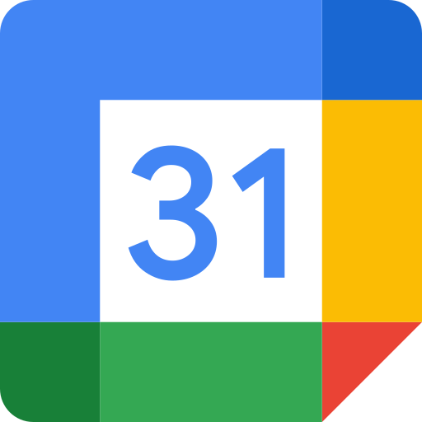
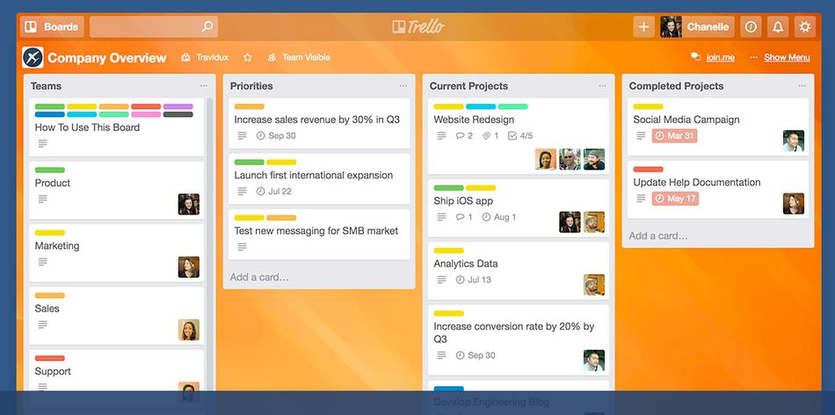
Examples of Digital Tools
Collaborating on projects and documents
Google Drive: You can upload spreadsheets, presentations and documents, or create them from scratch using Google’s own software.
Dropbox: application for sharing files
Trello: a user-friendly way to make and share to-do-lists and manage projects.
Surveymonkey: an easy tool for designing quick surveys and quizzes.
Organising meetings, people, and calendars
Doodle polls: create a list of potential dates and times for an event, and ask your attendees to select the dates
Eventbrite: create events and manage attendees.
Join.me: for organising web conferences and holding meetings online
Notes:
Pictures sources:
This Photo by Unknown Author is licensed under CC BY-NC-ND
This Photo by Unknown Author is licensed under CC BY-SA-NC
This Photo by Unknown Author is licensed under CC BY-SA

Slide 10
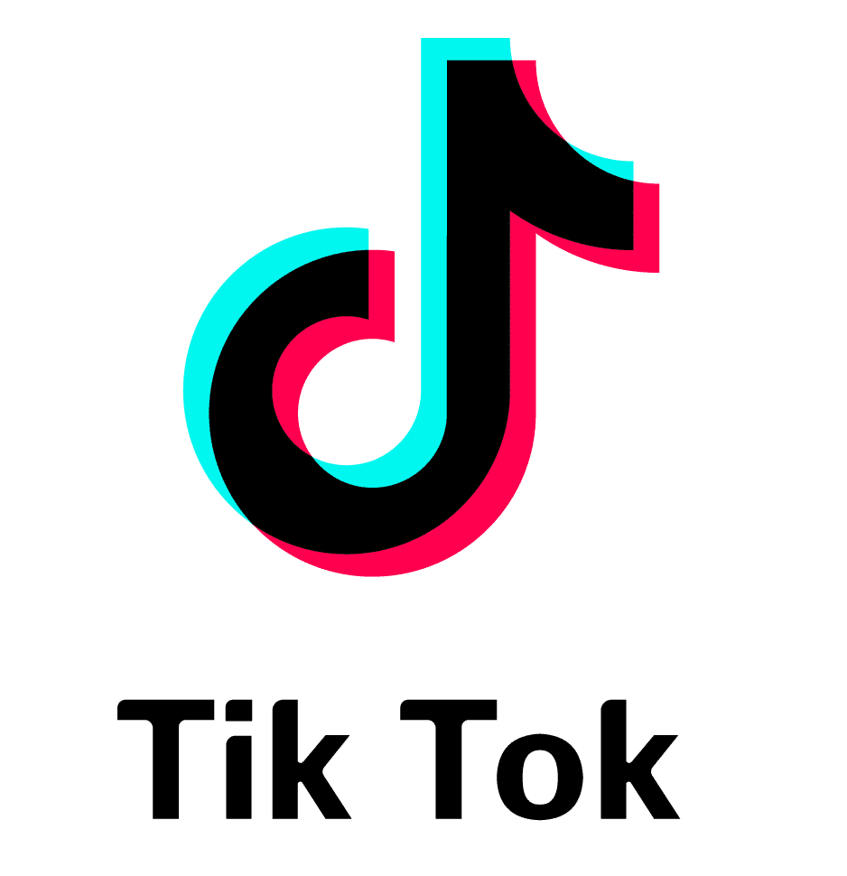
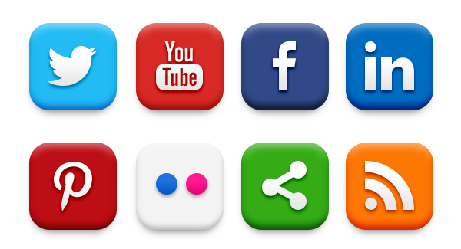
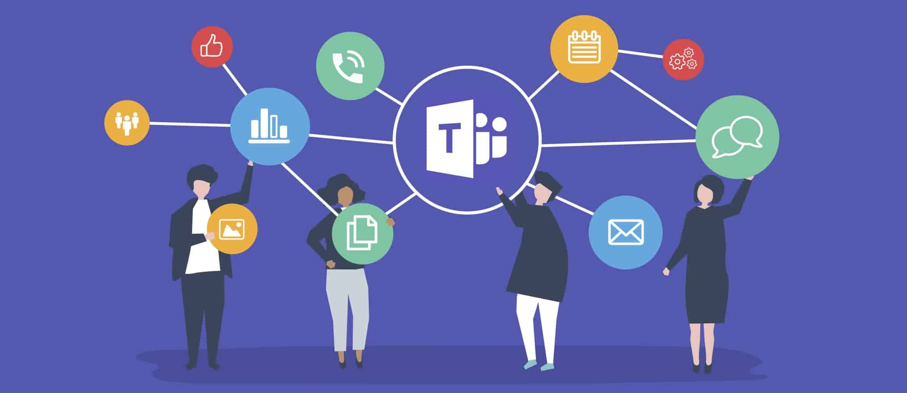
Examples of Digital Tools
Communication and Collaboration
Slack: Slack is a messaging app for business that connects people to the information that they need.
Microsoft Teams/Office 365: Microsoft Teams is the hub for team collaboration in Microsoft 365 that integrates the people, content, and tools your team needs to be more engaged and effective.
Social Media
Facebook
Instagram
Tik Tok
Yammer
Twitter
Storify
Notes:
Pictures sources:
This Photo by Unknown Author is licensed under CC BY-SA
This Photo by Unknown Author is licensed under CC BY-ND

Slide 11
Digital Tools for Online - Training
Zoom: It provides video telephony and online chat services and is used for teleconferencing, telecommuting, distance education, and social relations.
Skype for Business: Skype for Business was an enterprise software application for instant messaging and video telephony developed by Microsoft as part of the Microsoft Office suite.
Notes:
Picture sources:
This Photo by Unknown Author is licensed under CC BY-NC-ND
This Photo by Unknown Author is licensed under CC BY-SA

Slide 12
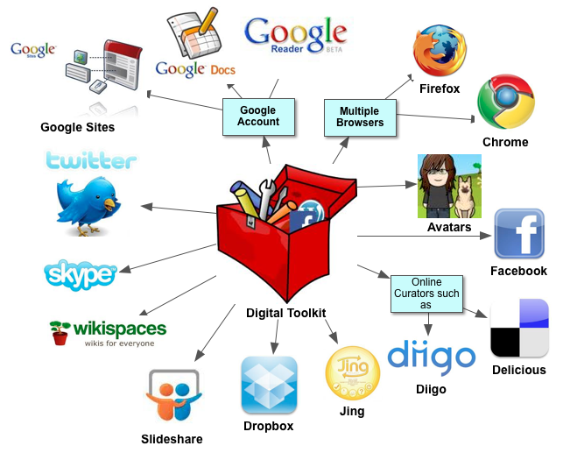
Activity
Could you give some examples of digital tools in your daily working and personal life?
Let’s break them down!
Notes:
Picture source: This Photo by Unknown Author is licensed under CC BY

Slide 13
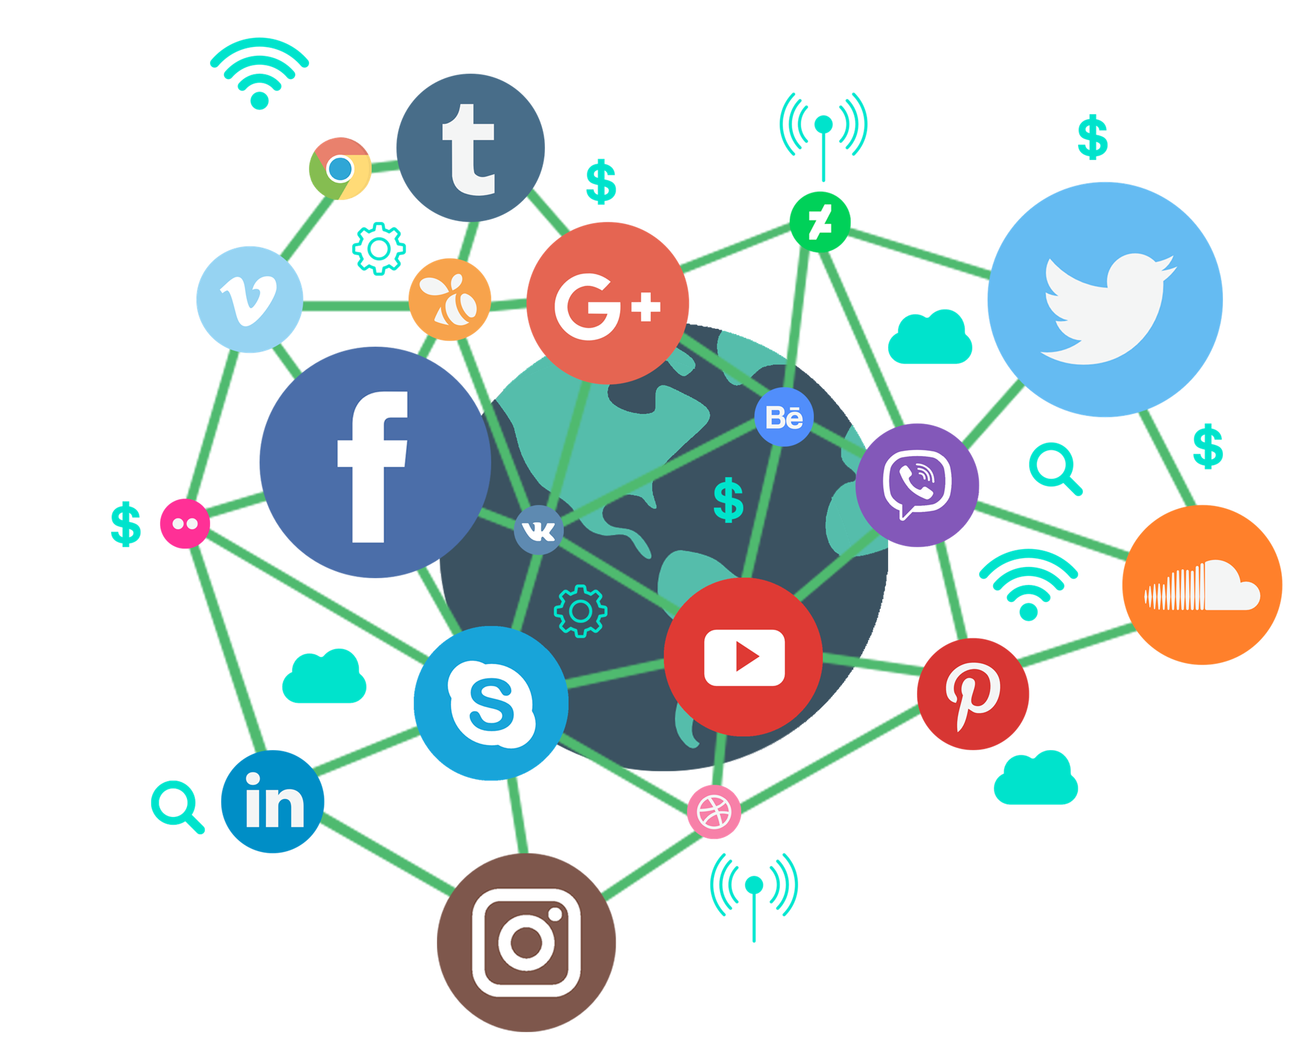
What is Digital Content?
Digital content is data that is produced and supplied in a digital form.
Types of digital content
Video: e.g. YouTube, Hulu, CBS All Access, Disney+, HBO Max,
Audio – Music: e.g. Spotify, Pandora, last.fm
Images: e.g., Flickr, DeviantArt, Instagram, Snapchat.
Visual Stories: e.g. Facebook
Text : e.g. Blogs, Websites
Notes:
Picture source: This Photo by Unknown Author is licensed under CC BY-NC

Slide 14
Who Creates Digital Content?
Everybody!
Irrespective of our personal views on social media, we have all become content producers.
Whether it's tweeting, uploading a video to Facebook, or updating our blogs, we contribute to the digital content ecosystem. In essence, each time we share information online, we create new digital content
Notes:
Picture source: This Photo by Unknown Author is licensed under CC BY-SA

Slide 15
Digital Content: Finding, Evaluating, Using and Creating it
Notes:
Picture source: This Photo by Unknown Author is licensed under CC BY

Slide 16
Digital Content: Finding, Evaluating, Using and Creating it
Finding
Employ a variety of search strategies to optimize your results.
Try using multiple search engines; this helps challenge your personal filter bubble.
Make use of oral, written, and visual resources to access information from various angles. By utilizing precise keywords and search strategies, you can improve the quality of your results.
Start by creating a list of keywords related to your inquiry or topic, and don't forget to include synonyms.
Adjust your search by using different keywords and techniques, allowing you to either narrow or broaden the scope as needed
Evaluating
Critically evaluate information to assess its relevance, usefulness, and reliability.
Ensure the information and sources are authentic; maintain a critical and skeptical perspective.
Check that the information is accurate, valid, and up-to-date.
Verify that all resources and information are appropriate and relevant to your needs.

Slide 17
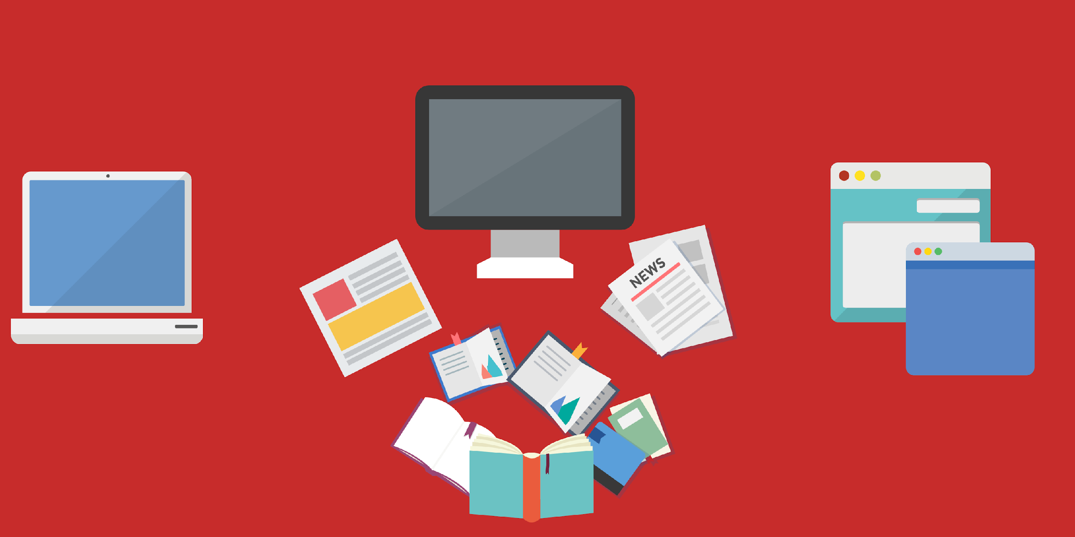
Digital Content: Finding, Evaluating, Using and Creating it
Responsible Use of Digital Data
Be aware of any restrictions on the use of digital content when you use it.
Acknowledge or attribute the creator of any digital content you use in your work.
Creating Digital Content
Creating meaningful digital content requires you to:
Address your audience's needs appropriately by understanding their needs
Use creative and critical thinking skills to produce quality materials that meet learning requirements
Be able to use a variety of digital tools effectively and confidently
Be honest, ethical and responsible when publishing
Be respectful of other copyright owners and protect your publisher's rights.
Notes:
Picture source: This Photo by Unknown Author is licensed under CC BY-SA-NC

Slide 18
Test Your Digital Skills
Test your digital skills in order to get a good understanding of your current digital competences and identify what you can do next to improve them.
The "My Digi skills" tool is based on the established European Digital Competence Framework - DigComp 2.0.
MyDigiSkills helps you to better understand your level of digital skills based on knowledge, skills and attitude in each of the five areas of the European Digital Competence Framework for Citizens, known as DigComp.
You will get a report on your levels of digital skills at the end.
Notes:
Picture source: This Photo by Unknown Author is licensed under CC BY-SA

Slide 19
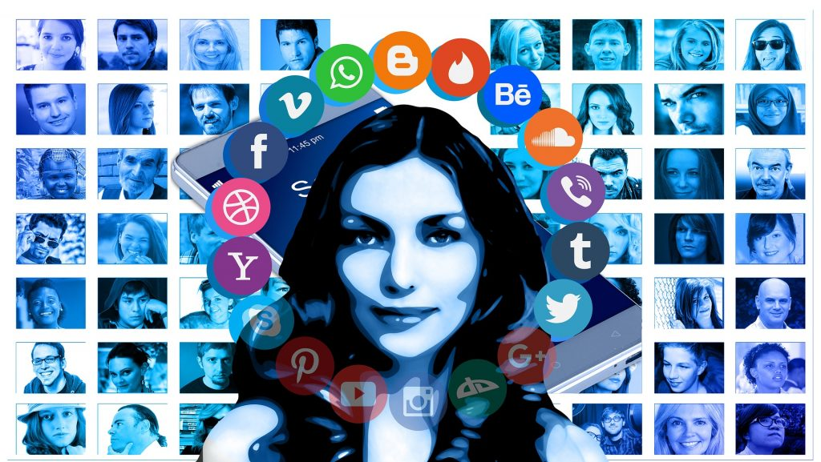
Tips for Digital Activism
Developing your online identity
Establishing a clear online identity is crucial for online success.
Your digital persona, a blend of your characteristics and online interactions, is key in the internet realm.
Your online persona is crafted through your engagements with different websites.
Aligning your online activities with your personal brand is critical for effective self-marketing.
To stand out digitally, be mindful of best practices for both online and offline posts.
Notes:
Picture source: This Photo by Unknown Author is licensed under CC BY-SA

Slide 20
Tips for Building Your Online Identity
Here are some tips and tricks for building your online identity:
Regularly perform a Google search of your own name. Monitor what the search results say about you, the accuracy of the information, and any potential mix-ups with other individuals. Aim to do this at least once a week to manage your online reputation.
Engage with social media platforms. Use networks such as LinkedIn, Facebook, Twitter, Google+, ZoomInfo, and Ecademy to connect with others. Edit your profiles to reflect your personal brand and appeal to your target audience.
Maintain a blog with relevant content. A blog not only showcases your expertise but also helps you meet new people and establish yourself as a thought leader in your field. Regular blogging can enhance your credibility and improve your search engine rankings.
Create an online career portfolio. Highlight your skills, passions, and unique attributes on your personal website. This can serve as a dynamic resume that showcases your achievements and professional journey.

Slide 21
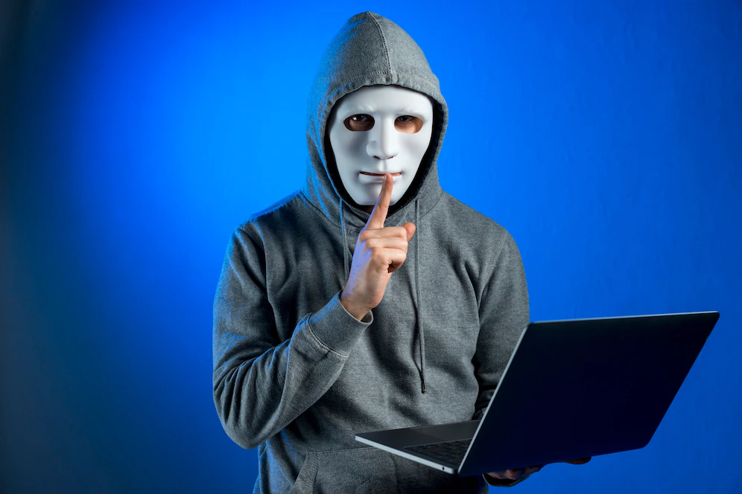
Protect Yourself Online
Rapid advancements in technology often bring along numerous challenges, some of which can potentially be hazardous depending on individual circumstances.
While certain regions may currently have a safe environment for online or on-ground activism, changes in laws or government regulations could undermine this safety. It's prudent to anticipate and prepare for potential future uncertainties.
There are valid concerns that these changes could be exploited. Many activists prefer to operate privately due to potential risks, such as physical danger in certain locations, workplace discrimination, or the need for online anonymity.
Notes:
Picture source: https://www.freepik.com/free-photo/portrait-hacker-with-mask_4473968.htm#query=online%20hacking&position=3&from_view=search&track=sph

Slide 22
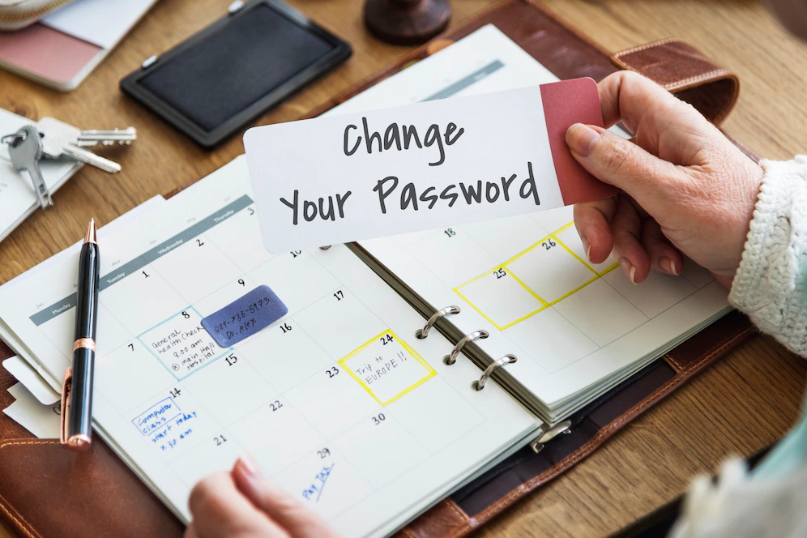
Protect Yourself Online
Here are a few tips on how to better protect yourself online
Maintain robust passwords: Ideally, your passwords should comprise a mix of at least 12 alphanumeric characters and special symbols. Longer passwords often correlate with enhanced security. Avoid reusing passwords across different websites to prevent a breach if one of your accounts gets compromised.
Prioritize online privacy: Regulate what personal information others can view about you online based on your comfort level. Be mindful that social media platforms generally offer lower privacy protections. Always avoid sharing anything online, including in private messages and emails, that you wouldn't want to be publicly accessible.
Notes:
Picture source: https://www.freepik.com/free-photo/change-your-password-privacy-policy-protection-security-system-concept_16471164.htm#query=password%20protection&position=15&from_view=search&track=sph

Slide 23
Protect Yourself Online
Stay alert to misinformation: One critical aspect of online safety is being able to identify and scrutinize false or deceptive content. It's unnecessary to trust any information online blindly. Be wary of attention-grabbing headlines that may serve as 'clickbait', designed to lure readers and boost ad revenues. Before sharing any content, read the full article and cross-check the information with other credible news sources. Be cautious if the story is reported only on one site, as it could be misrepresented or entirely false.
Notes:
Picture source: https://www.freepik.com/free-photo/woman-reading-newspaper_2753808.htm#query=fake%20news&position=5&from_view=search&track=sph

