Slide 1
Module 5 Understanding Digital Activism
Unit 3: Digital Tools for Digital Activism

Slide 2
Social Networks
Social media platforms have demonstrated their effectiveness as tools for disseminating information, rallying support, and highlighting issues often neglected by traditional media channels.
Facebook notably contributed to the organization and promotion of protests during the Arab Spring in Tunisia and Egypt in 2011. Similarly, social media was a major catalyst in mobilizing participants during the pro-democracy protests in Hong Kong in 2019, and it served as a bridge connecting environmental activists worldwide during movements like Extinction Rebellion and Fridays for Future.
Notes:
Picture source: https://www.freepik.com/free-photo/pile-3d-popular-social-media-logos_1191374.htm#query=Social%20networks&position=0&from_view=search&track=sph

Slide 3
Social Networks
Facebook
In order to increase the visibility of your activities and events, you should promote them. It is possible to create a public page, create events and share them to encourage people to attend. If you wish to reach a targeted audience of your choice, paid promotion can also be used.
Developing campaigns in collaboration with a community of online users. A Facebook group that focuses on a particular topic can be created or joined. Groups may be either private or public.
Notes:
Picture source: <a href="https://www.freepik.com/free-photo/woman-using-smartphone-social-media-conecpt_3213015.htm#query=facebook&position=1&from_view=search&track=sph">Image by rawpixel.com</a> on Freepik

Slide 4
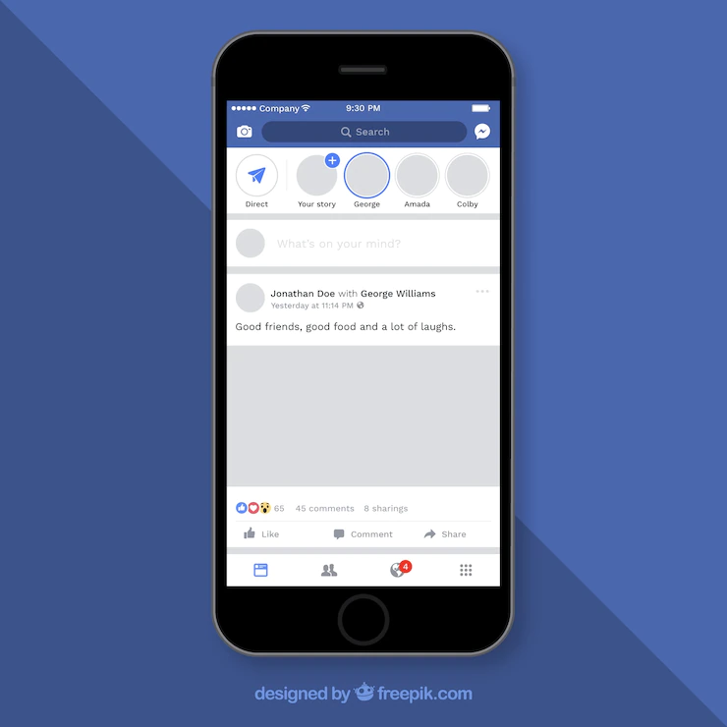
Social Networks
Facebook Tips
Before getting started with Facebook, identify your specific objectives. If broad outreach is your aim, consider creating a Facebook Page. If you're more interested in dialogue or sharing with a select group, opt for a Facebook Group. If neither suits your needs, you can simply use your personal profile.
Regardless of whether you're using a personal profile, page, or group, it's essential to regulate your posting frequency. Strive for 5-10 posts per week and avoid exceeding three posts in a single day. This helps maintain visibility without overwhelming your audience.
Conciseness is key in your posts. Strive for less than 250 characters to foster greater engagement. Incorporate engaging visuals, videos, or links to complement your message.
Monitor the analytics of your posts on your groups or pages. Understand when your audience is most likely to see your posts and what kind of content garners more responses. Consider adjusting your posting schedule based on your audience's online activity to maximize impact.
Notes:
Picture source: https://www.freepik.com/free-vector/facebook-mobile-post-with-flat-design_2387366.htm#query=Facebook%20posts&position=1&from_view=search&track=sph
Text Source: Amnesty International Australia, Level 2 - Fundamental activist skills. https://www.amnesty.org.au/skill-up/fundamental-skills/

Slide 5
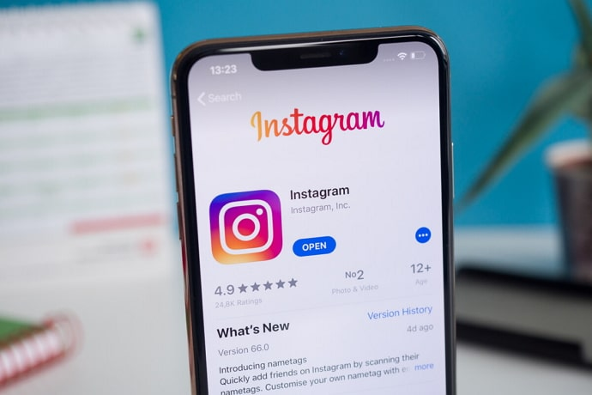
Social Networks
Instagram
Visual images, such as photographs and videos, are highly effective in engaging with people and can be effectively utilized on platforms like Instagram.
Creating original content on social media is a great way to showcase personal or group activities and initiatives.
Sharing content from others can help to reach and engage with followers, fostering a sense of community.
Social media platforms allow activists to demonstrate the size and impact of their movement, highlighting its scope and influence.
Notes:
Pictures sources:
This Photo by Unknown Author is licensed under CC BY
https://www.freepik.com/free-vector/simple-instragram-frame-template_2060737.htm#query=instagram&position=3&from_view=search&track=sph
Text Source: Amnesty International Australia, Level 2 - Fundamental activist skills. https://www.amnesty.org.au/skill-up/fundamental-skills/

Slide 6
Social Networks
Instagram Tips
Utilize hashtags in your social media posts to make your content more discoverable to a wider audience beyond your followers. Additionally, follow and engage with relevant hashtags to stay updated on related content and connect with like-minded individuals and organizations.
Familiarize yourself with basic image and video editing tools like Canva, Photoshop, and Premiere. This will enable you to enhance the visual quality of your content, making it appear more professional and engaging.
Connect your Instagram account to your Facebook profile to streamline your social media presence. By linking the two accounts, your Instagram posts will automatically be shared on your Facebook profile, increasing your content's reach and visibility.
Notes:
Pictures sources:
https://www.freepik.com/free-vector/social-media-concept-illustration_4957157.htm#query=hashtags&position=2&from_view=search&track=sph
https://www.freepik.com/free-vector/instagram-logo-collection_2060733.htm#query=instagram&position=6&from_view=search&track=sph
Text Source: Amnesty International Australia, Level 2 - Fundamental activist skills. https://www.amnesty.org.au/skill-up/fundamental-skills/

Slide 7
Social Networks
Twitter
Twitter serves as a platform for microblogging thoughts, opinions, and broadcasting activities.
It is a popular platform for staying informed about current events and gaining insights from diverse perspectives.
Information is often shared on Twitter faster than traditional news sites can report, allowing for real-time updates.
Twitter provides a direct communication channel for activists to connect with fellow activists and engage with campaign targets.
Following like-minded individuals and organizations on Twitter can help build networks and find inspiration for activism.
Twitter is also utilized by politicians and decision-makers, making it possible to send direct messages expressing concerns about specific community issues.
Notes:
Picture source: https://www.freepik.com/free-vector/twitter-logo-design_1177539.htm#query=twitter&position=11&from_view=search&track=sph

Slide 8
Social Networks
Twitter Tips
Manage your Twitter activities by focusing on your current projects and interests. Adjust the accounts you follow to align with your specific goals and priorities. Avoid feeling pressured to be constantly active on the platform.
Practice critical thinking and fact-check any information you come across on Twitter. Verify the credibility of sources before accepting information at face value.
Utilize hashtags strategically to expand the reach of your posts and connect with a broader audience. Stay updated on trending hashtags and participate in relevant conversations and events. Tag specific individuals in your posts to capture their attention.
Support fellow users by retweeting their posts, thereby amplifying their messages and fostering a sense of community on the platform. Engage in mutual support and collaboration with like-minded individuals and organizations.
Notes:
Picture source: https://www.freepik.com/free-vector/social-media-twittersplash_10695782.htm#query=twitter&from_query=twiiter&position=10&from_view=search&track=sph
Text Source: Amnesty International Australia, Level 2 - Fundamental activist skills. https://www.amnesty.org.au/skill-up/fundamental-skills/

Slide 9
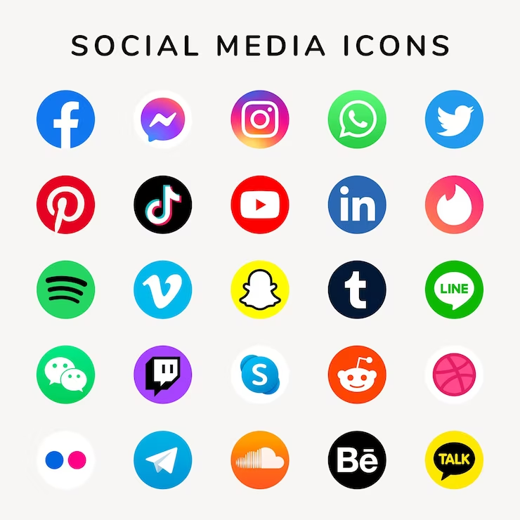
Social Networks
To maximize reach and engagement, focusing on the three most popular platforms can be beneficial. These platforms are more likely to connect you with your intended audience effectively. However, it's important to consider using other platforms if you have a specific target audience in mind, as different platforms cater to different demographics and interests.
YouTube provides the advantage of uploading videos of any length and covering a wide range of topics. Reddit, on the other hand, offers numerous forums that cover diverse subjects. For younger audiences, Snapchat and TikTok are popular choices, offering short video clips.
It's advisable to identify the platform(s) where your target audience is most active and prioritize those platforms. You don't need to be present on all platforms or even multiple platforms, as focusing on the platforms most relevant to your audience can yield better results.
Notes:
Picture source: <a href="https://www.freepik.com/free-vector/social-media-icons-vector-set-with-facebook-instagram-twitter-tiktok-youtube-logos_17221195.htm#query=social%20media&position=1&from_view=search&track=ais">Image by rawpixel.com</a> on Freepik

Slide 10
E-Petitions
E-Petitions are institutionalized mechanisms that allow citizens to participate in government decision-making.
They provide a formal avenue for citizens to submit requests to government institutions, seeking policy changes.
While not all E-Petitions lead to successful policy changes, the process itself holds significance.
The collection of signatures plays a crucial role in E-Petitions, emphasizing the importance of citizen involvement.
E-Petitions contribute to increased awareness and publicity surrounding specific issues or policies.
They foster a sense of solidarity within local and national communities.
E-Petitions promote a better understanding of government policies among the general public.
Notes:
Picture source: https://www.freepik.com/free-vector/online-voting-isometric-illustration-with-workspace-with-laptop-election-website-passport_14258184.htm#query=E-petitions&position=2&from_view=search&track=ais

Slide 11
E-Petitions
Change.org and Avaaz are technology-enabled platforms that have been utilized by campaigners globally.
These platforms expedite the process of collecting online signatures and enable reaching a larger audience simultaneously.
Individuals and organizations have the ability to create and launch petitions on these platforms.
The use of these platforms facilitates mobilizing support on a global scale for specific causes or issues.
Notes:
Picture source: https://www.freepik.com/free-vector/electronic-voting-abstract-concept-illustration_11667689.htm#query=E-petitions&position=1&from_view=search&track=ais

Slide 12
Blogging and Vlogging
A blog is similar to a website in that it contains written/text content as well as images, gifs, and other media. Vlogs, on the other hand, consist of video content published on any topic.
Should you start a blog or a vlog?
Starting a blog or a vlog can be daunting if you are not experienced with social media and blogging, but basic computer skills are sufficient to begin.
Being a great writer or videographer is not a prerequisite for success. Many successful blogs or vlogs adopt an informal and conversational style to offer a personal perspective.
Blogs allow for written content, while vlogs involve creating videos. Choose the format that aligns with your strengths and preferences.
Blogs provide the opportunity for in-depth written exploration of topics, while vlogs offer a more visual and interactive experience.
Consider your target audience and the type of content you want to create when deciding between a blog or a vlog.
Both blogs and vlogs can be monetized through advertisements, sponsorships, or product promotions.
Whichever option you choose, consistency and regular updates are key to building and maintaining an audience.

Slide 13
Blogging
How to get your blog online?
When it comes to getting your blog online, you have several options for blogging platforms, each with its own features and pricing structures. Here are some popular platforms to consider:
WordPress.org: A highly versatile and customizable platform that requires self-hosting. It offers numerous themes and plugins to enhance your blog's functionality. It does require a domain name and web hosting.
Blogger: A free platform owned by Google, Blogger is user-friendly and requires no coding skills. It provides a range of templates and allows for easy integration with other Google services.
Tumblr: A microblogging platform that combines blogging with social networking features. It's known for its simplicity and strong community aspect, and it's free to use.
Notes:
Picture source: https://www.freepik.com/free-vector/online-article-concept-illustration_22378349.htm#query=Blogging&position=29&from_view=search&track=sph

Slide 14
Blogging
Squarespace: A paid platform that offers visually appealing templates and easy-to-use design tools. It provides hosting, security, and support, making it a comprehensive solution.
Web.com: This platform offers website building and blogging services, with both free and paid options. It provides domain registration, hosting, and design templates.
Wix: A user-friendly website builder that includes blogging capabilities. It offers a drag-and-drop interface and a variety of templates to choose from.
WordPress.com: A hosted version of WordPress that provides a simplified setup process. It offers free and premium plans, with the option to upgrade for additional features.
To make the best choice, consider your specific needs and preferences. If you're a beginner with no coding skills, opt for an easy-to-use platform. Additionally, think about the type of blog you want to create, as switching platforms later on can be challenging. You can find comparisons and reviews of different providers online to help inform your decision.

Slide 15
Blogging
Before you launch your blog
Creating a blog that caters to your specific needs requires paying attention to readability. It is important to ensure that the text is legible, avoiding excessively small fonts or overcrowded layouts.
One crucial element to include is a biography or an about page, which allows readers to connect with the person behind the blog. Sharing some background information about yourself can pique readers' interest and establish a personal connection.
Implementing a comment section is also important for fostering engagement. It is necessary to outline your comment moderation policy, clarifying whether you will manually approve every comment or allow non-spam comments to be automatically published.
Finally, don't forget the enjoyable part: writing and publishing your first blog post. This is your chance to express your unique thoughts and ideas, providing valuable content to your readership. Embrace this opportunity to share your voice with enthusiasm.
Notes:
Picture source: https://www.freepik.com/free-vector/freelance-work-abstract-concept-vector-illustration-freelancer-job-remote-work-online-selfemployment-freelance-platform-available-hiring-independent-web-specialist-abstract-metaphor_24122175.htm#query=blogger&position=9&from_view=search&track=sph

Slide 16
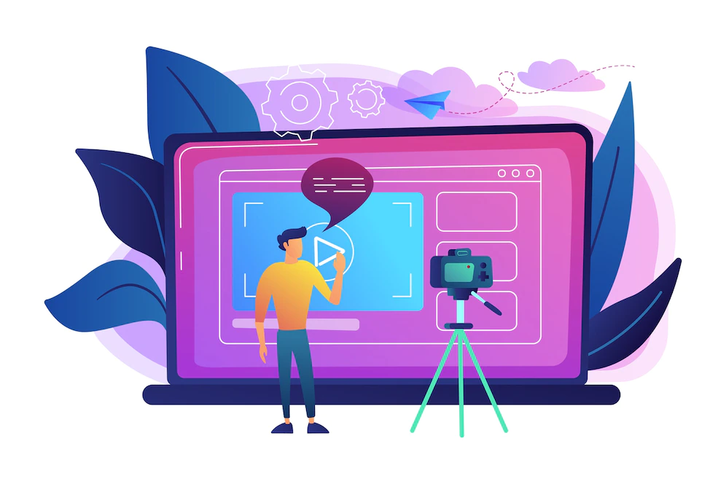
Vlogging
What is vlogging and how to start
Vlogging is different from blogging as it involves creating video content instead of written posts.
Vloggers document their own lives and experiences through videos rather than writing about them.
The frequency of vlogging can vary depending on the vlogger's content and preferences, with some vloggers posting daily while others do so less frequently.
Live video streaming on platforms like YouTube and Facebook is also a popular form of vlogging.
Vloggers typically speak directly to the camera, sharing their daily activities or discussing specific topics.
If you're interested in starting vlogging, it's helpful to watch and analyse various vloggers to gain inspiration and insights into different styles and approaches.
This Photo by Unknown Author is licensed under CC BY-ND
Notes:
Pictures source: https://www.freepik.com/free-vector/man-front-camera-recording-video-share-it-internet-illustration_10780340.htm#query=Vlogging&position=8&from_view=search&track=sph

Slide 17
Vlogging
How to start your own vlog – step by step:
Theme selection: Decide on a vlogging theme that resonates with your passion and interests, allowing you to consistently generate engaging content. Focus on a keyword that encapsulates your chosen theme.
Target audience: Identify and narrow down your target audience based on factors like gender, age, occupation, knowledge level, or location. Tailor your content to cater specifically to this audience segment. Utilize keyword research tools to gauge the monthly search volume related to your theme on platforms like YouTube.
Platform selection: Select a platform (such as YouTube, Facebook, or TikTok) where your target audience is most likely to be active and engaged.
Vlogging equipment: Gather the essential gear required for vlogging, including a camera, microphone, lighting equipment, editing software, and any additional tools or accessories that align with your specific needs.
Draw inspiration: Seek inspiration from other successful vloggers and channels related to your chosen theme. Engage with their content, leaving meaningful comments and utilizing your selected keyword to establish connections.
Brand building: Develop a strong brand identity for your vlog by defining its theme, understanding your audience, and selecting a few descriptive adjectives to guide your content creation. Consistency in posting, implementing SEO strategies, and providing valuable content to your audience are crucial for brand development.
Channel creation and launch: Plan your videos in advance by outlining topics and incorporating relevant keywords, or opt for a more spontaneous approach. Finally, create and release your first video to initiate your vlogging journey.

Slide 18
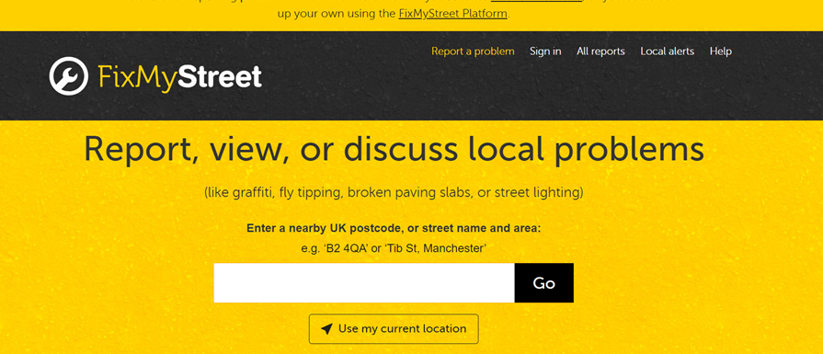
Crowdsourcing platforms
Online spaces known as crowdsourcing platforms, which are sometimes referred to as crowdfunding sites, provide a venue for local governments to utilize the collective intelligence of the crowd for diverse functions. These include:
By taking advantage of digital technology, civic engagement can be amplified. For instance, applications like FixMyStreet allow residents to track the work of public officials in real time, based on inputs from the public.
Crowdsourcing can be used as a strategy to rekindle the political interest of apathetic citizens by encouraging their expert insights. Platforms like Idée Paris allow residents to suggest and vote on new projects within their city.
Furthermore, a growing number of cities are introducing mobile applications that allow residents to directly alert the local government about issues ranging from waste disposal, road conditions, to traffic problems. "Find it, Fix it," a service adopted by Seattle, and Johannesburg's equivalent are examples of such initiatives.
An intriguing urban digital crowdsourcing model is the Hood Maps online map. This application permits anyone to contribute annotations about the demographics of specific neighbourhoods, identifying areas dominated by groups like hipsters, tourists, the affluent, average folks, business professionals, or college communities.
Notes:
Picture source: https://www.fixmystreet.com/

Slide 19
E-participatory Budgeting
This approach gives citizens the power to decide how a segment of the local governmental budget should be allocated.
This method enables the populace to propose and vote on initiatives that they deem significant, like enhancements to educational institutions, public dwellings, parks, and so on.
By incorporating technology, the entire process is made open and cooperative.
The origins of this method trace back to Porto Alegre, Brazil, in 1989, and today, it has been adopted in over 1,500 cities globally, including New York, Mexico City, Paris, and Reykjavik.
Around the world, the concept of electronic participatory budgeting is gaining momentum. In 23 countries, 101 cities have integrated some form of digital participatory budgeting in their operational procedures. Although this is a relatively small percentage of all participatory budgeting efforts, it's clear that digital participation is gaining a stronghold in the public expenditure process.
In cities implementing participatory budgeting, 81.8% use a hybrid method (incorporating both online and in-person collaboration), while 14.1% have completely transitioned to digital participatory budgeting.

Slide 20
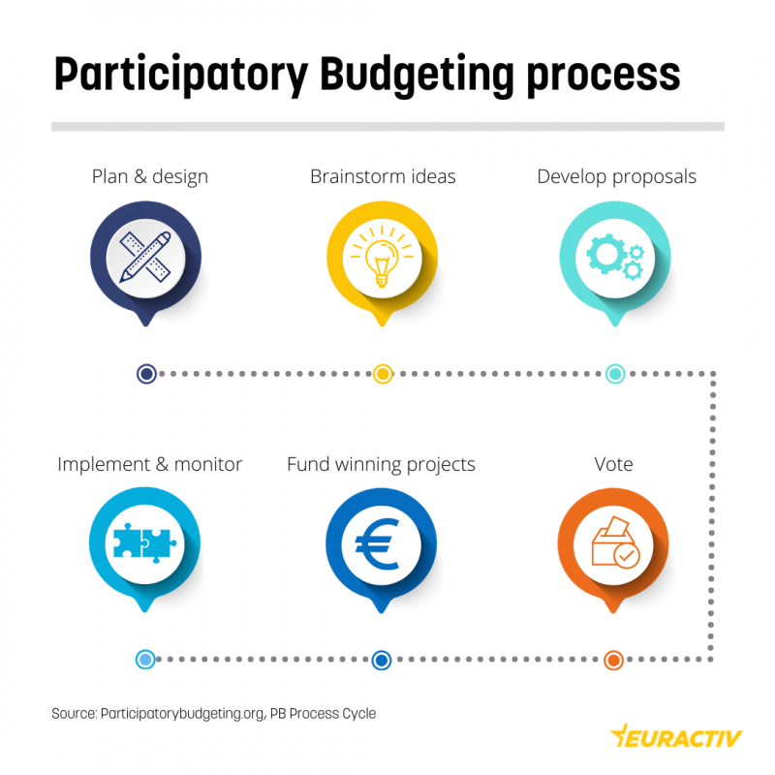
Activity Time!
Here is a video produced that provides a brief introduction to participatory budgeting:
Check out this article on participatory budgeting
Fill out the worksheet!
Notes:
Picture source: https://www.euractiv.com/section/participatory-democracy/infographic/participatory-budgeting-europes-bet-to-increase-trust-in-government/

Slide 21
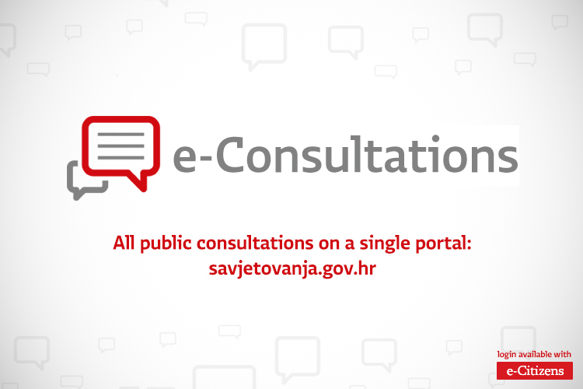
E-Public Consultations
Public consultations are intended to solicit public involvement in matters that concern them by obtaining their thoughts, responses, views, and feedback on a specific document or policy.
Online consultations are facilitated via a dedicated platform that showcases both ongoing and concluded consultations. The opinions of the participants are gathered through online surveys, which are displayed on the consultation website, unless the respondents choose to keep their identities hidden.
Presently, international organizations are adopting e-consultations to directly involve citizens in the decision-making process, frequently by gathering ideas about a city's future and allowing public voting.
E-consultations, which can be initiated by political institutions or non-governmental organizations, are diverse in their methodologies, themes, objectives, and targeted audiences, often enabling simultaneous input from citizens and their interactions with each other.
The European Union extensively employs e-consultations to encourage transparency, enable the participation of European citizens in EU legislative processes, and mitigate the frequently referenced democratic deficit.
Notes:
Pictures sources:
https://vlada.gov.hr/e-consultation-portal-launched-for-citizens-to-take-more-active-part-in-law-making/16865
This Photo by Unknown Author is licensed under CC BY

