Slide 1
Module 1 Democratic Ideals and Institutions
Unit 1: Understanding Democracy

Slide 2
Icebreaking Activity: Let's Meet Each Other
Steps:
Scan the QR Code
A random wheel will appear for our game.
Introduce Yourself
Name
Organization
Brief description of your daily work
Begin Module 1
Ready, set, learn!
Engage, enjoy, and learn together!

Slide 3
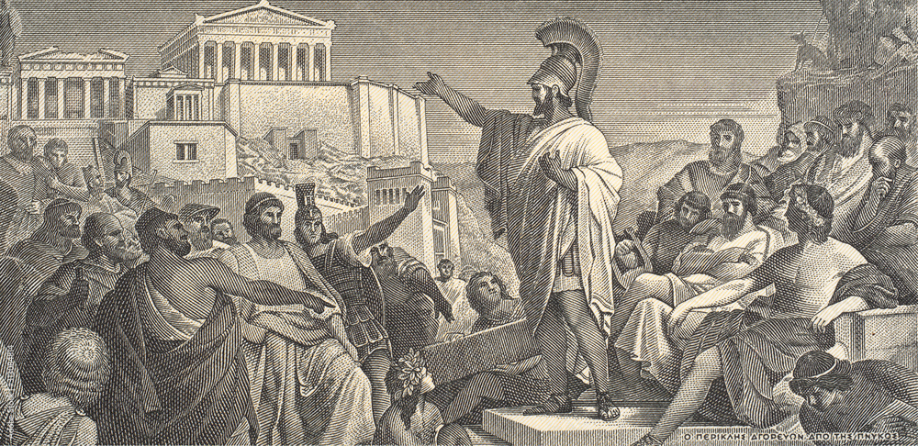
The Meaning of Democracy
Democracy originates from the Greek terms demos, representing "people," and kratos, signifying "power," signifying "people possess power." It denotes a governmental system where individuals have the ability to govern themselves.
The term democracy was initially employed in ancient Greece, specifically in the city-state of Athens, during the period of classical antiquity. It emerged from Greek political and philosophical thinking of that era.
Watch the following Video
Notes:
Picture source: https://www.britannica.com/video/213436/Questions-answers-democracy

Slide 4
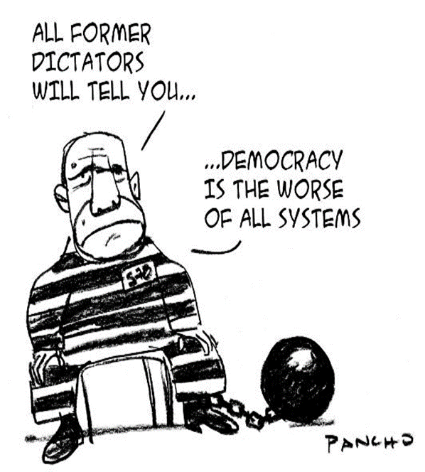
The Meaning of Democracy
To gain a clearer understanding of democracy, it can be helpful to consider what it is not, as there are various forms of democratic governance worldwide. Therefore, democracy should not be confused with autocracy or dictatorship, where a single individual holds power, nor with oligarchy, where a small portion of society governs.
When democracy is properly comprehended, the "rule of the majority" does not imply the disregard of minority interests. In theory, a democratic government represents the entire population and acts in accordance with the collective will of the people.
Notes:
Picture source: https://www.coe.int/en/web/compass/democracy

Slide 5
How Do You Define Democracy?
Get your devices (laptop or mobile) and access the internet – Search for definitions of democracy
Watch the following Video clip
Notes:
Picture Source: https://blogs.lse.ac.uk/lseupr/2021/01/18/democracy-at-its-best-majoritarian-or-parliamentary-electoral-systems/

Slide 6
Definitions/ Perceptions of Democracy
There is no consensus among stakeholders about what democracy is and how it is defined.
Woodrow Wilson "Democracy is not so much a form of government as a set of principles"
Britannica
“Democracy is a system of government in which laws, policies, leadership, and major undertakings of a state or other polity are directly or indirectly decided by the “people,” a group historically constituted by only a minority of the population (e.g., all free adult males in ancient Athens or all sufficiently propertied adult males in 19th-century Britain) but generally understood since the mid-20th century to include all (or nearly all) adult citizens.
Sinclair Lewis “In general, apart from outrageous exceptions, democracy has given the ordinary worker more dignity than he has ever had”
Aristotle “Democracy means government of the poor or those less fortunate”
Gandhi “Democracy, based on the idea that I do, should provide the same opportunities weaker than stronger. Only nonviolence can achieve this goal ”
Henry Ford “The democracy that I favor is one that gives everyone the same chance of success, depending on the capacity of each. The one that I reject is that which claims to provide the number the authority which belongs to merit
Rousseau “The sovereign can […] the filing of the Government commit to all the people or the majority of the people, so there are more citizens are magistrates than individuals. Given to this form of government called democracy ”
Albert Camus ‘Democracy is not the law of the majority, but the protection of the minority’.
Churchill “Democracy is the worst political system, with the exception of all others”
Notes:
Definitions of Democracy: https://www.civiced.org/pdfs/QuotationsCivicEducation.pdf

Slide 7
The Development of Democracy – Ancient History
Where did the idea of democracy come from?
The concept of democracy has emerged from a shared aspiration in various societies throughout history, wherein ordinary individuals desire to have a voice in decisions that impact their lives.
This idea has been manifested in different ways, such as tribal gatherings in Africa and popular assemblies in the early Middle East, among other practices.
Athens in the 5th century BC established a Greek model of democracy that stood in stark contrast to the autocratic and oligarchic political systems of that time. However, it is important to note that this ancient form of democracy differs from our contemporary understanding in two significant ways.
Direct Involvement: Citizens personally convened to discuss governance issues.
Collective Deliberation: Open forums for debate and decision-making.
Policy Implementation: Direct execution of policies by the people.
Limitations: Citizenship and rights to participate were restricted.
Exclusions: Women, slaves, non-citizens, and minors were not allowed to vote
Active Citizenry: Of about 300,000 inhabitants, only 50,000 men engaged in politics.

Slide 8
Types of Democracy (Direct/Representative)
What are the different types of democracy?
What does Direct and Representative democracy mean?
What are the differences?
What the following video and lets discuss!!

Slide 9
Direct Democracy: What Is It?
What is it?
Direct democracy is a form of governance where people vote on laws and policies directly.
It's also known as "pure democracy," emphasizing the direct involvement of citizens.
Two models of direct democracy:
Full-Scale Direct Democracy: All executive and legislative decisions are made by popular vote.
Policy-Specific Direct Democracy: Only certain decisions or legislative acts are subject to a popular vote.
Citation: (Day, January 2022)
Notes:
Picture source: Image by <a href="https://www.freepik.com/free-vector/international-day-democracy_9270978.htm#page=2&query=voting%20ballot&position=36&from_view=keyword&track=ais">Freepik</a>

Slide 10
Examples of Direct Democracy
Athenian Origins: Modern democracy echoes Athens circa 600 BCE, where citizens directly voted on laws.
Key Elements of Direct Democracy:
Referendums: Citizens vote on laws or policies.
Legislative Initiatives: Citizens propose laws or constitutional changes.
E-Democracy: Utilizing technology for broader participation.
Global Examples:
Switzerland: Referendums on any law and popular initiatives for constitutional changes.
United States: Town halls and state-level referendums, such as Alabama's for constitutional amendments.
United Kingdom: National referendums on major issues like Brexit.

Slide 11
Direct Democracy: What Are The Pros And Cons?
Pros
Direct Democracy: A paradigm of transparency and public involvement in legislative processes.
Public Debates: No backroom deals — vital issues are discussed openly.
Accountability: It's clear who shapes the nation's laws and policies.
Citizen Engagement: Empowers citizens to collaborate and communicate effectively.
Legislative Influence: Citizens not only review but also create laws that garner majority support and serve the greater good.

Slide 12
Direct Democracy: What Are The Pros And Cons?
Cons
Growing Population: With over 350 million people in the U.S., direct voting on every issue is impractical.
Busy Lives: People's schedules are filled with various duties, making active participation in each decision tough.
Decision Tensions: High-stakes decisions can create significant conflict among citizens with divergent views.

Slide 13
Representative Democracy: What Is It?
What is Representative Democracy?
A system where citizens elect representatives to legislative bodies.
Based on direct election of officials by the people.
Ensures accountability of the state's highest body to the populace.
Representatives are expected to act in the interests of their constituents.
Political parties play a crucial role in this democratic framework.
Notes:
Picture source: Image by <a href="https://www.freepik.com/free-photo/top-view-paper-style-voting-composition_18264674.htm#page=3&query=announcement%20banner&position=13&from_view=keyword&track=ais">Freepik</a>

Slide 14
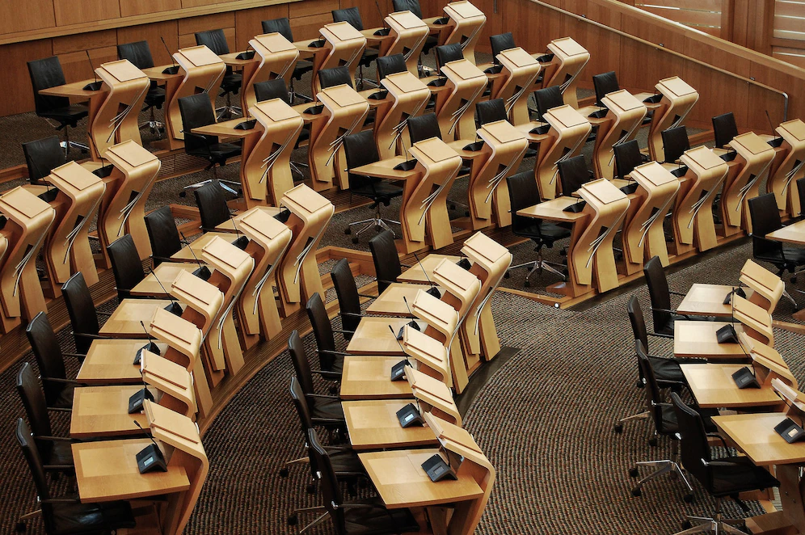
Examples of Representative Democracy
Which countries have a representative democracy?
Majority of European Union member states
Most countries in the Western Hemisphere
Around 110 countries classified by the Democracy Index
Full democracies
Flawed democracies
Hybrid regimes
Variations in structure
Parliamentary constitutional monarchies (e.g., UK, Netherlands)
Representative republics (e.g., Germany, USA)
Notes:
Picture source: <a href="https://www.freepik.com/free-photo/horizontal-shot-desks-inside-scottish-parliament-building_10303619.htm#query=parliament%20politics&position=0&from_view=keyword&track=ais">Image by wirestock</a> on Freepik

Slide 15
Representative Democracy: What Are The Pros And Cons?
Pros
Expertise in Governance: Representatives are tasked with understanding complex legislation.
Alignment with Interests: Elected officials ideally vote in sync with constituents' preferences.
Consolidating Concerns: Representatives distill the multitude of citizen interests into actionable laws.
Acknowledgment of Voices: While not all desires are met, the majority's interests are represented.
Efficient Legislation: Delegating lawmaking to elected officials streamlines the decision-making process.

Slide 16
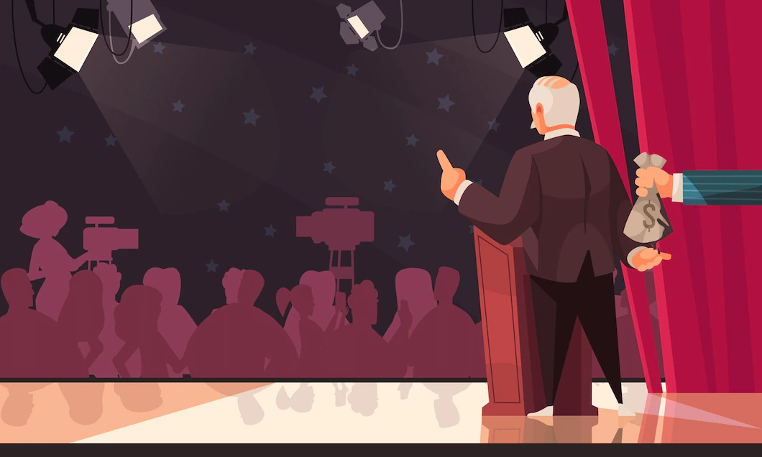
Representative Democracy: What Are The Pros And Cons?
Cons
Power Concentration: Power is vested in a few, potentially affecting the fairness of laws.
Legislative Bias: Risks of laws being skewed to benefit representatives or their circles.
Accountability Challenges: Representatives operate with significant autonomy between elections.
Delayed Response: Public may wait years to address grievances in the next election cycle.
Notes:
Picture source: <a href="https://www.freepik.com/free-vector/outlaw-dirty-money-secret-contributions-influence-election-process-cartoon-composition_16607620.htm">Image by macrovector</a> on Freepik

Slide 17
Group Activity
Activity Time!! (Worksheets)
Discuss the Types of Democracy:
Reflect on the specific form of democracy practiced in Cyprus.
Evaluate Pros and Cons:
What are the advantages and disadvantages of this system?
Analyse Strengths and Weaknesses:
Consider the strengths and weaknesses of representative democracy as it operates in Cyprus.

