Slide 1
Module 1 Democratic Ideals and Institutions
Unit 3: Challenges of Modern Democracy

Slide 2
Identifying Challenges of Democracy
Watch the following video.
Considerations:
What are the main challenges that democracy faces today?
Which do you consider the most important?
What we are doing as Citizens to overcome these challenges?

Slide 3
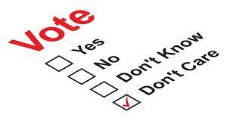
Challenges of Democracy: Political Apathy
Declining Election Participation
Decreased voter engagement in established democracies.
Impact of Apathy
Governments elected by minority, reflecting disinterest.
Lack of political understanding contributes to voter disengagement.
Consequences of Apathy
Hinders national development and law effectiveness.
Weakens checks and balances in governance.
Abstention as Expression
Non-voting as a deliberate political statement.
Notes:
Picture source: https://cite.org.zw/the-truth-reality-behind-voter-apathy-in-matabeleland/

Slide 4
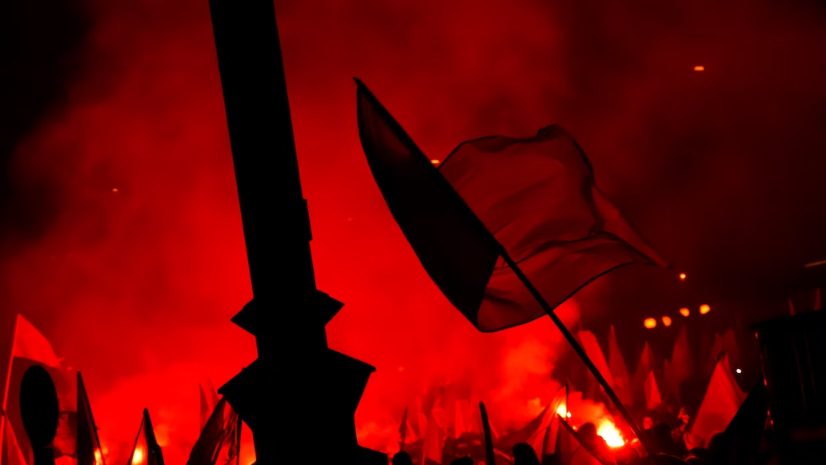
Challenges of Democracy: The Rise of Nationalism
“Democracy is best conceived as a process of democratization.”
Patomäkim,Teivainen
Impact on Democracy
Exploit nationalist sentiments against marginalized groups.
Target asylum seekers, refugees, and religious minorities.
Freedom of Expression
Potential need for restrictions in specific contexts.
Balancing expression with the gravity of issues.
Equality and Inclusivity
Denying political rights or suppressing minorities contradicts democracy.
Upholding democratic principles while addressing right-wing extremism.
Navigating Complexities
Balancing democratic values with human rights and inclusivity.
Notes:
Picture source: Photo by <a href="https://unsplash.com/@djmalecki?utm_source=unsplash&utm_medium=referral&utm_content=creditCopyText">Dawid Małecki</a> on <a href="https://unsplash.com/photos/cmJDHgN6Xjw?utm_source=unsplash&utm_medium=referral&utm_content=creditCopyText">Unsplash</a>

Slide 5
Challenges of Democracy
Overcoming polarization
It is important for democracy to have some partisan polarisation, but intense polarization is one of the leading causes of democratic decay in new and established democracies.
Political opponents begin referring to each other as existential enemies, allowing incumbents to justify abusing democratic norms in order to restrain the opposition, and encouraging the opposition to (re)gain power by whatever means necessary.
Politics polarization occurs when citizens remain loyal to a political party even when it violates key democratic norms.
Populism
Democracy is threatened by populism primarily because it can provide a moral status to the state that it does not otherwise possess.
As soon as the state becomes the embodiment of virtue, its defense mechanisms, such as freedom, checks and balances, the rule of law, tolerance, autonomous social institutions, individual and group rights, and pluralism, will become vulnerable. After oppressed people have been liberated, populism does not have a self-limitation programme.
The more relevant, negative aspect of populism in advanced democracies is that it erodes the respect for political opponents, minority groups, and erodes the culture of reasoned discussion.

Slide 6
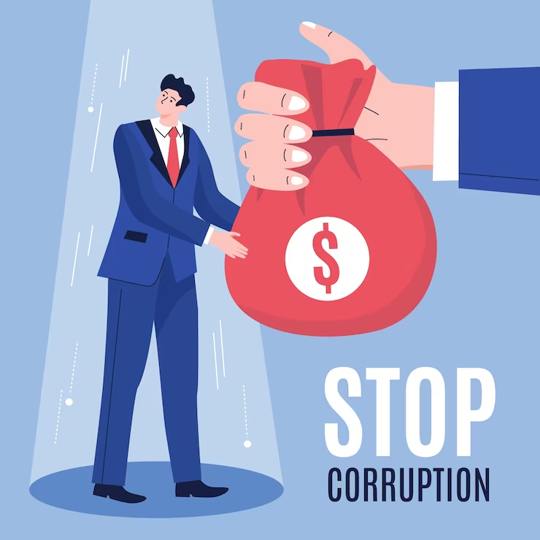
Challenges of Democracy
Immigration and the challenge of sustaining multi-ethnic democracies
Democracies of all types are challenged by multi-ethnic democracies. As ethnic diversity complicates redistribution politics, as well as immigration provoking right-wing populist backlash and exacerbated political polarization, both old and new democracies face dilemmas.
There is a possibility that party leaders on the right could use cultural diversity to gain power, thereby restricting and unequally representing ethnic minorities, thereby weakening democracy. Recently, parties on the left have been concerned about the compatibility of the welfare state with ethnic diversity because of this same politics
Corruption and Inefficiency
Corruption is when those in power engage in fraudulent or abusive activities that enrich themselves and their inner group at the expense of general public they are meant to serve.
Notes:
Picture source: Image by <a href="https://www.freepik.com/free-vector/hand-drawn-flat-anti-corruption-day-illustration_20549799.htm#query=Corruption%20a&position=1&from_view=search&track=ais">Freepik</a>

Slide 7
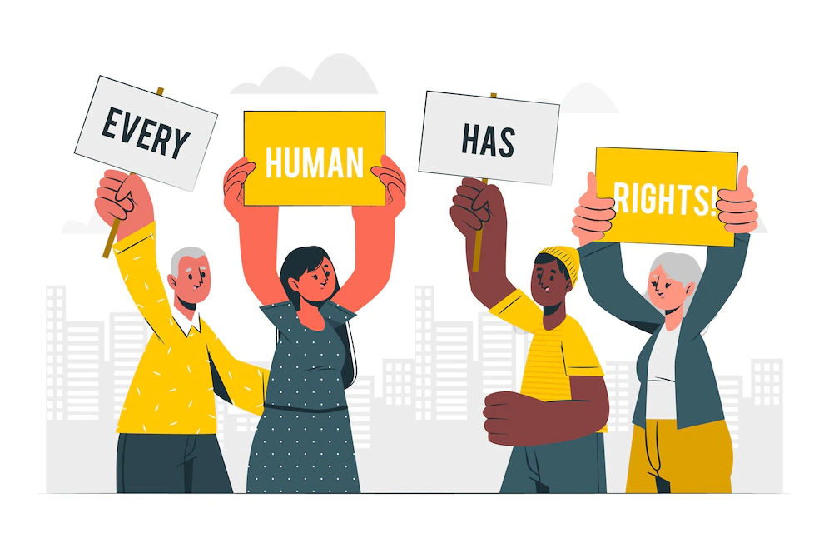
Challenges of Democracy: Human Rights Violations
Six Decades Later
Universal Declaration of Human Rights still largely aspirational.
Persistent global violations of individual rights.
Alarming Statistics
81 countries engage in torture or mistreatment.
Unfair trials prevalent in 54 countries.
Freedom of expression restricted in 77 countries.
Ongoing Struggles
Continued human rights violations worldwide.
Press freedom limitations; dissent often silenced.
The Need for Action
Significant gap between ideals and reality.
Global pursuit of human rights protection and promotion remains crucial.
Notes:
Picture source: <a href="https://www.freepik.com/free-vector/young-interracial-people-with-human-rights-label-vector-illustration-design_6360631.htm">Image by gstudioimagen</a> on Freepik

Slide 8
Challenges of Democracy: Terrorism and Democracy
Direct Threats
International terrorism poses a physical threat to civilians.
Democratic Dilemmas
Anti-terrorist legislation risks eroding civil and political freedoms.
Balancing security with the preservation of democratic values is crucial.
Intelligence Gathering
Requires cooperation with marginalized individuals.
Risk of further marginalization undermining effectiveness.
Repressive Measures
Repressive laws and militarization of police can be counterproductive.
Addressing underlying causes of terrorism is critical.
Promoting Inclusion
Inclusive societies and democratic principles key to combating terrorism.
Ensuring effective counter-terrorism while upholding democracy.

Slide 9
Challenges of Democracy in Cyprus
Activity Time!! [Worksheet]
Visit the websites ourworldindata.org and the Democracy Index 2021 to gather information about Cyprus.
Reflect on the data provided by these sources and combine it with your own knowledge and experience.
List and describe the key challenges facing democracy in Cyprus on this worksheet.

