Slide 1
Module 4 Understanding Active Citizenship & Civic Engagement
Unit 1: Citizenship and Key Citizenship Competences

Slide 2
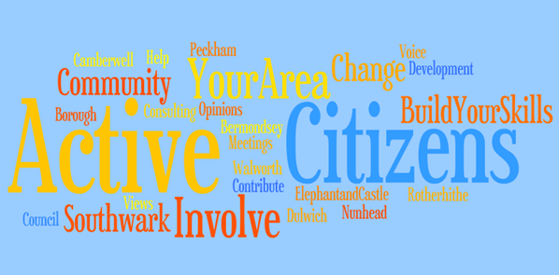
Introduction
Citizenship refers to membership of an individual in a group or community that involves certain rights and responsibilities.
Citizenship has been defined as a status in which a person has allegiance to a particular state and has the rights to participate in political, civil and social live on an equal basis other citizens.
Every community has had common understandings of who is a citizen. However, as communities have diversified, the notion of citizenship has had to change.
Notes:
Picture source: This Photo by Unknown Author is licensed under CC BY-SA-NC

Slide 3
What is Citizenship?
Get your devices (laptop or mobile) and access the internet
Search the term ‘Citizenship’
What did you find? What do you understand?
Notes:
Picture source: This Photo by Unknown Author is licensed under CC BY-ND

Slide 4
Historical Overview of Citizenship
The ancient Greeks first developed the concept of citizenship for property owners. But women, slaves, or people who had no property, i.e. the poorest members of society, were not considered citizens. Citizens in ancient Greece could vote, but they also had to pay taxes and serve in the military.
In the Roman era, there were two forms of citizenship: those who were residents of the city of Rome; those who were in territories that became part of the empire after being conquered.
The Middle Ages had a feudal system instead of the ancient concept of citizenship. People in Italy and Germany, for instance, were citizens to cities and towns. They came from the merchant or trading classes and thus were privileged over commoners.

Slide 5
Historical Overview of Citizenship
The American and French revolutions ushered in modern concepts of citizenship. In those new countries, a citizen was given constitutional freedoms while absolute monarchy was forbidden.
In England, a citizen originally referred to someone who belonged to a borough or local municipality. Individuals were also called ‘subject’, which referred to the fact that the monarch or king ruled over them. In modern British common law, subject is still used and more often than the word citizen, although they mean the same thing legally.
In the age of nation-states of Europe, the term citizenship has taken on new nuances. For example, a person was considered a citizen of their birthplace and not according to their family (Cesarini and Fulbrook, 2003).
Since the 1960s and 1970s, ethnic and minority groups have struggled for equal rights. As these groups have become more politically active and with the rise of international migration, the conceptions of citizenship and citizenship education have become complex. The new challenge is to design curriculum to cover subjects of democracy, social justice, and human rights (Banks, 2009).

Slide 6
Definitions
Marshall’s definition of citizenship has three elements: the civil; the political; and the social.
Civil citizenship includes freedom and liberty of speech and thought and the right to own property and the right to justice.
Political citizenship enables one to be politically active or seek political office in a council or other local office or in national parliament. Social citizenship means to be vested in rights for economic welfare and security. There is also a sense of common heritage and social standards of living (Marshall, 1991).

Slide 7
Citizenship as a legal term
Citizenship refers to the "relationship between an individual and a state to which the individual owes allegiance and in turn is entitled to its protection".
Citizenship implies the status of freedom with accompanying responsibilities. Citizens have certain rights, duties, and responsibilities that are denied or only partially extended to aliens and other noncitizens residing in a country. In general, full political rights, including the right to vote and to hold public office, are predicated upon citizenship. The usual responsibilities of citizenship are allegiance, taxation, and military service.
Each state determines the conditions under which it will recognize persons as its citizens, and the conditions under which that status will be withdrawn.

Slide 8
EU Citizenship
The Maastricht Treaty (1992) declared that anyone who is a citizen of a member state of the European Union is also a citizen of the European Union (EU).
Any person who holds the nationality of an EU country is automatically also an EU citizen. EU citizenship is additional to national citizenship and does not replace it.
EU citizens have four main Political Rights and Freedoms:
to move, reside and work freely within the EU territory;
to receive protection from the diplomatic authorities of any Member State when outside the EU;
to vote and stand for election at local and EU level in any Member State;
to participate in the EU legislative process, for example by petitioning the European Parliament; and organising/supporting a European Citizens’ Initiative (ECI).

Slide 9
The Charter of Fundamental Rights of the European Union
In 2007, the Lisbon Treaty strengthened EU citizenship by making the EU Charter of Fundamental Rights legally binding and by expanding the opportunities for democratic participation and increasing the visibility of EU citizen rights. But it is also about participation in and the feeling of belonging to the EU community.
The adoption of the Charter of Fundamental Rights of the European Union (CFR) enshrined specific political, social, and economic rights for EU citizens and residents. Title Five of the CFR focuses specifically on the rights of EU Citizens which include the following:
The right to vote and to stand as a candidate at elections to the European Parliament.
The right to vote and to stand as a candidate at municipal elections.
The right to good administration.
The right of access to documents.
The right to petition.
Freedom of movement and of residence.
Diplomatic and consular protection.

Slide 10
What about you?
How do you define CITIZENSHIP?

Slide 11
Reflection on Citizen Competences:
What do you believe are essential citizen competences?
You may use the internet.

Slide 12
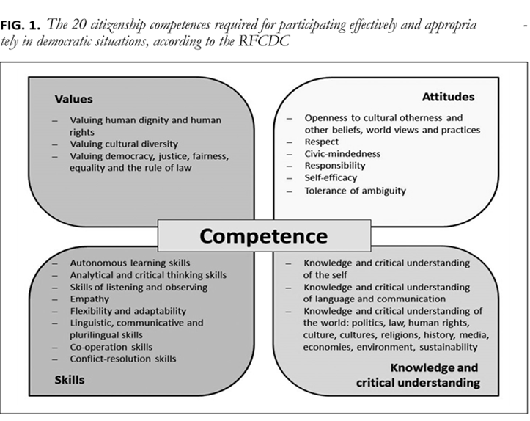
Key Citizens Competences - Council of Europe’s Reference Framework of Competences for Democratic Culture
There are 20 citizenship competences, according to the Council of Europe’s Reference Framework of Competences for Democratic Culture (RFCDC).
The Framework is a comprehensive conceptual model of competences that are deemed necessary for citizens to function in a democracy.
There are four categories of competences:
- Values
- Attitudes
- Skills
- Knowledge and critical understanding
Notes:
Text Source: Barrett (2016), Council of Europe

Slide 13
Summary Descriptions of the 20 Citizenship Competences
Values
Valuing human dignity and human rights. This means that all human beings have the same value and dignity. They are entitled to respect and the same human rights and freedoms as anyone else.
Valuing cultural diversity. This means that in the EU, everyone's culture is respected and diversity and pluralism are welcomed.
Valuing democracy, justice, fairness, equality and the rule of law. The EU values these values and expects the citizens to do so also.

Slide 14
Summary Descriptions of the 20 Citizenship Competences
Attitudes
Openness to cultural otherness and to other beliefs, world views and practices. In the EU, citizens should be open towards and inclusive of people of different cultural affiliations or who hold different beliefs from oneself. People who are open to others will be sensitive to and curious about others whom they engage with.
Respect. People must respect one another even if they have different cultural affiliations. This is because everyone has intrinsic value and importance. This competence is considered vital for effective intercultural dialogue and a culture of democracy.
Civic-mindedness. Civic-mindedness is a belief that one belongs to a community outside of one’s family or friends. It is an understanding that one act for the greater good of that community and is aware of how one’s actions influence other members of the community.

Slide 15
Summary Descriptions of the 20 Citizenship Competences
Attitudes
Responsibility. Everyone should take responsibility for their own actions, and they should act conscientiously and morally correct.
Self-efficacy. Self-efficacy is believing in one’s own ability to do whatever is necessary to meet an objective. People who have this competence are confident about their ability to control their behaviour and social environment.
Tolerance of ambiguity. Being tolerant of ambiguity is a competence where one can function in uncertain or conflicting situations. People who are tolerant of ambiguity tend to see positive aspects in these situations.

Slide 16
Summary Descriptions of the 20 Citizenship Competences
Skills
Autonomous learning skills. People need to have autonomous learning skills so that they can organise their own learning when it is necessary. Being able to learn in a self-directed manner is an essential skill for life-long learning.
Analytical and critical thinking skills. This is the skill to be able to analyse information carefully before making a judgement. It is a systematic type of reasoning.
Skills of listening and observing. Listening is the ability to pay attention carefully to what is being said and how it is being said and interpret, respond and reflect on the utterance. Observing skills are the ability to carefully notice details about people or the environment to have better understanding about how to respond.
Empathy. Empathy is the ability to place oneself in someone else’s situation and understand their perspectives.

Slide 17
Summary Descriptions of the 20 Citizenship Competences
Skills
Flexibility and adaptability. One who is flexible or adaptable can change their attitude or behaviour to accommodate demands or a new situation. Adaptability also implies an ability to anticipate needing to change, whereas flexibility connotes more immediate reaction to situations.
Linguistic, communicative and plurilingual skills. It is important to be able to communicate with people who speak the same or other languages. Being able help speakers of two different languages communicate together by acting as a mediator between them is a very important skill.
Cooperation skills. People must be able to work together on a task or project by sharing their skills and knowledge to successfully achieve group goals.
Conflict-resolution skills. Being able to resolve disagreements, arguments, or other conflicts between individuals or groups in a peaceful way is an important competence. It is crucial to find solutions that everyone will accept.

Slide 18
Summary Descriptions of the 20 Citizenship Competences
Knowledge and critical understanding
Knowledge and critical understanding of the self. This competence involves one being able to describe one’s motivations and understand what influences his/her behaviour. It also includes critically reflecting on how one’s thoughts, beliefs, feelings and motivations influence others, and how one’s own cultural affiliations influence his/her perspective on the world.
Knowledge and critical understanding of language and communication. This includes understanding how non-verbal cues affect communication. More advance evidence of the competence is when one understands in which social context to use different styles of communication and when one can assess why communication break down. It is also important to understand how every language expresses culturally shared meanings in a unique way.
Knowledge and critical understanding of the world. People with this competence are aware of basic differences in cultural practices. They know that, although cultures and religions are not heterogeneous or static, it is still important to understand how those can influence a situation, especially in intercultural interactions.

Slide 19
Key competences for lifelong learning
Citizenship competence is the ability to act as responsible citizens and to fully participate in civic and social life, based on understanding of social, economic, legal and political concepts and structures, as well as global developments and sustainability.
Essential knowledge, skills and attitudes related to this competence
Knowledge
A person who has citizenship competence has an understanding of the European common values of human dignity, freedom, democracy, equality, rule of law, and human rights.
An active citizen will know about things that are happening locally, regionally and throughout the world. The person should have a critical understanding of the main developments in national, European and world history.
Citizen competency includes an awareness of social and political trends, as well as of sustainability goals related to climate and the effects of demographic changes around the world.
A competent EU citizen should know about European integration and cultural diversity in Europe and the world. They should understand that European identity if formed from sum of national cultural identities.

Slide 20
Key competences for lifelong learning
Skills
• A competent citizen is able to cooperate with others in pursuit of common or public interest, including the sustainable development of society.
• The competent citizen should have. critical thinking and problem solving skills, as well as communication and negotiation skills to participate in activities at the local, national, European and international levels.
• The competent citizen should understand the value or use of different forms of media and how access them.
Attitudes
• The competent citizen respects human rights as a basis for democracy. The person should be willing to participate in democratic decision-making at all levels and in civic activities.
• The competent citizen supports social and cultural diversity, gender equality and social cohesion, sustainable lifestyles, promotion of culture of peace and non-violence, a readiness to respect the privacy of others, and to take responsibility for the environment.
• The competent citizen is interested in political and socioeconomic developments. The person will also strive to become better at intercultural communication to overcome prejudices, to be more flexible and adaptable, and to work towards social justice and fairness.

Slide 21
Worksheet Activity: Identify Citizens Competences
Each learner should work individually.
Select two citizens competences from each category (Values, Attitudes, Skills, knowledge, and critical understanding) that you want to improve.
You have 10 minutes to select in total 8 competences and include the reasoning (why).

