Slide 1
Module 6 Cypriot Active Citizens
Unit 2: How to Set Up an NGO in Cyprus

Slide 2
Learning Objectives
Upon the completion of this learning unit, learners will be able to:
• Gain knowledge about the necessary steps, paperwork, and compliance procedures required to establish an NGO in Cyprus
Notes:
Picture source: https://www.flaticon.com/free-icon/cyprus_303032

Slide 3
Step 1: Find Your Interest
Find a cause that interests you
Do your research, gather information
Identify the problem you want to solve
Get experience in the field
Notes:
Picture Source: https://www.who.int/news/item/10-12-2020-statement-from-the-civil-society-track-of-the-3rd-global-infodemic-management-conference

Slide 4
Step 2: Create Your Team
Who will help you?
Identify possible partners and supporters
Who do you want to work with?
Fill the positions on you board (e.g. president, treasurer, committee members)
Notes:
Picture Source: https://blog.vantagecircle.com/teamwork-and-team-building/

Slide 5
Step 3: NGOs Goals and Objectives
Set a realistic goal towards which you can work in your NGO
Write everything down
Be specific and work towards your cause
Define a motto, slogan, vision statement
Notes:
Picture Source: https://intermountainhealthcare.org/blogs/topics/live-well/2023/04/effective-goal-setting-using-the-smart-method/

Slide 6
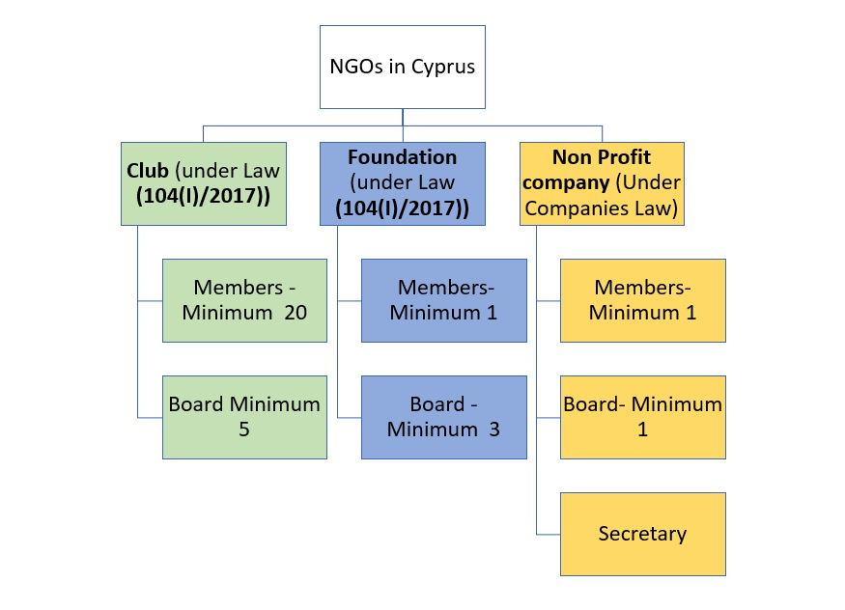
Step 4: Legal Requirements
Notes:
Picture Source: https://www.lawyer.com.cy/category/company-and-corporate-mattters/page/2/

Slide 7
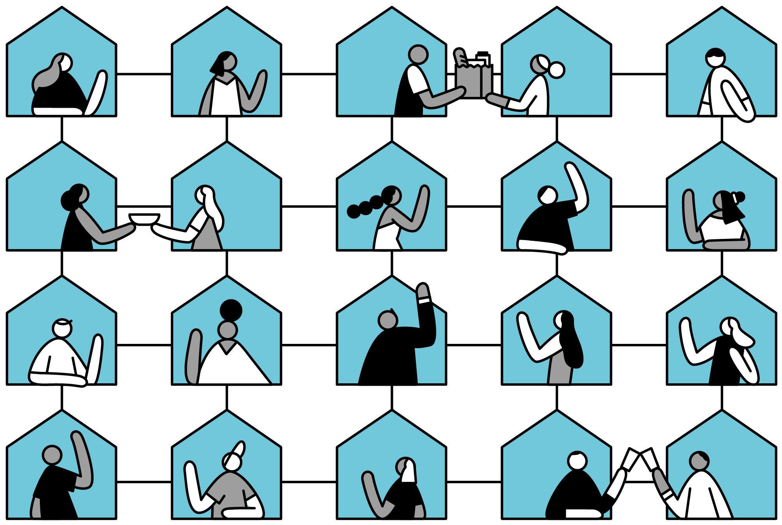
Step 4: Legal Requirements (Register a New Association)
Obtain the application forms that are required by the current regulations, from the Ministry of Interior in the District Office you are based in, or the Ministry of Interior’s website.
Obtain the names and signatures of at least twenty (20) founding members.
Appoint/Vote the Board of Directors, which should consist of at least five founding members.
Compose your Articles of Association, which should include as a minimum what the Law requires (Article 8).
Submission of documents to the District offices.
Notes:
Picture Source: https://www.nytimes.com/2020/06/06/smarter-living/how-to-start-a-neighborhood-association.html

Slide 8
Step 4: Legal Requirements (Register a New Foundation)
The main requirement for the establishment of a foundation is the Founding Act. The Founding Act may be produced either through a legal act of donation—when the property owner (the founder) is alive - or through a legal document detailing the founder’s future wish, such as a will. Through the Founding Act, the founder transfers the dedicated funds or property to the foundation, thus ensuring its operation and the implementation of its objectives.
Obtain the application forms that are required by the current regulations from the Ministry of Interior, the District office you are based in, or the Ministry of Interior’s website.
Prepare and sign all the relevant documents.
Submission of documents to the District offices.
Notes:
Picture Source: https://www.nytimes.com/2020/06/06/smarter-living/how-to-start-a-neighborhood-association.html

Slide 9
Step 4: Legal Requirements (Register a New Federation and/or Union Org)
Obtain the application forms that are required by the current regulations, from the Ministry of Interior in the District Office you are based in, or the Ministry of Interior’s website.
Obtain the names and signatures of at least twenty (20) founding members.
Appoint/Vote the Board of Directors, which should consist of at least five founding members.
Compose your Articles of Association, which should include as a minimum what the Law requires (Article 8).
Submission of documents to the District offices.
Notes:
Picture Source: https://www.nytimes.com/2020/06/06/smarter-living/how-to-start-a-neighborhood-association.html

Slide 10
Step 4: Legal Requirements (Register a Non Profit Organization)
All Cyprus Companies, including non-profit ones, are regulated by the Companies Law (Cap.113).
Non-profit companies are subject to the same requirements as for-profit companies (i.e. audited accounts, annual levy etc.). The Competent Authority for the registration is the Registrar of Companies.
Notes:
Picture Source: https://www.nytimes.com/2020/06/06/smarter-living/how-to-start-a-neighborhood-association.html

Slide 11
Step 5: Take Care of Funding
Identify ways to finance your NGO: e.g. donations, grants, crowdfunding
Ask for help
Establish a budget for your NGO
Raise enough money to start your work
Notes:
Picture Source: https://www.nytimes.com/2020/06/06/smarter-living/how-to-start-a-neighborhood-association.html

Slide 12
Group Activity (Worksheet)
SETTING UP YOUR OWN NGO!
Notes:
Picture Source: https://hover.blog/how-to-lead-an-effective-brainstorm-with-your-team-or-just-you/

