Slide 1
Module 2 Strategic Planning
Unit 1: Introduction to Strategic Planning

Slide 2
Overview
This module aims to introduce to the learners the process of Strategic Planning CSOs and enable them to guide or contribute to the development of a Strategic Plan for their own CSO.
Upon completion of this unit participants should be able to:
Define Strategic Planning for Civil Society Organizations (CSOs)
Recognise the benefits and prominence of Strategic Planning for organizational sustainability, as well as, its challenges
Outline the competent actors that ought to be involved in Strategic Planning
Identify and utilise relevant tools for Strategic Planning
Fathom the key principles of Strategic Planning
Develop a Strategic Plan for their unique organisational structures
Notes:
Image Source: https://www.freepik.com/free-vector/youth-empowerment-abstract-concept-vector-illustration-children-young-people-take-charge-take-action-improve-life-quality-democracy-building-youth-activism-involvement-abstract-metaphor_11668194.htm#query=community

Slide 3
Defining Strategic Planning for an CSO
Brainstorming Activity:
What do you think Strategic Planning is?
What do you think the difference is between a corporate Strategic Plan and a CSO Strategic Plan?

Slide 4
Defining Strategic Planning for a CSO
A strategic planning process identifies strategies that will enable a non-profit organisation to advance its mission. Ideally, it entails measurable goals, approved priorities for implementation, and make a plan to revisit the strategy on an ongoing basis as the internal and external environments shift (National Council of Nonprofits).
Strategy involves setting an objective, the actions required to meet the objective mapped against the necessary resources needed to execute the objective. At its core strategic planning is the process of defining the goals of your organization for the future and the strategies by which these goals will be achieved and resourced (Conscious Governance).
Strategic planning is the ongoing process of using available knowledge to document an organisation’s intended direction. This process is used to prioritise efforts, effectively allocate resources, align shareholders and employees on the organisation’s goals ensuring that these goals are a product sound reasoning (Harvard Business School).
Strategic planning is the process of creating a vision of the desired future for the organisation, translating this into broad goals which are then further broken down into a series of steps ultimately resulting in the achievement of the vision. Although strategic planning will include an assessment of where the organisation presently stands, it is important to start with the ideal future for the organization and work backwards (Leading Governance).

Slide 5
Defining Strategic Planning for an CSO
Vision
Long-Term Competitive Advantage
Mission
Strategic Planning
Action Plans
Objectives
Strategies
Watch this video and comment

Slide 6
The Importance of Strategic Planning
Brainstorming Activity:
What do you think the benefits of Strategic Planning are for a CSO?
How can Strategic Planning distinguish a successful CSO from a less successful or an unsuccessful CSO?

Slide 7
The Importance of Strategic Planning
Clarity
While a clear direction may exist anyway, writing it down enables it to be better understood by partners, donors, staff and trustees. This is especially useful when people in the organisation frequently leave or new ones join (turnover). Strategic planning provides all the representatives with clear destinations and bearings to the future of the organization. The vast majority perform better (in quality and amount) in the event that they realize what is anticipated from them and where the organization is headed at.
Notes:
Image Source:
https://www.constructionexec.com/article/leverage-strategic-planning-to-ensure-your-workforce-thrives-in-2020

Slide 8
The Importance of Strategic Planning
An Honest Image of the Organizational Functioning
Strategic planning entails collecting statistics and knowledge on the company's internal and external operational environments by identifying internal capabilities and what characterizes the organisation in terms of strengths and weaknesses, opportunities and threats. As a result, the knowledge collected is analysed and synthesized in accordance with the organisational vision. Strategic planning is a process of reflection and careful consideration in which multiple options are weighted in before a final course of action is chosen.
Notes:
Image Source:
https://www.google.com/search?q=strategic%20planning&tbm=isch&tbs=rimg:CZUJ5JSOTO9WYf9JpdLM5hUTsgIRCgIIABAAOgQIABAAVbZAiD7AAgDYAgDgAgA&rlz=1C1GCEA_enCY1043CY1043&hl=en&sa=X&ved=0CBoQuIIBahcKEwigyMipsIuAAxUAAAAAHQAAAAAQBg&biw=1903&bih=912#imgrc=cR8SCb4PqPJ06M

Slide 9
The Importance of Strategic Planning
Sense of Shared Responsibility - Cohesion
A strategic plan offers both the much-needed foundation from which an organisation can grow but also helps create a sense of collaboration and collective responsibility. When everybody has a sense of a purpose in their role within the greater organisation, they tend to be more invested in their outcomes.
Managing Expectations and Bolstering Trust
A strategic plan increases transparency which helps build trust and eliminate ambiguity inside the organisation and among key stakeholders. Strategic planning is beneficial because it creates more opportunities for collaboration across teams. Working together to see what each department is doing improves trust in the overall direction of the organisation. Because so much of strategic planning refers to determining organizational goals, this helps set expectations across the different areas of your organization, and improves the overall functioning of the company. Lastly, it serves as a basis against which to measure progress.
Notes:
Image Source:
https://cater2.me/blog/page/3/

Slide 10
The Importance of Strategic Planning
Responding to Challenges - Environmental Shifts
Many organisations spend most of their time realising and reacting to unexpected changes and problems instead of anticipating and preparing for them (crisis management). Organisations caught off guard may spend a great deal of resources in catching up. They use up their energy coping with immediate problems with little energy left to anticipate and prepare for future challenges. This vicious cycle locks many organizations into a reactive posture. Organisations taking a proactive strategic approach have better service delivery than those taking a reactive strategic approach.
Notes:
Image Source:
https://www.google.com/search?q=strategic%20planning&tbm=isch&tbs=rimg:CZUJ5JSOTO9WYf9JpdLM5hUTsgIRCgIIABAAOgQIABAAVbZAiD7AAgDYAgDgAgA&rlz=1C1GCEA_enCY1043CY1043&hl=en&sa=X&ved=0CBoQuIIBahcKEwigyMipsIuAAxUAAAAAHQAAAAAQBg&biw=1903&bih=912#imgrc=k5KZ0-weK47M0M

Slide 11
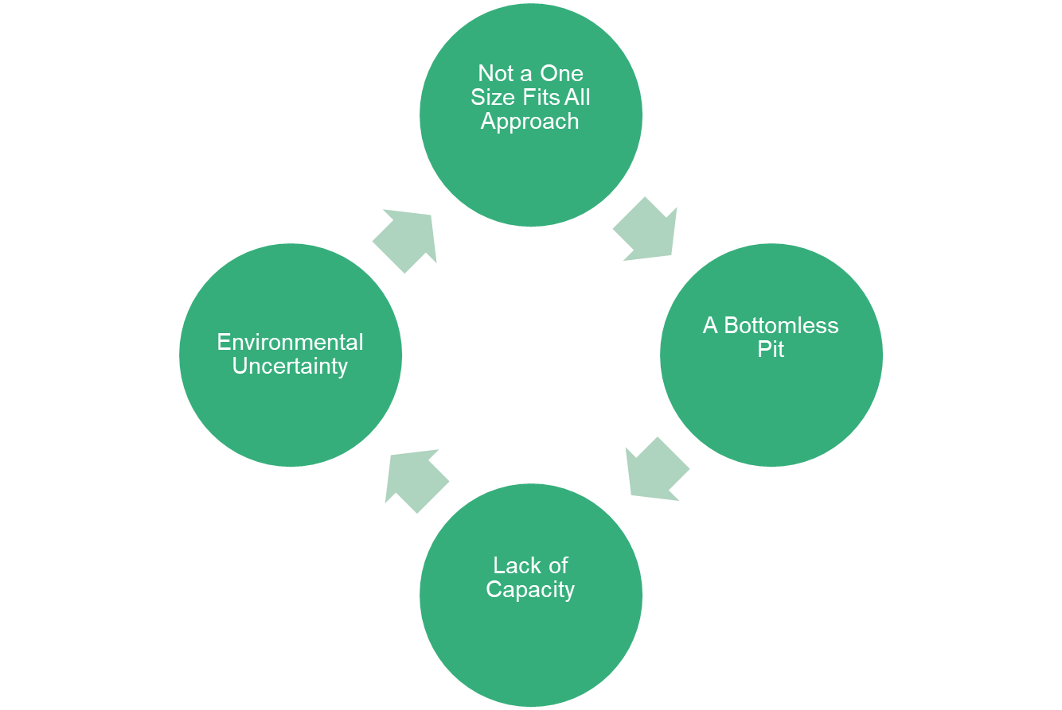
Limitations of Strategic Planning
Notes:
Notes:
Not a One-Size-Fits-All Approach
A frequent approach of increasing performance in non-profits is to adopt one or more of the methods and techniques used in the private sector. However, the operational differences that exist in non-profits as opposed to private sector businesses, as well as, the lack of qualified management-level personnel do not permit for such an approach. Even within the CSO field, strategic planning and management approaches need to be tailored to the specific characteristics of the entity.
Lack of Capacity
Management of CSOs is generally poor with few organisations using recommended tools and little effort is made to measure performance - partly due to the intangibility of the services being provided. Favoured sophisticated financial management techniques used in the private sector are largely ignored by non-profits due to the lack of awareness and training in this area.
A Bottomless Pit
Strategic planning for CSOs and NGOs is often proven to be challenging as they encounter a non-exhaustive list of interconnected issues which they need to be prioritised and attended to. Strategic planning should make realistic and often hard decisions about the direction of the organisation.
Environmental Uncertainty
Strategic planning requires predicting the future - something impossible to do perfectly especially in turbulent global environments. Developing a robust, yet flexible, strategic plan is a rather challenging endeavour. At the same time, planning and setting concrete objectives can be risky as CSOs are largely dependent on external stakeholders funding.

Slide 12
The Importance of Strategic Planning
Brainstorming Activity:
How can CSOs potentially counter these challenges to Strategic Planning?

Slide 13
Who should be involved in Strategic Planning for CSOs? (ACTIVITY)
Step 1:
The participants will work in groups to identify and list the actors whose involvement is considered vital in the Strategic Planning process
Step 2:
When doing so discuss and agree among your groups on the desired degree and nature of involvement of their chosen actors
Step 3:
Each team will present their findings and a brief discussion will follow

Slide 14
The Importance of Strategic Planning
Participation creates a sense of ownership in the process of strategy development and ownership encourages commitment. Broader participation leads to the creation of a better, more knowledgeable workforce: increased participation and usage of employees’ ideas communicates confidence in participants’ abilities, making them more creative and motivated to perform well.
Commitment to the strategy makes its achievement more likely. If all employees are aware and participate in the desired future outcomes of the organisation, they are more likely to take actions that will lead to the achievement of the objectives.
It is both a top-bottom and a bottom-up process!
EVERYONE SHOULD BE INVOLVED IN THE STRATEGIC PLANNING PROCESS!
Notes:
Image Source:
https://www.pvblic.org/post/importance-of-strategic-planning-ngos

