Slide 1
Module 2 Strategic Planning
Unit 2: Tools and Principles for CSO Strategic Planning

Slide 2
Tools for CSO Strategic Planning
Brainstorming Activity:
Have you ever used any planning or Strategic Planning tools?
What are they and how did you utilise them?

Slide 3
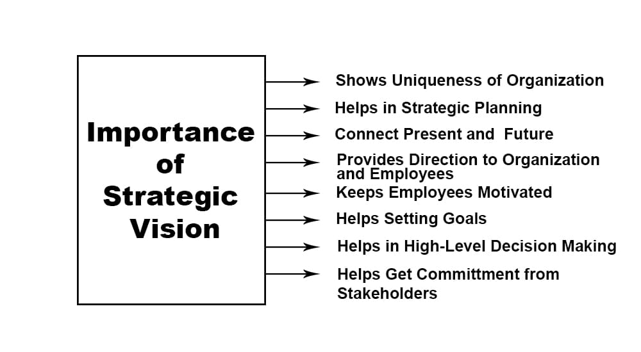
Tools for CSO Strategic Planning
Visioning
The vision of an organisation is the most important piece of foundation that guides all its further plans and prospects. Visioning starts with brainstorming which gradually leads to the long-term visualization, as desired by the organisation. Visioning answers basic questions such as:
what does the organisation want to achieve in future?
what it shall look like?
what image should build in the minds of its prospects and who shall be the potential customers?
Notes:
Image Source:
https://parsadi.com/strategic-vision/

Slide 4
Tools for CSO Strategic Planning
Overall, visioning gives a futuristic revelation to the organisation’s present image and standing. Organisational leaders look back to the vision and design their statement accordingly in order to have a realistic approach for the organisation. The vision statement should be expressive and well drafted so that it appeals to people and at the same time give a direction to the NGO.
Notes:
Image Source:
https://parsadi.com/strategic-vision/

Slide 5
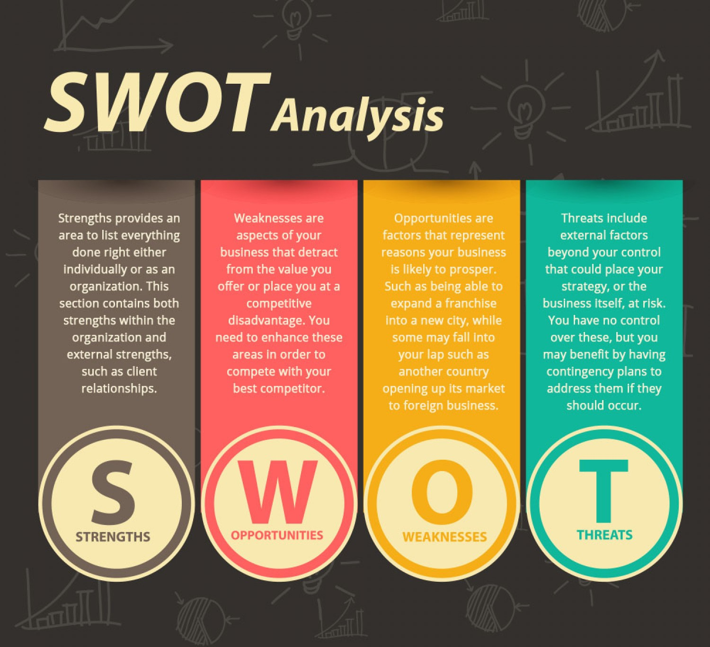
Tools for CSO Strategic Planning
SWOT Analysis
A SWOT analysis is a framework to help assess and understand the Strengths, Weaknesses, Opportunities, and Threats. Whereas strengths and weaknesses are internal factors which assert a relative advantage (or disadvantage) to an organization over its competition, opportunities and threats are elements of the external environment that management can seize upon to improve performance.
CSOs and NGOs may use the information gained from a SWOT analysis to determine which tasks are more important for meeting their goals and objectives. This can help the organisation plan for the future and determine which tasks to assign team members.
Notes:
Image Source:
https://www.giveffect.com/nonprofit-resource-center/volunteer-management-software-swot-analysis/

Slide 6
Tools for CSO Strategic Planning
PESTLE Analysis
NGOs are often subject to external factors which can have a significant impact on their operations. Therefore, strategic planning for NGOs should involve assessing these external factors and developing strategies that are flexible enough to adapt to changes in the external environment.
A PESTLE analysis studies the key macro-level external factors (Political, Economic, Sociological, Technological, Legal and Environmental) that influence an organisation. It can be used in a range of different scenarios, and can guide people professionals and senior managers in strategic decision-making. By conducting research analysing those factors, organisations can assess any risks specific to their industry and organisation, and make informed decisions.
The application of PESTEL analysis can help CSOs identify the major external environmental forces that shape the strategy and competitive landscape and support its strategic decision-making process. As Civil Society looks to expand and leverage its competencies and core capabilities, conducting the PESTEL analysis is imperative for developing effective strategies and achieving long-term growth objectives.
Notes:
Image Source:
https://www.cubic.id/journals/penerapan-pestle-analysis-dalam-perencanaan-strategi-lingkungan-eksternal-startup

Slide 7
Tools for CSO Strategic Planning
Hedgehog Concept
The hedgehog concept is created to produce the best long-term results and distinguish the key chances from the unqualified opportunities. It the intersection of three circles: 1. what you are deeply passionate about 2. what you can be the best in the world at and 3. what best drives your economic or resource engine. Transformations from good to great come about by a series of good decisions made consistently with a Hedgehog Concept. The hedgehog concept is of particular significance in the social sector due to the complexity of the social sector where success is measured by brand reputation built upon tangible results and emotional connection instead of financial success. At the same time, it is an effective tactic against the danger of the bottomless pit.
Notes:
Image Source:
https://www.sloww.co/infographics/

Slide 8
Principles of Strategic Planning for CSOs
Communication - Collaboration: A good strategic plan provides a collectively developed road map for achieving an organisation’s vision. Identifying and involving key stakeholders and employees from the offset of the planning process, as well as maintaining consistent lines of communication with them is critical.
Transparency: Openness in the strategic planning process is as important as communication and accountability. No part of the planning process should take place behind closed doors. Effective strategic planning is both a ‘bottom-up’ and a ‘top-down’ process.
Flexibility: Strategic planning is a dynamic and continuous process. Successful strategic plans are adjustable and responsive to environmental and conditional changes. A strategic plan must be a living document which can adapt to the fast-changing environment in which NGOs work in.

Slide 9
Principles of Strategic Planning for CSOs
Specificity: With strategic planning, setting specific priorities is an important step in achieving strategic objectives. Without sufficient specificity in central elements of the plan such as strategies and action plans, an organization risks producing a long list of ambitious objectives with no clear picture of how to implement them.
Assessment: Assessment is one of the most important but one of the most frequently overlooked aspects of planning, especially among CSOs where success is not always measurable. Assessment of outcomes and achievements is an obvious necessity but assessment should be emphasized throughout the process. It is critical that every goal (and accompanying strategies and action plans) is written in such a way that measurability is feasible.
Leverage Strengths: Understanding what is driving success in an organization is essential to maintaining its sustainability. By balancing that with innovation it will reinforce the core and expand to new opportunities that leverage strengths and capabilities.

Slide 10
Principles of Strategic Planning for CSOs
Brainstorming Activity:
Why do you think these principles should guide the Strategic Planning process?
Can you think of any other principles that should guide the Strategic Planning process?

Slide 11
Principles of Strategic Planning for CSOs (ACTIVITY)
Step 1:
The participants will work in groups to groups to identify an organization that they believe conforms to the prescribed principles.
Step 2:
Participants are encouraged to utilise their devices and search online.
Step 3:
Each group will present their findings and demonstrate their reasoning for the choice they have made.
Notes:
Images Source:
https://lucidspark.com/blog/the-pitfalls-of-strategic-planning

