Slide 1
Module 2 Strategic Planning
Unit 3: Steps for Strategic Planning for CSOs

Slide 2
Steps for Strategic Planning
Brainstorming Activity:
What do you think the process of Strategic Planning for a CSO consists?
What is a Strategic Plan comprised by?

Slide 3
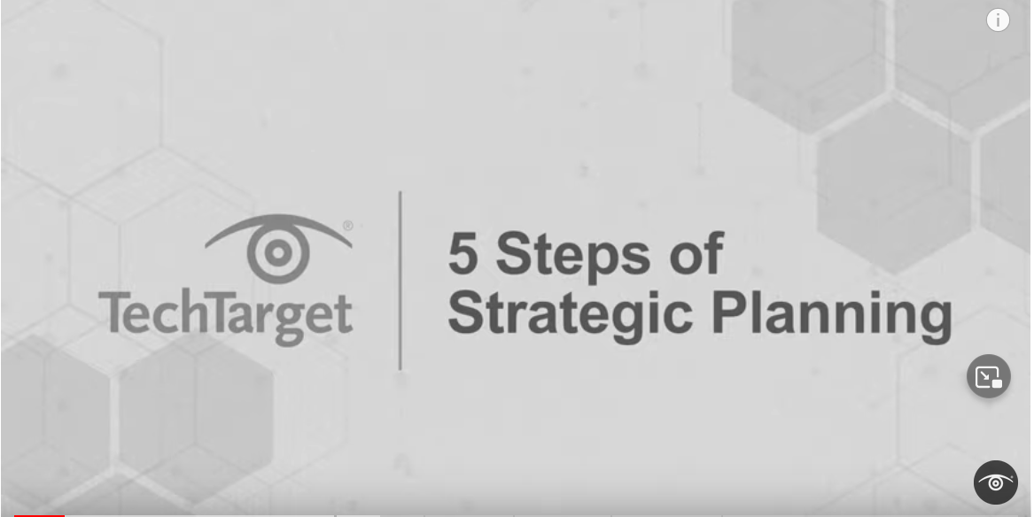
Steps for Strategic Planning
Watch this video and comment

Slide 4
Steps for Strategic Planning
Get Organized
Review and Update the Strategy
Gather Information
Steps for Strategic Planning
Implement, Monitor and Evaluate Progress Against Strategy
Analyze the Information Gathered and the Key Issues and Make Strategic Choices
Resource Planning
Develop Strategic Priorities
Develop a Monitoring Evaluation and Learning (ME&L) Plan

Slide 5
Steps for Strategic Planning
Step1: Get Organised
By the end of the process the CSO needs to have a comprehensive understanding of the context that informs the strategic planning process. This is achieved by looking outwards, as well as, inwards:
The outward-looking process involves a thorough understanding of the external-environmental context over the past few years alongside the opportunities and threats that arise as a result of it.
The inward-looking process involves establishing a clear understanding of the vision, mission and values of the organisation. It also involves reflecting on the strengths and weaknesses encountered by the organisation, as well as, the challenges that were met with success or those that the CSO failed to meet.
Step 2: Gather Information
Carry out a Situational Analysis; The strategic planning process is an excellent opportunity to gather the views and wishes of the CSO’s constituents. Acknowledging the different views of the stakeholders during the process of strategy development can legitimise the process. It is critical that these voices are clearly heard in a meaningful but cost-effective way.
It is also important the board is involved from the outset with the degree of involvement depending on the situation. Ultimately, the board has to approve the strategy, but this does not mean that they have to develop it themselves. Nevertheless, there is a risk that if the board is too distant from the realities on the ground, they will remain out of touch which could adversely affect the strategic plan.

Slide 6
Steps for Strategic Planning
Step 3: Analyse the Information Gathered and the Key Issues and Make Strategic Choices
In order to develop a strategic plan a CSO must begin by developing its parameters. There are certain parameters that define or limit what it can and cannot do, based on what it can (and cannot) do well. A strategic plan enables a CSO to work within its agreed parameters that are defined by its understanding of the problems it aims to address, and what causes them. These parameters will be defined by:
The Problem Analysis
The Stakeholders
The CSO’s distinctive competencies
The CSO’s competitive advantage
The CSO’s Values
Access to Resources
Risks - Critical Issues
Step 4: Develop Strategic Priorities
With the groundwork done, the CSO is ready to develop the content of the strategic plan, by developing the ‘strategic framework’ which includes:
A clearly stated vision
Clearly articulated values
A clear mission statement (this should fit with the Values and the Vision of the CSO and should address the key needs of its constituents)
The overall goal of the CSO (Impact)
Key Result areas (Objectives/Outputs) of the CSO (these should be SMART, in order for progress to be monitored and measured
Outline the gaps between where the CSO is now and where it needs to be

Slide 7
Steps for Strategic Planning
Step 5: Develop a Monitoring Evaluation and Learning (ME&L) Plan
The purpose of an ME&L plan is to encourage the project or programme staff to think clearly about what they intend doing in the way of ME&L before implementation of a project or a programme begins, and to ensure those plans are adequately documented. The ME&L Plan should provide the collection of indicators against each of the statements in the strategic framework. This should ensure that firm plans are in place to monitor progress by collecting information based on the indicators.

Slide 8
Steps for Strategic Planning
Step 6: Resource Planning
It is important for CSOs to continually reassess their ability to generate funding - adapting their fundraising approaches and introducing new income streams where possible. CSOs are encouraged to develop a Fundraising Strategy to focus their cause:
Step 1: Provide an engaging reason as to why a donor should support an organisation
Step 2: Decide on the sources of funds a CSO will focus on. Ideally this should be a mixed portfolio so there is no dependency on any single source
Step 3: Structure fundraising
Step 4: Identify the specific donors a CSO plans to target. The key here is to explain how to go about finding donors and supporters that will have a reason to support a CSO. It is important to gain a clear understanding of the donors' interests (relevance)
Step 5: Create a proposition and demonstrate how the CSO will match its needs with the donors interests focusing on the long-term change their donation can make
Step 6: Approach donors by organising events or by writing to them. Crowdfunding may be another opportunity to fundraise for a specific tailored activity. Often a personal approach has a greater chance of success.
Step 7: Think about how to build long-term relationships where possible, reporting back on progress and the difference their contribution has made, continuing to involve donors in the CSO where possible.

Slide 9
Steps for Strategic Planning
Step 8: Review and Update the Strategy
Based on an agreed timeframe, it is recommended that the CSO holds a 1–2-day(s) session with staff and key stakeholders to review the progress of its strategy towards its agreed objectives. This is an opportunity for the CSO to revise its approach and plans. Additionally, an annual review against its strategy is a very useful exercise for the CSO where the strategic can be amended based on learning in a controlled and planned way.
Step 7: Implement, Monitor and Evaluate Progress Against Strategy
During the process of implementation, monitoring and progress evaluation, gathering information to report progress including learning, and evidence of change that can directly be attributed to its actions can enable adjustments and modifications

Slide 10
Steps for Strategic Planning | Worksheet
Step 1:
The participants will work in groups in order to discuss how these steps can be incorporated in their existing practices and existing Strategic Plans (if they exist).
Step 2:
Each team will share their findings and conclude on how they could potentially move forward.

