Slide 1
Module 3 Organisational Management
Unit 2: Controlling and Organizing

Slide 2
Overview
This module aims to contribute to the learners’ knowledge about the available controlling and organizing tools for the CSO sector.
Upon completion of this unit participants should be able to:
Understand the different available types of controlling and organising structures
Distinguish the best appropriate controlling and organising structure for the CSO
Choose and adopt the most appropriate controlling and organising structure to the CSO

Slide 3
Defining the Controlling Structures (CSO)
Watch this video and discuss the below questions:
What are the types of controlling structures in management?
What are the pros and cons of them?
What suits best to your environment?
What is the span of control?

Slide 4
Defining the Controlling Structures (CSO)
"Organizing is what you do before you do something,
so that when you do it, it is not all mixed up."
A.A. Milne
Notes:
https://www.brainyquote.com/quotes/a_a_milne_121656

Slide 5
Defining the Controlling Structures (CSO)
The Organising function can be defined as the process of creating a structure of relationships that enable employees to carry out management’s plans and meet organisational goals.
Its responsible for the interrelationships between the other functions; planning, control and leadership in finding the right ‘fit’ in order to reach the organisation’s strategy.
Organising is the process of gearing up to implement decisions that result from the planning process.
Organising involves delineating tasks and establishing a framework of authority and responsibility for the people who will perform these tasks It also involves analyzing the workload, distributing it among employees, and coordinating the activities so that work proceeds smoothly.
Notes:
Develop a clear mission statement: A mission statement outlines the purpose of your organization and the impact it wants to make. It provides a clear direction and helps to keep everyone focused on the same goal.
Establish a strong leadership team: A strong leadership team can help to steer the organization in the right direction and ensure that everyone is working towards the same goal. Good leaders are also essential for motivating and inspiring others.
Define roles and responsibilities: Each member of the organization should have a clearly defined role and responsibility. This helps to ensure that everyone knows what is expected of them and avoids duplication of efforts.
Develop policies and procedures: Policies and procedures help to ensure that everyone is following the same rules and guidelines. This can help to avoid conflicts and ensure that everyone is working towards the same goal.
Monitor and evaluate performance: Regular monitoring and evaluation of performance can help to identify areas that need improvement and ensure that everyone is working effectively towards the organization's goals.
Build partnerships and networks: Building partnerships and networks with other organizations can help to leverage resources and expertise, as well as increase the organization's visibility and impact.
Use technology effectively: Using technology effectively can help to streamline processes, improve communication, and increase efficiency.
Picture Source: https://www.freepik.com/free-vector/technical-support-programming-coding_11669310.htm#from_view=detail_author

Slide 6
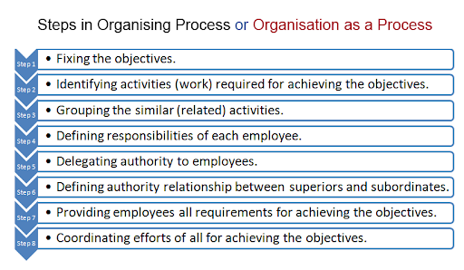
Defining the Controlling Structures (CSO)
Notes:
Develop a clear mission statement: A mission statement outlines the purpose of your organization and the impact it wants to make. It provides a clear direction and helps to keep everyone focused on the same goal.
Establish a strong leadership team: A strong leadership team can help to steer the organization in the right direction and ensure that everyone is working towards the same goal. Good leaders are also essential for motivating and inspiring others.
Define roles and responsibilities: Each member of the organization should have a clearly defined role and responsibility. This helps to ensure that everyone knows what is expected of them and avoids duplication of efforts.
Develop policies and procedures: Policies and procedures help to ensure that everyone is following the same rules and guidelines. This can help to avoid conflicts and ensure that everyone is working towards the same goal.
Monitor and evaluate performance: Regular monitoring and evaluation of performance can help to identify areas that need improvement and ensure that everyone is working effectively towards the organization's goals.
Build partnerships and networks: Building partnerships and networks with other organizations can help to leverage resources and expertise, as well as increase the organization's visibility and impact.
Use technology effectively: Using technology effectively can help to streamline processes, improve communication, and increase efficiency.
Graph Source: https://kalyan-city.blogspot.com/2011/07/steps-in-organising-process.html

Slide 7
The Necessity of the Controlling Structures (CSO)
Effective control and organization are critical for the success of CSOs in achieving their goals. Here are some tips for controlling and organizing CSOs:
Develop a clear mission statement
Establish a strong leadership team
Define roles and responsibilities
Develop policies and procedures
Monitor and evaluate performance
Build partnerships and networks
Use technology effectively
Notes:
Develop a clear mission statement: A mission statement outlines the purpose of your organization and the impact it wants to make. It provides a clear direction and helps to keep everyone focused on the same goal.
Establish a strong leadership team: A strong leadership team can help to steer the organization in the right direction and ensure that everyone is working towards the same goal. Good leaders are also essential for motivating and inspiring others.
Define roles and responsibilities: Each member of the organization should have a clearly defined role and responsibility. This helps to ensure that everyone knows what is expected of them and avoids duplication of efforts.
Develop policies and procedures: Policies and procedures help to ensure that everyone is following the same rules and guidelines. This can help to avoid conflicts and ensure that everyone is working towards the same goal.
Monitor and evaluate performance: Regular monitoring and evaluation of performance can help to identify areas that need improvement and ensure that everyone is working effectively towards the organization's goals.
Build partnerships and networks: Building partnerships and networks with other organizations can help to leverage resources and expertise, as well as increase the organization's visibility and impact.
Use technology effectively: Using technology effectively can help to streamline processes, improve communication, and increase efficiency.
Photo Source: https://www.lucidchart.com/blog/time-management-at-work

Slide 8
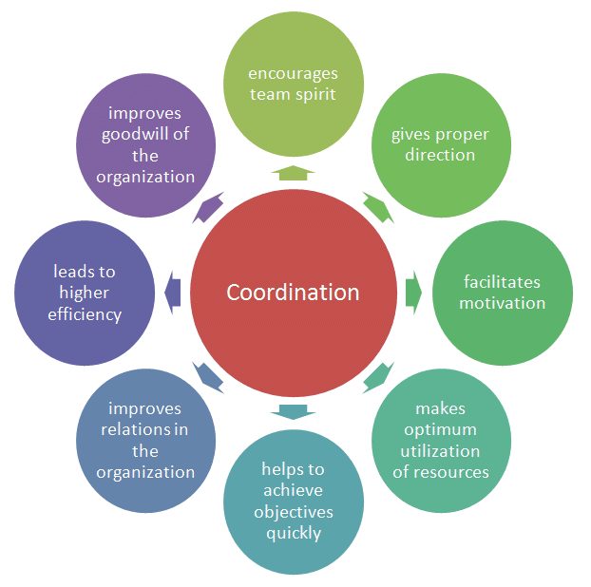
Defining the Controlling Structures - Coordination (CSO)
Coordination involves the process and mechanisms used to integrate the tasks and activities of individuals and organisational units. The coordination element of a manager’s job can be referred to as the cost of communication as the organisation grows in size. Extra hierarchical layers of management add on to the time and cost of the decision making process and do not add value to the value chain.
Notes:
Develop a clear mission statement: A mission statement outlines the purpose of your organization and the impact it wants to make. It provides a clear direction and helps to keep everyone focused on the same goal.
Establish a strong leadership team: A strong leadership team can help to steer the organization in the right direction and ensure that everyone is working towards the same goal. Good leaders are also essential for motivating and inspiring others.
Define roles and responsibilities: Each member of the organization should have a clearly defined role and responsibility. This helps to ensure that everyone knows what is expected of them and avoids duplication of efforts.
Develop policies and procedures: Policies and procedures help to ensure that everyone is following the same rules and guidelines. This can help to avoid conflicts and ensure that everyone is working towards the same goal.
Monitor and evaluate performance: Regular monitoring and evaluation of performance can help to identify areas that need improvement and ensure that everyone is working effectively towards the organization's goals.
Build partnerships and networks: Building partnerships and networks with other organizations can help to leverage resources and expertise, as well as increase the organization's visibility and impact.
Use technology effectively: Using technology effectively can help to streamline processes, improve communication, and increase efficiency.
Photo Source: https://aprika.com/glossary/coordination/

Slide 9
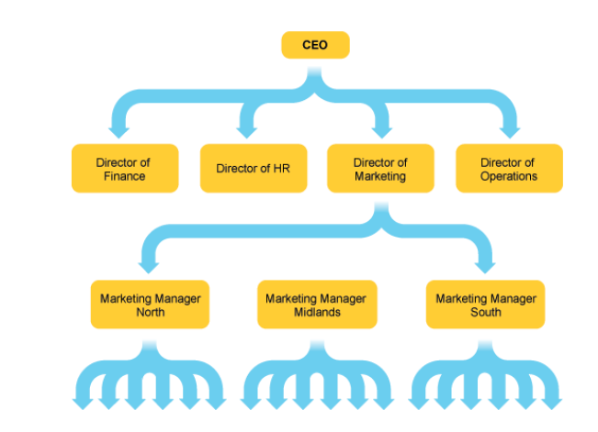
Tools of Coordination
Committees are primarily established to enhance coordination within an organization. However, it is worth noting that committees can be expensive, time-consuming, and sometimes ineffective. The effectiveness of committee actions lies in their ability to synthesize diverse viewpoints and perspectives.
Coordinators assume vital responsibilities in areas such as quality management, employee safety, risk management, customer service, staff training, and cost containment.
Organizational charts visually depict the structure of a firm by illustrating both vertical linkages and horizontal linkages. They provide a graphical representation of how the organization is structured and how different parts are interconnected.
Notes:
Photo Source: http://www.crowe-associates.co.uk/wp-content/uploads/2014/06/organisation-structure-1.jpg

Slide 10
Examples of Controlling Structures that a CSO may use
Budgeting: CSOs may use budgets to control and monitor their financial performance and ensure that they are allocating resources effectively.
Grant management: CSOs may use grant management systems to monitor the progress of their projects and ensure that they are meeting the objectives of their funders.
Impact measurement: CSOs may use impact measurement tools to assess the outcomes of their projects and programs, and make changes where necessary.
Notes:
Image Source: https://www.freepik.com/free-photo/top-view-game-domino_5062385.htm#query=Examples%20of%20Controlling%20structures&position=1&from_view=search&track=ais#page=1&query=E&from_query=undefined&position=1&from_view=search&track=ais

Slide 11
Examples of Controlling Structures that a CSO may use
Performance metrics: CSOs may use performance metrics to track progress towards specific goals, such as the number of beneficiaries served or the amount of funding raised.
Compliance checks: CSOs may perform compliance checks to ensure that they are complying with relevant laws, regulations, and policies.
Notes:
Picture Source: https://www.freepik.com/free-vector/customer-support-abstract-concept_12084787.htm#query=performance%20management&position=13&from_view=search&track=country_rows_v2

Slide 12
Examples of Organising Structures that a CSO may Use
01
ORGANISATIONAL CHARTS
PROJECT MANAGEMENT
05
ORGANISING STRUCTURES
02
STANDARD OPERATING PROCEDURES
VOLUNTEER MANAGEMENT
04
03
COMMUNICATION PLAN
These are just a few examples of controlling and organizing structures that a CSO may use to manage their operations effectively. The specific structures and tools used will depend on the size and scope of the organization, as well as its specific goals and objectives.
Notes:
Organisational chart: CSOs may use an organizational chart to define the roles and responsibilities of employees, including volunteers and board members.
Project management: CSOs may use project management tools to plan and organize their projects, including task assignments, timelines, and resource allocation.
Volunteer management: CSOs may use volunteer management tools to recruit, train, and supervise volunteers, ensuring that they are contributing effectively to the organization's goals.
Communication plan: CSOs may use communication plans to ensure that information flows effectively within the organization, and that stakeholders are informed about the organization's activities and outcomes.
Standard operating procedures (SOPs): CSOs may use SOPs to ensure that their operations are consistent and efficient, and to ensure that staff members are following established protocols and procedures.

Slide 13
Benefits of Effective Controlling and Organizing
Improved Efficiency
Better Decision-Making
Enhanced Accountability
Increased Effectiveness
Improved Stakeholder Relationships
Greater Adaptability
Enhanced Reputation
Notes:
Discuss the benefits that effective controlling and organizing can bring to CSOs, such as increased efficiency, better use of resources, improvedB decision-making, and greater accountability. Provide examples of CSOs that have achieved success by implementing effective controlling and organizing structures.
Improved efficiency: By implementing effective controlling and organizing structures, CSOs can streamline their operations and use resources more efficiently, leading to cost savings and increased productivity.
Better decision-making: Effective controlling and organizing structures provide CSOs with the data and information they need to make informed decisions about their operations and strategy.
Enhanced accountability: Controlling and organizing structures help CSOs monitor their activities and demonstrate their impact to stakeholders, enhancing their accountability and transparency.
Increased effectiveness: Effective controlling and organizing structures help CSOs focus on their mission and goals, leading to increased effectiveness in achieving their objectives.
Improved stakeholder relationships: By implementing effective controlling and organizing structures, CSOs can better engage with their stakeholders, including donors, volunteers, and beneficiaries, leading to stronger relationships and greater support.
Greater adaptability: Effective controlling and organizing structures help CSOs respond more quickly to changes in their environment, such as shifts in funding or emerging social issues, leading to greater adaptability and resilience.
Enhanced reputation: By demonstrating effective controlling and organizing structures, CSOs can build a positive reputation for themselves as well-managed and trustworthy organizations, leading to increased support from stakeholders
Picture Source: https://www.freepik.com/free-vector/corporate-meeting-employees-cartoon-characters-discussing-business-strategy-planning-further-actions-brainstorming-formal-communication-seminar-concept-illustration_11668427.htm#&position=17&from_view=author

Slide 14
Best Practices for Controlling and Organizing for CSOs
Involve stakeholders: Involving stakeholders, such as staff, volunteers, partners, and beneficiaries, in the process of designing and implementing controlling and organizing structures can help to ensure that the structures are relevant, practical, and effective.
Use technology: Leveraging technology, such as project management software, online collaboration tools, and data analytics platforms, can help CSOs to streamline their operations, automate processes, and generate insights that can inform decision-making.
Adopt a continuous improvement approach: Regularly reviewing and refining controlling and organizing structures can help CSOs to adapt to changing circumstances, address emerging challenges, and capitalize on new opportunities.
Notes:
Provide some best practices for CSOs to consider when implementing controlling and organizing structures, such as involving stakeholders in the process, using technology to streamline operations, and adopting a continuous improvement approach. Provide examples of CSOs that have successfully implemented these best practices.
Picture Source: https://www.freepik.com/free-vector/successful-financial-operation-cash-currency-money-income-credit-approval-savings-insurance-finance-contract-creative-budget-management_11668563.htm#query=best%20practice&position=2&from_view=author

Slide 15
Best Practices for Controlling and Organizing for CSOs
Ensure compliance: Ensuring compliance with legal, regulatory, and ethical standards is critical for maintaining the trust and credibility of CSOs. Effective controlling and organizing structures can help to identify and mitigate compliance risks.
Communicate effectively: Effective communication is essential for ensuring that all stakeholders are aligned with the mission, goals, and strategies of the CSO. Clear communication channels, regular feedback mechanisms, and open communication culture can help to facilitate effective communication.
Focus on impact measurement: Measuring and reporting on the impact of the CSO's programs and activities is critical for demonstrating accountability, learning, and improvement. Effective impact measurement structures can help ensure that the CSO is achieving its objectives and making a positive difference in the community.
Notes:
Provide some best practices for CSOs to consider when implementing controlling and organizing structures, such as involving stakeholders in the process, using technology to streamline operations, and adopting a continuous improvement approach. Provide examples of CSOs that have successfully implemented these best practices.
Picture Source: https://www.freepik.com/free-vector/successful-financial-operation-cash-currency-money-income-credit-approval-savings-insurance-finance-contract-creative-budget-management_11668563.htm#query=best%20practice&position=2&from_view=author

Slide 16
Conclusion
Effective controlling and organising is essential for the success of CSOs (civil society organisations) for several reasons:
Achieving objectives
Accountability
Credibility
Sustainability
Innovation
In conclusion, effective controlling and organizing is critical for the success and sustainability of CSOs. By adopting best practices and continuously improving their structures, CSOs can enhance their effectiveness, accountability, credibility, sustainability, and innovation, and make a positive difference in the world.
Notes:
Summarize the main points of the presentation and emphasize the importance of effective controlling and organizing for CSOs.
Encourage CSOs to take action and implement these structures to achieve greater success.

