Slide 1
Module 4 Project Management
Unit 1: Project Management Introduction

Slide 2
Module Contents
Unit 1: Project Management Introduction
Unit 2: Life Cycle – INITIATION
Unit 3: Life Cycle – PLANNING
Unit 4: Life Cycle – EXECUTING AND CONTROLLING
Unit 5: Life Cycle – CLOSING
Notes:
Sourced by pexels.com - fauxels (Found here)

Slide 3
Learning Outcomes of the PM training
Upon Completion of Today’s Session you will be able to:
Understand the theoretical background of project management, including the Chaos Report findings, typical reasons for project failures, and the definitions related to a project.
Learn core project management activities, such as planning, executing, checking, and acting, to effectively manage project tasks and achieve project objectives.
Explain the Purpose and Components of the Main Process Groups, recognizing its significance in setting the project's direction and tone.
Explain each step of the main process groups, including stakeholder identification, risk assessment, and alignment with organizational strategies.
Notes:
Sourced by freepik.com - fauxels (Found here)

Slide 4
History of Project Management
Notes:
Max (2023). He history of Project management: Planning the 20th Century. Retrieved from The History of Project Management - And How Did It Begin?
Four periods in project management history:
Before 1958
1958 to 1979
1980 to 1994
1995 to the Present

Slide 5
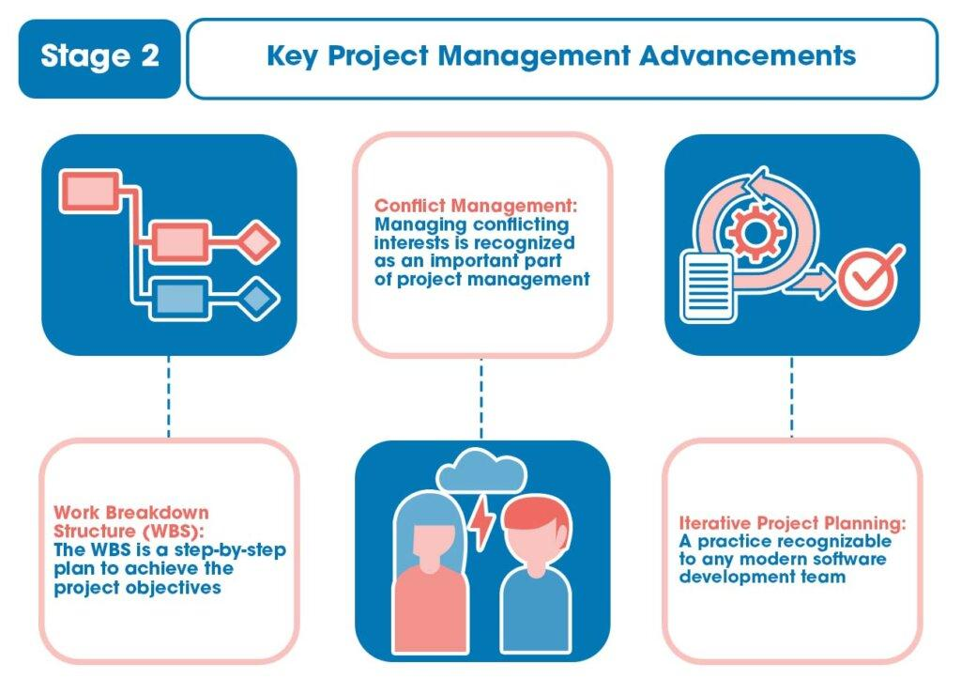
History of Project Management
Notes:
Max (2023). He history of Project management: Planning the 20th Century. Retrieved from The History of Project Management - And How Did It Begin?
Four periods in project management history:
Before 1958
1958 to 1979
1980 to 1994
1995 to the Present

Slide 6
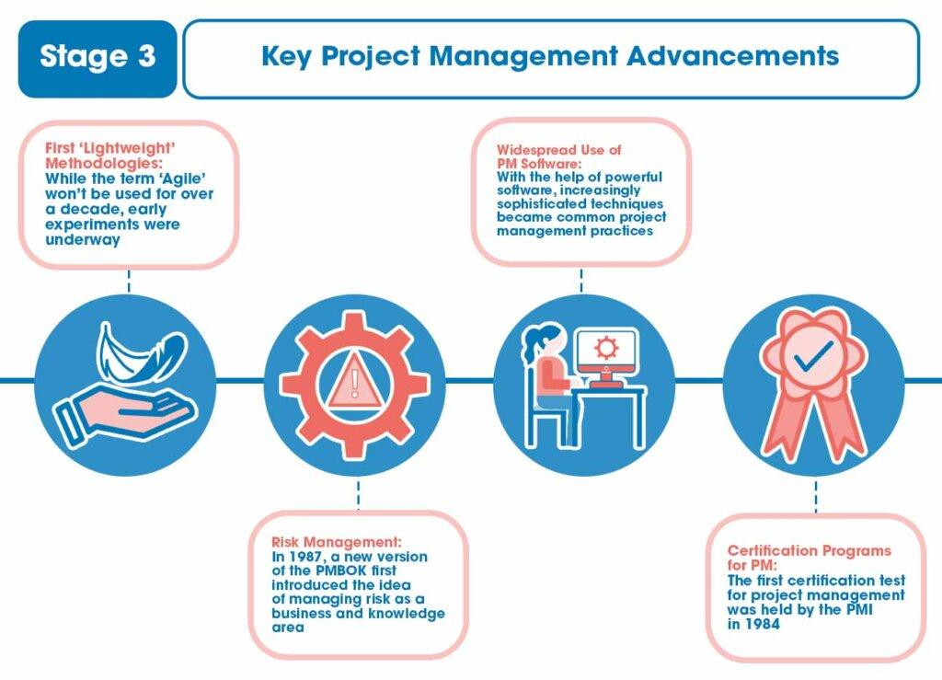
History of Project Management
Notes:
Max (2023). He history of Project management: Planning the 20th Century. Retrieved from The History of Project Management - And How Did It Begin?

Slide 7
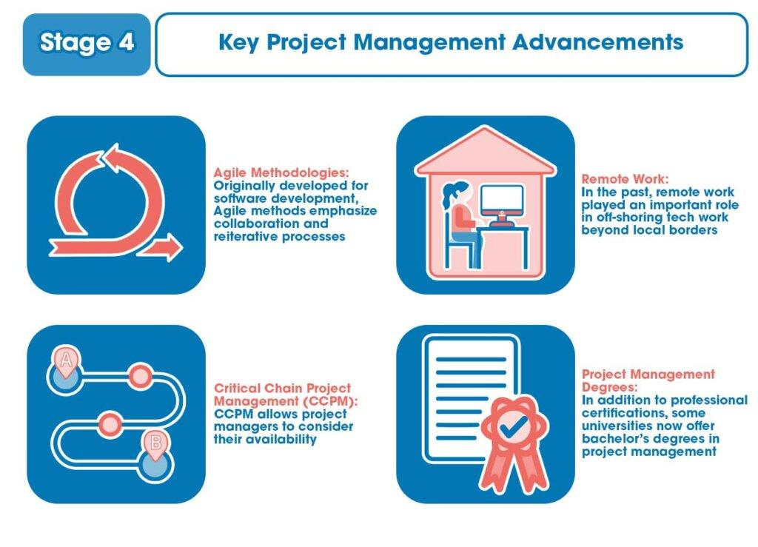
History of Project Management
Notes:
Max (2023). He history of Project management: Planning the 20th Century. Retrieved from The History of Project Management - And How Did It Begin?

Slide 8
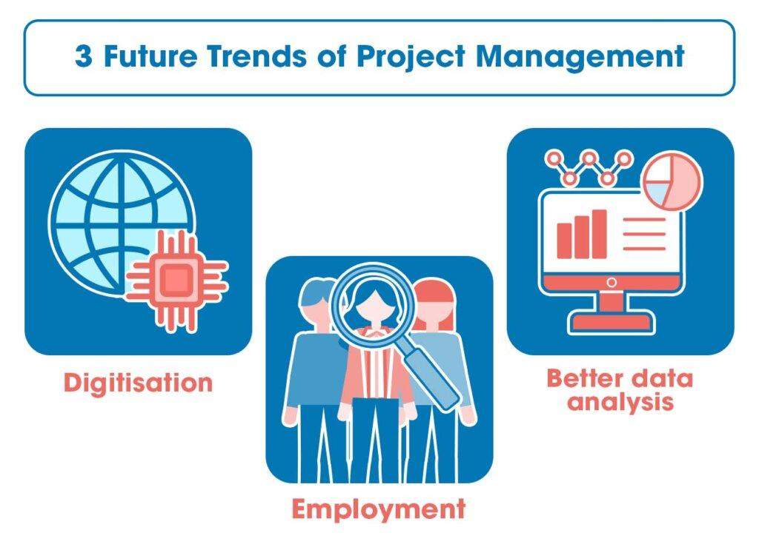
Future Project Management Tools
Notes:
Max (2023). He history of Project management: Planning the 20th Century. Retrieved from The History of Project Management - And How Did It Begin?
Cloud storage allows for easily scalable IT infrastructure. Machine learning tools help manage that information, while modeling by artificial intelligence may aid in decision making. Project management may become a universally integrated process once more, to some extent part of everyone’s job. Data analysis may also reveal ways to reduce project costs and more efficiently manage project activities.

Slide 9
Are Project Management Skills Essential?
Is PM not yet another pointless layer of non-value-added bureaucracy? Will using PM not only make it take longer to complete the actual work?
... or can PM offer anything that might be beneficial?
Unit 1: Project Management Introduction

Slide 10
Kahoot GAME
Follow https://kahoot.it/ and
Introduce the Game PIN: 09115898
Notes:
https://create.kahoot.it/share/importancy-of-project-management-in-our-daily-life/1d908073-cfd7-4da5-bc92-5931222160f5

Slide 11
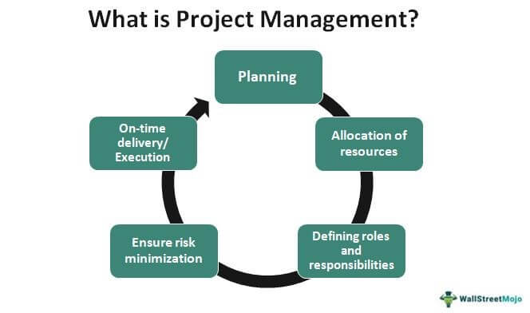
Unit 1: Project Management Introduction
We DO NEED Project Management Skills
Projects are the vehicles by which strategy is delivered.
Project management is becoming an increasingly complex aspect of how organizations operate.
Notes:
Source: Project Management (wallstreetmojo.com)
Project management is the application of processes, methods, skills, knowledge and experience to achieve specific project objectives according to the project acceptance criteria within agreed parameters. Project management has final deliverables that are constrained to a finite timescale and budget.

Slide 12
Projects Go BAD
According to the Chaos Report conducted in 1995, concluded that:
31% of projects will be shelved before they are even finished.
Over 189% of the initial budget.
52% of projects will cost more.
The success rate for software projects that are finished on time and within budget is only 16.2% on average.
Tom Clancy (1995). Chaos report. The Standish Group International Inc. Retrieved from https://personal.utdallas.edu/~chung/SYSM6309/chaos_report.pdf

Slide 13
Typical Reasons Projects Fail
1. The project's relationship to the organization's main strategic aims, including established success metrics, is not well defined.
2. Lack of ownership and leadership from senior management and ministers.
3. Ineffective interaction with stakeholders.
4. Lack of project management and risk management expertise and tried-and-true methods.
5. There isn't enough focus on organizing development and implementation into doable steps.
6. Evaluation of proposals is based more on the initial cost than on overall value for money, especially when it comes to ensuring the delivery of business advantages.

Slide 14
PMI and Prince 2 - Definition of a Project
In accordance to the PMBOK® Guide - Fourth edition the definition of a project is “a temporary endeavor undertaken to create a unique project service or result.” Projects are transient in nature and end once the task assigned to them is finished.
According to the Prince 2, the definition of a project is “A temporary organisation that is created for the purpose of delivering one or more business products according to a specified Business Case.”.
‘’A project is a temporary endeavor undertaken to create a unique product, service, or result. The temporary nature of projects indicates a definite beginning and end. Temporary does not necessarily mean a project has a short duration. A project’s end is reached when the objectives have been achieved or when the project is terminated because its objectives will not or cannot be met, or when the need for the project no longer exists. The decision to terminate a project requires approval and authorization by an appropriate authority.’’
Notes:
Make a question here in respect to the definition of PMBOK.
Is this an operation??
‘’ well there is a difference. Operation is an ongoing work that is repetitive.’’
PMBOK® Guide - Fourth edition (PMI, 2008a, p. 434)

Slide 15
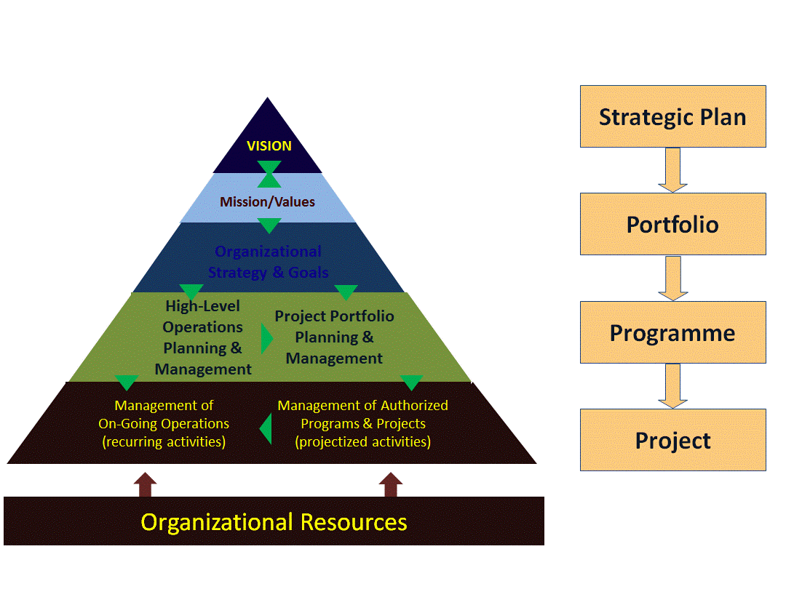
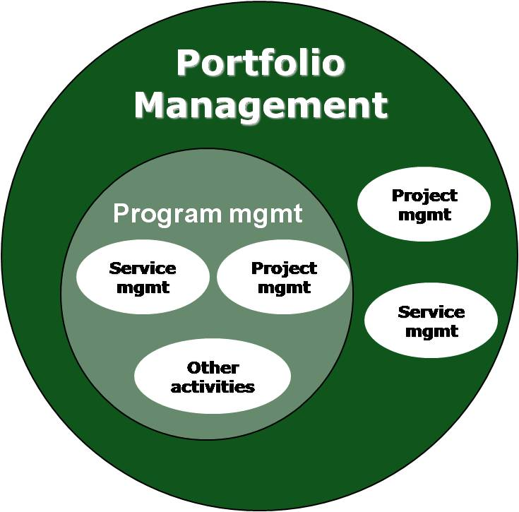
Program and Portfolio
Notes:
Source:Link with Organizational Strategy (found here)
Program is multiple projects put together, managed towards shared strategy. Portfolio is multiple programs put together, which could have different types, managed towards organizational objectives.

Slide 16
Two (2) Methodologies Needed to Run to any Project! (many mistake this)
Project Life Cycle
Project Management process
Is unique to the project, to an industry, to your needs. It is highly customizable. Can be predictive or adaptive.
For Instance:
Human Development
Conceiving
Childhood
Teenage hood
Adulthood
Death
5 Process Groups According to the PMI that are not Customizable
Initiation: Justification, Authorization
Planning: Establish Scope , Refine Objectives, Define the Course of Action
Executing: Put the Plan in Action
Monitoring and Controlling: Understand your Variances, Performance and Forecast
Closing: Formally Close the Project
Notes:
REMEMBER
There is no ideal LC structure. These are sequential phases that are unique to your own project and needs. Could have 1 or more LC phases to your project. An example of LC project for a company could have the beginning from the feasibility study, but other companies do not include this step.

Slide 17
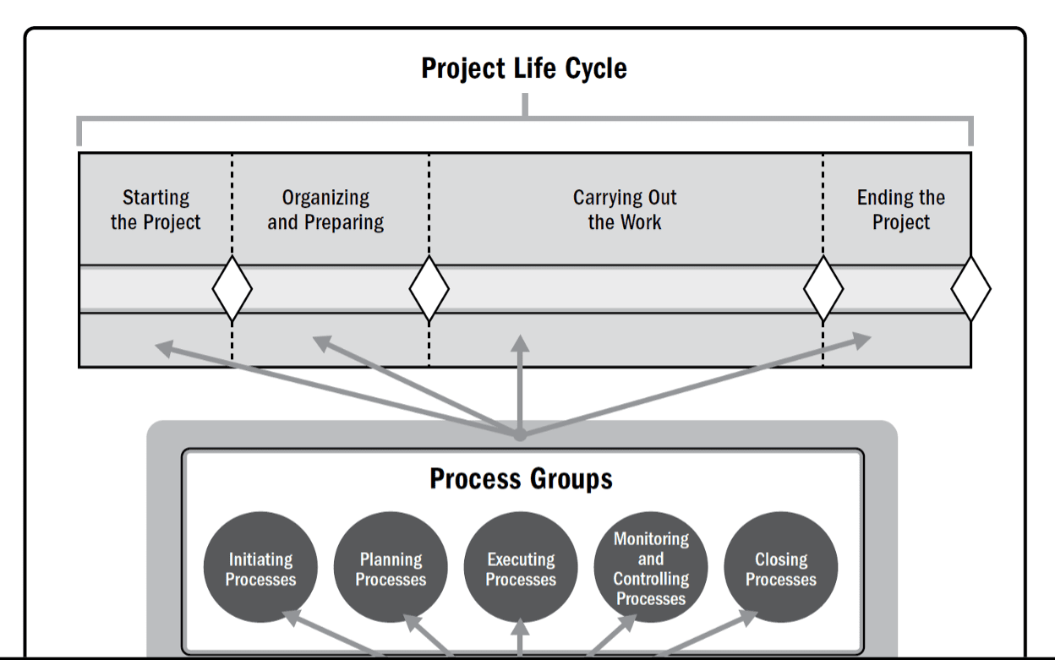
But Where Do Many Amateur PMs Make the Mistake
Note: Project Management Processes & Product-Oriented Processes overlap & interact throughout the life of a project.

Slide 18
Characteristics of the Project Life Cycle
Influence, Risk & Cost of Changes
Cost and Staffing Levels:
Low at the Start
Peak as the Work is Carried Out
Drop Rapidly as the Project Draws to a Close
Ability to influence the final characteristics of the project’s product, without significantly impacting cost:
Highest at the Start
Decreases as the Project Progresses Towards Completion
Notes:
Source: Jerome Rowley (2013). 5th Edition PMBOK® Guide—Chapter 2: Project Life Cycle. (Found here)

Slide 19
Generic Project Life Cycle Structure
Phase Gate Decisions
Continue to the Next
Continue to the Next with Modifications
End the Project
Remain in the Phase
Repeat the Phase or Elements of it
Recognising Phase Completion
You will recognize the phase completion because each phase has a specific deliverable, or multiple deliverables that mark the end of the phase.
Phase Gate
End of the phase to assess progress and performance against:
Business Case
Project Charter
Project Management Plan
Benefits Management Plan
Notes:
Source: Project management Office (PMO) Overview (found here)

Slide 20
Basics of Project Management
Managing a Project Typically Includes:
Managing Stakeholder Expectations
Requirements Identification
Balancing the Competing Constraints
Project Communication Needs
Due to the potential for change, the development of the project management plan is an iterative activity and is progressively elaborated throughout the project’s life cycle.
Notes:
Sourced byfreepik.com - katamangostar (Found here)

Slide 21
How Continued Changes can be Managed?
Based on the concept of the PDCA management method focusing on control & continuous improvement.
Initiating
Closing
(Act)
Planning (Plan)
Controlling
(Check)
Executing
(Do)
OPINION:
Prevention vs Correction

Slide 22
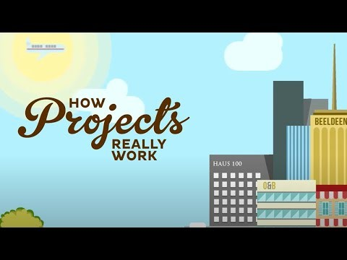
How Projects Actually Work
Link here

Slide 23
One Out of Many PMs Challenges
Constraints
An applicable restriction or limitation, either internal or external to the project, will affect the performance of the project or a process.
The Competing Constraints
Scope
Quality
Schedule
Cost
Resources
Risks
Take-Away
It is the PMs’ responsibility to continue balancing of the competing constraints.

Slide 24
Project Management: Time - Cost - Quality Triangle
Project Management is like juggling three balls – time, cost and quality. Program management is like a troupe of circus performers standing in a circle, each juggling three balls and swapping balls from time to time
G. Reiss
Change in one side MUST affect another side (or both)
THE IRON TRIANGLE
SCOPE
COST
QUALITY
SCHEDULE

Slide 25
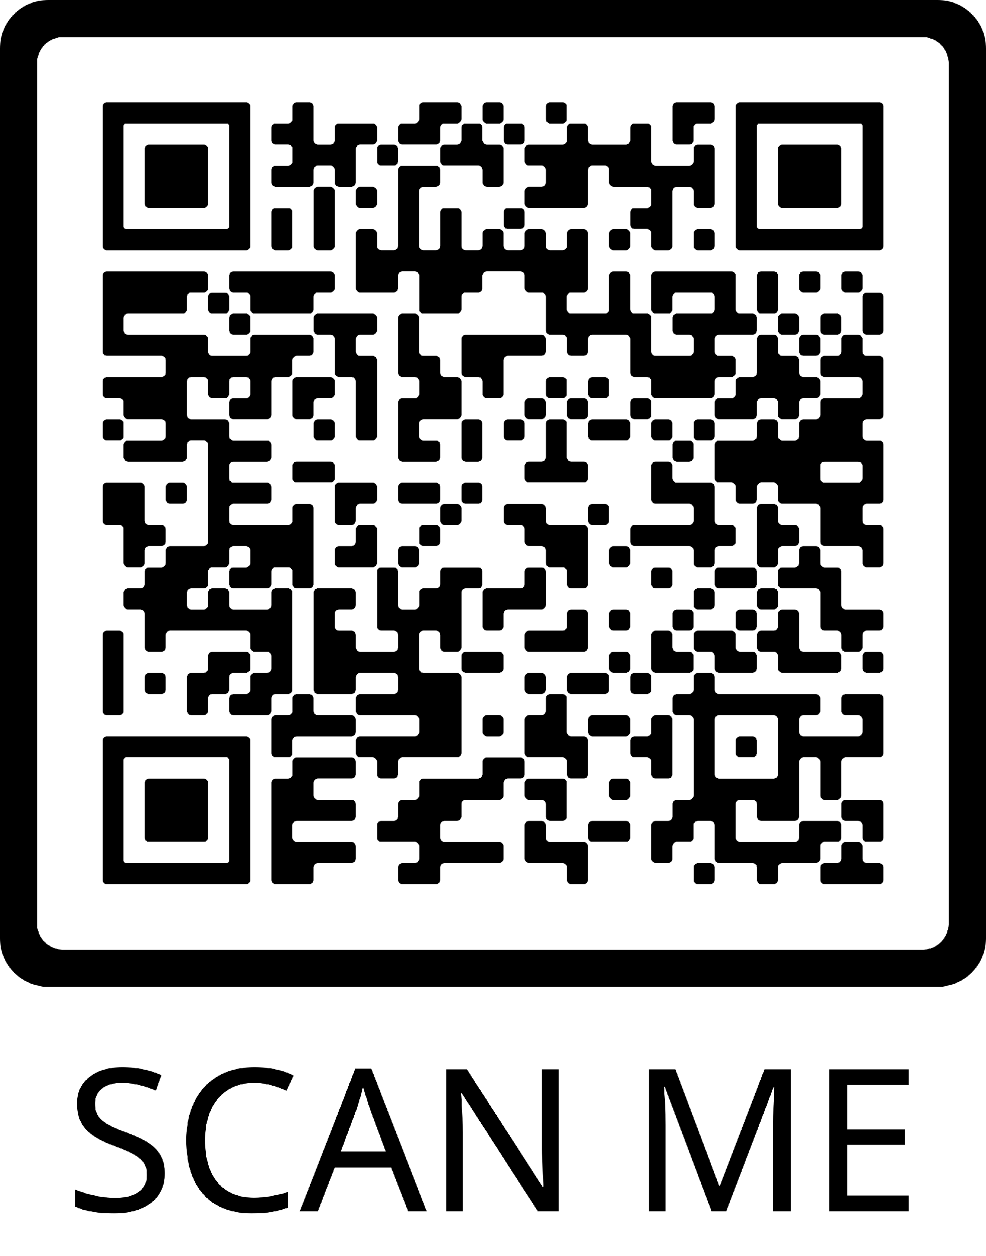
Google Form Quiz
Constraints link quiz here or scan

