Slide 1
Module 4 Project Management
Unit 2: Project Management - INITIATION

Slide 2
Module Contents
Unit 1: Project Management Introduction
Unit 2: Life Cycle – INITIATION
Unit 3: Life Cycle – PLANNING
Unit 4: Life Cycle – EXECUTING AND CONTROLLING
Unit 5: Life Cycle – CLOSING
Notes:
Sourced by pexels.com - fauxels (Found here)

Slide 3
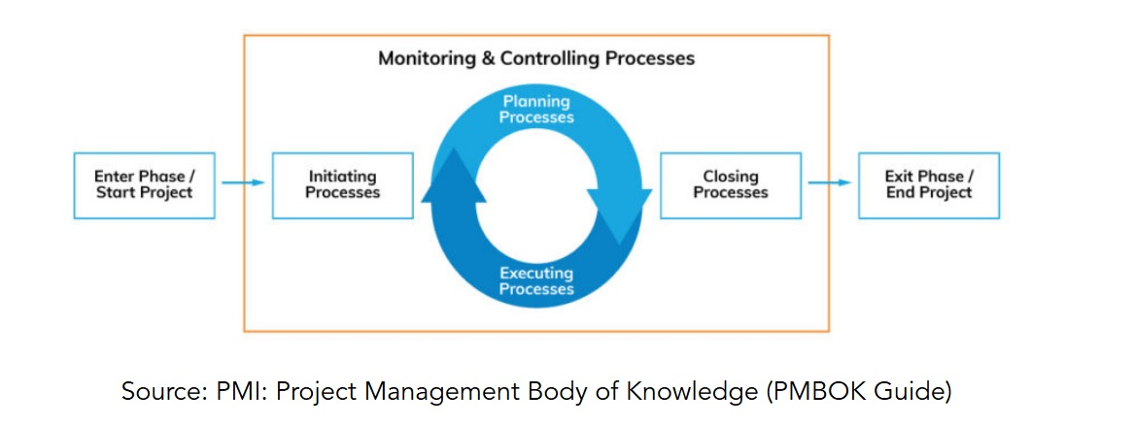
Project Management Processes
Project Management Processes
INITIATION
Develop Two (2) Processes
Develop the Project Charter
Identify Stakeholders

Slide 4
Project Charter
Start the Project: Document ‘Hallway’ Conversation
Project Charter - Project Definition - Business Case
What are you doing?
What are you not doing?
Why are you doing this?
How will you know when you are done?
PROJECT KICK OFF WITH THE PM TEAM!
Notes:
Sourced by pexels.com - cottonbro studio (Found here)
The project charter is a fairly simple document outlining a few things. Especially when you are finding an answer to; why you are doing what you doing. Not a detailed one.
Why do we prepare the project charter document?
Because we need to have a buy-in! An approval to continue investing time and effort to the rpopose3d proposal. For instance, I want to expand to an early market but the leadership team or invertors are not convinced so they kill it off the potential project from the get go.
Of course if the project idea is a 10 billion proposal, this document will entail much much more details, like high level planning etc.

Slide 5
INITIATION – Project Charter
Overview
Goal (Justification)
Objectives
Benefits
Success Criteria
Assumptions
Scope (in / out) - major deliverables
Stakeholders
Risks
Authorities
Communications
Approval
Constraints

Slide 6
Case Study (10 Minutes)
Read Case Study
What would be the 1st question to ask if you are the responsible PM?
Notes:
FIND the WHY – BUSINESS VALUE
Why is this super important for the PM? To know the business value of each project?
===coz Every action we do should add up to business strategy! – panda we ask our self-what is th4e business value mesa apo to implementation autou tou ergou
Source: Freepik (found here)

Slide 7
Case Study (I)
Organization: Island University
Project: The Future of Education
Objective: Organising the conference meeting where top influential thinkers (Salman Khan, Diana Rhoten, David Thornburg) of the world will share their thoughts about the future of Educational Systems.
Dates of Conference: 28 - 30 March 2024 (Day 1: Individual meetings of subcommittees, Day 2: Conference, Day 3: Visits/Entertainment).
Registration Fees: Project manager to decide.
Accommodation: Attendees will book and pay for their accommodation - but you will facilitate the process.
Dedicated Project Team - Working Time per Day: 4h (Monday to Friday) – 4 employees of the organisation
Notes:
Source: http://teqlearn.com/pm/

Slide 8
Case Study (II)
The Conference Should Provide at Minimum:
Conference Room with a Capacity of at Least 200 People and 5 Meetings Rooms with a Capacity of 15 to 20 People
Website with Information and Registration - Reservations Form
2 Lunches, 1 Dinner and 1 Gala Dinner (outside the conference venues)
Sightseeing Excursion (e.g. visits at schools, educational institutes, other organisations, museums, other sightseeing) after the conference completion (day-excursion)
Airport Transportation

Slide 9
Activity 1 - Develop ID stakeholder register in groups of 3-5 (15 min)
Follow the same case study found in the previous activity.
Try to identify stakeholders and write them down with your team for each.
An example of a stakeholder registry template can be found here. Note: Documents and examples will be sent out to you for your own use by the end of the course.
Notes:
Source: Rawpixel (found here)

Slide 10
Activity 2 - Develop Project Charter in Groups of 3-5 (15 min)
Follow the same case study found in the previous activity.
Let’s go back to slide five (5) and try to write down with your team 1-2 points for each section for discussion.
The project charter document is found here.
Note: Documents and examples will be sent out to you for your own use by the end of the course.
Notes:
Source: macrovector (found here)

Slide 11
Activity 3 - Reflection
WHAT ARE THE ELEMENTS TO A SUCCESSFUL
PROJECT INITIATION?
YOU HAVE TWO (2) MINUTES IN A GROUP OF THREEs (3) TO DISCUSS

Slide 12
Activity 4 - Indicative Answers
Involve Decision Makers: Be sure to include the decision-makers during the Charter preparation. This ensures that they are aware of and agree to the terms of the project. Their buy-in can be critical for the smooth initiation and continued support throughout the project's lifecycle.
Identify and Engage Stakeholders: Remember to identify all stakeholders, including those who support or oppose the project. Understand their positions and actively work to gain the support of those against it. Maintain ongoing involvement with all stakeholders to foster collaboration and alignment throughout the project. This strategic engagement helps in creating a supportive environment for the project's success.
Notes:
Source: macrovector (found here)

