Slide 1
Module 4 Project Management
Unit 3: Project Management - PLANNING

Slide 2
Module Contents
Unit 1: Project Management Introduction
Unit 2: Life Cycle – INITIATION
Unit 3: Life Cycle – PLANNING
Unit 4: Life Cycle – EXECUTING AND CONTROLLING
Unit 5: Life Cycle – CLOSING
Notes:
Sourced by pexels.com - fauxels (Found here)

Slide 3
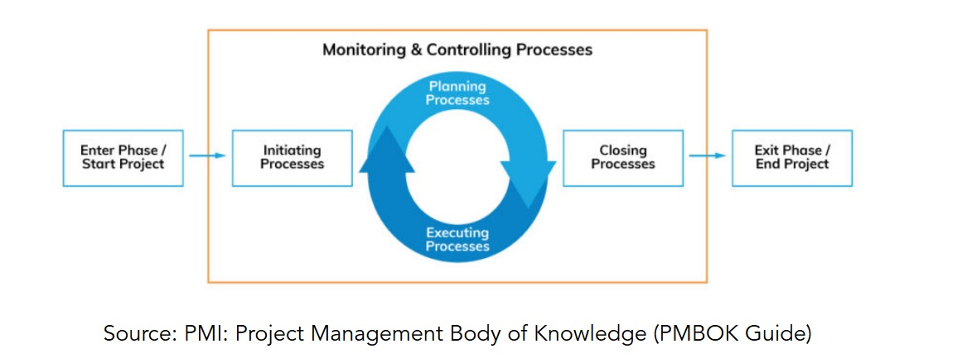
Concept – Project Lifecycle
Project Management Processes
INITIATING
PLANNING
EXECUTING
CONTROLLING AND MONITORING
CLOSING
Notes:
Source: PMI: Project Management Body of Knowledge PMBOK Guide

Slide 4
Prior to Planning Progress Group
WE GOT THE APPROVAL FROM THE LEADERSHIP TEAM - INVESTORS AND DONE THE INITIATION
Baselines
During the Planning Processes the Baselines are Developed
The Baseline Represents the Initial Planning of the Project
It Includes all the Information about the Activities
Duration: Start - Finish Date
Resources and Assignments
Work & Cost
NOW WE CAN PLAN THE PROJECT!!

Slide 5
Prior to Planning Progress Group
Expand Project Charter to a Greater Detail
How are you going to complete your project?
What steps or actions are required?
What resources are required?
What is the timeline?
What is the cost?
What might derail you (risks)?
At the end of the planning process we end-up with a comprehensive Project Plan/ Project Handbook.
Notes:
Sourced by pexels.com - cottonbro studio (Found here)
The project planning progress area is a lot more detailed and comprehensive than the INITIATION process! We will talk about a lot of knowledge areas and details.
With planning process, we need to find answer to 3 main questions:
What are we going to do?
How to do it?
How to know when the project is done! (the 3rd question is very important because many projects are converted to operations in the long run but the PM still considers them a PM)
Source : master1305(found here)

Slide 6
What are the Project Plan parameters?
Project requirements
Defining the Scope
WBS
Schedule
Budget
Quality
And other knowledge areas requirements such us procurement / HR etc

Slide 7
Project requirements
Considering the project requirements, then everybody is going to want to have the best of everything, with our considering budget/schedule/quality.. So there will be clashes!
In this stage a PM has only a rough idea of the project cost/budget and quality, so you need to somehow gather the requirements based on your assumptions.
There are many methods for collecting requirements:
- mapping tool (it is subjective to the person understanding that prepares it)
- 1 on 1 interviews
- Apply the Delphi technique (provides great and close-to-reality results but is time consuming)
- Nominal group technique
- group meeting with all involved (suggested)
Notes:
For instance, If my wife comes and asks me, its is time to buy you a new car! I will just say let’s buy a Porshe 911 GT3 .... Not taking into account the family’s budget, the needs or maintenance expenses!
It is the same as asking in the project Management context, what they want! And of course, they will shoot to the moon!
Requirements Traceability Matrix (RTM) is a project management tool that helps keep track of project requirements, making sure they are clear, complete, and linked to various project components

Slide 8
Defining the scope statement
What is IN and what is OUT of the project (describes the output’s boundaries)
Importance of defining the Project scope???
As PMs we tend to include everything in your project Plan, resulting to an impossible plan to execute.
To do this we need the following documents:
Project charter
Projects requirements, assumptions, risks and constraints
The Project Scope Statement document includes the following:
Project justification
Project scope
Deliverables
Success criteria
Notes:
Source: vectorjuice (found here)

Slide 9
ATTENTION to WBS - Work Breakdown Structure
What steps or actions are required?
Work Breakdown Structure (WBS) - This process is called “decomposition”
Addresses total scope of project
Divides work into manageable components
Scope decomposition – start at the end
Hierarchical depiction
Defines High-level Tasks
How many levels should a WBS have?
As many as possible till you are able to have a clear time estimation and cost assumption!!
Having in mind the following:
The work should be broken down to a level that makes sense for the project manager to control. A common rule is to break the activities that are larger than 80 hours and not break those that are less than 8 hours.
Notes:
The Work Breakdown Structure (WBS) is a fundamental and indispensable tool in project management. Its importance lies in its ability to help project managers and teams effectively plan, manage, and execute projects.
If you are strictly following the PMI framework , then work packages have to be ‘’things’’, like documents/ buildings Nooo ACTIONS!
The importance of this lies on the fact that it Provides a framework of what has to be delivered.
How many levels should a WBS have?
As many as possible till you are able to have a clear time estimation and cost assumption!!
Having in mind the following:
The work should be broken down to a level that makes sense for the project manager to control. A common rule is to break the activities that are larger than 80 hours and not break those that are less than 8 hours.

Slide 10
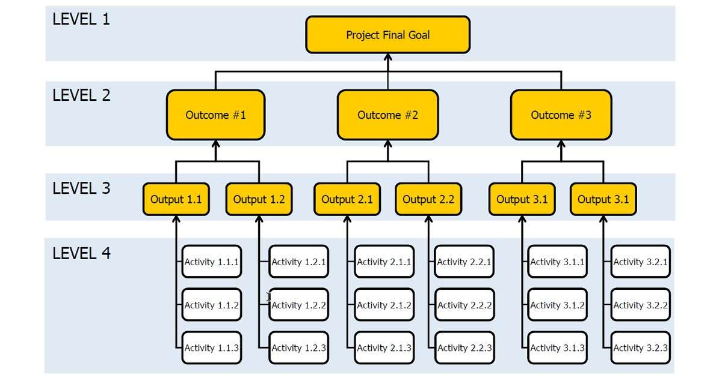
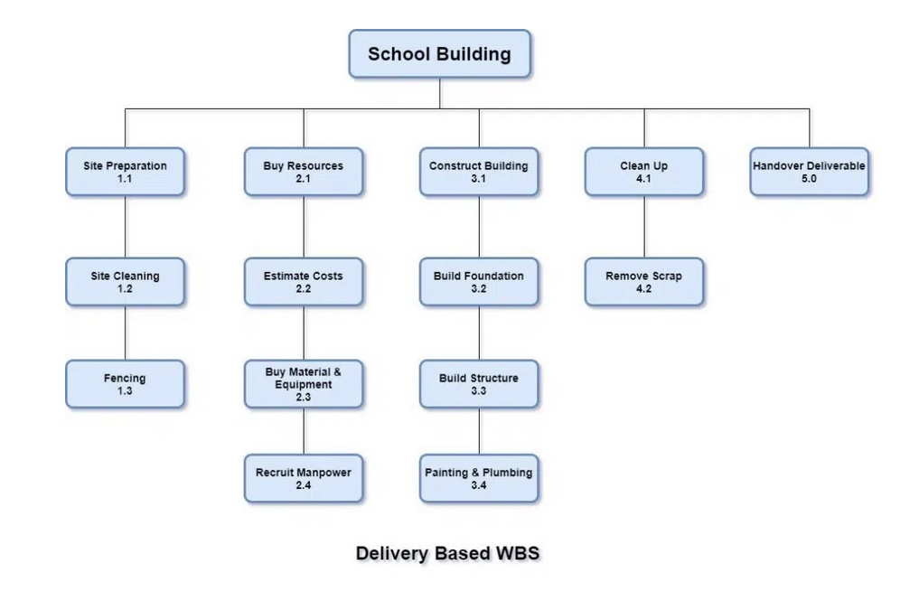
WBS - EXAMPLE
WHO prepares and contributes to the WBS ??
WHO is responsible for managing the WBS?
100% Rule
When all levels of WBS are rolled up – you should end
up with the project level and no work should be left
outside

Slide 11
Activity 1. Develop WBS. (30min)
In groups of 3-4, utilize the case study from Unit 2 and Develop a WBS plan

Slide 12
Case Study (I)
Organization: Island University
Project: The Future of Education
Objective: Organising the conference meeting where top influential thinkers (Salman Khan, Diana Rhoten, David Thornburg) of the world will share their thoughts about the future of Educational Systems.
Dates of Conference: 28 - 30 March 2024 (Day 1: Individual meetings of subcommittees, Day 2: Conference, Day 3: Visits/Entertainment).
Registration Fees: Project manager to decide.
Accommodation: Attendees will book and pay for their accommodation - but you will facilitate the process.
Dedicated Project Team - Working Time per Day: 4h (Monday to Friday) – 4 employees of the organisation
Notes:
Source: http://teqlearn.com/pm/

Slide 13
Case Study (II)
The Conference Should Provide at Minimum:
Conference Room with a Capacity of at Least 200 People and 5 Meetings Rooms with a Capacity of 15 to 20 People
Website with Information and Registration - Reservations Form
2 Lunches, 1 Dinner and 1 Gala Dinner (outside the conference venues)
Sightseeing Excursion (e.g. visits at schools, educational institutes, other organisations, museums, other sightseeing) after the conference completion (day-excursion)
Airport Transportation

Slide 14
Time Efforts and Costs estimates
Various tools and techniques that can be employed to achieve accurate estimates:
Expert Consultation: Seek advice and input from subject matter experts who have relevant experience and expertise in the specific domain or task. Their insights can help provide more accurate estimates.
Historical Data: Draw on data from past projects that are similar in nature. Historical data provides valuable benchmarks for estimating time, effort, and costs, taking into account past performance and outcomes.
Analogous Estimation: Compare the task in question to other tasks with similar characteristics that have been previously completed. This comparative approach can yield reliable estimates.
PERT (Program Evaluation and Review Technique): PERT is a probabilistic technique that considers three time estimates for each task: optimistic, pessimistic, and most likely. By combining these estimates, PERT provides a more realistic time estimation, considering uncertainties.
Notes:
Time and Effort are difficult to estimate time because:
Costs are often underestimated
Benefits are often overestimated
Complexity
Estimates are often made early

Slide 15
PERT technique for time and effort estimation
Expected Time (TE): A weighted average of the optimistic (O), pessimistic (P), and most likely (M) times, calculated using the formula:
TE = (O + 4M + P) / 6.
SD = (b – a)/6
Optimistic time (O): The shortest possible time required to complete the activity. Should not be more than 1% - (i.e. there is 99% probability that the cost/effort or duration of this activity will be larger than this estimate)
Pessimistic values (P): The longest possible time required to complete the activity. Should not be more than 1% - (i.e. there is 99% probability that the cost/effort or duration of this activity will not exceed this estimate).
Most Likely time (M): The best estimate of the time required based on realistic conditions.
Notes:
The PERT technique uses these three point estimates to create a network diagram, commonly represented as a PERT chart or PERT network. The network diagram visually illustrates the sequence of activities and their dependencies. It helps project managers to:
Identify the critical path: The longest path of dependent activities that determine the minimum time required to complete the project.
Determine the project's expected duration.
Understand which activities can be delayed without affecting the project's overall timeline (float or slack).
Allocate resources efficiently to manage project schedules effectively.

Slide 16
EXAMPLE
1 man day = 7.5 hrs
Activity | Predecessors | Optimistic (O) | Most Likely (M) | Pessimistic (P) | Expected Time (TE) | Standard Deviation (SD)
A | - | 3 | 4 | 6 | (3 + 4*4 + 6) / 6 | (6 - 3) / 6 = 0.5
B | - | 2 | 5 | 7 | (2 + 4*5 + 7) / 6 | (7 - 2) / 6 ≈ 0.83
C | A | 4 | 6 | 8 | (4 + 4*6 + 8) / 6 | (8 - 4) / 6 = 0.67
D | A | 3 | 3 | 5 | (3 + 4*3 + 5) / 6 | (5 - 3) / 6 = 0.33
E | B, C | 5 | 7 | 9 | (5 + 4*7 + 9) / 6 | (9 - 5) / 6 = 0.67
A big standard deviation (SD) indicates a low likelihood of achieving the expected cost or duration.
Involving experts to provide these three estimates enhances the accuracy of the technique and reduces project risks and uncertainties.
Let's calculate the Expected Time (TE) for each activity:
For Activity A: (3 + 4*4 + 6) / 6 = (3 + 16 + 6) / 6 = 25 / 6 ≈ 4.17 man days
For Activity B: (2 + 4*5 + 7) / 6 = (2 + 20 + 7) / 6 = 29 / 6 ≈ 4.83 man days
For Activity C: (4 + 4*6 + 8) / 6 = (4 + 24 + 8) / 6 = 36 / 6 = 6 man days
For Activity D: (3 + 4*3 + 5) / 6 = (3 + 12 + 5) / 6 = 20 / 6 ≈ 3.33 man days
For Activity E: (5 + 4*7 + 9) / 6 = (5 + 28 + 9) / 6 = 42 / 6 = 7 man days
Now, you have the expected time for each activity, which can be used for further project planning and scheduling.
Notes:
Standard deviation is a statistical measure that quantifies the amount of variation or dispersion in a set of data points. It provides insight into how spread out or clustered data values are relative to the mean (average) of the data set. In essence, the standard deviation indicates the degree of uncertainty or the typical "distance" between individual data points and the mean.

Slide 17
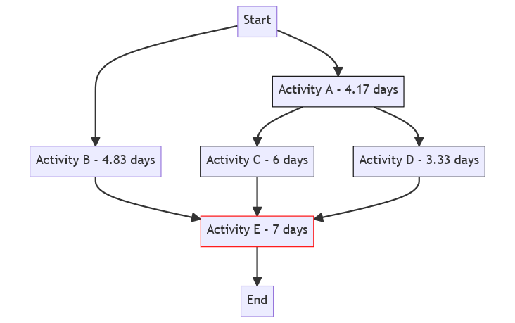
EXAMPLE
Activity | Predecessors
A | -
B | -
C | A
D | A
E | B, C,D

Slide 18
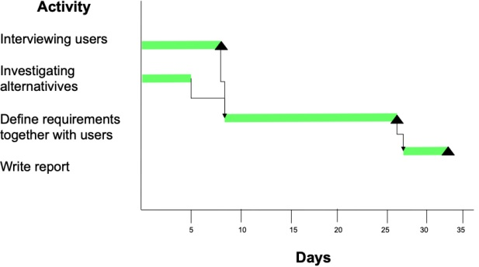
GANTT Diagrams – Way to illustrate the project activities in a timeline (schedule representation)
Helps the project manager to quickly see:
What are the different activities
Dates when the action began and ended
If activities overlap with other
Activities
Begin and finish dates for the entire
If there are any tasks that have slack
Critical path of the project
In case we want to accelerate the project’s completion!!! What do we do??
What is the critical path here and why is important?
Is there any activities with slack?
Notes:
Time estimation is very important to meet your deadline and be withing the budget!
For this reason, we have the Gantt chart to help the PMs to have a look through the project activities and deadlines.
A Gantt chart is a visual project management tool that uses horizontal bars to represent project tasks and their durations over time. It helps project managers plan, track progress, and manage resources effectively. The chart shows task names, start and end dates, dependencies, and critical path activities. It is widely used in various industries for project planning and communication.
The critical path in a project is the longest sequence of dependent activities that determines the total time required for the project. Any delay in activities along the critical path will delay the entire project's completion. The critical path is the path in the network where none of the activities have slack (i.e., the difference between LF and EF). Activities on the critical path have zero slack, meaning they directly impact the project's total duration.
To accelerate the project's completion, resources can be added to decrease the time for activities on the critical path. This shortening of the project is often referred to as "project crashing."
Importance of critical path is that identifying the critical path helps determine the project's completion date, allowing project managers to prioritize and allocate resources effectively. By focusing on the critical path activities, project managers can ensure on-time project delivery and, if needed, take measures to accelerate the project completion
In project management, "slack" refers to the amount of time that a task or activity can be delayed without causing a delay in the project's overall timeline or the subsequent tasks.

Slide 19
Develop Project Schedule – Sequence of Activities – Network Diagram
Sequence Activities
Identify and document dependencies/relationships among the project activities
Defines the logical sequence of work to obtain the greatest efficiency (optimize)
The result of sequencing is:
Project Schedule Network Diagrams

Slide 20
Quality
Quality is the degree to which a set of inherent characteristics fulfill requirements (refers to performance or result)
“Quality is generally defined as the totality of features and inherent or assigned characteristics of a product, person, process, service and/or system that bear on its ability to show that it meets expectations or satisfies stated needs, requirements or specification”
Responsibilities Regarding Quality
Ultimate responsibility for project’s product : Project Manager
Ultimate responsibility for quality in the organisation: Senior Management
Responsibility for project assigned work : Assigned Project Team Member (Before delivering the work)

Slide 21
Most common results of poor Quality
Increased Cost
Decrease in profits
Low morale
Low customer satisfaction
What is your opinion on the quality of McDonald’s?
Quality assurance can be defined as "part of quality management focused on providing confidence that quality requirements will be fulfilled." The confidence provided by quality assurance is twofold—internally to management and externally to customers, government agencies, regulators, certifiers, and third parties.
Notes:
Source: Mcdonald from 2003 logo found here
Source: azabaijan_stock (found here)

Slide 22
Planning – Project Budget
What is the cost?
Project Budget
Hard budget (Euro)
Hardware, software, vendor / consulting services, travel
Funding: capital vs. departmental
Do not forget operating costs
Soft budget
Services and subcontracting
Based on project schedule
Notes:
Sourced by pexels.com - Karolina Grabowska (Found here)

Slide 23
Stakeholders’ Management
Stakeholders Assessment Matrix
It is the project manager’s responsibility to manage the influences of these various stakeholders in relation to the project requirements to ensure a successful outcome
Contribution to the Matrix:
1. Project Team Members
2. Interested Entities Internal or External
to the Performing Organization
Stakeholder identification is a continuous process throughout the entire project life cycle
Failure to do so can lead to delays, cost increases, unexpected issues and other negative consequences including project cancellation

Slide 24
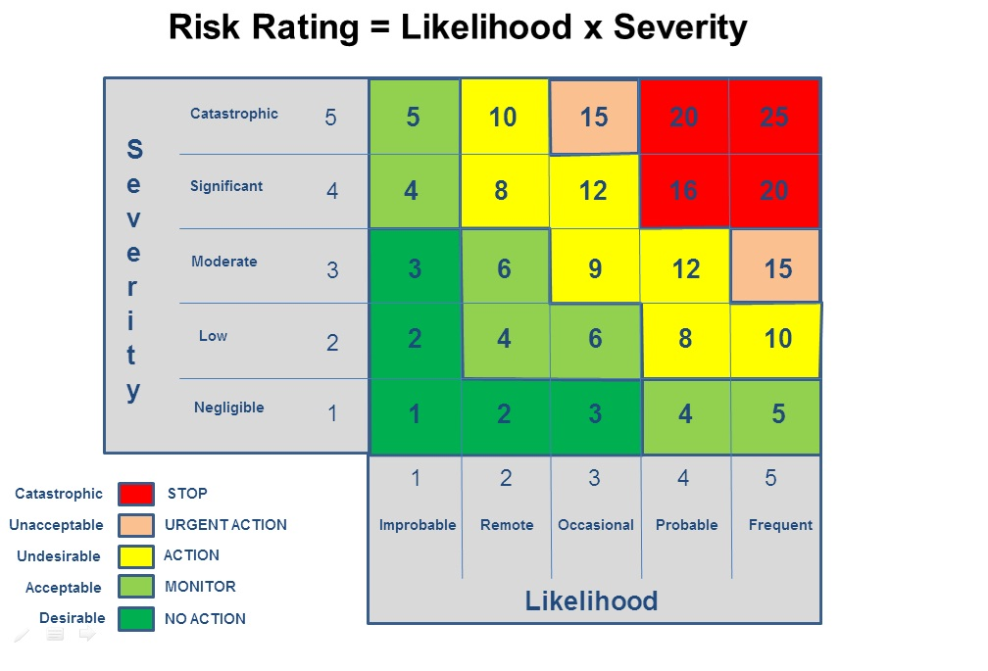
Planning – Project Risk
Project Risks
What could happen?
What is the likelihood of it happening?
What would happen if it actually did?
For high priority items, define risk strategy / approach
Accept, mitigation, contingency
Risk Identification, Action Planning and Trigger
Notes:
Source: ENVS 298 (found here)
In project management, "risk" refers to the possibility of unexpected events, issues, or uncertainties that can have a negative impact on a project's objectives, such as its schedule, budget, quality, or overall success. Risk assessment is a systematic way of figuring out what could go wrong, how bad it could be, and what we can do to prevent or deal with it. It helps us make better decisions and prepare for potential problems.
Key Benefit of the Risk Assessment Process
• Reduces the Uncertainty for the Project Manager & the Team
• Allows to Focus on High-Priority Risks

Slide 25
Activity 2: Identify Risks (30 minutes)
Organization: Island University
Project: The Future of Education
Objective: Organising the conference meeting where top influential thinkers (Salman Khan, Diana Rhoten, David Thornburg) of the world will share their thoughts about the future of Educational Systems.
Dates of Conference: 28 - 30 March 2024 (Day 1: Individual meetings of subcommittees, Day 2: Conference, Day 3: Visits/Entertainment).
Registration Fees: Project manager to be decided.
Accommodation: Attendees will book and pay for their accommodation - but you will facilitate the process.
Dedicated Project Team - Working Time per Day: 4h (Monday to Friday) – 4 employees of the organisation

Slide 26
Activity 1: Identify Risks in Groups of 3-5 (30 minutes) Case Study 2 (II)
The Conference Should Provide at Minimum:
Conference Room with a Capacity of at Least 200 People and 5 Meetings Rooms with a Capacity of 15 to 20 People
Website with Information and Registration - Reservations Form
2 Lunches, 1 Dinner and 1 Gala Dinner (outside the conference venues)
Sightseeing Excursion (e.g. visits at schools, educational institutes, other organisations, museums, other sightseeing) after the conference completion (day-excursion)
Airport Transportation

