Slide 1
Module 4 Project Management
Unit 4: Project Management - Executing and Controlling

Slide 2
Module Contents
Unit 1: Project Management Introduction
Unit 2: Life Cycle – INITIATION
Unit 3: Life Cycle – PLANNING
Unit 4: Life Cycle – EXECUTING AND CONTROLLING
Unit 5: Life Cycle – CLOSING
Notes:
Sourced by pexels.com - fauxels (Found here)

Slide 3
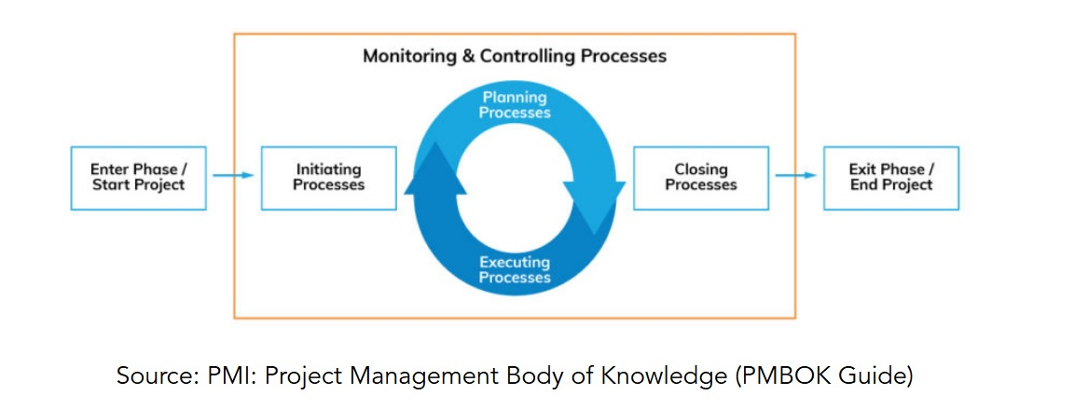
Concept – Project Lifecycle
Project Management Processes
INITIATING
PLANNING
EXECUTING
CONTROLLING AND MONITORING
CLOSING

Slide 4
Techniques – Execution / Control
Implement the Project Schedule & Control the Project
Manage Reality
Scope Changes, Scope Creep, Scope Misunderstandings
Resource Changes, Resource Unavailability, Resource Skills
Estimates are Incorrect, Tasks are Missing
Risk Events Occur
“No Battle Plan Survives Contact with the Enemy” - Colin Powell
Notes:
Pic 1: Sourced by pexels.com - Dmitry Demidov (Found here)
Pic 2: Sourced by pexels.com - Scott Webb (Found here)

Slide 5
Project Execution / Control
Tracking
Progress Against Project Schedule
Risks
Change Control
Manage Change Process
Communication
Update Team and Stakeholders
Notes:
Sourced by pexels.com - Leeloo Thefirst(Found here)

Slide 6
Project Execution – Tracking
Implement the Project Schedule
Project Tracking
Schedule – % complete
Risks: keep an eye out for triggers and take new risks seriously.
Issues and actions log: new or overlooked issues, problems inhibiting task completion
Make it happen
Notes:
Sourced by pexels.com - Mikhail Nilov (Found here)

Slide 7
Project Execution – Change
‘Manage’ the Project Schedule
Project Change
Recognize change
Accept / manage change
Assess impact
Approve & implement change (or not)
Integrate change, update project plan, and communicate revised plan
Notes:
Sourced by pexels.com - Pixabay (Found here)

Slide 8
Project Execution – Communications
Keep the team & stakeholders informed
Project Communications
Stakeholders: control expectations and message customization
Effective meetings with an agenda, monitoring, and a summary
Email – targeted and tagged
Files – standard naming convention
Reporting – status reports
Takeaway: The right people receiving the correct information at the right time

Slide 9
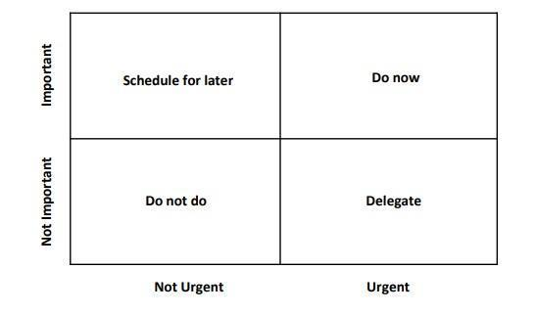
Activity 1: Apply a To-Do List to Categorize Tasks into Different Quadrants based on Importance and Urgency (Discussion)
In small groups, create a To-Do-list to support you time management /prioritisation and organisation of your project at the case study we have been working.
Eisenhower Matrix

Slide 10
Case Study (I)
Organization: Island University
Project: The Future of Education
Objective: Organising the conference meeting where top influential thinkers (Salman Khan, Diana Rhoten, David Thornburg) of the world will share their thoughts about the future of Educational Systems.
Dates of Conference: 28 - 30 March 2024 (Day 1: Individual meetings of subcommittees, Day 2: Conference, Day 3: Visits/Entertainment).
Registration Fees: Project manager to decide.
Accommodation: Attendees will book and pay for their accommodation - but you will facilitate the process.
Dedicated Project Team - Working Time per Day: 4h (Monday to Friday) – 4 employees of the organisation
Notes:
Source: http://teqlearn.com/pm/

Slide 11
Case Study (II)
The Conference Should Provide at Minimum:
Conference Room with a Capacity of at Least 200 People and 5 Meetings Rooms with a Capacity of 15 to 20 People
Website with Information and Registration - Reservations Form
2 Lunches, 1 Dinner and 1 Gala Dinner (outside the conference venues)
Sightseeing Excursion (e.g. visits at schools, educational institutes, other organisations, museums, other sightseeing) after the conference completion (day-excursion)
Airport Transportation

Slide 12
Activity 2: Effective Communication
What strategies/approaches can you incorporate to better address effective communication with your project stakeholders?
See Worksheet Activity 2

Slide 13
Activity 3: Introduction to a PM Tool for Sequencing and Monitoring the Activities
Project Libre Software
Please download the free version here: https://sourceforge.net/projects/projectlibre/

Slide 14
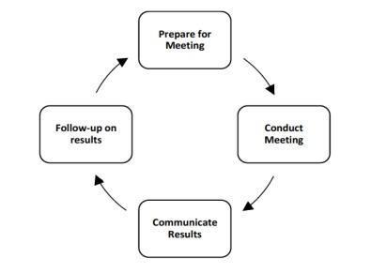
Effective Meetings – Discussion
Which techniques have you been using in order to run effective meetings?
Managing a project, and managing many projects even more so, entails managing many meetings. Project meetings typically consist of:
Project team meetings
Steering Committee Meetings
Status meetings
PMO meetings
Cross-project synergy meetings
Programme Management Meetings
These meetings are more focused, provide results, aid the project, and really favorably impact the team's time management due to the ability and habit of handling them successfully and efficiently.

Slide 15
Effective Meetings – Discussion
Managing a project, and managing many projects even more so, entails managing many meetings. Project meetings typically consist of:
Project team meetings
Steering Committee Meetings
Status meetings
PMO meetings
Cross-project synergy meetings
Programme Management Meetings
These meetings are more focused, provide results, aid the project, and really favorably impact the team's time management due to the ability and habit of handling them successfully and efficiently.
Notes:
Employees in many firms can waste a lot of time in project-related meetings that don't have a clear agenda or end without a list of next steps. In order to plan the meeting in the most productive way, it is crucial to first grasp its goals.
The image above illustrates a series of general actions that should be taken to guarantee that meetings are conducted effectively and efficiently. This strategy focuses on carefully planning the meeting to make sure the goals are met, increase communication, and follow-up after previous meetings. The general idea is to be clearer and more focused, and to make sure that meetings end with a set of important actions.

Slide 16
Indicative Answers
Step 1: Prepare for Meeting
Establish the meeting's goals.
Specify the meeting's format and any necessary instruments to make it operate well.
Create an agenda outlining the goals and expectations for the meeting.
Establish a list of attendees, keeping in mind that smaller meetings are more productive and it is preferable to only invite the necessary stakeholders.
Send the schedule with the invitation.
Step 2: Conduct Meeting
Declare the meeting's goals and lay out the ground rules before the outset (for example, no food and no use of technological devices).
Follow the agenda strictly and make an effort to limit conversations that are off-topic.
Prioritizing discussions is crucial for a meeting with many goals.
Define speaking time as a technique for time-boxing dialogue and preventing veering off subject.
Notes:
It is advantageous to have supporting staff take care of all the record keeping and aid in the organization of larger or longer meetings, especially brainstorming sessions.
These jobs consist of:
Reminds the facilitator of the time allotted for important agenda items as the timekeeper.
Note-taker: Distributes meeting notes and records and summarizes the meeting minutes.
Whiteboard Note-taker: During brainstorming meetings, writes ideas on the whiteboard and captures the key points to send to everyone invited.
The meeting should be run by the organizer, who should assume control of the proceedings. Do not be afraid to table or set aside discussions that do not advance the meeting's goals or are not on the schedule. The meeting's main objective

Slide 17
Indicative Answers
Step 3: Communicate Actions
Have someone record the meeting's decisions, issues, risks, and actions while also taking minutes.
Send the meeting minutes as soon as possible after the meeting is over.
Step 4: Review Actions
The meeting's action items should be examined in accordance with the deadlines.
The affected parties should receive reminders that they need to take action.
In follow-up meetings, a review of work completed and work still to be done should be done.

