Slide 1
Module 4 Project Management
Unit 5: Project Management - CLOSING

Slide 2
Module Contents
Unit 1: Project Management Introduction
Unit 2: Life Cycle – INITIATION
Unit 3: Life Cycle – PLANNING
Unit 4: Life Cycle – EXECUTING AND CONTROLLING
Unit 5: Life Cycle – CLOSING
Notes:
Sourced by pexels.com - fauxels (Found here)

Slide 3
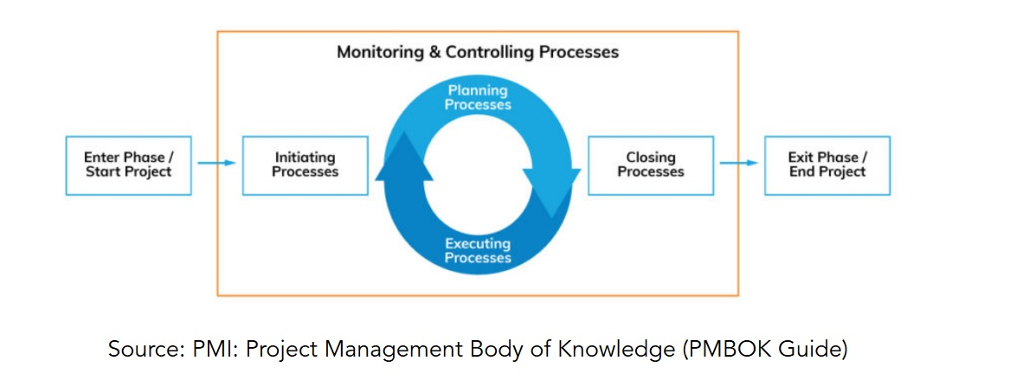
Concept – Project Lifecycle
Project Management Processes
INITIATING
PLANNING
EXECUTING
CONTROLLING AND MONITORING
CLOSING

Slide 4
Techniques – Project Close
Achieve your Project’s Objective
Project Transition
To Support / Operations
Project Closeout
Lessons Learned & Continuous Improvement
Celebration & Thank You
“Insanity: Doing the same thing over and over again and expecting different results.” (Albert Einstein)
Notes:
Source : vectorjuice (found here)

Slide 5
Close – Project Close
Project Summary
Description, Size, Complexity and Resources
Metrics: Baseline vs Actuals (variance)
Explanation of the Schedule, Cost, Scope and Variance
Lessons Learned and Post-Project Recommendations (Project- End Report)
PM Project Life Cycle
Process and Product Related
Administrative Closure and Complete Project Closeout Checklist
Example Template of Post Implementation Review (PIR) Project End Report
Example Template of Benefits Realization Plan
Example template of Closeout Checklist
Project closure marks the end of the project phase and paves the way for operations mode to begin!
Notes:
Source: Freepik (found here)
The Closing Project Phase is the final stage of the project lifecycle, where the project is formally concluded, and the deliverables are handed over to the stakeholders.
This phase is essential to ensure that all project objectives have been achieved, and the project has been successfully completed.
It's a time for reviewing all aspects of the project to confirm that everything has been done according to plan.
Project End Review Meeting
Project closure marks the end of the project phase and paves the way for operations mode to begin.

Slide 6
Activity 1 - Metrics : Baseline vs Actuals
In this activity your are asked to define and discuss the benchmark and actual variances encountered in the case study presented in the previous Units.
In this case please consider that the variances were timeframe and quality related.

Slide 7
Case Study (I)
Organization: Island University
Project: The Future of Education
Objective: Organising the conference meeting where top influential thinkers (Salman Khan, Diana Rhoten, David Thornburg) of the world will share their thoughts about the future of Educational Systems.
Dates of Conference: 28 - 30 March 2024 (Day 1: Individual meetings of subcommittees, Day 2: Conference, Day 3: Visits/Entertainment).
Registration Fees: Project manager to decide.
Accommodation: Attendees will book and pay for their accommodation - but you will facilitate the process.
Dedicated Project Team - Working Time per Day: 4h (Monday to Friday) – 4 employees of the organisation
Notes:
Source: http://teqlearn.com/pm/

Slide 8
Case Study (II)
The Conference Should Provide at Minimum:
Conference Room with a Capacity of at Least 200 People and 5 Meetings Rooms with a Capacity of 15 to 20 People
Website with Information and Registration - Reservations Form
2 Lunches, 1 Dinner and 1 Gala Dinner (outside the conference venues)
Sightseeing Excursion (e.g. visits at schools, educational institutes, other organisations, museums, other sightseeing) after the conference completion (day-excursion)
Airport Transportation

Slide 9
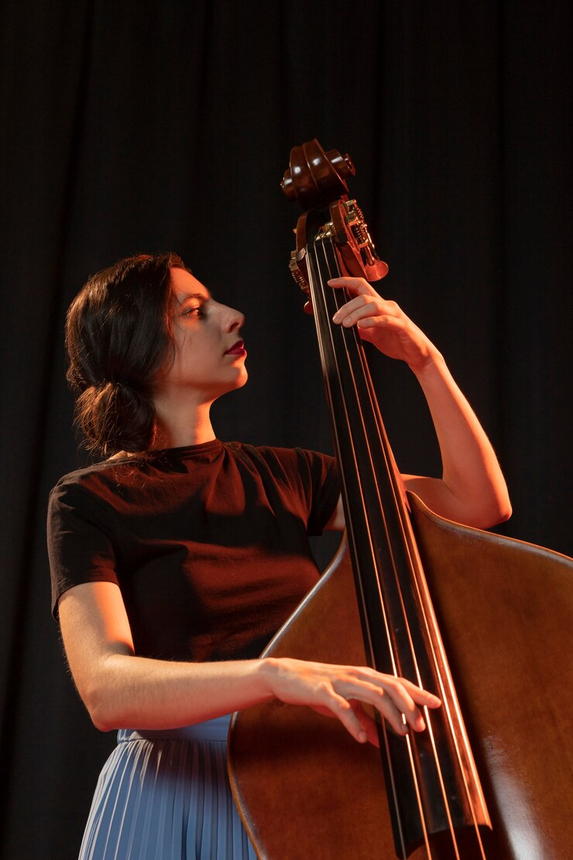
What Kind of a PM do you Want to be?
A. Ricardo Muti – Video Link
B. Leonard Bernstein – Video Link (start from 16:40 min)
Notes:
Source: Freepik (found here)
As seen Ricardo is very dominant, guiding the orchestra by his own guidelines. Saying that ‘you’ should comply with my lead. While Leonard, provides motivation/initiation and sits back monitoring the orchestra and with some simple expressions provides support to the orchestra. The takeaway is that there are different types of PM, and you need to understand your personality with some online test (for instance you are dominant or extrovert, ethic and loyal, etc.). IT is fine to have diverse types of PMs due to the several different project types and stakeholders to manage. Remember that 92% of PM is based on communication!! The important thing is that we need to always adapt, adjust, and overcome obstacles in tackling the current needs and expectations of the project and stakeholders!

