Slide 1
Module 5 Strategic Communication for Civil Society Organizations (CSOs)
Unit 1: Strategic Communication Planning

Slide 2
Overview and Learning Objectives
Overview
The aim of this unit is to present the various steps for the development of a comprehensive strategic communication planning.
Learning Outcomes
Upon completion of the module participants will be able to:
Implement the various steps for the development of a strategic plan
Write communication objectives
Identify key policy audiences
Develop evidence-based policy messages
Identify and use communications tools

Slide 3
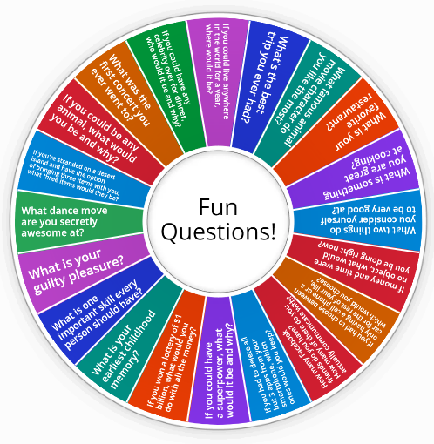
Overview and Learning Objectives
Notes:
https://wordwall.net/resource/38035766/emergeicebreakerrandom-questions

Slide 4
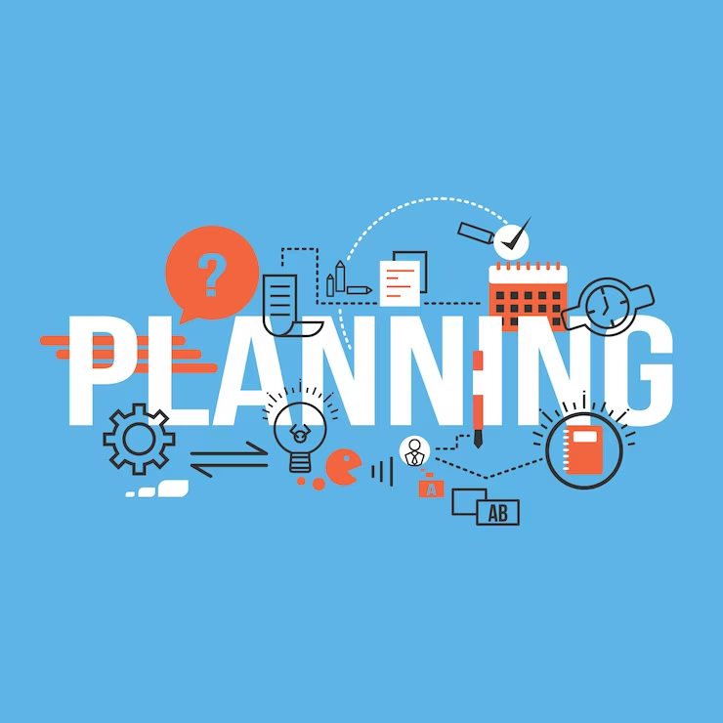
Develop a Communication Plan – Overview
For any initiative, be it a town hall assembly or a large-scale community effort, fruitful communication planning requires dedicating time to establish a concrete objective.
By identifying a definitive goal, coordinators can craft a communication strategy specific to the given task more efficiently.
This significance arises from the opportunity it provides the organizers to pinpoint the most potent channels for reaching their audience, establish a project timeline, and set tangible goals and objectives to monitor the project's advancement. Furthermore, it aids the organizers in devising a budget and strategizing the optimal resource allocation.
Notes:
Picture source: <a href="https://www.freepik.com/free-vector/business-background-design_1068430.htm#query=communication%20plan&position=2&from_view=search&track=ais">Image by GraphiqaStock</a> on Freepik

Slide 5
Develop a Communication Plan – Overview
It's crucial to frequently update communication strategies based on continuous assessment, irrespective of whether they exist as written documents.
This practice ensures that the communication plan dynamically adapts to the ongoing project status and keeps participants informed about recent modifications. It also enables resource optimization, as any modifications can be integrated swiftly and conveniently.
For the execution of a communication plan, it's necessary to pinpoint principal communication drives and devise methods for their operationalization.
This facilitates a more productive interchange of data amongst stakeholders and fosters a better comprehension of the project's progress.
Moreover, it ascertains that all participants maintain alignment and that any modifications are disseminated promptly. Ultimately, this results in a more streamlined project execution process.
Notes:
Picture source: <a href="https://www.freepik.com/free-photo/plan-education-inspire-learn-diagram-concept_17133920.htm#query=communication%20plan&position=3&from_view=search&track=ais">Image by rawpixel.com</a> on Freepik

Slide 6
Communications Strategy
Steps to Develop a Communications Strategy

Slide 7
Step 1: Define Your Goals for Communication Strategy
Establishing communication goals prior to initiating any related activities contributes to the effectiveness and efficiency of these endeavors.
Many organizations mistakenly equate communication tactics with communication objectives, overlooking the fact that tactics are merely tools employed to bolster the main communication thrust.
These objectives need to align with the organization's principles and competencies to ensure collaborative efforts towards their achievement.
The communication objectives for your organization should be lucid, succinct, and explicit as a fundamental step.
The strategy outline should unambiguously stipulate both long-range and short-range targets, along with their respective timeframes.
Inconsistencies or ambiguities in your communication goals will be instantly perceptible to your audience. This may lead to confusion, rendering your message indistinct at the very least.

Slide 8
Questions to Consider
When establishing goals, consider these essential questions to identify and rank their importance:
What transformation are you aiming for?
What is your long-term objective?
What changes will be evident in your community once your goal is accomplished?
Considering your available resources and time constraints, can your community execute this action?
Will it be feasible to quantify any alterations afterwards?
Are any of these goals contingent on time?

Slide 9
Activity time!
List your CSO’s Communication Objectives in order of priority

Slide 10
Step 2: Define Your Target Audiences
Identify Target Audiences: Understand the groups or individuals that can help you achieve your strategic organizational objectives. They may range from potential donors, decision makers, and community leaders to local businesses, not-for-profit organizations, and potential volunteers.
Recognize Audience Diversity: Communication strategies should be tailored to the specific audience you're addressing, whether it's donors, decision makers, or community members.
Establish Audience Engagement Levels: Classify your audiences based on their engagement level with your organization. This could range from no engagement (unaware of your organization) to high engagement (actively involved as a donor, volunteer, etc.).
Formulate Appropriate Messages: Use your knowledge of the audience to craft a message that resonates with them and determines the best channels and platforms to reach them effectively.

Slide 11
Step 2: Define Your Target Audiences
Engage Key Audiences: Once you have identified your key audiences, figure out the best ways to engage them and tailor your messages to their needs and preferences.
Allocate Necessary Resources: Identify the resources needed to meet the needs of your audiences and work on building long-term relationships with them.
Identify Ambassadors and Free Agents: Discover individuals who can spread your message across target communities.
Recognize the Importance of Communication Planning: Understanding your target audience is crucial in communication planning as it directly links to your strategic communication objectives.

Slide 12
Step 2: Define Your Target Audiences
Identifying Target Audiences: A Simplified Process
Step 1: Audience Segmentation
Make a list of potential audiences, crafting your message to suit each group or person. Determine who has the influence or power to help reach your goals and who can influence others in your community or key leaders.
Step 2: Analysing Relationships
Consider the relationships between you, your target audience, and decision-makers. Understand who your target audience trusts and takes advice from, who you can influence, and who else could potentially persuade the decision-makers in your favor.
Step 3: Recognizing Core Interests
Discover what matters to each target audience, what's important to the people they trust, and identify the common values you share with those you want to influence.
Notes:
Picture Source: Image by <a href="https://www.freepik.com/free-photo/high-angle-piece-paper-with-target-audience_6950747.htm#query=target%20auduence&position=2&from_view=search&track=ais">Freepik</a>

Slide 13
Activity Time!
Map your target audience and write the
goal for each target audience.

Slide 14
Step 3: Evaluate Your Current Situation - Using the Maturity Practice Model (Crawl, Walk, Run, Fly)
Self-Assessment Process
Prior to formulating your communications action plan, conduct a self-assessment to understand your position.
This self-evaluation will aid in identifying communication strengths and weaknesses, as well as pinpointing areas that require enhancement.
It will assist in setting realistic objectives, formulating an action plan, and prioritizing tasks necessary to achieve those goals.
Crawl, Walk, Run, Fly Model
The CWRF model is a practice maturity model that aids non-profits in enhancing their communication methods to achieve strategic objectives.
This model enables non-profits to gradually expand their capacity and incorporate new strategies and tactics until their strategic goals are met, fostering steady and sustainable growth.
Notes:
Picture source: Image by <a href="https://www.freepik.com/free-photo/woman-planning-scrum-method_7816299.htm#query=Self-Assessment%20Process%20identify%20needs&position=1&from_view=search&track=ais">Freepik</a>

Slide 15
Step 3: Evaluate Your Current Situation - Using the Maturity Practice Model (Crawl, Walk, Run, Fly)
Other Tools for Evaluation
SWOT Analysis: Document your strengths, weaknesses, opportunities, and threats.
PEST Analysis: Consider political, economic, social, and technological impacts on your endeavours.
Competitor Analysis: Compare your strengths and weaknesses to those of your competitors.
Stakeholder Feedback: Gather data and perspectives from a broad spectrum of stakeholders. Directly engage with key stakeholders, and utilize communication surveys for wider inclusion.
Notes:
Picture source: <a href="https://www.freepik.com/free-photo/swot-business-company-strategy-marketing-concept_17433135.htm#query=swot%20analysis&position=1&from_view=search&track=ais">Image by rawpixel.com</a> on Freepik

Slide 16
Step 4: Formulating Your Essential Messages
Understanding Key Messages and Their Importance
A key message is a crucial element of strategic communication, especially in the non-profit sector. It influences the creation of all types of communication tools. Effective messages are clear, concise, and engaging, crafted specifically to resonate with the target audience and aligned with the organization's objectives.
A well-crafted message can promote an organization's objectives, foster trust and loyalty, and effectively communicate the organization's mission and values. It helps distinguish an organization from its competition and establishes it as a leader.
They should be memorable and offer a clear understanding of the organization's purpose and goals.
Key messages play a vital role in maintaining a consistent brand identity and in articulating the organization's mission, values, and goals to the public. They can be controlled to prioritize and define information, ensure consistency and accuracy, track success, and maintain focus during interactions with media or stakeholders.

Slide 17
Step 4: Formulating Your Essential Messages
Characteristics of Effective Key Messages
Succinct: Stick to three to five key messages per topic, each comprising one to three sentences, and deliverable in 30 seconds or less.
Strategic: Highlight what differentiates you and the benefits you offer.
Relevant: Balance your need to communicate with what your audience needs to understand.
Engaging: Create informative messages that stimulate action.
Simple: Avoid jargon and acronyms, use simple language.
Memorable: Make messages easy to recall and repeat, avoid lengthy sentences.
Authentic: Use active voice, avoid advertising slogans.
Customized: Adapt language and information depth for effective communication with different target audiences.

Slide 18
Step 4: Formulating Your Essential Messages
Steps to Craft Key Messages The key message development process can be divided into three stages:
Brainstorm: Start by identifying your communication goals and messaging needs. Understand your target audience's needs and expectations. If you have multiple target audiences, customize your key messages accordingly. Develop key messages by answering a few concise questions related to your primary message, its significance, uniqueness, relevance to the target audience, and any challenges or barriers to address.
Refine: After brainstorming, revise your draft key messages. Ensure they align with your communication objectives, are conversational when read aloud, can be further simplified or made more concise, and encourage the target audience to take action.
Test and Update: After refining the draft, test the key messages with internal and external audiences, including members of your target audience. Incorporate their feedback and finalize the messages. Periodically review and update the key messages to ensure they continue to meet your and your audience's needs and reflect current trends, research, and your organization's focus.

Slide 19
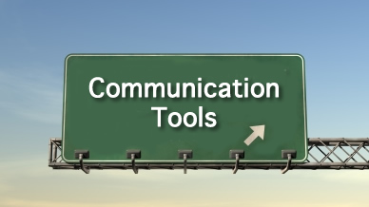
Step 5: Choosing Communication Channels and Tools
Diverse communication methods exist, from direct discussions to social media usage. Selecting the right tool can aid in effectively reaching your audience and controlling your narrative.
It's important to understand the limitations of each communication channel such as timeliness, reach, length limit, cost, etc.
Choose the communication channels based on the audience preference and the need for your message to be received promptly.
Notes:
Picture source: This Photo by Unknown Author is licensed under CC BY-SA-NC

Slide 20
Step 5: Choosing Communication Channels and Tools
Brainstorming Accessible Tools for Audience
Consider how your target audience communicates with one another and with organizations, and their preferred ways of receiving information.
Understand their trusted sources for news or information and the leaders they trust.
Check the suitability and feasibility of the communication tool considering your topic, budget, schedule, and feedback collection mechanisms.
Common communication channels include email newsletters, advertisements, press releases, workshops, events, website blogs, and social media.

Slide 21
Step 6: Create a Work Plan
A work plan is crucial for implementing a communications strategy effectively. It outlines the necessary tasks, resources, and personnel involved in executing the strategy.
By having a well-defined work plan, the steps of the communications strategy can be mapped out, assigned to the appropriate individuals or teams, and completed efficiently. This ensures that everyone understands their responsibilities and can collaborate effectively to achieve the strategy's goals.
Notes:
Picture source: <a href="https://www.freepik.com/free-photo/top-view-black-notebook-pen-female-hand-black-surface_17188391.htm#query=work%20plan&position=7&from_view=search&track=ais">Image by KamranAydinov</a> on Freepik

Slide 22
Contents of a work plan
Tasks and Responsibilities:
Clearly outline the specific tasks that need to be completed as part of the communications strategy.
Assign responsibilities to individuals or teams to ensure accountability and effective collaboration.
Resources and Personnel:
Identify the necessary resources, such as budget, technology, tools, and personnel, needed for the strategy's execution.
Allocate resources appropriately to ensure smooth implementation of the plan.
Timeline and Milestones:
Establish a timeline that includes key milestones and deadlines for each task or phase of the communications strategy.
Setting clear timeframes helps keep the team on track and ensures timely completion of objectives.

Slide 23
Contents of a work plan
Campaign Events:
Document important events related to the communications strategy, such as product launches, press conferences, or promotional campaigns.
Include detailed information about these events, such as dates, locations, and target audiences.
Risk Assessment and Contingency Planning:
Identify potential risks and challenges that may impact the execution of the communications strategy.
Develop contingency plans to mitigate risks and overcome challenges effectively.
Monitoring and Evaluation:
Establish methods and metrics to monitor the progress and success of the communications strategy.
Regularly evaluate the outcomes and make adjustments if necessary to ensure desired results.

Slide 24
Contents of a work plan
Budget:
Develop a comprehensive budget that includes costs for various aspects of the communications strategy, such as advertising, content creation, and marketing campaigns.
Allocate funds based on priorities and projected outcomes to optimize resource utilization.
Key Activities:
Identify and list the crucial activities required to achieve the goals of the communications strategy.
This could include activities such as market research, content creation, media outreach, social media management, and analytics tracking.

Slide 25
Step 7: Set Key Performance Indicators (KPIs)
Measuring the effectiveness of your communication plan is crucial to determine if it is achieving the desired results. If it falls short, adjustments can be made to tailor it to the specific context and audience. Regular measurement also enables progress monitoring and ensures that the plan is on track.
By measuring effectiveness, you can identify areas that need improvement, such as reaching the intended audience or ensuring that the messaging resonates with them. This process ensures that the plan is optimized for the specific context and audience, maximizing its effectiveness.
Key Performance Indicators (KPIs) are metrics used to track and measure progress towards achieving specific goals.
They provide a clear way to evaluate performance and help teams stay focused on their objectives. Managing KPIs involves establishing targets and regularly monitoring progress.
By implementing KPIs, you can assess team performance, identify areas for enhancement, and develop strategies to mitigate potential risks. This approach ensures that your team is working towards the desired goals in an efficient and timely manner.

Slide 26
Which KPIs to select?
Visibility Indicators
Social Media:
Rate or number of impressions: The number of times your content is displayed to users.
Number of visits: The total visits to your social media profiles or pages.
Total number of subscribers/followers: The number of people who have subscribed to or followed your social media accounts.
Number of views on a video: The number of times your video content has been viewed.
Website:
Number of unique users: The number of distinct individuals who have visited your website.
Rate of new visitors: The percentage of visitors who are visiting your website for the first time.
Newsletters:
Number of subscribers: The number of people subscribed to your newsletter.
Rate of deliverability: The percentage of newsletters successfully delivered to subscribers.

Slide 27
Which KPIs to select?
Engagement Indicators:
Social Media:
Total number of interactions (likes, shares, comments...): The overall engagement, such as likes, shares, comments, and other interactions on your social media posts.
Number of subscribers gained: The number of new subscribers or followers gained.
Rate of clicks: The percentage of people who clicked on a specific link or call-to-action.
Engagement rate: The percentage of people who engaged with your content relative to the total number of impressions.
Website:
Bounce rate: The percentage of visitors who leave your website after viewing only one page.
Engagement rate: The level of engagement users have with your website, often measured by the time spent on site or the number of pages visited per session.
Number of visitors per channel (direct, organic, ads, social media...): The number of visitors coming from different channels to your website.
Newsletters:
Opening rate: The percentage of recipients who opened your newsletter.
Click-through rate: The percentage of recipients who clicked on a link within your newsletter.
Unsubscribe rate: The percentage of recipients who unsubscribed from your newsletter.

Slide 28
Which KPIs to select?
Conversion Indicators:
Number of messages received: The total number of messages or inquiries received as a result of your communication actions.
Rate of conversion of visitors into leads: The percentage of website visitors who take a desired action, such as filling out a form or subscribing.
Number of subscribers/registers to a newsletter or webinar: The number of people who subscribe or register for your newsletter or webinar.
Notes:
Picture source: Image by <a href="https://www.freepik.com/free-photo/medium-shot-people-addicted-social-media_33300298.htm#query=social%20media%20indicators%20likes&position=16&from_view=search&track=ais">Freepik</a>

Slide 29
What if “success” isn’t achieved?
Reflection Questions
Is my communication plan's goal clearly defined using the SMART goal framework?
Did I set goals that align with my intended audience in step 1?
How do I know whether the content I'm creating and the platform I'm using is the right choice for my target audience?
How well did my KPIs measure my goal?
Do any external factors impact my ability to reach my audience, such as holidays, significant events, or unexpected news stories?

