Slide 1
Module 5 Strategic Communication for Civil Society Organizations (CSOs)
Unit 2: Social Media Platfroms for CSOs

Slide 2
Overview and Learning Objectives
Overview
The power of social media as a platform for communication, outreach, and engagement is undeniable. For Civil Society Organizations (CSOs), these digital tools can serve as invaluable assets in furthering their cause and building a network of support. This unit aims to guide CSOs in identifying and utilizing the most relevant social media tools, along with providing actionable insights to enhance their social media strategy.
Learning Outcomes
Understand Different Social Media Platforms
Select Appropriate Platforms
Develop Engaging Content
Build and Nurture an Online Community
Implement Fundraising and Awareness Campaigns
Analyze Social Media Performance

Slide 3
Social Media Platforms – Overview
If you haven't already done so, incorporating social media into your strategic communication plan is highly recommended. Essential activities for organizations include sharing work, storytelling, conducting market research, building relationships, and providing customer service.
By utilizing social media, organizations can expand their reach to a broader audience, establish connections with customers, and gain valuable insights into customer needs and preferences. Moreover, it enables personalized communication with the audience, leading to increased customer loyalty and satisfaction.
Social media also offers opportunities for organizations to enhance brand recognition and cultivate a positive public image. It can be leveraged to raise awareness about campaigns, events, and promotions. Additionally, it facilitates collaboration and idea sharing, allowing organizations to tap into the collective intelligence of their audience and improve efficiency.
Notes:
Picture source: <a href="https://www.freepik.com/free-photo/pile-3d-popular-social-media-logos_1191374.htm#query=social%20media&position=2&from_view=search&track=ais">Image by natanaelginting</a> on Freepik

Slide 4
Identifying the Most Relevant Social Media Platforms
Identifying the most relevant social media platforms depends on various factors such as your target audience, goals, and the benefits offered by each platform. Here are some popular social media platforms and their key characteristics:
Facebook: With over 2.8 billion monthly active users, Facebook remains one of the largest social media platforms. It attracts a diverse user base across different age groups and interests. Facebook provides a wide range of advertising options, targeting capabilities, and detailed analytics.
Instagram: Known for its visually focused content, Instagram is particularly popular among younger audiences, although its user base has been expanding. It offers opportunities for sharing photos, videos, and stories. Instagram's advertising options include photo ads, video ads, carousel ads, and influencer partnerships.
Twitter: Twitter is a microblogging platform where users can share short messages called tweets. It is often used for real-time updates, news, and discussions. Twitter can be effective for reaching a broad audience, engaging in conversations, and monitoring trends and sentiment.

Slide 5
Identifying the Most Relevant Social Media Platforms
LinkedIn: As a professional networking platform, LinkedIn caters to businesses, professionals, and job seekers. It is ideal for B2B marketing, recruitment, and industry networking. LinkedIn offers advertising options such as sponsored content, display ads, and InMail messages.
YouTube: The largest video-sharing platform, YouTube has billions of users and offers extensive reach. It is effective for video-based content, tutorials, product reviews, and entertainment. YouTube advertising includes pre-roll ads, sponsored videos, and display ads.
TikTok: TikTok is a short-form video platform with a primarily younger user base. It is known for its viral challenges, dances, and creative content. TikTok advertising options include in-feed ads, branded effects, and influencer collaborations.
Pinterest: Pinterest is a visual discovery platform where users can find and save ideas. It is popular for fashion, home decor, recipes, and DIY projects. Pinterest advertising features promoted pins, shopping ads, and personalized recommendations.
.
Notes:
Picture source: <a href="https://www.freepik.com/free-photo/diagram-social-media-s-elements_902889.htm#query=social%20media%20consistency&position=3&from_view=search&track=ais">Image by creativeart</a> on Freepik

Slide 6
Identifying the Most Relevant Social Media Platforms
LinkedIn: As a professional networking platform, LinkedIn caters to businesses, professionals, and job seekers. It is ideal for B2B marketing, recruitment, and industry networking. LinkedIn offers advertising options such as sponsored content, display ads, and InMail messages.
YouTube: The largest video-sharing platform, YouTube has billions of users and offers extensive reach. It is effective for video-based content, tutorials, product reviews, and entertainment. YouTube advertising includes pre-roll ads, sponsored videos, and display ads.
TikTok: TikTok is a short-form video platform with a primarily younger user base. It is known for its viral challenges, dances, and creative content. TikTok advertising options include in-feed ads, branded effects, and influencer collaborations.
Pinterest: Pinterest is a visual discovery platform where users can find and save ideas. It is popular for fashion, home decor, recipes, and DIY projects. Pinterest advertising features promoted pins, shopping ads, and personalized recommendations.
.
Do you use social media for the purposes
of your organization?
What do you use and why?
Notes:
Picture source: <a href="https://www.freepik.com/free-photo/diagram-social-media-s-elements_902889.htm#query=social%20media%20consistency&position=3&from_view=search&track=ais">Image by creativeart</a> on Freepik

Slide 7
What Style/Tone/Voice Should You Use?
This consistency establishes a sense of continuity and trustworthiness for the brand, aiding in the formation of a distinct brand identity. Additionally, conveying a consistent message and vision helps to foster a bond with your audience.
Consistency is key in social media management. It's crucial to uphold a specific brand persona and maintain a consistent tone and writing style across all platforms.

Slide 8
What Style/Tone/Voice Should You Use? Benefits of Consistency
1.Brand Recognition
When you maintain the same tone and style across different social media platforms, your audience can easily recognize your brand. This consistent 'voice' becomes an integral part of your brand identity.
2. Building Trust:
Consistency in your brand's messaging conveys professionalism and reliability, which can help build trust with your audience. Inconsistencies, on the other hand, can lead to confusion and mistrust.
3. Creating a Community
A consistent tone and style help create a community feeling among your audience. They know what to expect and look forward to your posts.

Slide 9
What Style/Tone/Voice Should You Use? Benefits of Consistency
4. Enhancing Brand Image
Consistency helps shape and reinforce your brand image. Whether your brand is serious, fun, innovative, or traditional, a consistent tone and style reaffirm these traits at every customer touchpoint.
5. Engaging the Audience
: By using a consistent style and tone that resonates with your audience, you can increase audience engagement. They will be more likely to interact with posts that feel familiar and align with their expectations of your brand.
6. Stand Out From the Crowd
In the crowded social media landscape, a distinct and consistent voice can help your brand stand out. This unique voice can be a powerful tool in differentiating your brand from competitors.

Slide 10
Who Will Measure Your Success?
Evaluating your success on social media platforms often involves the use of analytics tools. These can help guide what you post, how you engage with audiences, and how you optimize your content. Here's more on this:
Utilizing social media analytics can be a powerful tool in understanding and improving your posting strategies. Alongside this, personalization methods can be employed to adapt your content to cater to specific audience segments, enhancing the impact and resonance of your messages.
By scrutinizing the statistics from your social media accounts, you can glean insights into which types of content generate the best performance and attract engagement. This data can also help identify specific audience segments that are more likely to interact with your content. Furthermore, by personalizing your content, you can forge stronger relationships with your followers, fostering greater engagement and yielding superior outcomes.
Gaining a comprehensive understanding of your followers, including their demographics and interests, allows you to tailor content that deeply resonates with them. Monitoring which posts attract the most views and interactions can guide your content strategy. This data-driven approach can lead to the creation of content that your audience is more inclined to engage with, enhancing the effectiveness of your social media efforts.
Reflection:
How is success measured in the social media sphere?

Slide 11
Who Will Measure Your Success?
Evaluating your success on social media platforms often involves the use of analytics tools. These can help guide what you post, how you engage with audiences, and how you optimize your content. Here's more on this:
Utilizing social media analytics can be a powerful tool in understanding and improving your posting strategies. Alongside this, personalization methods can be employed to adapt your content to cater to specific audience segments, enhancing the impact and resonance of your messages.
By scrutinizing the statistics from your social media accounts, you can glean insights into which types of content generate the best performance and attract engagement. This data can also help identify specific audience segments that are more likely to interact with your content. Furthermore, by personalizing your content, you can forge stronger relationships with your followers, fostering greater engagement and yielding superior outcomes.
Gaining a comprehensive understanding of your followers, including their demographics and interests, allows you to tailor content that deeply resonates with them. Monitoring which posts attract the most views and interactions can guide your content strategy. This data-driven approach can lead to the creation of content that your audience is more inclined to engage with, enhancing the effectiveness of your social media efforts.

Slide 12
Social Media Checklist
Reply to Everyone: Responding to comments and messages is vital for maintaining engagement and fostering relationships with your audience.
Check Your Mentions: Keep track of where and how your brand is being talked about. Respond or engage where necessary.
Monitor Social Media for Keywords and Phrases: Use social listening tools to track brand- or industry-related keywords, helping you stay on top of trends and conversations.
Schedule Your Updates for the Next Day: Planning and scheduling posts in advance can help maintain a consistent posting schedule.
Check Out Other Social Media Profiles: Keep an eye on competitors and industry leaders for inspiration and to stay up-to-date with current trends.
Weekly Goals Check-In: Regularly review and adjust your goals to ensure your strategy stays effective and relevant.
Update Your Social Media Ads: Regularly review and update your ad campaigns to ensure they're still relevant and effective.
Curate Content to Share: Sharing relevant third-party content can provide additional value to your audience and complement your original content.
Advocacy: Make it Easy for Your Team to Share: Encourage your team to share and engage with your brand's content to increase reach.
Follow Back Those Who Follow You: It's a way to show appreciation to your audience and can help grow your follower base.
Check Your Stats: Regularly review your analytics to understand what's working and to inform future strategies.
Engage with Influencers: Collaborating or engaging with influencers can expand your reach and boost your brand's credibility.
Engage with Partners: Regularly interact with your business partners on social media to strengthen relationships and potentially reach a wider audience.

Slide 13
TWITTER
Overview
Twitter is an online platform for microblogging and global information sharing.
Users can share news, videos, and pictures in real time.
Character limit for tweets is 280.
Used for short commentaries, engaging with others, and staying updated.
Organizations use Twitter for quick communication and building connections.
Notes:
Picture source: <a href="https://www.freepik.com/free-photo/pile-3d-twitter-logos_1191372.htm#query=twitter&position=0&from_view=search&track=sph">Image by natanaelginting</a> on Freepik

Slide 14
TWITTER
Tips for Effective Twitter Usage
Set limits on engagement for healthy social media habits.
Keep your bio up to date to attract followers.
Follow influential figures in your field for visibility.
Use "@" to send direct messages and give credit to others.
Understanding Hashtags
Hashtags are denoted by "#" and used for tracking trending topics.
Can be included anywhere in a tweet.
Websites like tagdef.com, hashtags.org, and Twitter's help center provide insights.
Notes:
Picture source: <a href="https://www.freepik.com/free-photo/hand-holding-hashtag-symbol_3476877.htm#query=twitter%20hashtag&position=2&from_view=search&track=ais">Image by rawpixel.com</a> on Freepik

Slide 15
TWITTER
Managing Character Limit and Analytics
Twitter expanded character limit to 280, but focus on content quality.
Twitter Analytics provides engagement metrics.
Uploading media enhances content.
Help center offers guidance on media formats.
Tools for Twitter Management
For setting up an account and optimizing use of the platform: https://help.twitter.com/
For advertising and marketing: https://business.twitter.com/
See Twitter blog for updates and news: https://blog.twitter.com/
Use Tweetdeck to schedule tweets, add filters, monitor mentions and hashtags, and manage unlimited accounts: https://tweetdeck.twitter.com/
Notes:
Picture source: Image by <a href="https://www.freepik.com/free-photo/close-up-businesspeople-with-digital-tablet-social-media-icons-table_2610637.htm#query=Tools%20for%20Twitter%20Management&position=48&from_view=search&track=ais">Freepik</a>

Slide 16
FACEBOOK
Overview
Facebook, founded in 2004 by Mark Zuckerberg and his team, is a widely-used social media platform that started as a means for college students to connect but has since become a global platform for individuals from all backgrounds.
On Facebook, users have the ability to create profiles, connect with friends and family, and share various forms of content, such as updates, photos, and videos. It serves as a virtual space for people to engage with others and interact with the content they post, fostering connections and communities.
A prominent feature of Facebook is the news feed, which presents a personalized stream of content based on a user's connections and interests. Users can engage with posts by liking, commenting, and sharing, enabling interaction and conversation among their circle of friends and acquaintances.
In its growth trajectory, Facebook has expanded its services through the acquisition of other popular apps and platforms like Instagram and WhatsApp.
Notes:
Picture source: <a href="https://www.freepik.com/free-photo/pile-3d-facebook-logos_1191368.htm#query=facebook&position=0&from_view=search&track=sph">Image by natanaelginting</a> on Freepik

Slide 17
FACEBOOK
Facebook can be a valuable tool for Civic Society Organizations (CSOs) to engage with their audience, raise awareness about social issues, and mobilize support for their causes. Here are some key considerations and strategies for CSOs when using Facebook:
Establish a Strong Presence:
Create a Facebook Page specifically for your organization to showcase your mission, activities, and impact.
Customize your Page with a compelling profile picture, cover photo, and a concise and engaging description.
Use the "About" section to provide relevant information and include links to your website or other online platforms.
Content Strategy:
Develop a content strategy that aligns with your organization's goals and target audience.
Engage and Interact:
Actively respond to comments, messages, and inquiries from your audience.
Encourage discussions and create a sense of community by asking questions, seeking opinions, and hosting polls or surveys.
Facebook Groups:
Consider creating or participating in relevant Facebook Groups to connect with like-minded organizations and individuals who share similar interests or concerns.
Engage in discussions, share resources, and collaborate on joint initiatives within these groups.

Slide 18
FACEBOOK
Fundraising and Donations:
Utilize Facebook's fundraising features, such as creating fundraisers or adding a "Donate" button to your Page, to raise funds for your organization.
Share compelling stories, impact data, and specific goals to encourage donations and showcase the impact of contributions.
Facebook Events:
Organize and promote events through Facebook Events to reach a wider audience and track attendance.
Leverage the event features to share event details, updates, and interact with participants before, during, and after the event.
Facebook Advertising:
Consider using targeted Facebook ads to reach specific demographics, expand your reach, and drive engagement or support for your organization.
Define your target audience, set clear campaign goals, and track the performance of your ads to optimize results.
Monitoring and Evaluation:
Regularly monitor the performance of your Facebook efforts using Facebook Insights and other analytics tools.
Evaluate the engagement, reach, and impact of your posts and campaigns to refine your content strategy and maximize effectiveness.

Slide 19
YOUTUBE
Overview
YouTube is a well-known platform where users can upload and watch videos across a wide range of categories. It serves as a hub for diverse content, including entertainment, education, music, and more.
Users have the freedom to share their own videos or explore the extensive collection available for free. YouTube encourages social engagement through features like commenting, liking, and sharing, fostering an active and interconnected community.
Additionally, the platform offers live streaming capabilities and provides valuable tools to assist content creators in improving their videos. With its extensive reach and expansive content library, YouTube has become a prominent destination for video sharing and viewing on the internet.
Notes:
Picture source: Image by <a href="https://www.freepik.com/free-vector/youtube-player-icon-with-flat-design_2448079.htm#query=youtube&position=0&from_view=search&track=sph">Freepik</a>

Slide 20
YOUTUBE
Things you can do on YouTube:
Start creating your own videos: Begin by storyboarding your ideas and creating a compelling narrative. Storyboards are visual representations of your story, using screenshots or illustrations. They help in the development of your videos. Before filming, create a storyboard and a script. Break down your story into different scenes to organize your content effectively.
Create a YouTube channel for your organization: Set up a dedicated channel where you can upload and showcase your videos. This will allow you to centralize your content and make it easily accessible. You can then share these videos on your social media platforms to reach a wider audience.
Engage with other YouTube videos: Like, comment, and share videos that are relevant to your organization. This can help you build connections and engage with the YouTube community. It's a great way to show support and collaborate with other creators.
Utilize live streaming: Live streaming enables you to share real-time experiences and engage with your audience. You can use it to provide unscripted responses to events, news, or even do unboxings. Although live streaming may have a learning curve, it can become the easiest way to create video content once you've mastered the format.

Slide 21
YOUTUBE
YouTube Tips for Videos:
Begin each video with an interesting hook: Grab your viewers' attention right from the start to keep them engaged throughout the video.
Develop a sustainable video production workflow: Establish a systematic process for planning, shooting, editing, and uploading your videos. This ensures consistent quality and timely delivery.
Create a consistent look and feel: Develop a recognizable visual style for your videos by using consistent branding, graphics, and editing techniques. This helps to build a cohesive identity for your channel.
Collaborate with other YouTubers: Seek out channels with similar audiences but different content and explore collaboration opportunities. This can help you tap into new audiences and expand your reach.
Develop videos as a series: Consider creating a series of videos that revolve around a specific theme or topic. This encourages viewers to watch multiple videos, increasing engagement and subscriber loyalty.

Slide 22
YOUTUBE
For measuring, creating content, scheduling, and monitoring on YouTube, you can utilize the following tools:
YouTube Live: YouTube Live is a powerful tool for live streaming events, performances, or interactive sessions. You can engage with your audience in real-time and build a sense of community. To learn more about using YouTube Live, you can access a free course provided by YouTube on livestreaming through this link: https://creatoracademy.youtube.com/page/course/livestream
YouTube Analytics: YouTube Analytics provides valuable insights into your channel's performance and audience engagement. It allows you to track metrics such as views, watch time, audience demographics, and more. To understand how to use YouTube Analytics effectively, you can refer to this link for more information: https://support.google.com/youtube/answer/1714323?hl=en
These tools will help you gain a deeper understanding of your channel's performance, audience behavior, and enable you to make data-driven decisions to enhance your content strategy.

Slide 23
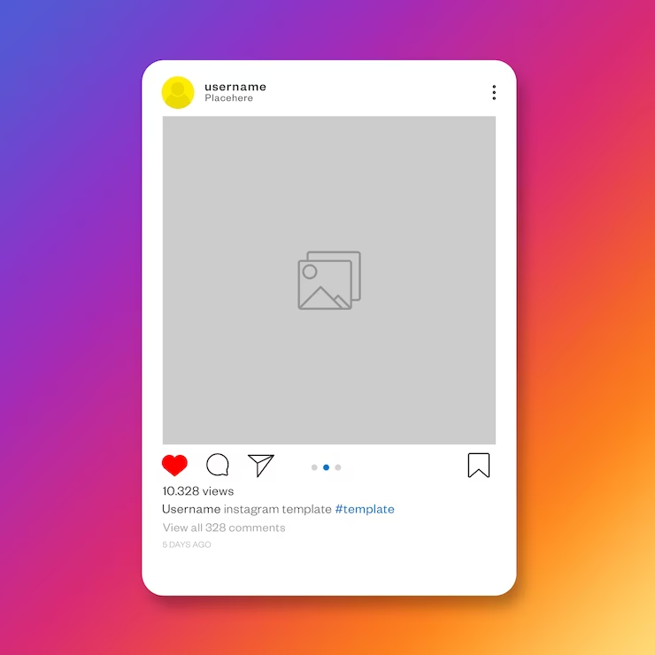
INSTAGRAM
Overview
Instagram, available at www.instagram.com, is a popular mobile application used for sharing photos and videos. Users typically upload media from their mobile phones to their Instagram accounts, where others can like and comment on them.
The app can be linked to other social media platforms, allowing for simultaneous posting across multiple networks.
Notes:
Picture source: <a href="https://www.freepik.com/free-psd/social-media-instagram-post-template_6353554.htm#query=instagram&position=1&from_view=search&track=sph">Image by antonioli</a> on Freepik

Slide 24
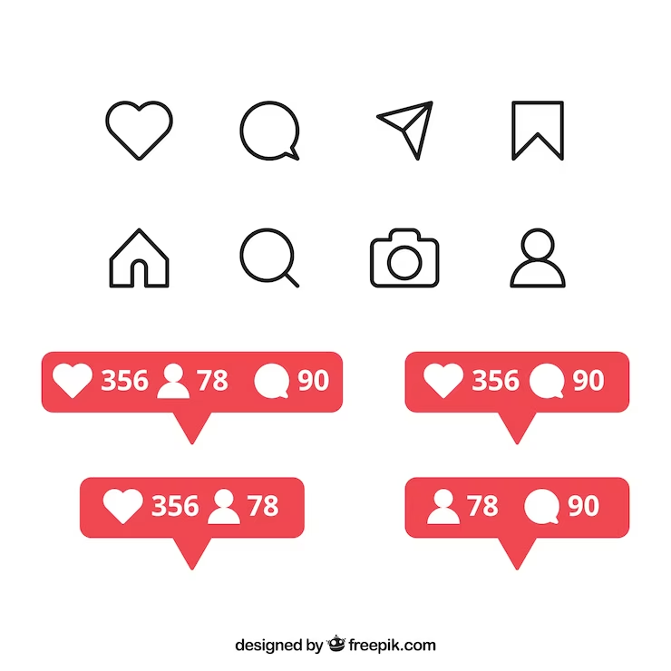
INSTAGRAM
Features
Instagram Live: Users can live stream video content in real-time using Instagram Live. It allows for direct interaction with followers and viewers.
Instagram Stories: This feature enables users to post multiple photos or videos that are displayed as a slideshow. Stories disappear after 24 hours, making them ideal for sharing temporary content. They can be discovered by users who don't follow you, expanding your reach. Stories are commonly used for storytelling, brand promotion, and event promotion.
Hashtags in Stories: Users have the option to add hashtags to their Instagram Stories, increasing the visibility of their content. Hashtags help categorize and make stories discoverable by a wider audience.
Notes:
Image Source:
https://www.freepik.com/vectors/social-share

Slide 25
INSTAGRAM
Tips
Event Promotion with Instagram Stories: Enhance event promotion using Instagram Stories by including preview images and sharing behind-the-scenes content like venue photos, meetings, and setup. Encourage event attendees to utilize Instagram Stories to increase reach and engagement.
Timing and Hashtags for Increased Engagement: Consider the timing of your posts to maximize visibility and engagement. Incorporate popular hashtags, but limit their use to 1-3 relevant hashtags per photo. This helps increase the discoverability of your content.
Authenticity and Engagement: Host contests and share candid shots that offer an inside look into your organization's inner workings. This makes your Instagram feed more engaging and authentic, appealing to your audience.
Live Video Broadcasting: Utilize Instagram's live video broadcasting feature to share real-time content with your audience. These live videos can be saved as posts for later viewing and are available for 24 hours, similar to Instagram Stories.

Slide 26
Other Tools for Monitoring, Planning and Sharing Content on Social Media
Here are some additional tools for monitoring, planning, and sharing content on social media:
Hootsuite: A social media management tool that helps coordinate your posts and presence across various platforms. It allows scheduling posts, aggregating analytics from multiple accounts, and more. Visit https://signup.hootsuite.com/ for more information.
Mentionmapp: An analytic tool specifically designed for Twitter. It enables media mentions monitoring, conversation tracking, visualization of analytics, retweeting, and liking posts. You can explore it at https://mentionmapp.com/.
Socialbakers: Offers free tools for obtaining statistics on Facebook, Instagram, and YouTube. It can help discover influencers and important topics. Check out their offerings at https://www.socialbakers.com.
Buffer: A comprehensive tool that allows scheduling posts, analyzing performance, and managing multiple social media accounts from one platform. Learn more at https://buffer.com/.

Slide 27
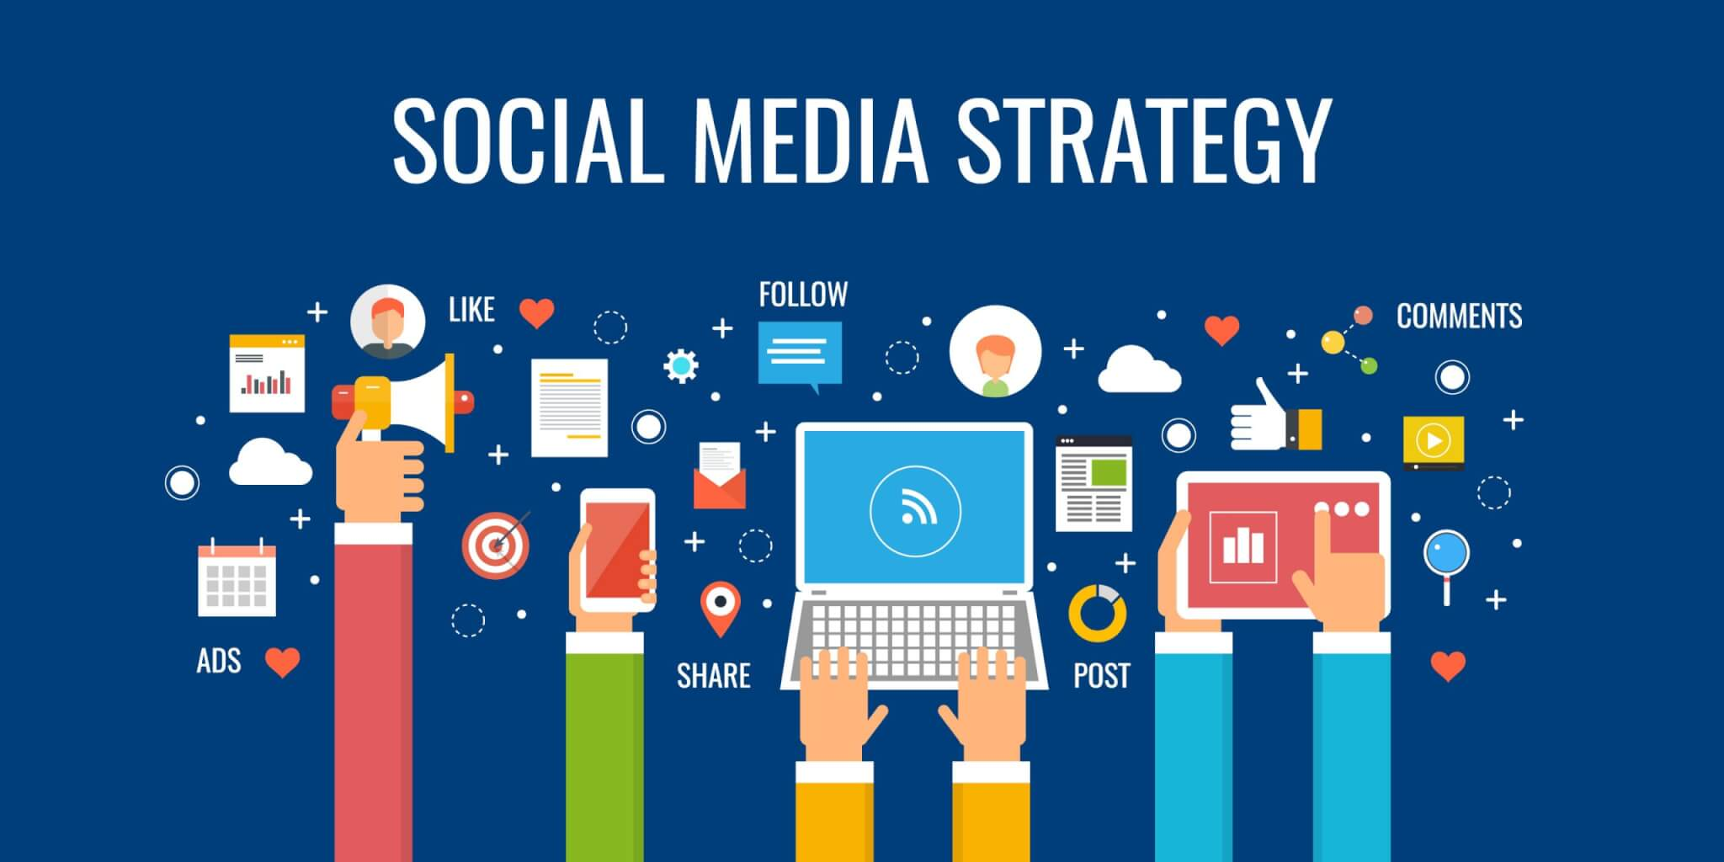
Group Activity (Worksheet)
BUILDING A SOCIAL MEDIA STRATEGY
FOR YOUR ORGANIZATION
Notes:
Image Source:
https://1stplace.dk/kompetencer/digitalisering/social-media-marketing/

